Slide 1
Volunteer Training

Slide 2
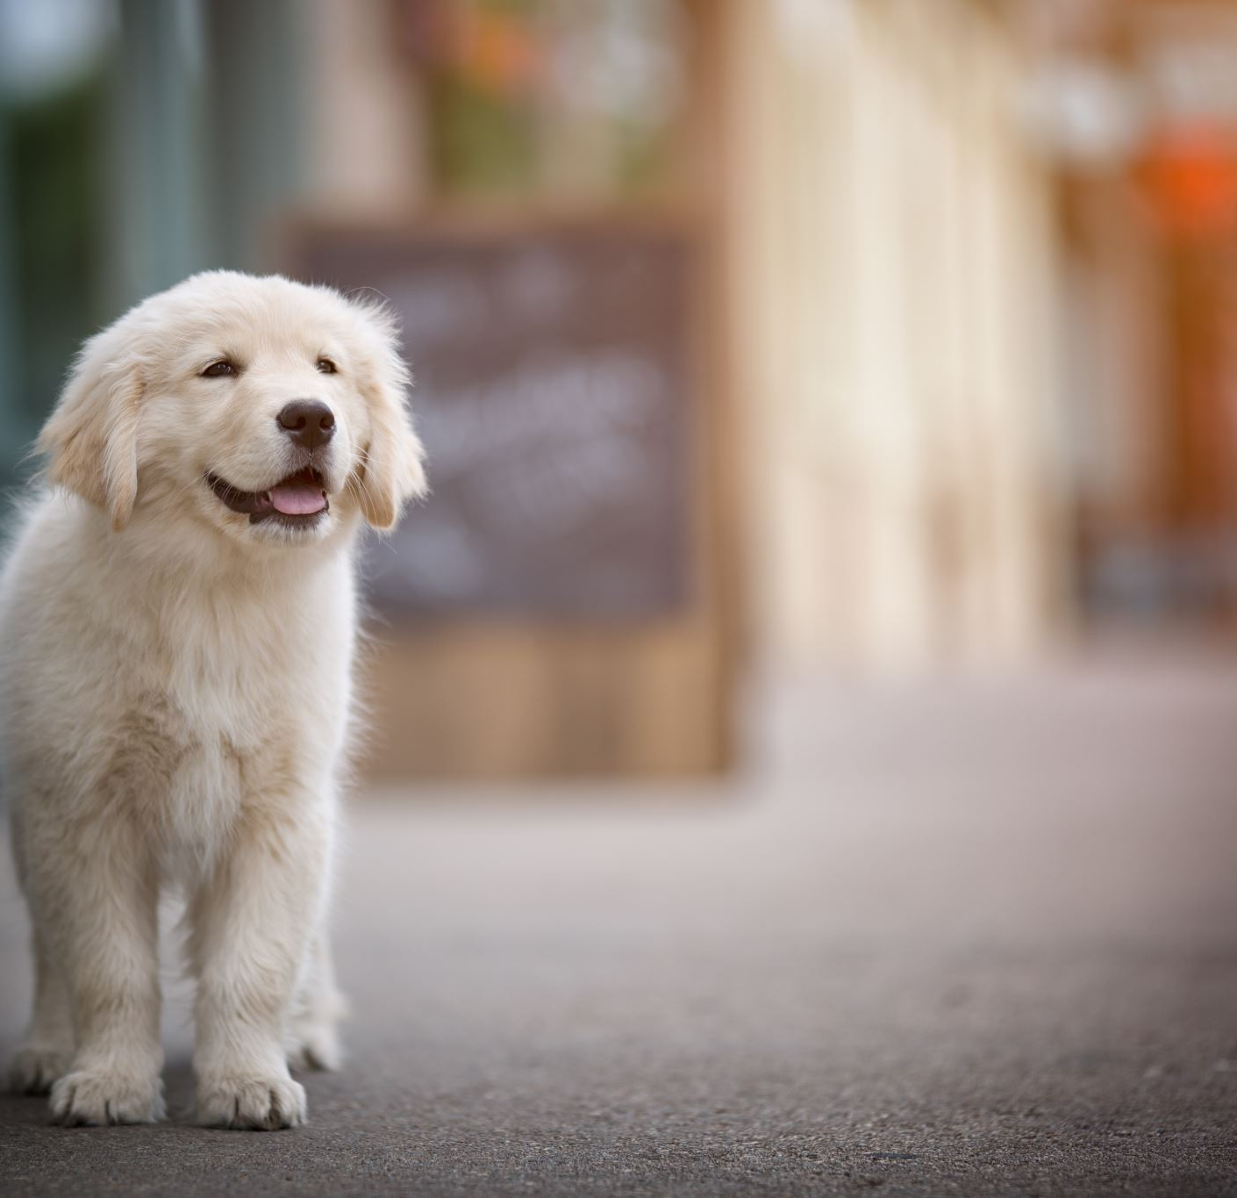
VOLUNTEER REQUIREMENTS
Must be 18 years of age or older
A proven understanding of basic dog body language
A proven understanding of what your body language tells the dog
Knowledge of positive reinforcement training
Ability to walk shelter dogs who often pull and are medium to large sized animals.
Know your limits.
Volunteers will never be asked to walk a dog they are not comfortable walking.
Wear long pants and closed toe shoes even in the summer months.
Communicate all valuable findings with staff, including dog likes, behavior or medical concerns

Slide 3
WHY DO WE WALK DOGS?
Walking shelter dogs has multiple benefits:
Good for the mental health of the dog
Exercises the dog for health and weight control
Socializing with continuous positive experiences with new people
Time to work on basic dog skills like loose leash walking helps pet retention after adoption
Walking a dog lets out pent up energy from being kenneled at night. This allows for better meet and greets during adoption hours

Slide 4
DOG WALKING LEVELS
Green: Dog displays little to no concerning behaviors. Walks well on a leash. Any handler can walk this dog.
Blue: Dog is shy, timid or fearful. Requires handler with knowledge about safely handling shy, timid or fearful dogs
Orange: Dog displays some concerning behaviors such as jumping, mouthing and/or poor leash skills. Requires handler who has experience and is comfortable handling an untrained dog.

Slide 5
DOG WALKING LEVELS
Red: Dog displays concerning behavior, has not been evaluated and/or is a medical case. Volunteers CANNOT handle these dogs, only staff may handle
Purple: Dog has been treated for parvo and may be walked.
Pink: Dog is too young and has not had all its vaccines. It is unsafe to walk these dogs. Please do not touch puppies that are not fully vaccinated through kennel bars.

Slide 6
VOLUNTEER IDENTIFICATION
Volunteers with a green bone have been trained to work with the green dogs.
Additional training is required to work with blue and orange dogs. This is reserved for those who display excellent handling skills.
If you feel you are ready to walk blue and/or orange dogs, e-mail the volunteer coordinator to express your interest. A one on one with the behavior lead will be set up to test out your skills.
Volunteers with multiple color strips have been trained in multiple areas.
Yellow is for feline friend training.

Slide 7
GET FAMILIAR WITH THE EQUIPMENT
It’s important to make sure that each individual dog is fitted correctly before going out. This prevents accidental escapes and injury.
Equipment needed for dog walking:
Martingale collar
Clip leash
Slip leash
Harness
Treat bag
Poop bags
Aprons

Slide 8
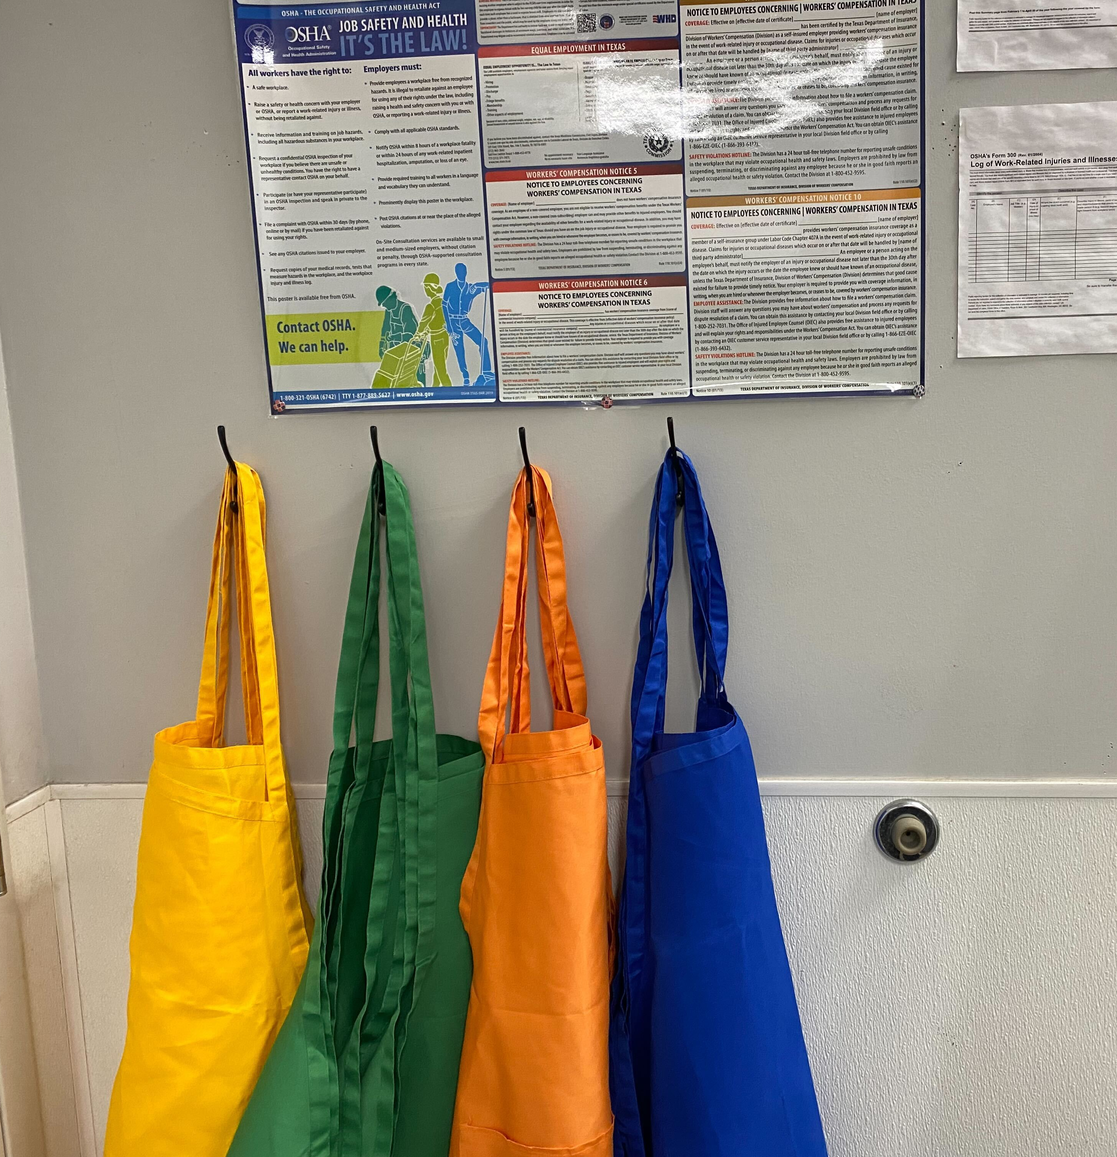
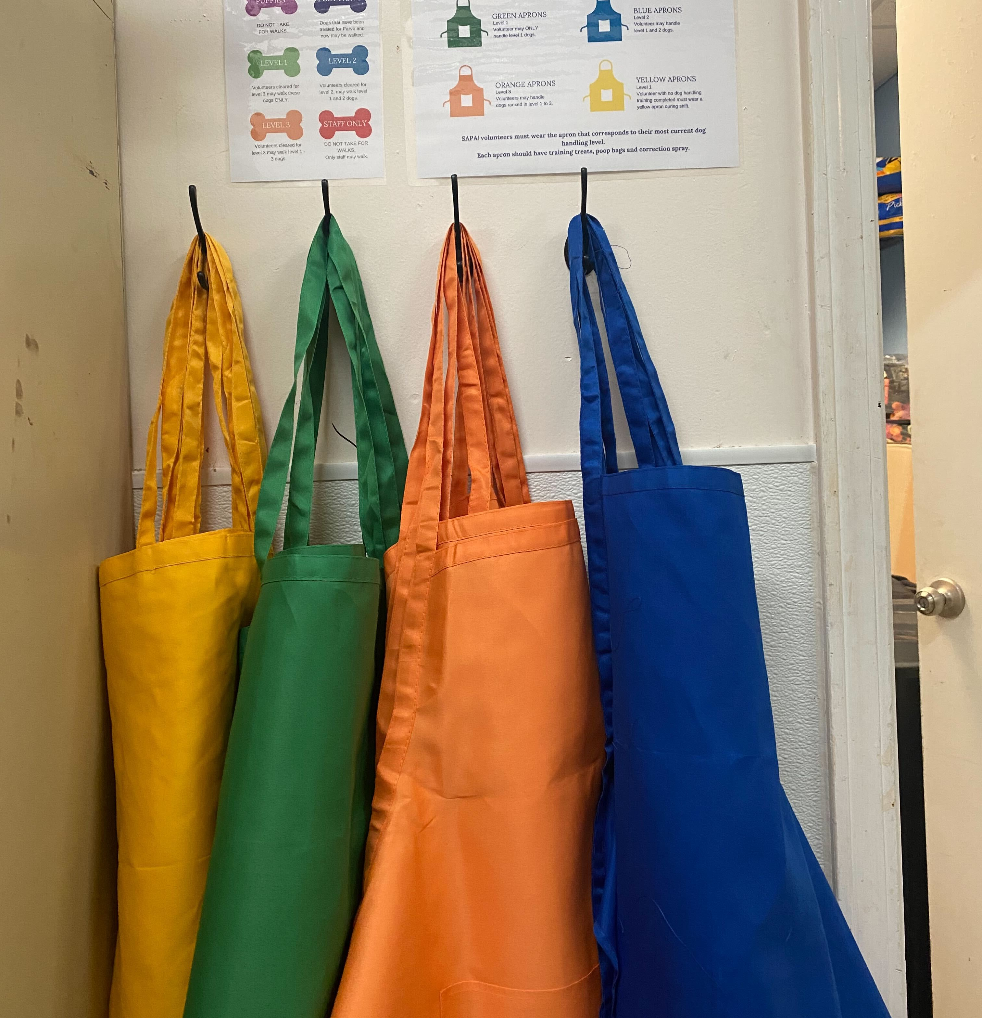
Volunteer Stations
PETCO
Aprons and Volunteer supplies can be found behind the door entering the dog kennels
RESCUE CENTER
Aprons and Volunteer supplies can be found in the puppy room.
MEDICAL CARE CLINIC
Aprons and Volunteer supplies can be found next to the food storage room.

Slide 9
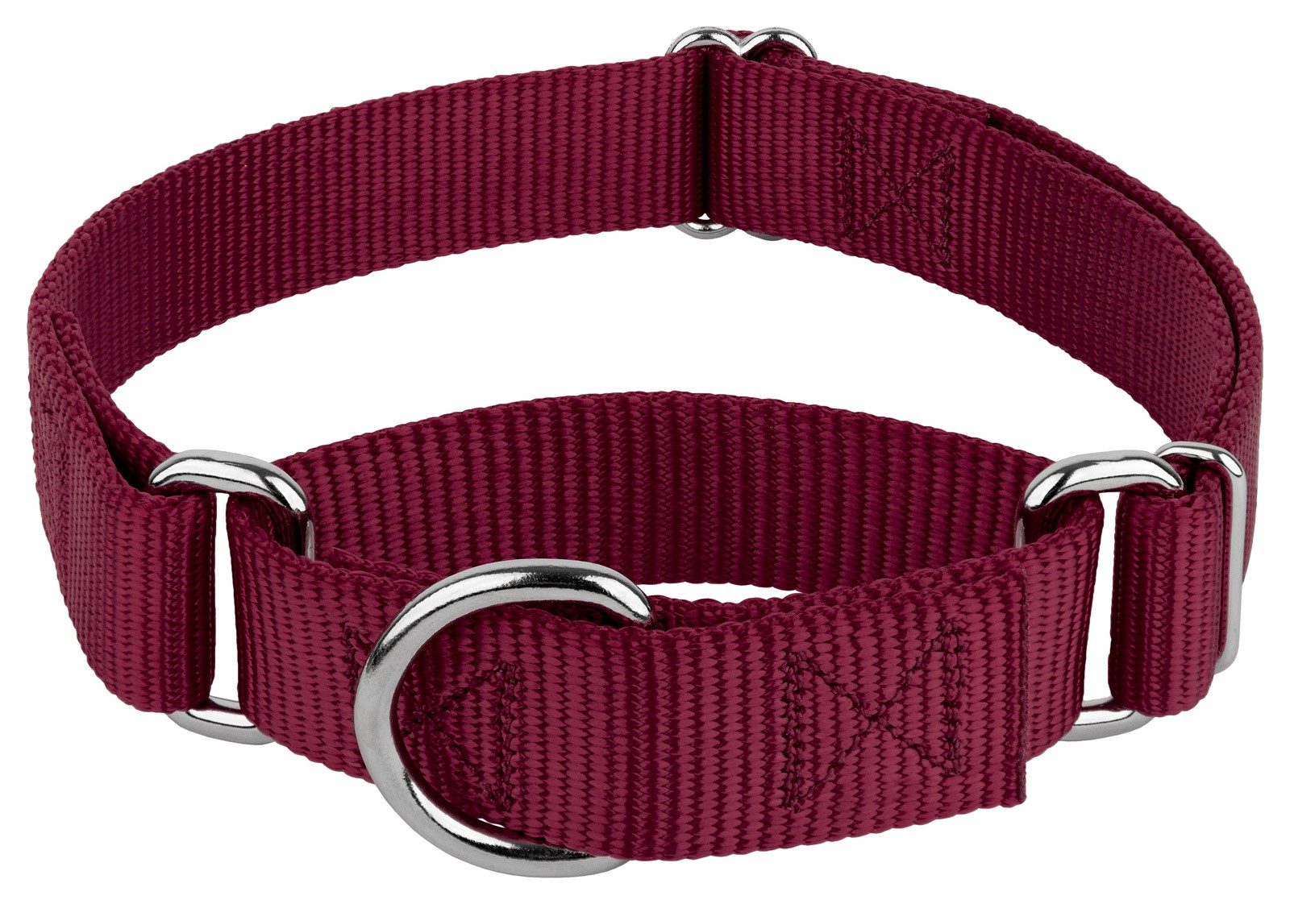
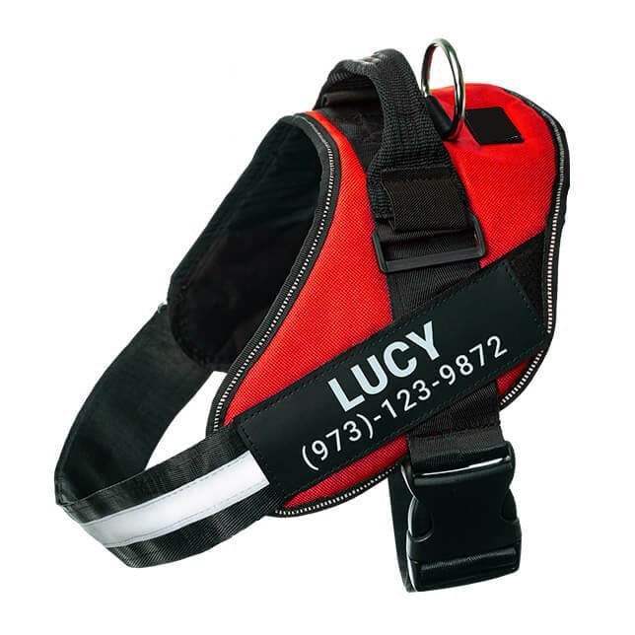
Martingale collar: All SAPA dogs wear a martingale collar with a dog tag attached. Used correctly martingales are a great tool while walking, they prevent a dog from being able to back out of their collar. Clip leashes are to be attached to martingales.
Harness: Is a strap that crosses the chest and encircles the body behind the front legs. A harness can be used to walk dogs that pull which includes orange dogs. A harness may also be used with a dog that has a neck injury.

Slide 10
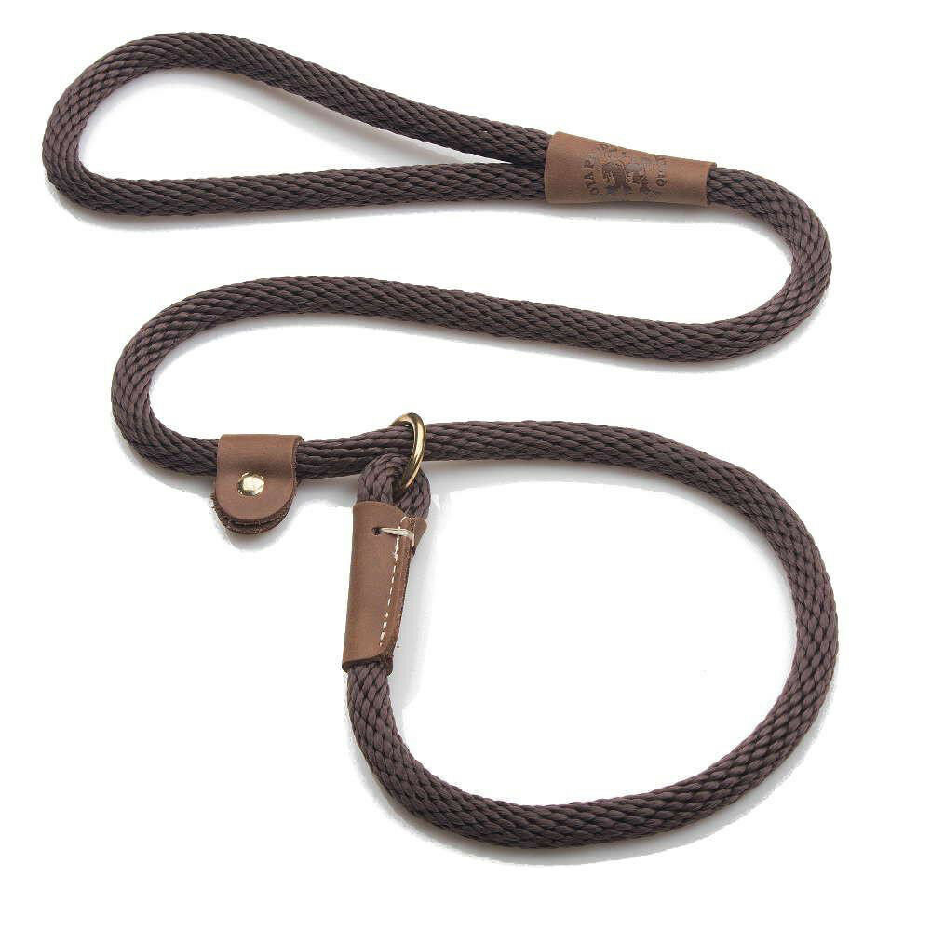
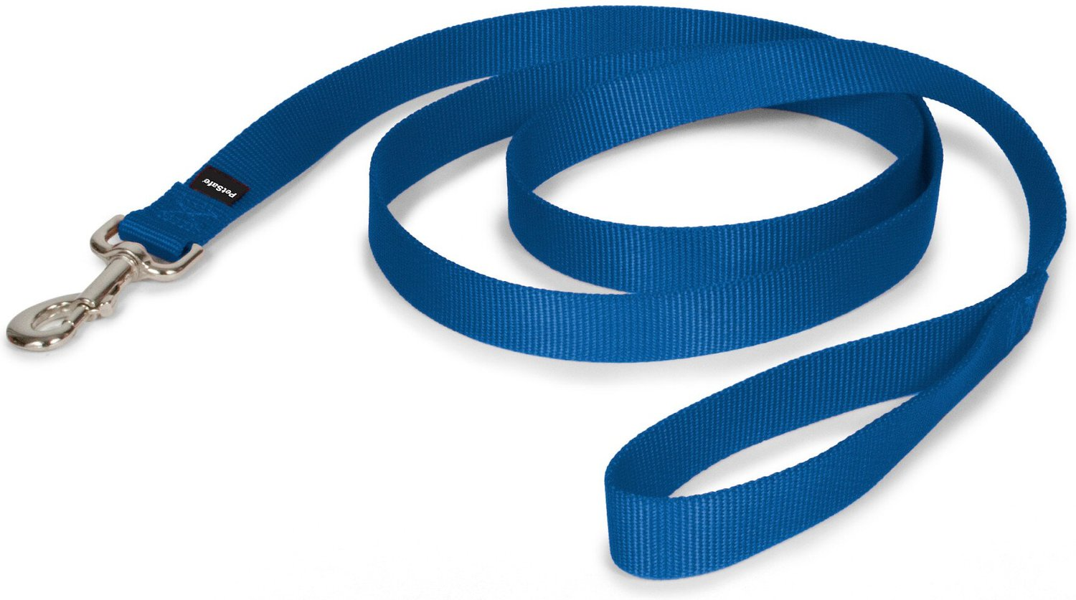
Slip leash: A rope leash is used to form a loop above the dog’s head. This allows handlers to take dogs out of the kennel without placing their hands near an excited dog’s mouth and is especially helpful if you don’t have a prior relationship with the dog.
Clip leash: These traditional leashes are used while walking. The leash attaches to a harness or martingale.

Slide 11
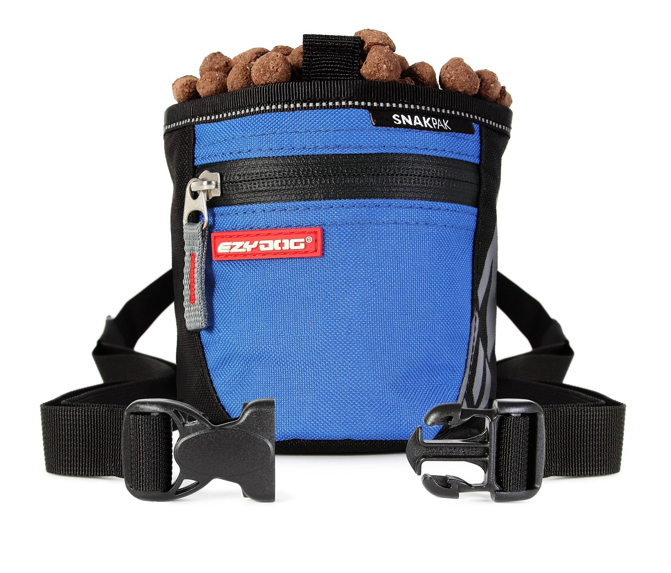
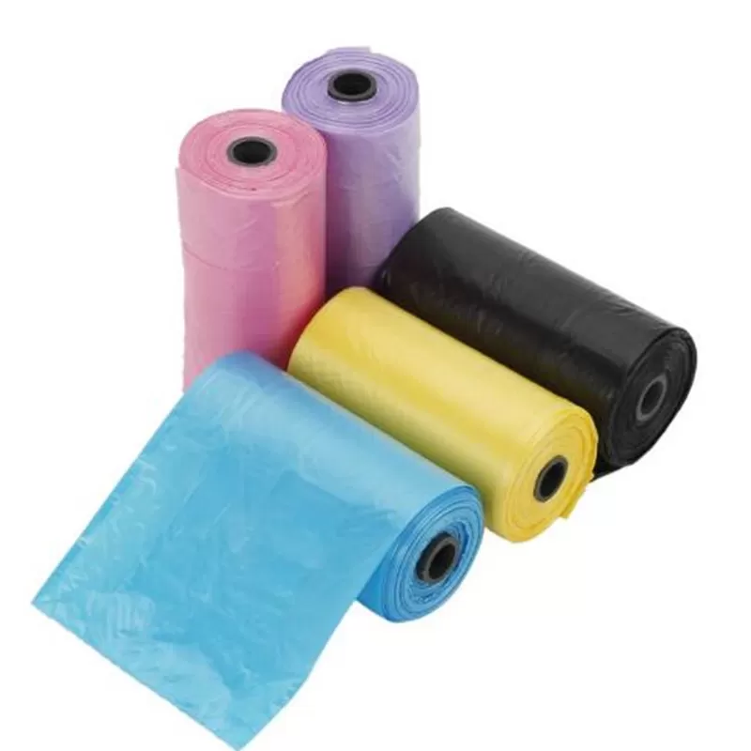
Treat bag: Treat bags are an essential part of successful dog training. It is a pouch attached to a belt that you wear around your waist. Treat bags ensure you always have easy access to a reward when the dog displays positive behaviors.
Poop bags: To ensure that we are good neighbors and responsible dog handlers you always want to carry poop bags with you to clean up after the dogs.

Slide 12
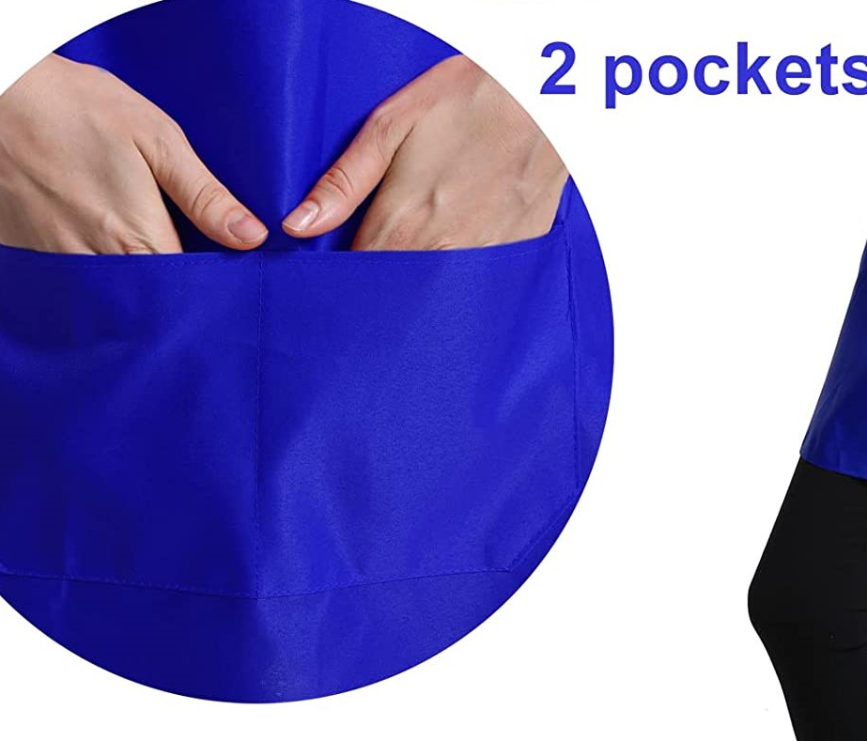
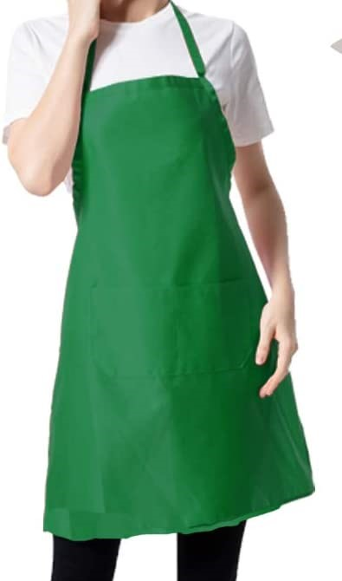
Aprons: These are color coded for easy identification of handler's training level. The aprons have pockets on the front for easy access to treats, poop bags and correction spray.

Slide 13
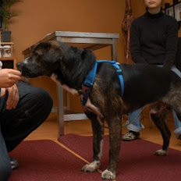
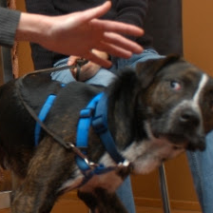
GREETING A NEW DOG
Approach from an angle. Turn sideways.
Use neutral, non-threatening body language.
Continue avoiding eye contact and keep your body loose.
Turning the body slightly to the side with the head facing away from the dog will make you seem less threatening.
Stand straight or crouch down, still with your knees and face turned to the side.
DON'T bend over the dog. Would you like a large stranger looming over you?

Slide 14
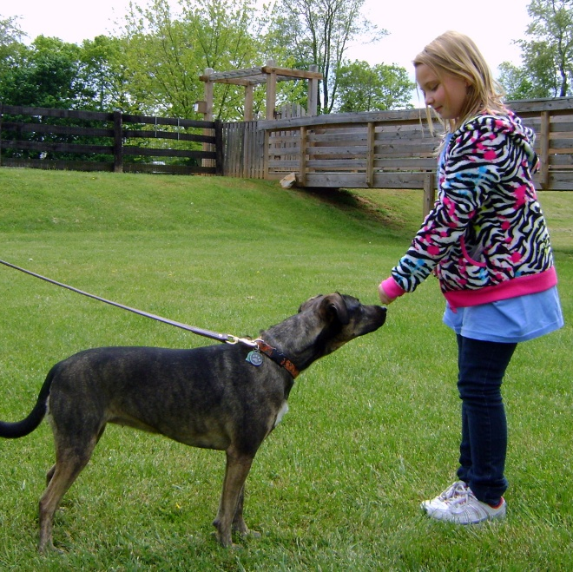
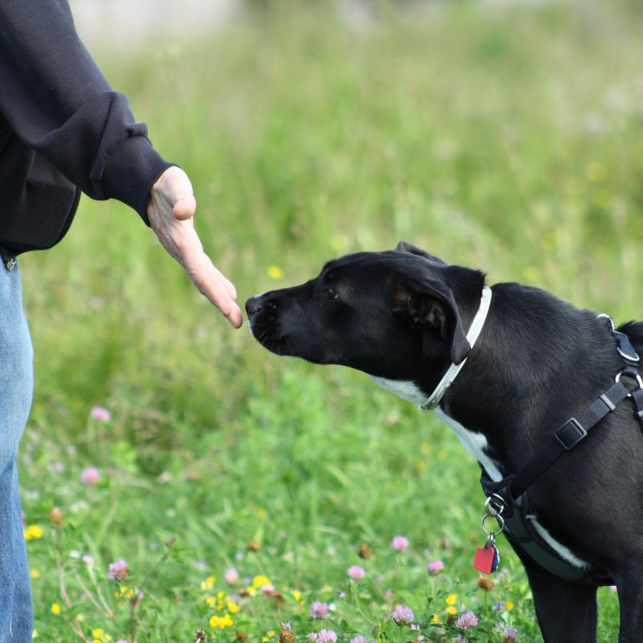
Stay relaxed as dogs can read your body language.
Allow the dog to make the approach.
Do not stare the dog in the face; keep a soft gentle gaze.
Do not take a dog’s food or other high value items (toys, raw hides, treats).

Slide 15
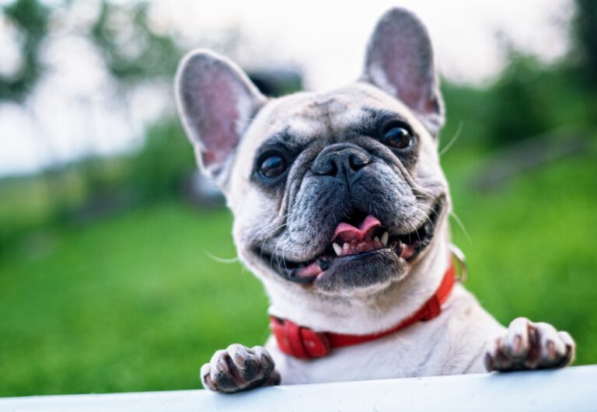
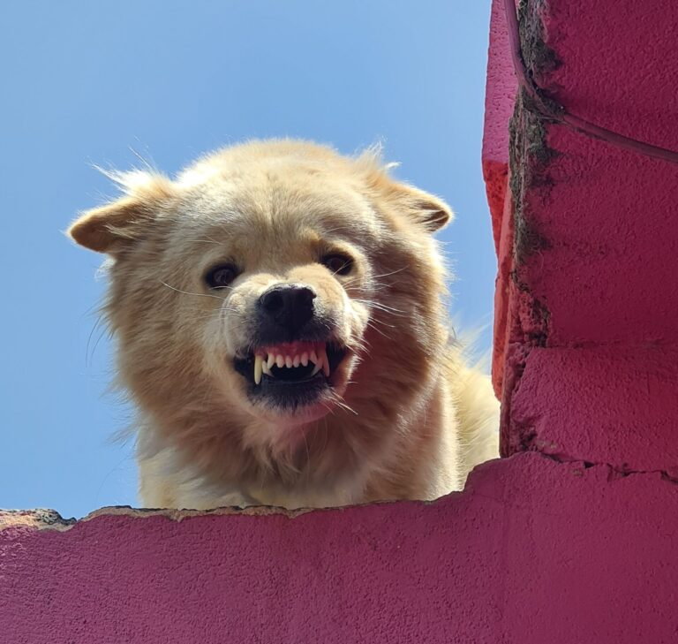
INTRODUCTION TO DOG BODY LANGUAGE
A dog with a wagging tail is not necessarily friendly, nor is a growling dog necessarily vicious.
It’s important to understand what a shelter dog is telling us to ensure our interactions are not only safe, but enjoyable for the dogs.
Take the time to observe first. This will make the time spent more enjoyable and safer, and you will become stronger in your handling skills.
Observe the whole picture.
Study the ears, mouth, and tension in the face.
Look at the body position and tail together. This will give the most accurate reading.
If at any time you are unsure of the dog’s behavior, return the dog to the kennel or call a staff person for assistance.
Hi! Nice to meet you!
Go Away!!

Slide 16
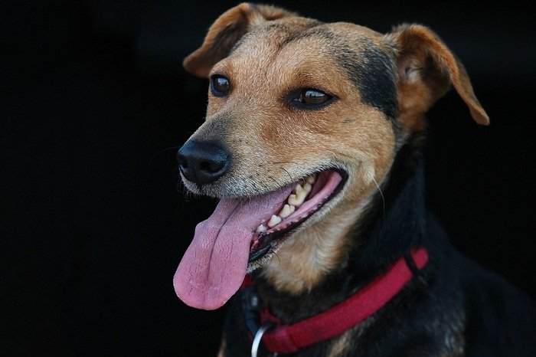
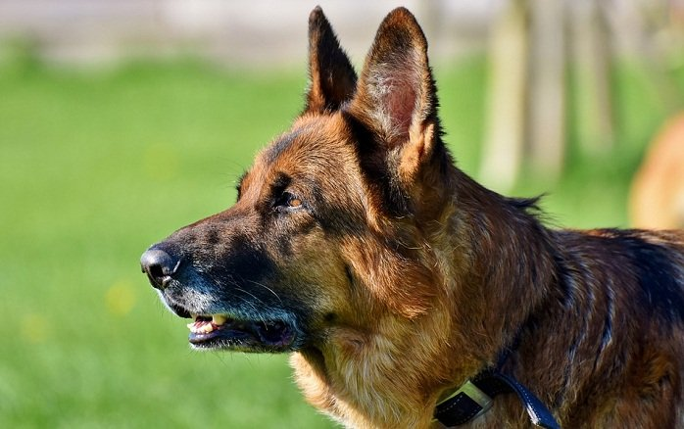
A DOG’S EARS:
Neutral Position
A relaxed dog will have both ears sitting in a neutral position. Typically, a neutral position is where the ears are freely relaxed on the sides, not pricked forward, pasted to the head, or drooping down.
Pricked/Attentive Ears
If a dog’s ears are pricked forward, it means that he is focused on something. If he is in the park, it could be his playmates, but if he is close to some bush or thicket, he could be prying on some squirrel. Other times, dogs can prick their ears forward when they hear unusual sounds from a certain direction.

Slide 17
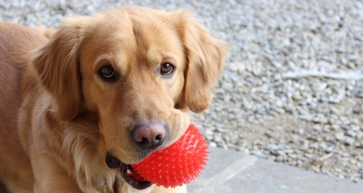
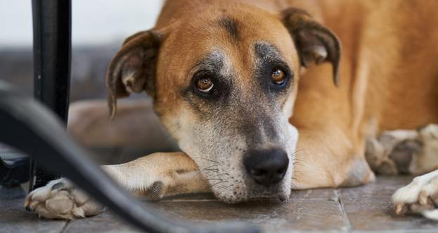
Dropped Back Or Pinned Ears
Dropped back or pinned ears means that the ears are pinned/pasted on the side of the head. In most instances, dogs pin their ears when they feel happy and nervous at the same time.
If you notice dropped or pinned ears, take time to read the rest of the dog’s body language to understand what they mean.
For example, a dog could drop his ears when giving you a kiss on the face – it’s his way of assuring you that the kiss is harmless but just his way of expressing love and happiness.
Such pinned ears will be accompanied by the waggling of the tail and loosening of the body.

Slide 18
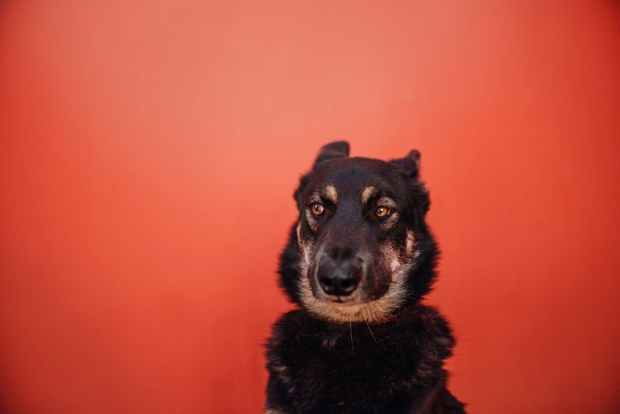
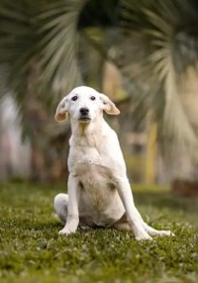
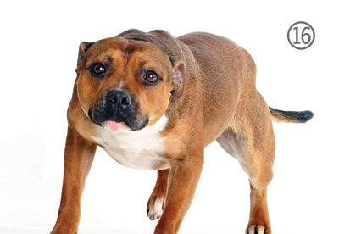
Extremely Pinned Ears
A fearful dog will use every square inch and muscle in her body to tell you she is nervous and fearful, and that includes her ears.
The ears can extremely become pinned tight beside the head and the tail coiled between the legs.
Additionally, a fearful dog will tightly bend his knees and sink his movements to an extremely slow pace. They may also turn their shoulder and body from the aggressor.

Slide 19
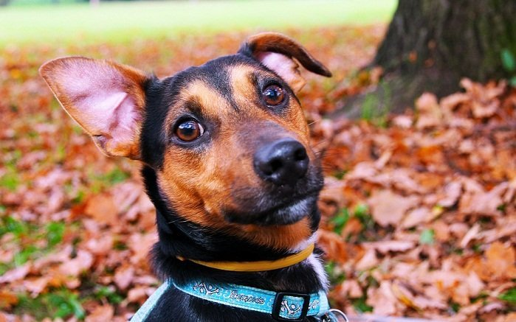
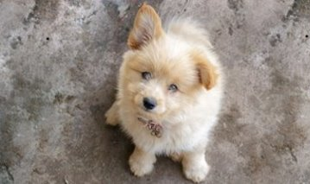
Ears Changing Positions (Airplane ears)
If a dog’s ears are changing positions and flicking back and forth, it could be an indication that the dog is concerned about something and is trying to figure it out.
Dogs can struggle and get confused about the right way to react to a new situation or strange sounds around them.
This can often happen if you take your dog out for a walk along a busy street with speeding cars and numerous people for the first time. Other than ears changing positions, the dog may have a tight jaw and closed mouth.

Slide 20
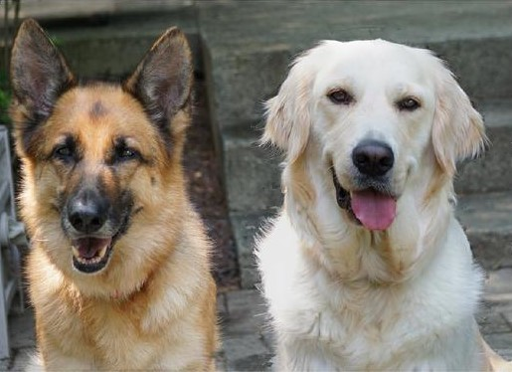
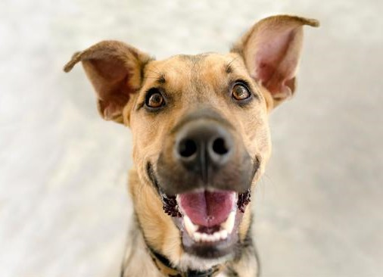
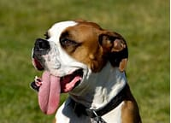
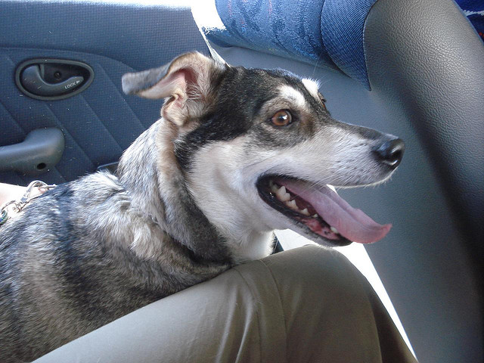
A DOG'S MOUTH:
Relaxed
A dog’s mouth, when relaxed should closed, or slightly open. If closed and relaxed, the skin around the mouth will be wrinkle-free, with possible exceptions for the wrinkly and bracycephalic (short-faced) breeds.
Open, Panting
A dog can pant for several reasons.
To cool off.
Stressed.
Acute stress and distress panting is often very fast and shallow, as opposed to relaxed panting which is often slower and deeper.

Slide 21
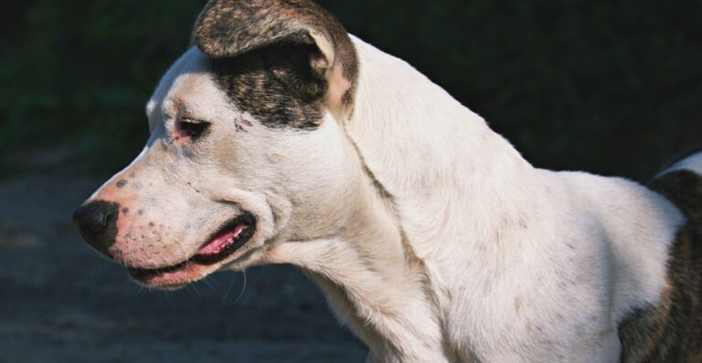
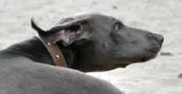
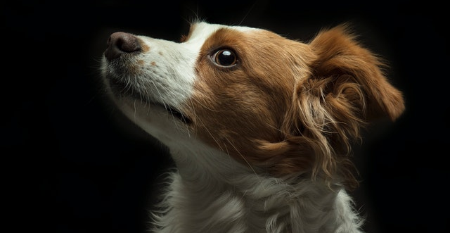
Tense
If a dog’s mouth is relaxed and open, and he slowly closes it, his body goes still, and there are lines around his mouth, he is not happy. Use caution, especially if his body also goes still. This is often part of the freeze sequence that is the precursor to a bite.
A tightly closed mouth often indicates fear or nervousness in dogs. You may also see a frightened dog pull the corner of his lip back, referred to commonly as “long lip”.

Slide 22
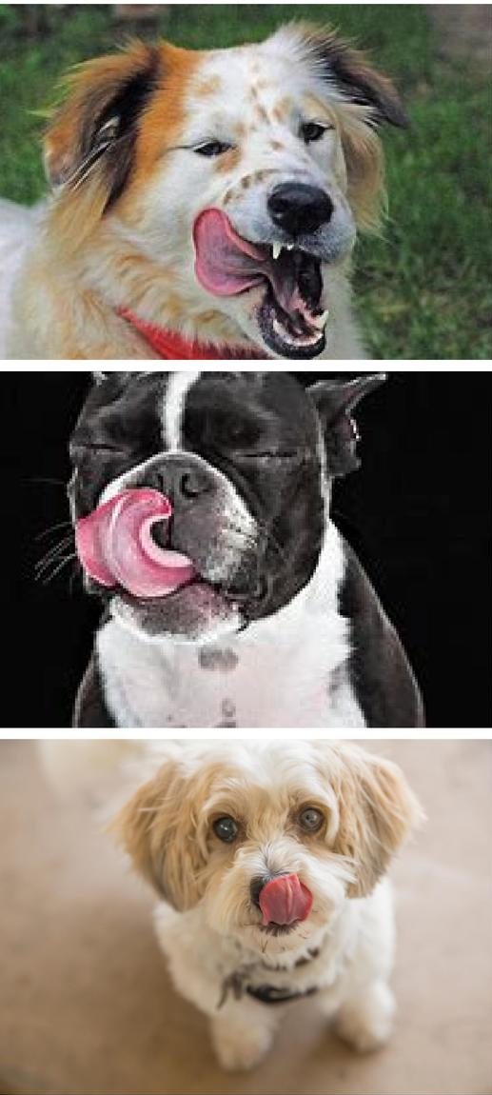
Licking
Dogs
lick to greet.
Do appeasement licking.
lick their lips to get the last bits of flavor from the last tasty thing they ate.
lick themselves persistently because of allergies or some other medical issue, or because of a canine compulsive disorder.
lick their lips because they are stressed.
Read the whole body to find out which one is happening!
Notes:
Top dog: This dog is showing signs of stress: Ears back, hard eyed and squinting, open mouth with a tight jaw, tongue pushed right back against the back of the jaw, stiffness in the body
Middle dog: this dog is giving a lot of signs of anxiety; eyes tightly closed, ears and head pulled back, lots of tightness in the jaw, tongue out and tight against the dogs nose, stiffness in the body
Bottom dog: this dog is a lot more relaxed and is likely lip licking due to the presence of food; ears in normal carriage, relaxed head, wide open eyes with small pupils and a softer gaze, relaxed body in a sitting position, no tension in the jaw and a more relaxed tongue flick.

Slide 23
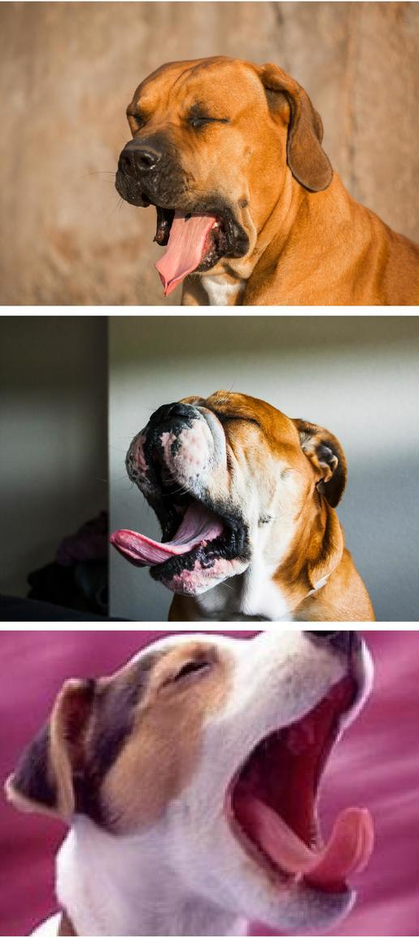
Yawning
Dogs yawn because:
They are tired.
Yawning is contagious.
They are stressed.
Look at the whole dog – and then decide.
Notes:
Top dog: Possibly stress yawning; ears are drawn back to the head, eyes tightly clamped shut, tension lines in the head and stiffness in the neck, open mouth with a tight jaw and tongue hanging out with a lot of tension
Middle dog: stress yawning; ears clamped tight against the head, head drawn back with tightly closed eyes, eye brows drawn forward and nose drawn back with lots of tension lines, wide open stiff mouth, tight jaw, turning to the side (avoidance), tongue pushed out and very rigid, very stiff neck and body.
Bottom dog: normal yawn; ears relaxed, open relaxed mouth and head, no tension lines, softer squinty eyes, tongue out but much less tension, no tension lines across the nose.

Slide 24
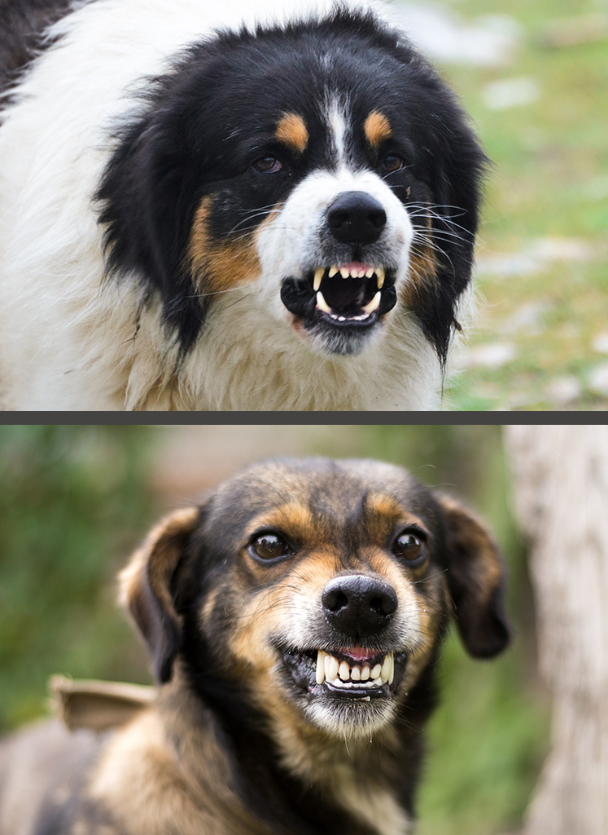
Commissure
Fancy word for the corners of your dog’s mouth.
Take note of how the commissure looks when your dog is calm and relaxed.
There are two significant variations on the commissure.
Corners are pulled forward and the commissure forms a “C” shape, the dog is being offensively aggressive.
Corners are pulled tightly back, forming a “V” shape, the dog is being defensively aggressive.
If the dog is displaying either of these variations be careful the dog is likely to bite!
Notes:
Top dog has a "C" shaped commissure and is offensively aggressive
Bottom dog has a "V" shaped commissure and is defensively aggressive

Slide 25
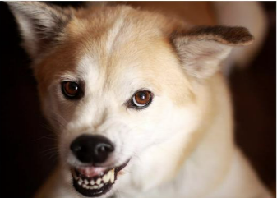
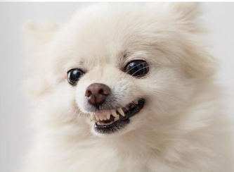
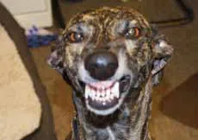
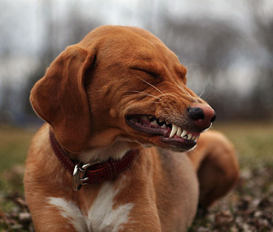
Snarl
When the lips curl up and all those shiny white fangs are exposed, the message is usually pretty clear.
Usually accompanied by very hard eyes, while the ears may be pricked hard forward or pinned back, depending on whether the dog is being offensively or defensively aggressive.
Submissive/appeasement grin
Often mistaken for a snarl, is a bit of a mystery in canine communication.
Seen very rarely in dog-dog interactions
Not uncommon for dogs with soft, appeasing personalities to offer to humans.
One theory is that the dogs are mimicking human smiles!
Can get dogs in trouble because people think they are being aggressive when they most certainly aren’t.
If you’re not sure, quickly check the rest of the dog’s body language to clues as to which it really is.

Slide 26
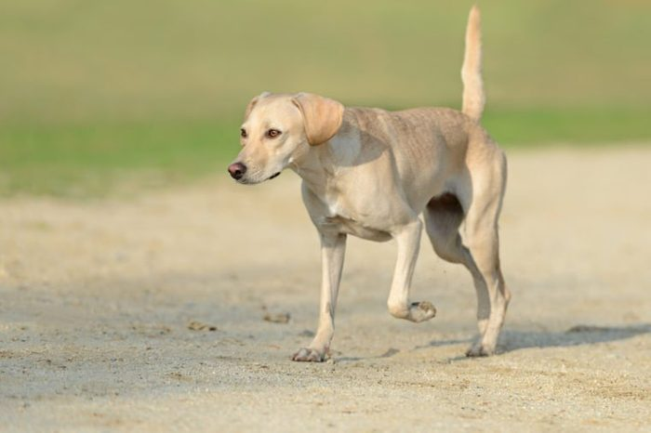
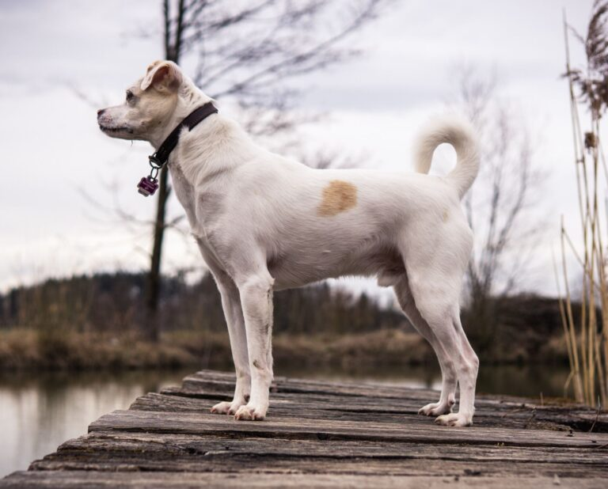
A Dog's Tail:
The height of the tail as well as the speed of its wag has meaning. Some breeds (Alaskan malamutes, Pugs) have a high carriage of their tail. For these breeds the tail will not be your strongest indicator of the dog’s mood.
High tail, quick tight wag:
Highly aroused
A fast, vigorous, almost shaking tail, take it as a cue of tension and/or hostility.
Notes:
This section is best explained by demonstration, not still images.

Slide 27
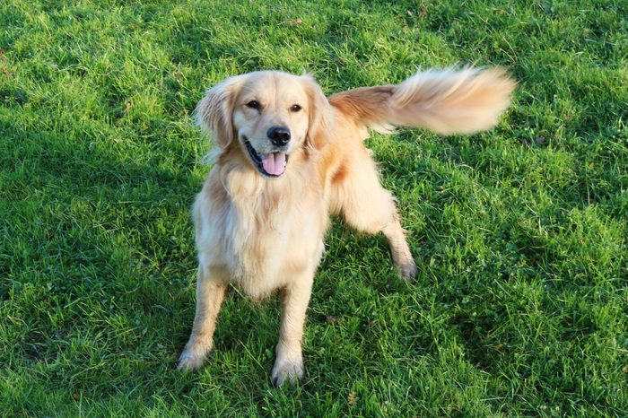
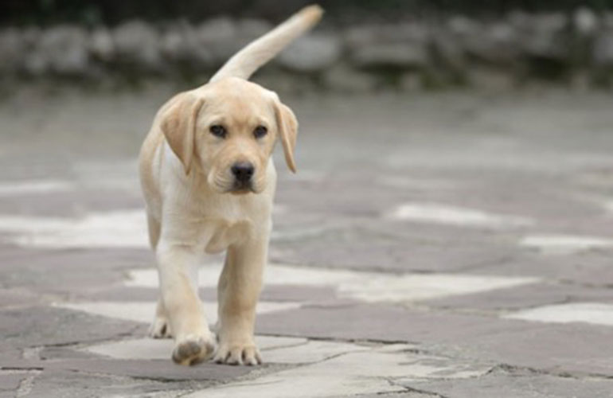
Full body wag
A tail wagging in a big circle.
Dog typically shakes their entire body in a loose way, accompanied by a submissive grin or a soft open mouth.
The more swaying and wiggly motion closer to the head of the dog, the friendlier the dog is.
Slow wag
The pup seems to be contemplating his next move.
A slow wagging tail may indicate that a dog is unfriendly, so proceed with caution.

Slide 28
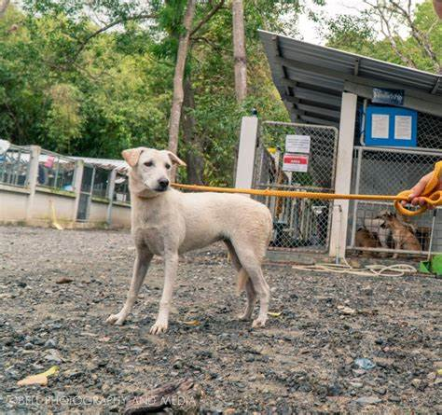
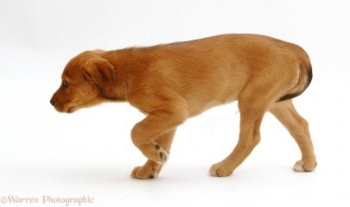
Pulled down
The tail is being held at a low level, often covering the dog’s anus but not yet disappearing between the dog’s legs.
Shows a dog is not entirely comfortable with the situation he’s in and could be feeling anxious, nervous, or unsure. A tail wag or wiggle may also be included as a sign of appeasement.”
Tucked in
Slightly different from a pulled down tail, this tucked in version is a tail that is tucked between the legs.
Can mean a dog is feeling threatened or is fearful of the situation he’s in. A tail tucked between the legs covers a dog’s genital area for protection

Slide 29
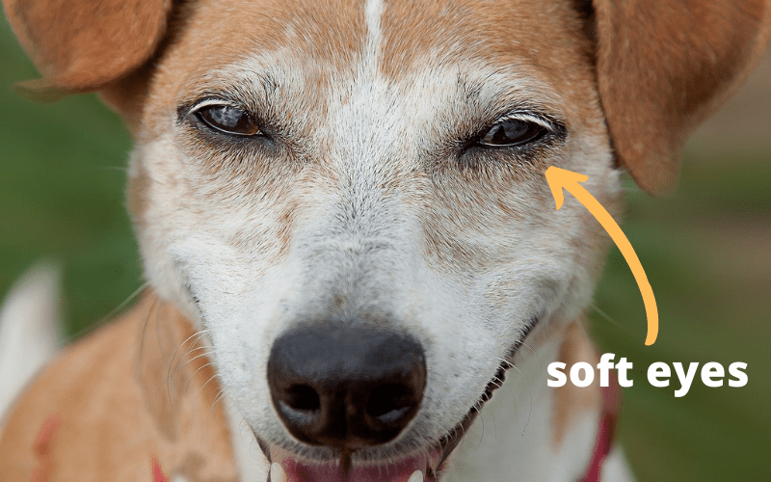
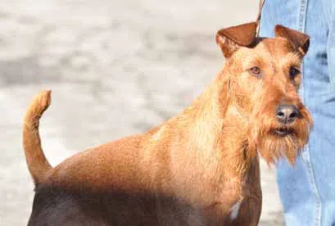
A Dog's Eyes
Soft Eye Contact
Conveys a dog is social, confident and friendly.
The eyes are round or almond-shaped and soft, with the pupils dilated appropriately for available lighting .
Often accompanied by affiliative (distance decreasing) behavior such as a relaxed tail wag, and body curved or even wiggling.
Hard Eye Contact
A hard, direct stare which, if you are good at reading dogs, gives you the chills.
It is not friendly.
The eyes are piercing, and there is often little or no body movement.
Accompanying body language is usually assertive
If this warning is ignored, the dog is likely to bite.
Notes:
Assertive dog body language– dog is standing tall and forward, tail erect and still or wagging stiffly. This may be part of a pre-aggression “freeze” where the dog goes completely still.

Slide 30
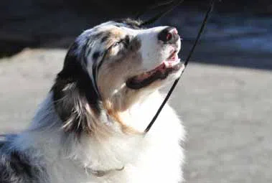
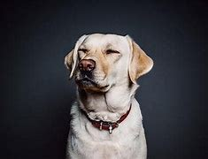
Squinty Eyes
Sign of appeasement
Often a good thing, if it is simply the dog’s nature to be appeasing
Can also be a signal for fear, which is not such a good thing.
If the dog is squinting:
and approaching, it’s a friendly, social expression, and it is probably safe to interact with him.
with his body posture back and lowered, it is likely fear. If you approach he may feel threatened, and bite.
Dog Whale Eye
Dog trainer term for when a dog shows the whites of his eyes.
While often a warning sign and precursor to a bite, dog whale eye just means the dog is looking sideways while his nose is pointing forward.
Often seen with resource guarding because the dog is keeping his nose pointed at the valuable resource while watching you to gauge how much of a threat you are.
The rest of the dog’s body language is key to knowing when whale eye is an aggression signal and when it is not.
If the body is relatively still and forward, it’s aggression.
If other body signals indicate relaxation and play, then it is likely not aggression.

Slide 31
Avoiding Eye Contact
In the human world direct eye contact is a measure of someone’s character and honesty. In the dog world, direct eye contact can be perceived as a threat.
Often, unless a dog has been strongly reinforced for making and keeping eye contact, he will look away when you look at him.
It’s a deference behavior – his way of saying he doesn’t have any desire to challenge you. He’s doing his best to be polite and non-confrontational.
Humans often perceive a dog as being sneaky if he won’t look them in the eye or your dog is looking sideways.
Never force a dog to look you in the eyes and avoid hard staring at them.

Slide 32
Reading the Full Body
Time to put it all together!

Slide 33
Notes:
- Dog is dominant or aggressive and is saying I'm not approachable
- In this instance, he is not a happy dog.
- An aggressive dog will have his tail up.
- Their ears are perked and alert.
- "C" shaped mouth
- He will likely be snarling and baring his teeth and his nose will be wrinkled.
- You will likely notice hackles on his back (by this we mean raised hair along his shoulders and down his spine).
DEFENSIVE AGGRESSION: A dog showing aggressive behaviors who is not acting on its threats is letting you know it has the ability to become aggressive if the need presents itself. Respect the signs being given and allow the dog its space.

Slide 34
Notes:
- Fearful submission "leave me alone"
- This dog just wants to be left alone
- A fearful dog may roll completely onto their back exposing their stomach and throat.
- They will usually turn their head away to avoid confrontation.
- Their ears will be flat and back.
- If they have a long tail, it will often be tucked between their legs.
- Many fearful dogs will close their eyes, again to avoid confrontation.
- They are hoping if they don’t get involved, or don’t respond, the aggressor will just leave them alone.

Slide 35
Notes:
- Ears Perked – I’m Interested
- The dog body language here indicates your dog is interested.
- This dog is very confident and very interested in his new friend or object.
- His tail will usually be horizontal and may wag slightly.
- You will notice that he is leaning in slightly to his new friend.
- His eyes are wide, to take all the information in.
- His ears are perked and alert.
- Despite being interested, his posture is relaxed and non threatening.

Slide 36
Notes:
- Fearful & Worried – I’m Not Approachable
- This is a scared dog, but still contemplating they may be able to escape the situation, slowly.
- Here you will notice they will be looking away, they may even close their eyes slightly.
- Their body will be lowered and they may be moving or walking very tentatively; some dogs will even raise a paw.
- Their ears will be flat and back; their mouth often closed.
- Their tail will be down, sometimes even tucked. Some dogs may attempt to very slowly wag their tail.
Remember that dogs do not want to be comforted the way a friend would. Hugs, overcrowding or cornering will only make the dog more uncomfortable. Give a fearful dog its space.

Slide 37
Scenario 1: What is happening below?

Slide 38
Answer: Interested
This would be the ideal scenario in a dog park
The dog on the right is interested
Horizontal tail
Relaxed posture despite leaning forward
The dog on the left is happy being sniffed
Has a relaxed posture
Tail is up and could mean
allowing other dogs to sniff
He is sniffing something that interests him

Slide 39
Scenario 2: What is happening above?

Slide 40
Answer: This won't end well
Immediately notice the fixed gaze between these two dogs
They are both pulling on their leashes
The whites of their eyes are showing
Both mouths are closed and faces are tense
The base of the ears on the dog on the left are moving back, suggesting fear
Owners should calmly distract and move these dogs away from each other

Slide 41
Scenario 3: What is happening here?

Slide 42
Answer: Fearful or Submissive
May be a typical visit to the vets for some dogs
Dog really doesn’t want to be there
Head is lowered
Looking away.
Whites of eyes showing
Mouth pressed closed
Stiff body posture
He just wants to be left alone.

Slide 43
Scenario 4: What is happening below?

Slide 44
Answer – Scared or Worried
At first glance you may see an aggressive dog.
Fearfully aggressive and asking to be left alone.
Remaining on the floor as she doesn’t really want confrontation.
Bared teeth are a warning that she just wants to be left alone. "V" shaped mouth
Raised tail signals arousal and if the warning isn’t heeded, she may further protect herself

Slide 46
DOG ON DOG FIGHTS:
If a dog-to-dog fight is to occur:
DO NOT try to separate the dogs.
DO NOT grab for collars.
Never put yourself between the dogs.
If you have control of the leash, hold it and call for staff.
You may try to stop the fight by - Loud noises, yelling, air horn

Slide 47
DOG-ON-HUMAN AGGRESSION:
OFF– LEASH DOG:
DO NOT run; remain calm and move slowly.
Avert your eyes and turn your body.
Cross your arms slowly and stand with legs together. “Be A Tree”
Take a fistful of treats and slowly toss them away from you
“Feed” your leash, coat or article of clothing to the dog
Call for a staff person
Remember: Aggression + Aggression = More Aggression!

Slide 48
LEASHED DOG:
Run the leash through something to get the dog away from you - a door or wrap a tree
Keep arms rigid and hold the dog away from you—short enough they cannot reach your legs, or hands
Call for a staff person

Slide 49
DO’S AND DON’TS IN HANDLING
Observe: Always start with observing the dog within the cage. If there are any concerning behaviors that you are not trained or comfortable to work with, do not take that dog out. While observing make sure not to be staring directly at the dog in front of its kennel. Observe from a distance.
Get Acquainted: Let the dog get used to your presence, smell, voice, and give the dog a treat. Once the dog appears more calm than aroused, you may begin the process of taking the dog out.
No Punishment: SAPA’s staff and volunteers use positive reinforcement only. At no time are you to strike an animal. Never correct a dog by jerking the leash. Always apply gradual pressure to redirect a dog while on a walk.

Slide 50
Never Corner a Dog: At any time for any reason. If a dog will not approach the front of the kennel for its walk, it does not want to go with you. The dog will be walked by staff.
Keep Your Balance: Always keep your balance while with the dog. With feral cats and wildlife in the area, you never know when a dog with prey drive may spot an animal to chase.
Special Signage: Never walk dogs with special signage indicating they are staff only, quarantined, in the medical area, or just had surgery. Only walk dogs with approved color.

Slide 51
Removing Dogs From Kennels
SIGN OUT: Sign the dog out on the clipboard so staff is aware that the dog is on a walk. Place the “I’m on a walk” card on the front of the kennels to let staff know where the dog is.
OBSERVE: Always start with observing the dog within the cage. If there are any concerning behaviors that you are not trained or comfortable to work with, do not take that dog out. Let the dog get used to your presence, smell, voice, and give the dog a treat.
WAIT: Once the dog appears more calm than aroused, you may begin the process of taking the dog out. Do a quick last-minute check of yourself for treats, poop bag, and secure collar, leash and slip lead.

Slide 52
ENTER: Once the dog is calm unlatch the door and push inward allowing just enough space for you to enter. Lock the door behind you to ensure the dog doesn't push out past you.
SECURE: Loop the slip lead over the dog's head and allow it to tighten behind the ears. Slide the fastener down to secure the slip lead. Then clip the leash to the martingale collar. Double check that you have a firm grip on both leashes.
EXIT: Open the kennel door and exit with the dog on a short leash. The dog will be very excited to be going on a walk so you want to move them through the building quickly and on a short leash. Exit building (Marbach – back door, 151 – side door. Once outside allow the dog to get comfortable and familiar with you before starting the walk.

Slide 53
WHILE ON A WALK
DOG TIME: Dogs who are going out with volunteers are going out for quality time beyond good toiletry habits. Watch the dog for signs of fatigue, over heating or becoming too cold. A walk could be between 20 minutes to an hour.
AVOID DISTRACTIONS: While on the walk, do not use your cellphone or headphones. Do bring your cellphone in case of an emergency and program the phone number of the front desk of your shelter location into the phone. (Bldg 1 : 512-994-9116 / Marbach: 210-297-3297)
OTHER DOGS: While on the walk, do not allow your dog to interact with any other dog. Whether it is another shelter dog or a member of the general public with a pet, the dog will not meet other dogs on the walk.

Slide 54
WHILE ON A WALK
PEOPLE ON YOUR WALK: Do not allow your dog to interact with the general public while on their walk. Politely thank the person for their interest and instruct them to ask for the dog at the front desk to begin a meet and greet with a staff person.
PLAY YARDS (Bldg 1): Dogs can enjoy free time off leash in the play yards. If you choose to play with toys in the yard, it's important to bring several. Do not take a toy from a dog; the dog may lash out if they are guarding it. Throw a new toy or a treat rather than picking up a toy from a dog near you. Keep a leash on

Slide 55
HOW TO WALK POLITELY ON LEASH
If pulling on the leash gets your dog where he wants to go, he'll keep pulling. To avoid teaching the dog that pulling is a good strategy, use one of the following techniques.

Slide 56
Technique 1: "I am a rock."
When your dog pulls, stop in your tracks. As you wait pretend you have no dog.
When the dog backs up or turns to you, click or say "yes" and feed a treat at the seam of your pant leg.
Then move forward again.
Note: This will be tedious at first and it may take a long time to go a short distance but the dog will catch on if you stay consistent.

Slide 57
Technique 2: "Back and Forth"
When your dog pulls, turn around and walk purposefully in the opposite direction. When the dog catches up to the heel position...
Click or say "yes" and treat. Then turn around and continue in your original direction.

Slide 58
Technique 3: "Off at an angle"
This is a great technique for dogs who are very strong. When your dog pulls, simply move away at a random angle that isn't 180 degrees.
Wait for the dog to catch up to heel position
Click or say "yes" and treat. Then turn around and continue in your original direction again.

Slide 59
BRINGING THE DOG BACK IN
RETURN
RETURN TO THE BUILDING:
Enter through an appropriate kennel door.
WALK BACK
WALK BACK: Walk the dog back to the kennel, keeping the leash length short.
Open
INTO THEIR KENNEL: Open the door, allow the dog to walk into the kennel, loosen the lead and close the door.
SIGN
SIGN THE TIME IN/OUT: Record the amount of time you spent with the dog on the walk log. Also note any behavior or medical concerns you noticed on the walk.

Slide 60
The Puppy Particulars
Our puppies follow another set of rules for handling. Puppies are still in the process of developing and require a gentle hand as well as knowledge of some health and safety specifics.
Here are a couple of things to remember when handling puppies:
Use hand sanitizer before and after handling all puppies
Puppies under 6 months of age are only allowed in the designated puppy pavilion or room
Puppies over 6 months of age may have access to a puppy-specific outdoor play area dependent per site discretion
Always ask before taking a puppy out
Pay attention to kennel cards which lists the age of the puppy
Never remove a puppy without knowing its age

Slide 61
Some Last Notes
Handling our kennel dogs can be a handful at certain times and can be loads of fun at other times! Taking our dogs out and about helps them get the socialization and exercise that they need to be happy, healthy, and ultimately, ready to be adopted!!
Here are some last reminders about handling dogs with SAPA!
Never handle any dog you’re uncomfortable with
Always feel free to ask for help
Remember that our dogs are unique and may have certain likes and dislikes
Treats will go a long way!
Only volunteers ages 18+ and Dog Handling Cleared may handle dogs

