Slide 1
Cal Animals Emerging Leaders: Developing Others “To Inspire and Be Inspired by Those We Lead”
July 26, 2021

Slide 2
Group 3 “Common Ground”
Stephanie Amato, Yolo County Animal Services
Camrin Christensen, Stray Cat Alliance
Jessica Helgesen, Rancho Cucamonga Animal Services
Shannon Quinn, Front Street Animal Shelter, Sacramento,
Rachelle Saelor, LA County Department of Animal Care & Control

Slide 3
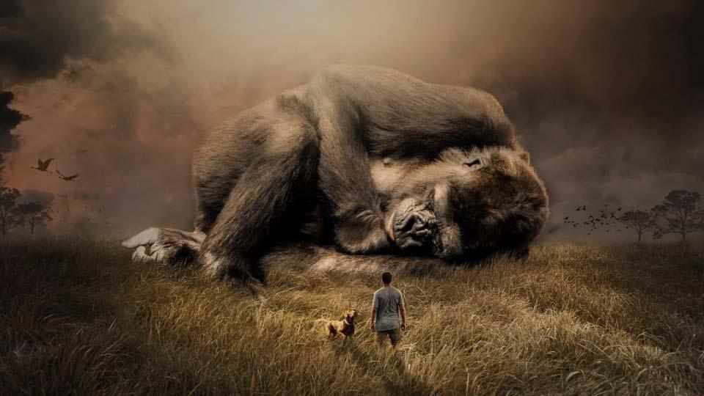
BE THE CHANGE you want to see IN THE WORLD.
Mahatma Gandhi – Civil Rights Activist
Notes:
*Since our topic is “Emerging Leaders: Developing Others”:
Aimee Gilbreath said “culture eats strategy for breakfast” where the Leader is the culture. The team will model what the leader does. How the leader shows up everyday will be more of a take away than the words being said or the mission, vision, values you have displayed.
Even if only subconsciously, Gandhi hit it on the money where as emerging leaders we need to recognize that we need to BE the change.

Slide 4
“Motivate Yourself to Inspire Others”
What INSPIRES you?
What MOTIVATES you?
What do YOU need to BELIEVE
in yourself and others?
Notes:
TEAMWORK Mentality- discuss knowing your team, what inspires each person including the BOSS/leader. When feeling inspired, motivated and engaged will help move team as a whole towards goal.

Slide 5
To INSPIRE (v) Fill (someone) with the urge or ability to do or feel something; create a feeling, especially a positive one in a person; to excite, encourage or to breathe life into. Latin word meaning To INFLAME

Slide 6
When a LEADER who is INSPIRED to grow as an individual but who at the same time strives to help others grow creates a solid foundation for the team.
GROWING TOGETHER
Growth is the direct result of INSPIRATION.
Notes:
Creating a solid foundation with team by: empowering them to “think outside the box” and make their own decisions.
Gaining and GIVING trust to the team members

Slide 7
Each person plays a part, whether big or small when it comes to building a TEAM.

Slide 8
Perspective is EVERYTHING… Are they really FAILURES ??? OR Are they CHALLENGES ??? Influence others with an OPEN MIND

Slide 9
.
ENCOURAGE A “WHY NOT” ATTITUDE
Think OUTSIDE the box!!!
Notes:
*Just do It/Why Not- coincides w/April’s session that helped us hear other’s stories about developing, coaching and engaging those around us (INCLUDE GAME/SNACKS, ETC. here??)...

Slide 10
EVERYONE LOVES SNACKS!!
“Sit and Snack”
How did you feel when there were fun snacks available?
How does it make you feel if you are the one providing the snacks?
This Photo by Unknown Author is licensed under CC BY-NC-ND

Slide 11
WHICH TEAM ARE YOU ON??
STARBUCKS
DUTCH BROS
This Photo by Unknown Author is licensed under CC BY
This Photo by Unknown Author is licensed under CC BY-NC-ND

Slide 12
Remember… KEEP IT SIMPLE
Unexpected Rewards
It’s the Little things that get noticed
Personal/Thoughtful
THINK OUTSIDE THE BOX
This Photo by Unknown Author is licensed under CC BY-SA-NC

Slide 13
A team is not a group of people who work together. A team is a group of people who trust each other.
-Simon Sinek
The more you invest in building your TEAM, the more your TEAM will invest in YOU!!

Slide 14
Leaders are those who always empower others
Bill Gates

Slide 15
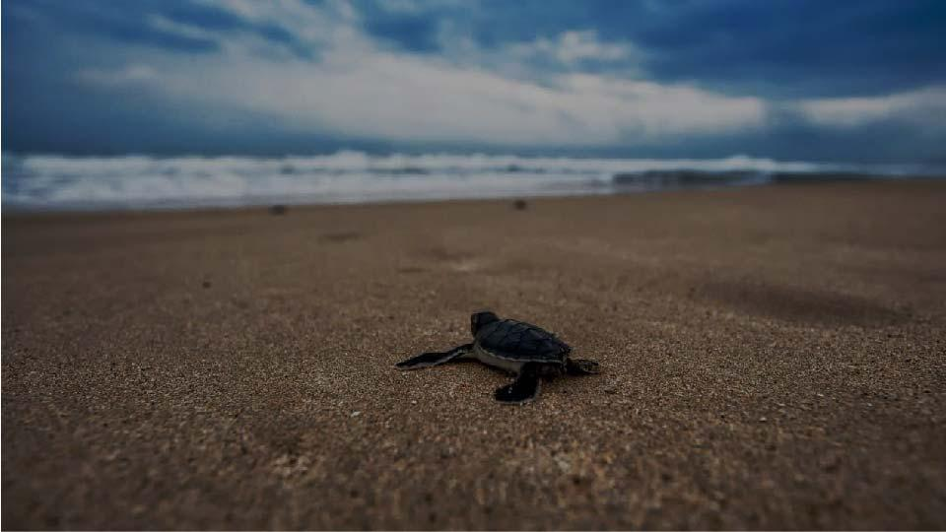
“There’s no need to be perfect to inspire others. Let people get inspired by how you deal with your imperfections”

Slide 16
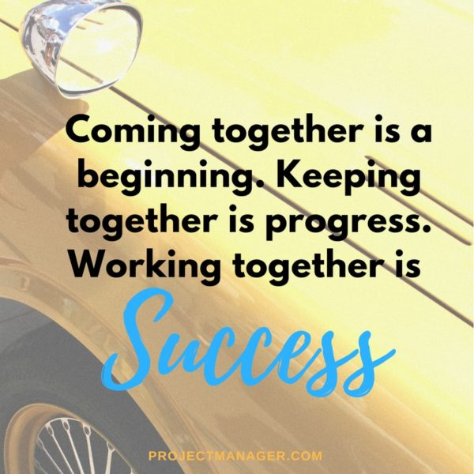
HENRY FORD
Notes:
RESOURCES TO DEVELOP SKILL IN THIS AREA:
Ted Talks
Leadership Workshops (ask w/in your organization if there are workshops available: LA County has UDEMY which is online, Management Development Program through LA County University)
Books:
Stephen Covey’s The 7 Habits of Highly Effective People
Simon Sinek’s Start with Why
Jim Collin’s Good to Great

Slide 17
Leadership classes Peer Groups Well Known Books: -Stephen Covey’s The 7 Habits of -Highly Effective People -Simon Sinek’s Start with Why -Jim Collin’s Good to Great FIND NEW WAYS TO BE INSPIRED…OR GO BACK TO YOUR “WHY” IF IT’S BEEN AWHILE
As Leaders we MUST commit to continuing to GROW…
-

Slide 18
THANK YOU!!
Questions? Comments?

