Slide 1
Community Cats
Rafa Garcia
Community Cat Coordinator
Notes:
To use this title animation slide with a new image simply 1) move the top semi-transparent shape to the side, 2) delete placeholder image, 3) click on the picture icon to add a new picture, 4) Move semi-transparent shape back to original position, 5) Update text on slide.

Slide 2
MISSION
To reduce the number of homeless pets through adoption, rescue and spay and neuter programs.

Slide 3
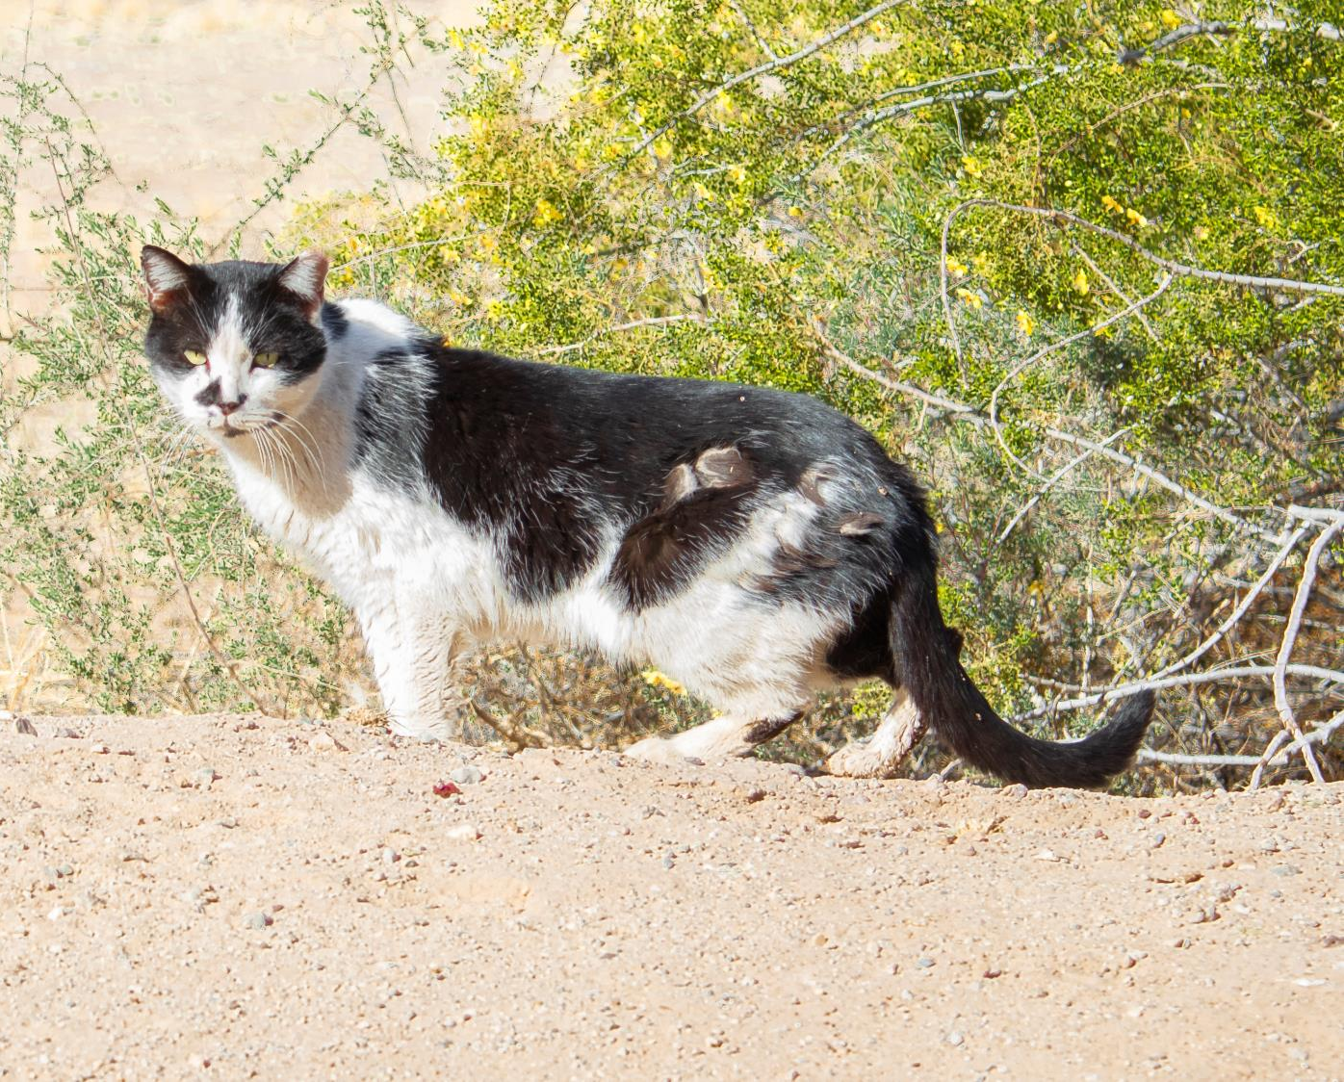
What is a community cat?
Community cats is a term used to describe any outdoor free-roaming cat that may be cared for by one or more residents of the immediate area. If it DOES NOT have any identification HSOY categorizes it as a community cat.
Community Cats
How it Starts
Temperament
Caregivers
Cat Colonies

Slide 4
WHAT’S THE PROBLEM?

Slide 5
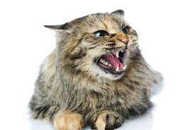
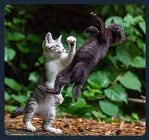
Bad Behaviors
Spraying to mark territory
Fighting for competition
Roaming the streets
Yowling during mating season

Slide 6
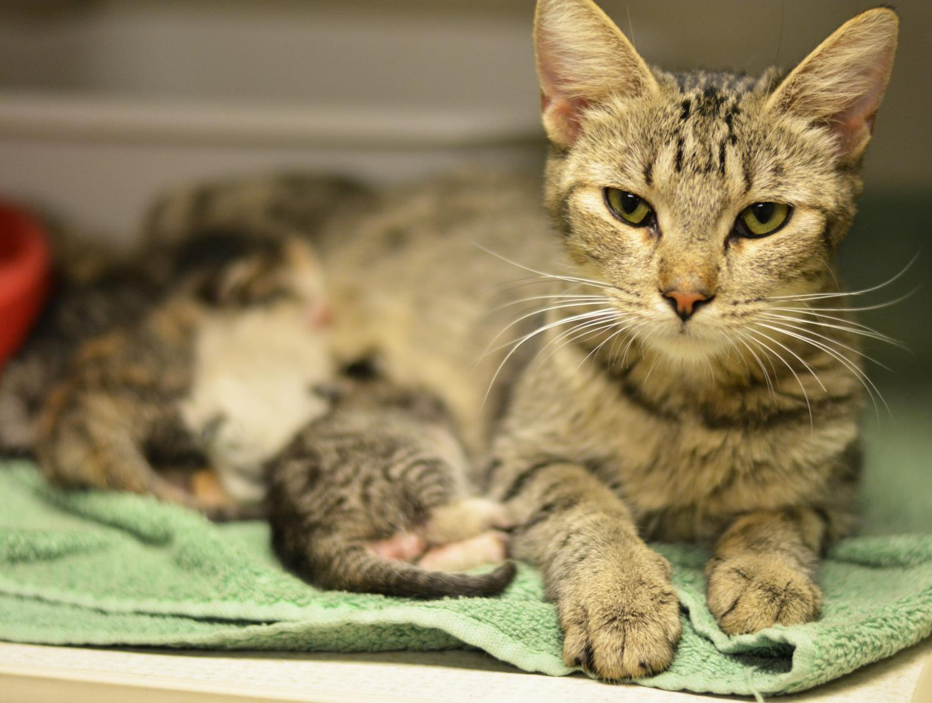
Cat Facts
Male and female fertility can occur as young as 4 MONTHS OLD.
An unaltered female can produce up to THREE LITTERS A YEAR.
Average litter sizes range from 1 TO 8 KITTENS.

Slide 7
WHAT DOESN’T WORK
Feeding bans
Feeding bans incorrectly assume that if you stop feeding feral cats, they will simply leave the area. This is not the case with cats, who are scavengers and will search/hunt for a new food source. Feeding bans actually create more nuisance behavior than they eliminate.
Trap and kill
Trap and kill all community cats whether they are sick or perfectly healthy was a concept widely practiced by shelters nationwide until it was proven to be completely ineffective. HSOY practiced trap and kill, however each year the rate of community cats were not effective at eliminating or reducing populations. No community has killed it’s way out of the “feral cat problem”.
Relocation
Relocation is most often the complainant's first request while caretakers want to rescue. Cats are territorial and form strong bonds with their outdoor homes. Relocation can be extremely stressful and risky for the cats AND the person doing the relocating. Free-roaming cats will often find their way back home because of their strong bond with their home.
*These cats do not need to be “rescued” but they do need to be spayed or neutered and vaccinated.

Slide 8
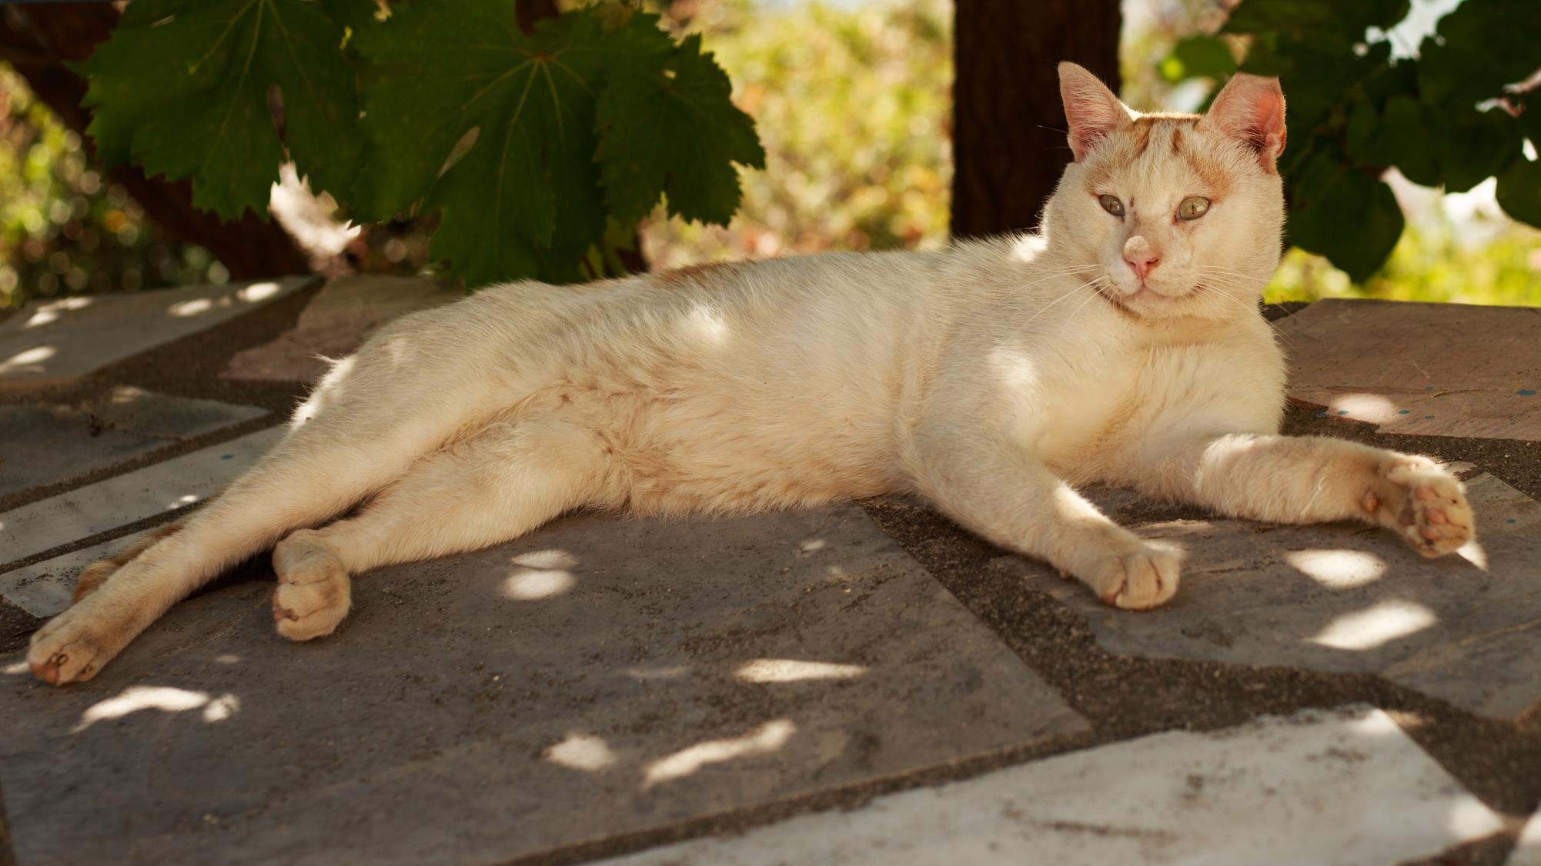
Trap - Neuter - Return, or TNR, is a method of managing feral cat colonies humanely and effectively. Feral cats are trapped in humane cages using food as bait. They are then spayed or neutered and released where they were originally trapped. We are able to continue to track these colonies because a cat that has gone through the TNR process will have the tip of his/her ear "tipped" off. That way if a cat is ever re-caught for TNR, he/she can be re-released and will in-turn save precious resources. These cats will also be vaccinated for many feline diseases including rabies.

Slide 9
TNR Supporters
Alley Cat Allies
NACA(National Animal Control Association)
Best Friend Animal Society
ASPCA
Million Cat Challenge
University Shelter Medicine Program
and many more

Slide 10
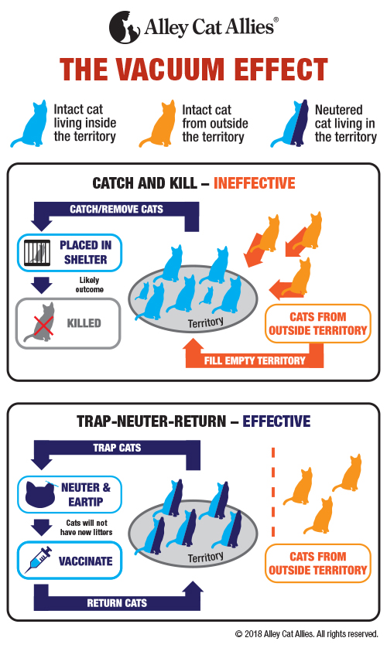
Notes:
-Vacuum effect - The Vacuum Effect has been documented worldwide in many species. Animal control’s traditional approach has been to catch and kill community cats. While this may temporarily reduce the number of community cats in a given area, it is ultimately counterproductive, as the population of cats rebounds. Due to the Vacuum Effect, unfixed cats continue to breed, and other cats move into the newly available territory. Litter-bearing mammals will breed to the capacity of the environment
Irresponsible people will still continue to abandon cats or leave their unsterilized pet cats outdoors which contributes to the reproductive rates in a colony.

Slide 11
Story of Community Cats
TRADITIONAL APPROACH:
Due to the overwhelming number of cats coming into the shelter and the limited space, cats have traditionally been euthanized. The shelter setting is no place for cats.
7,539
cats have been euthanized between 2016 and 2022.

Slide 12
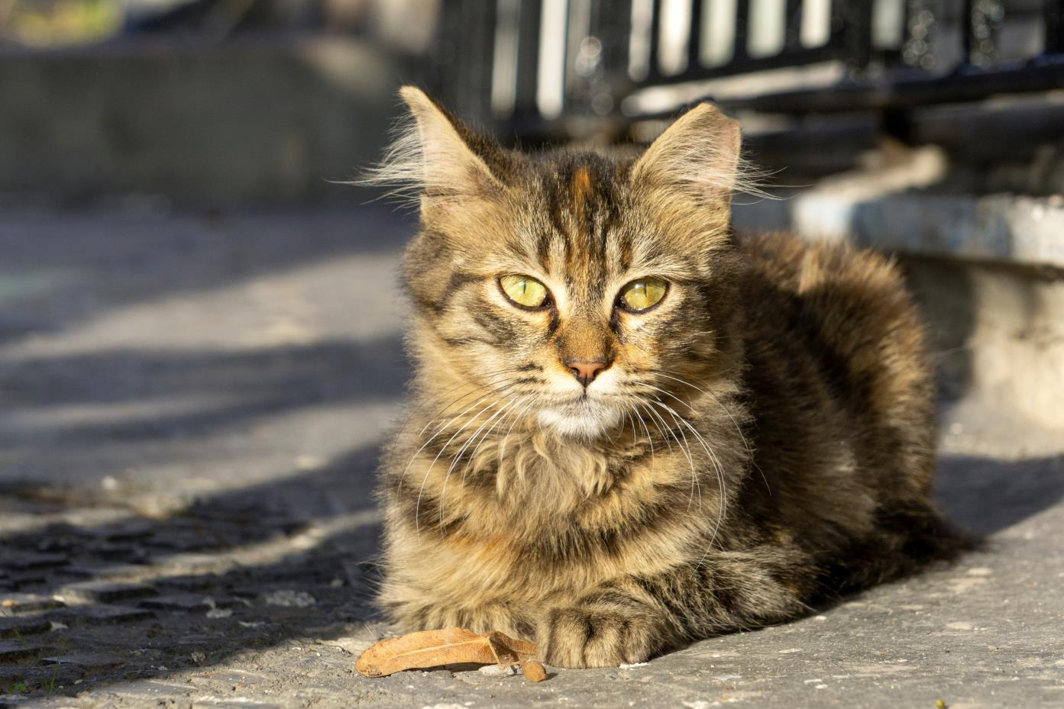
Why Support TNR
Bye-bye bad behaviors
Effective population control
Completely free

Slide 13
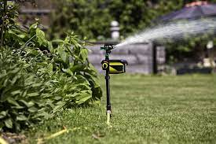
Humane Deterrents!
*There are a number of humane deterrents on the market. Scat mats, Spray Away or Scarecrow (motion-actived sprinklers), ultra sonic high frequency deterrents, or scent repellents such as Critter Ridder.

Slide 14
In 2022, the Humane Society of Yuma has spayed/neutered, vaccinated and returned 1,288 cats.

Slide 15
Total of Surgeries of 2022
With 1 Doctors a total of 5,340
3,001 were shelter animals(shelter animals must be our priority)
1,051 were owned animals
1,288 were community cats

Slide 16
2022 Intake
Cats: 2,805
Stray……. 2,412
Owner Surrender..275
Other intake ……. 97
Quarantine ……. 21
Notes:
We’ve come to realize that shelters aren’t the best places for cats. Less than 1% of “stray” cats impounded at shelters are reunited with their family. Lost cats are 13 times more likely to find their way home if they DON’T enter an animal shelter. Cats tend not to be reclaimed when they come in as a stray.

Slide 17
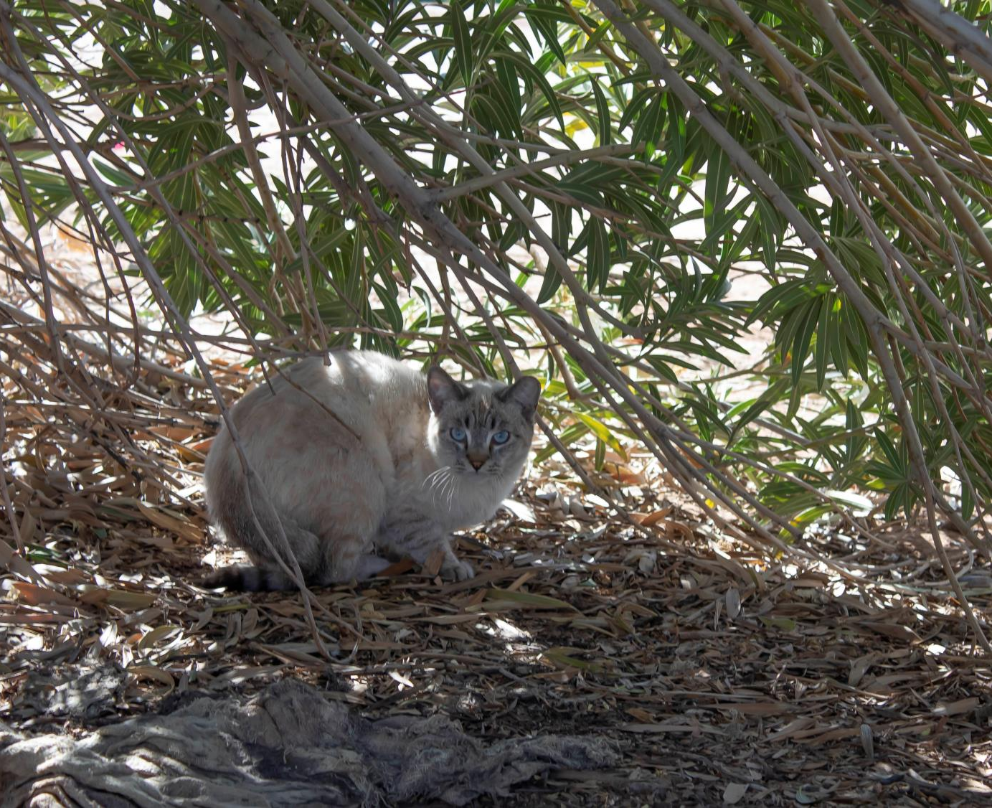
If you would like to participate in colony caretaking or the TNR program please register at catstats.org/Yuma
THANK YOU!

