Slide 1
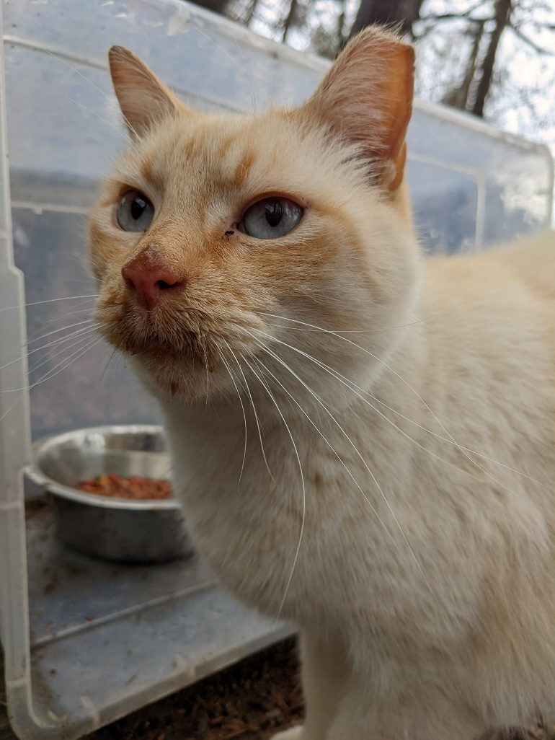
The Basics of TNVR (Trap-Neuter-Vaccinate –Return)
Notes:
This is Gravy Face and he’s one of the reasons I have such a passion working with community cats.

Slide 2
What are feral cats?
Feral cats are not socialized to humans. They don’t want to live with us or become our friends.
Feral cats DO NOT belong in a shelter.
Feral kittens can be socialized if they are caught at an early age. The ideal age would be 6-8 weeks or after they are weaned.
Rescuing all of the kittens and friendly cats can become overwhelming.
TNVR at its core is about reducing overpopulation and not rescue.

Slide 3
Where do outdoor cats come from?
The domestic cats’ natural habitat is outdoors in close proximity to people/food source.
Cats came into existence approximately 10,000 years ago when humans first began farming. People used cats as “Green Pest Control.”
Cats are very prolific and kittens sexually mature very young. Female kittens can begin having kittens at 4-6 months of age.
Female cats can have up to 3 litters per year.
Most litters are 4-6 kittens which can equal 12-18 new kittens into the population yearly.
If half of mom’s kittens are females, that’s 6-9 females that will start going into heat at 4 months of age and begin another breeding cycle.
A female cat and her offspring can produce over 370,000 kittens in 7 years!

Slide 4
What is the difference between a stray cat and a feral one?
Stray cats:
Will approach people, houses, porches or cars
Walk like a house cat, tail up, meow and answer you
Visible in the day
Likely to be disheveled and dirty
Feral cats:
Hide from people
Crouch, crawl and protect body with tail
Won’t make a sound or purr
Nocturnal
Clean, well-kept coat

Slide 5
Cat Math-not your standard 1+1=2

Slide 6
Why TNVR?
Every year hundreds of thousands of feral and stray cats are losing their lives in municipal shelters. Ironically, shelters are meant to be a temporary sanctuary and refuge for cats in need. The majority of these cats are perfectly healthy.
Bird populations are also on a decline due to humans and development. Much of the blame goes to cats.
TNVR is the only humane solution to reduce overpopulation-meaning less cats and more birds!
The outdated “catch and kill” method has been scientifically proven to be ineffective.

Slide 7
You spot a “community cat”, what’s next?
The term used to describe free-roaming, unowned cats is “community cat.” Community cats can be feral, any degree of socialized, abandoned, and homeless cats.
If the cat is friendly and able to be handled, take the cat to a local vet office to be scanned for a microchip and post the cat on lost and found sites.
www.trianglelostpets.org
Pawboost.com
Craigslist
N & O
Throughout the neighborhood
WRAL Out and About
https://www.lostmykitty.com/
http://www.tabbytracker.com/
Facebook has several lost and found sites, just enter lost and found pets and the groups will populate.
Regardless of whether a cat is friendly or feral, if the cat isn’t altered, it’s still a good idea to get the cat spayed/neutered.
Notes:
I was trapping in one area and didn’t realize that there were a number of neighbors feeding the cats. It took several failed attempts before I finally trapped the cats since I had to communicate with all of the neighbors to withhold the food.

Slide 8
If the cat is feral (and NOT already ear-tipped), determine if there is a caretaker or source of food/cats in the neighborhood.
If the cat is in good condition with a healthy body weight then the cat has a food source.
Ask people in the area
Notice food dishes outside
Post on Next Door/Neighborhood paper, etc.
Approach the caretaker to see if they would like information and/or help in getting the cat(s) altered and vaccinated.
If a caretaker isn’t identified, then can start feeding to get the cat on a regular feeding schedule.
Once the cat is consistently showing up for a meal at the same time every day, then it’s time to set up an appointment.
Schedule an appointment with a veterinarian that is comfortable working with feral cats.
Arrange getting a trap the week before the appointment.

Slide 9
Low-cost clinics and voucher programs in this area.
SAFE Care Clinic
Operation Catnip-monthly clinic-100% volunteer run
Saving Lives-SPCA
Five County Spay/Neuter Clinic in Zebulon
SNAP-(Spay-Neuter-Assistance-Program) Mobile vet clinic
Independent Animal Rescue in Durham
Vouchers accepted at numerous clinics in the area:
Operation Catnip
SPCA
Alley Cats & Angels
Friends of Animals
$20 Fix-Alamance & Orange County
SpayUSA

Slide 10
Tips on trapping
Don’t wait to befriend a cat and try to coax into a carrier.
Only use humane traps-not squirrel traps.
Don’t try to pick up cats-let the traps do their job!
Withhold food from the cats. This is typically for 24 hours. Hungry cats go into traps.
Bait the trap with super smelly food-tuna in oil, sardines, mackerel even KFC chicken!!
Also, place traps on a flat and stable ground in a quiet area. A cat won’t go into an unsteady trap in a noisy area.
Monitor and keep track of the traps. Don’t leave the traps unattended but stay a far enough distance away to give the cat a sense of safety.
Don’t worry about betraying the cat’s trust. This is what’s best for the cat, the community, environment and wildlife. The cat will forgive you.

Slide 11
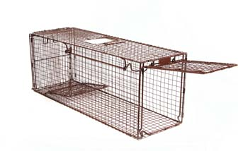
Setting the trap
Trapping supplies:
Smelly bait
Spoon/fork for scooping out food
Food container (small paper plates, aluminum foil, plastic container lids)
Newspaper/pee pee pads/plastic bag
Trap covers-towel, sheet
Zip ties, carabiners

Slide 12
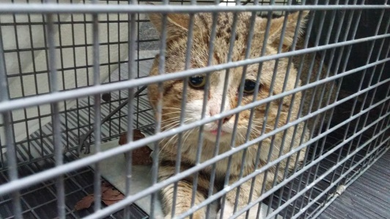
The cat is in the trap!!
Immediately cover the trap with a towel or sheet. This will calm the cat down.
Very carefully move the covered, trapped cat to a quiet and safe area. Make certain that the trap is secure by using zip ties or carabiners.
Have a climate controlled, quiet area to keep the cat in until you can transport to the appointment and for recovery after the surgery. This should be an area safe from predators.
NEVER OPEN A TRAP BEFORE THE APPOINTMENT (even a little bit)!

Slide 13
Appointment day:
Bring your feral in the trap covered with a towel to the veterinary clinic.
It is essential for feral cats to arrive in traps. This applies to any cat that you are unable to pick up and hold.
Safer for cats
Safer for medical staff
Now it’s time for the N and V of TNVR

Slide 14
T - N - V- R
N - Neutering
Applies to both spaying and neutering of feral cats
Performed by veterinarians, not techs.
High-quality, high-volume, low-to-no cost surgical procedures
Some full-service vet clinics will work with feral/community cats.
Make sure the clinic understands that the cat will arrive in a trap.
Don’t let anyone open trap to pull the cat out!! Cat should be sedated while in trap!

Slide 15
Trap-Neuter-Vaccinate-Return
Neutering/Spaying Benefits:
Less mating and territorial behaviors
Fewer fights and injuries from fighting
Decreases mating behaviors and vocalizations
Less kittens born into the feral colony
Helps slowly lower colony population
Keeps existing cats and kittens healthier
Healthier overall colony population

Slide 16
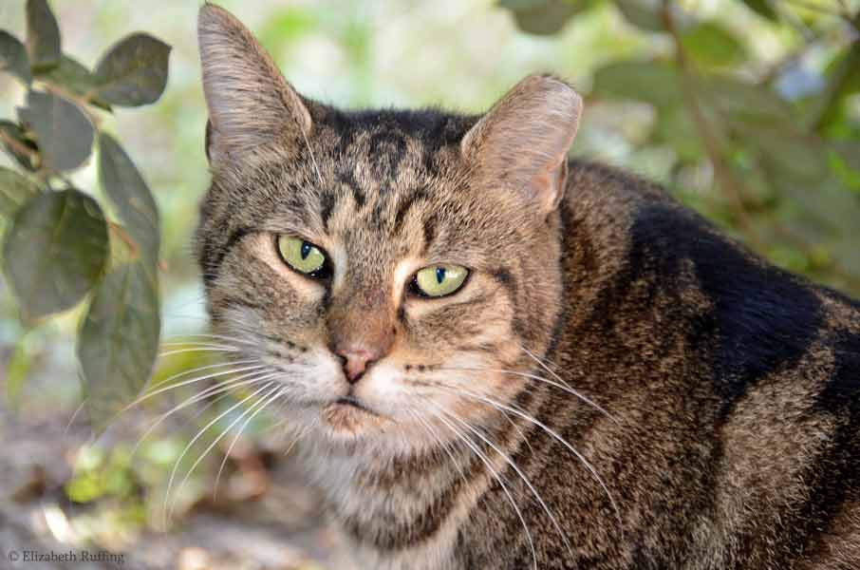
T – N – V – R
Ear tipping
Performed while cat is under anesthesia for spay/neuter
Top 3/8” (1cm) of left ear is removed
Universal symbol indicating a cat is spayed/neutered
Any outside cat-friendly or feral- will benefit from being ear-tipped.

Slide 17
T – N – V – R
V – Vaccination
Alley Cat Allies has changed terminology from TNR to TNVR
Emphasizes the importance of vaccinations
Educate the public that feral cats are vaccinated
All TNR and TNVR programs vaccinate cats
Vaccinations help prevent spread of disease
Vaccinations help keep colony cats healthy

Slide 18
Trap – Neuter – Vaccinate - Return
All TNR or TNVR cats receive a rabies vaccination at the time of surgery
Rabies vaccination helps protect the cats from rabies
Rabies vaccination prevents the spread of disease
Studies show that a one-year rabies vaccine can provide several years of protection.
Most programs also provide feline distemper vaccination

Slide 19
The Do’s and Don’ts of recovering feral cats.
The cat is returned to you in the same trap. Typically, the trap is lined with newspaper or pee-pee pads. You’ll receive the medical records, rabies certificate and an after-hours emergency number.
Do keep the trap covered.
Do have a temperature-controlled, quiet environment to recover the cat in.
Do monitor the cat for any bleeding, infection, vomiting, breathing irregularly or not waking up. Be sure to read through the complete surgery recovery instructions.
Do provide wet food once the cat is alert. Open the back door slowly and only open a small gap to slide in a plastic lid with food. If you don’t feel that you can open the door without the cat escaping then drop food in through the trap or set the trap on the food.
Do keep the cat at least 24-48 hours after the surgery. Females typically will need longer than males. Your veterinarian will give you this information at discharge.
Don’t open the trap door to reach in, clean or let the cat out unless you have a separator.

Slide 20
Trap-Neuter-Vaccinate-Return
Once the cat is clear-eyed and alert, return to the location that you trapped him/her. This is their home even if it’s not ideal. Remember, at its essence, TNVR is NOT about rescuing cats; it’s about population control and reducing the number of feral cats in that area.
Point the trap away from traffic. Set the trap down for a moment to give the cat time to take in the surroundings and then calmly release.
Don’t relocate the cat to a different location. If the cat is relocated they will try to make their way back home. This can set the cat up for failure. Relocation requires an acclimation period of being confined for at least 3-4 weeks.
If you are assuming the role of a caretaker then you should begin providing food and water on a regular basis. In this climate it is recommended that shelter be provided.
Congratulations!! You have made a difference in the life of that cat and prevented others from being born!!

Slide 21
Tough to trap cats tips
Trap training
Drop trapping
Bottle prop
Remote control
Different types of traps
Camouflage

Slide 22
Helpful websites:
https://www.alleycat.org/
https://www.neighborhoodcats.org/
https://www.communitycatspodcast.com/
https://www.aspca.org/helping-people-pets/shelter-intake-and-surrender/closer-look-community-cats
https://www.humanesociety.org/resources/community-cat-program
https://www.austinpetsalive.org/blog/feral-rehab-recovery-and-release

Slide 23
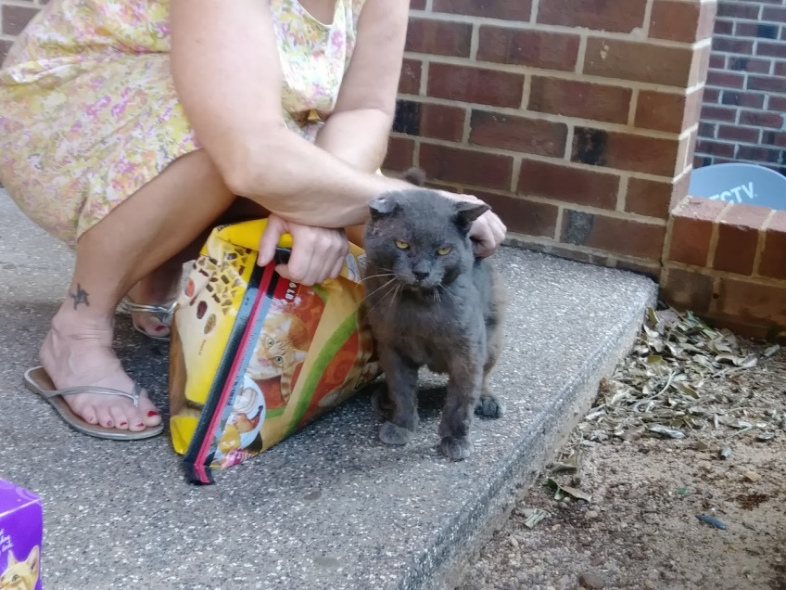
Sometimes ferals turn out to be friendly.

Slide 24
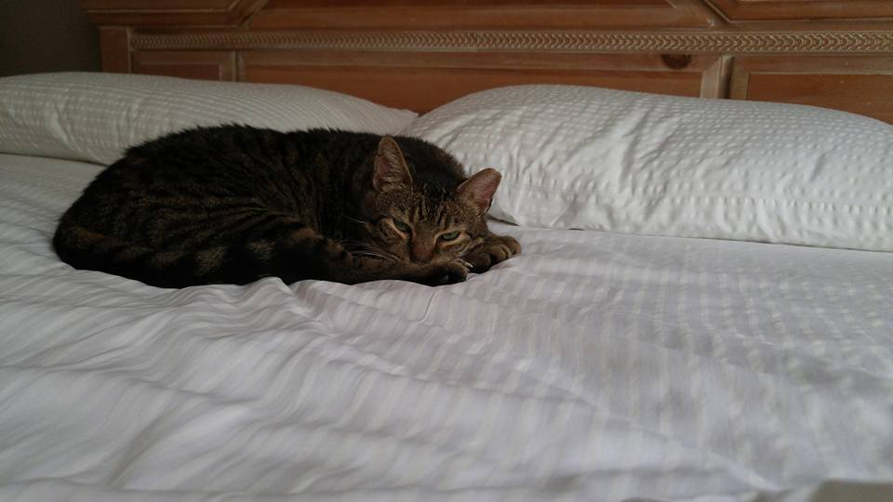
Some decide they want to live as a spoiled house cat.

Slide 25
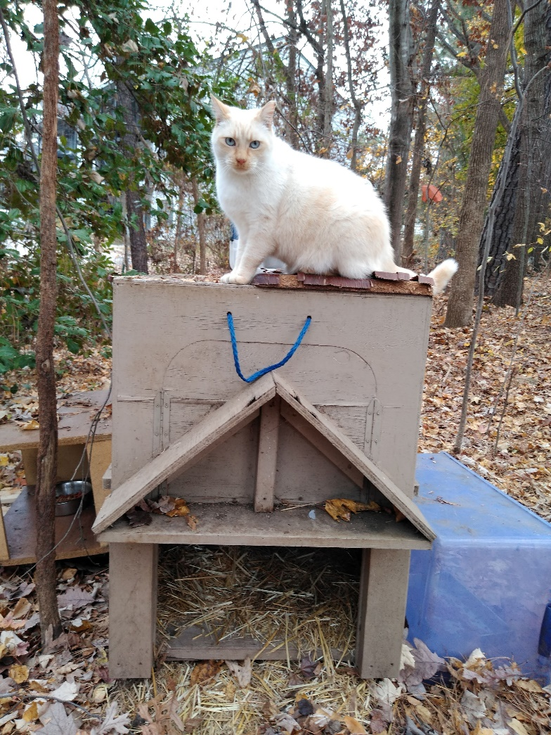
But typically, they prefer to stay in their home.

