Slide 1
Active Pathway
Jess Charlton, Emily Keegans, Loralee Greco

Slide 2
About Us
Jess Charlton (they/them) – Intake Director
9 years at Seattle Humane (Cat Program, Pet Resource Center, Community Outreach, Intakes), 12 years in animal sheltering (Operation Catnip, PAWS)
Oversees owner surrender, temporary foster care, end of life program, and lifesaver transfer programs.
Emily Keegans – Chief of Animal Behavior
20 years at Seattle Humane (adoption and intake adviser, dog training class instructor, behavior program)
Oversees shelter dog behavior program and public dog training class program.
Loralee Greco (she/they) – Animal Pathway Coordinator (APC)
3 years at Seattle Humane, 6 years in animal welfare
Leads daily Rounds, coordinates between teams to address animals' needs, leads Animals of Concern meeting

Slide 3
History, Intakes
By Jess

Slide 4
Intake
Managed intake system
Seattle Humane is 125 years old. Historically, we were an open admission municipal shelter, then a non-profit with government contracts. Currently, we are a private non-profit without contracts. Countless changes to systems over the past 7 years. Emphasis now on making data driven decisions and lowest hanging fruit.
Expected to see 4,500 animals come through our system this year. Now expecting around 7,000.
Appointment based system for intakes is utilized. This allows us to accept emergencies and walk-ins as needed. Community members contact us via email, phone, text, or face to face. Consent based pet retention is our #1 priority.
Pre-intake to placement goals
Gather information on pets and place in the system as inactive. Evaluate diversion options. Evaluate transfer commitments and weekly goals. Tools: weekly team meeting, daily huddle, teams channels, Petpoint, Excel
Utilize behavior and medical approval channels to prepare teams for specific pet needs and pathways.
Complete intake assessments (inclusive of medical and behavioral components) on arrival. Assign handling level, adoption recommendations, and holds as needed to determine next steps by end of day.
Pathways for typical dog, typical cat, neonates, pets with behavior concerns, pets with medical concerns, SPOT pets

Slide 5
Animal Flow
Intake
Medical/Behavior Care
Owner Surrender
Transfer
Strays*
Intake Assessment
Surgery
Treatment Plans
Outcome
Adoption
Return to Owner (RTO)
Transfer
Euthanasia
Foster Support
Enrichment

Slide 6
Kitten emergency pathway
Intake
Medical Care
Owner Surrender
Transfer
Strays*
Triage
Treatment Plans
Outcome
Adoption
Return to Owner (RTO)
Transfer
Euthanasia
ICU
Foster Support

Slide 7
Emergencies
What steps do you take when a kitten arrives at SH and appears to be hypothermic, hypoglycemic, or extremely lethargic?
Assess the kitten
Alert a DVM
Gather & begin to administer heat support (SnuggleSafe in microwave, Bair Hugger, fleece bedding)
Gather glucometer and karo
Take temp*
Take BG and administer karo if warranted*
Gather IVC supplies (and place)
Repeat steps 4 and 5 every 5-10 minutes until stable

Slide 8
Data, Handling Levels
By Emily

Slide 9
 | Green | Blue | Purple | Red
Definition | Beginner/Novice level handler. All volunteers and staff with dog handling training should be able to handle this dog. | Intermediate level handler. Behavior(s) exhibited requires a higher level of competency than green dogs. | High-intermediate level handlers. Behavior(s) exhibited requires a higher degree of competency than blue level dogs. | Advanced level handlers. Behavior(s) exhibited requires a very high degree of competency. On Bite Quarantine
Behavior Towards People | Within 24hrs of arrival to shelter dog can be approached and handled easily (minimal changes to human body language need to be made, responds to standard treats) Displays affiliative behavior. | Shy/Fearful: Requires moderate changes to handler/human body language May need some coaxing/treats, but generally able to walk on leash through shelter and outdoors | Shy/Fearful: Does not warm up within 20 minutes Mild to Moderate threat displays (low growl, lip curls, air snaps) Backs away during threat display(s) | Moderate to Severe threat displays (lunging and snapping, growling, snarling, tense body, barking) Does not back away during threat display(s)
Yellow – Behavior Staff

Slide 10
Seattle Humane Data Review
Compiled and analyzed by Dr Krystal Price, Seattle Humane Senior DVM
Considering capacity and resources are not unlimited: Who should be the priority for additional support?
Dogs with higher level of behavior needs (purple/red handling level) had 3 – 4 times higher LOS than green/blue level dogs.
Within this group: 60 pounds or larger = 5 times higher LOS; Returns = 5 times higher LOS. Red collar = higher likelihood of behavioral euthanasia
Cats and dogs with a medical or behavioral consultation before adoption
Dogs on Behavior Medication (for shelter stress or for generalized fear or anxiety)

Slide 11
Active Pathway Eligibility
Enrollment
Animals who are statistically likely to have a high LOS based on SH data (applies to adult animals)
Purple Handling Level dogs who are large (≥ 60 pounds)
Purple Handling Level dogs who are returns
Any Red handling Level
Any Yellow Handling Level
Dogs on Behavior Medication
Adult animals with Medical or Behavior Consultations required before adoption
Adult animals on Bite Quarantine
Animals who have/reach a high LOS without a reasonable explanation such as medical treatment, underage, or SPOT (temporary foster—Supporting Pet Owners in Transition) program enrollment.
LOS on a visually available stage greater than 21 days

Slide 12
Data
Data
Here's the link I found to Price's data: Pathway Medical and Behavioral stats.docx

Slide 13
Active Pathway Process
By Loralee

Slide 14
Intake Assessment *SOP will be shared
Handling level assignment *SOP will be shared
Holds and Daily Rounds
Active Pathway Matrix *Copy will be shared
Animals of Concern Meeting *SOP will be shared

Slide 15
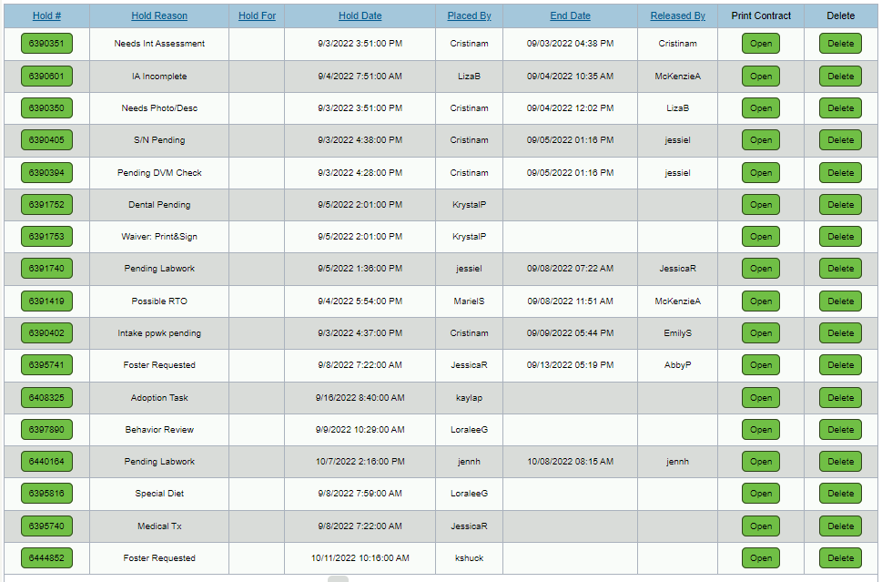
Rounds Example (holds, tracking)

Slide 16
Daily Rounds
In-person / Shelter Rounds
"What does this pet need today?"
APC reviews on-campus updates over past 24 hours that may need to be addressed by the team
Holds, Monitoring Sheets, Exercise Notes, Staff/Volunteer concerns
Each Ops teams represented
DVMs, Foster, Adoptions, Behavior, Intakes, Shelter Care
Foster Rounds
APC reviews holds for pets in Foster to see if any action is needed
i.e. change stage, request to bring back to campus
Email Rounds
Includes who was present during Shelter Rounds and any additional questions or updates that need to be addressed today

Slide 17
Rounds Example (holds, tracking)

Slide 18
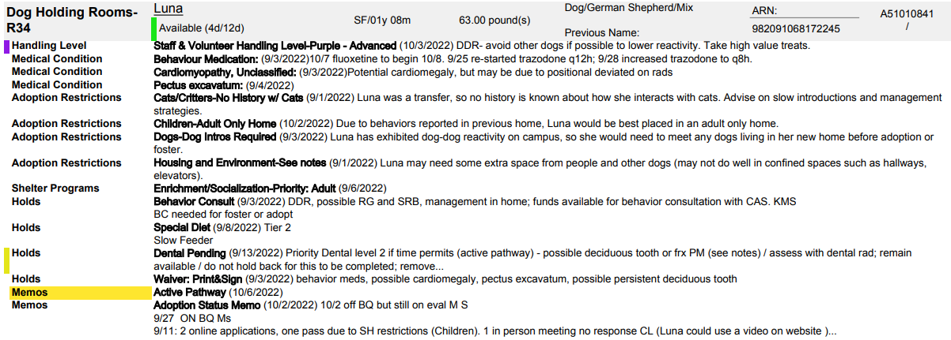
Rounds Example (holds, tracking)

Slide 19
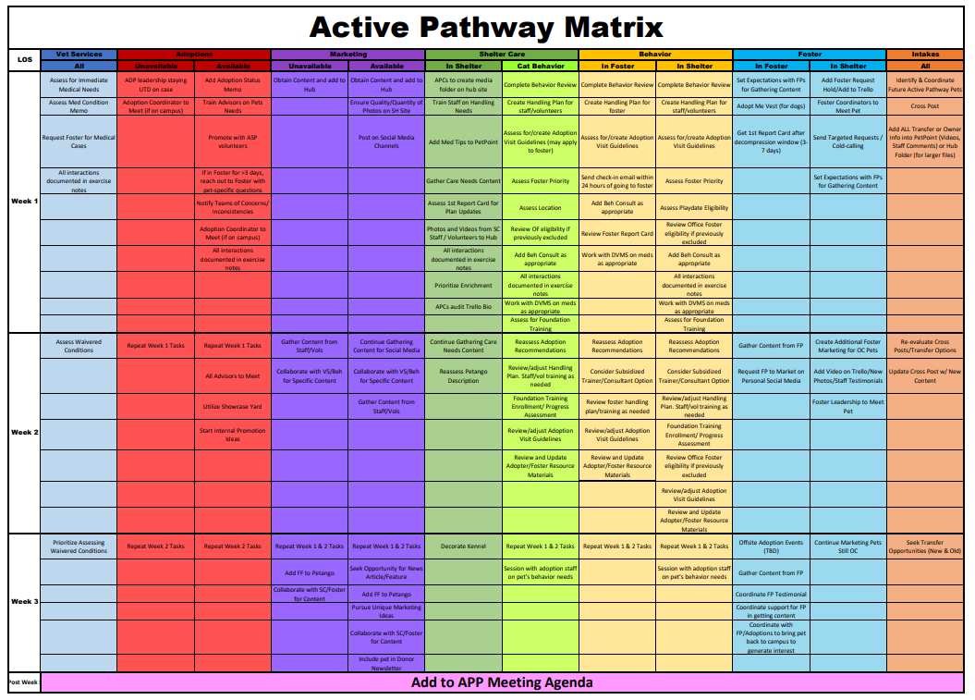
Active Pathway Matrix

Slide 20
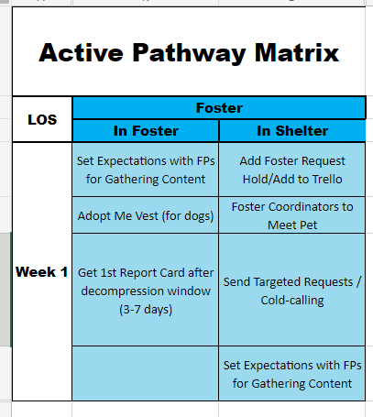
Active Pathway Matrix

Slide 21
Animals of Concern meeting
Red/Yellow/BQ
Goal: FYI for all teams, verify if stable / unstable, identify and assign tasks if unstable
Nebuso – BQ thru 10/12
Puppy play bite, BR cleared
Possible Medical NACs
Goal: FYI for all teams
Fluffy – not responding to treatment, recheck tomorrow
Unstable (SPOT or on Active Pathway)
Goal: identify unstable pets and what is needed to get them stable, assign discrete tasks and assign to specific team or person
Tuna – SPOT cat on campus for 2 weeks
Foster to send targeted emails to FPs

Slide 22
Animals of Concern meeting (continued)
Week 3+ on Active Pathway
Goal: discuss biggest barrier that is holding them back, come up with 2 ideas that would have biggest impact, break up ideas into discrete tasks and assign to specific team or person
Weasley
Biggest barrier – dog reactivity and on-campus behavior
Beh planning dog-to-dog intro offsite, trying for Friday morning before he returns to campus
APC – update Petango (want to promote that he's a great dog in a home environment)
Other Topics
Goal: bring up ideas for APM/AoC process changes to relay to WG, etc
Shelter Care working on updates for Active Pathway Matrix tasks for Week 1

Slide 23
Active Pathway memo
Week 4
Start: Monday, [10/3/22]
VS: 10/5 added medical condition memo for possible retained deciduous tooth, added back "priority" to dental hold. LR
ADP: 10/2 we need to make an updated video once available. MS to work with KS. MS
MKT: completed
SC: completed with exception of decorating kennel. Assigning for next week. LG
BEH:10/3 completed video w/ Mel. 10/9 completed. KMS
FOS: staying OC per APC ACS 10/9
INT: n/a
Ends: Sunday, [10/9/22]
Active Pathway Meeting Notes:
Biggest Barrier – main behavior issue on campus is DDR, in the home there was DDR and also RG/mouthy, higher energy
APC to refresh pics and Petango (recent return, newly Available again)
Beh to upload new play date videos when they happen

Slide 24
Questions?
Jess: jessicac@seattlehumane.org
Emily: emily@seattlehumane.org
Loralee: loralee@seattlehumane.org

