Slide 2
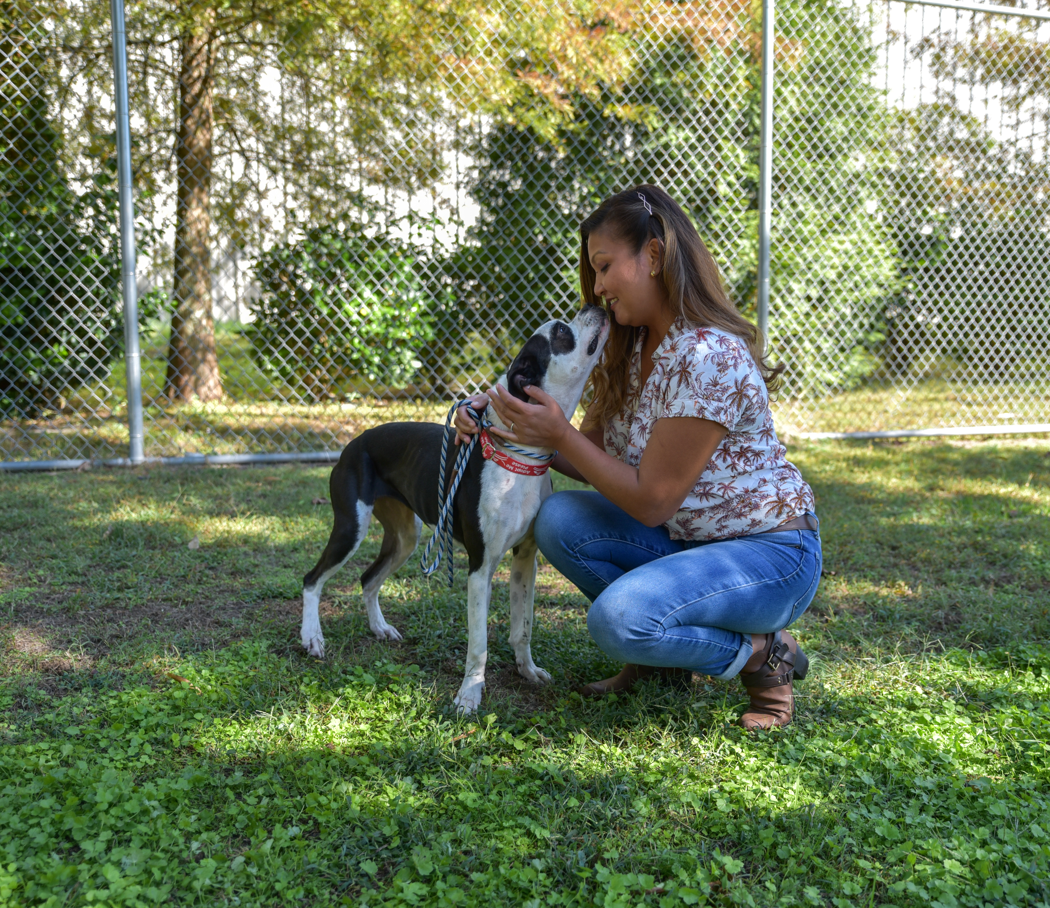
Shelter at a Glance
Non-Profit with Municipal Contract
Partner with but do not oversee Animal Control
No Staff Veterinarian (at the time)
Annual Operating Budget: $750,000
Annual Intake: 1,600 – 1,900 dogs, cats, and small animals
18 Full-Time Staff, 2 Part-Time
Notes:
During most of these changes, we had 12-14 staff members and were at or over capacity
Our team members do not routinely work more than 40 hours per week

Slide 3
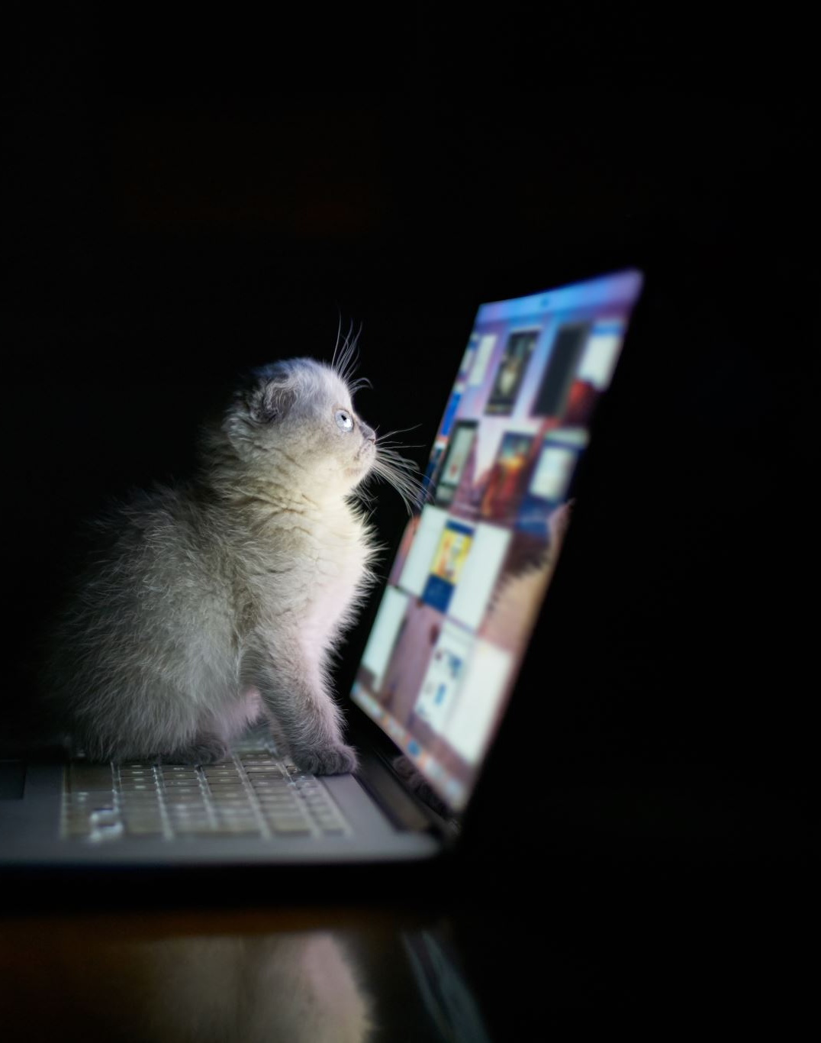
Support for “Stray” Animals
We were doing the minimum
Scanning lost pets/Tracing microchips
Accepting hand-written lost reports
Stray in care animal listing online (no photos)
Reporting via Shelter Software
Staff cared about it but weren’t invested
This program was selected first because of a Maddie’s Fund Grant Challenge
Notes:
- Shift process midway through challenge

Slide 4
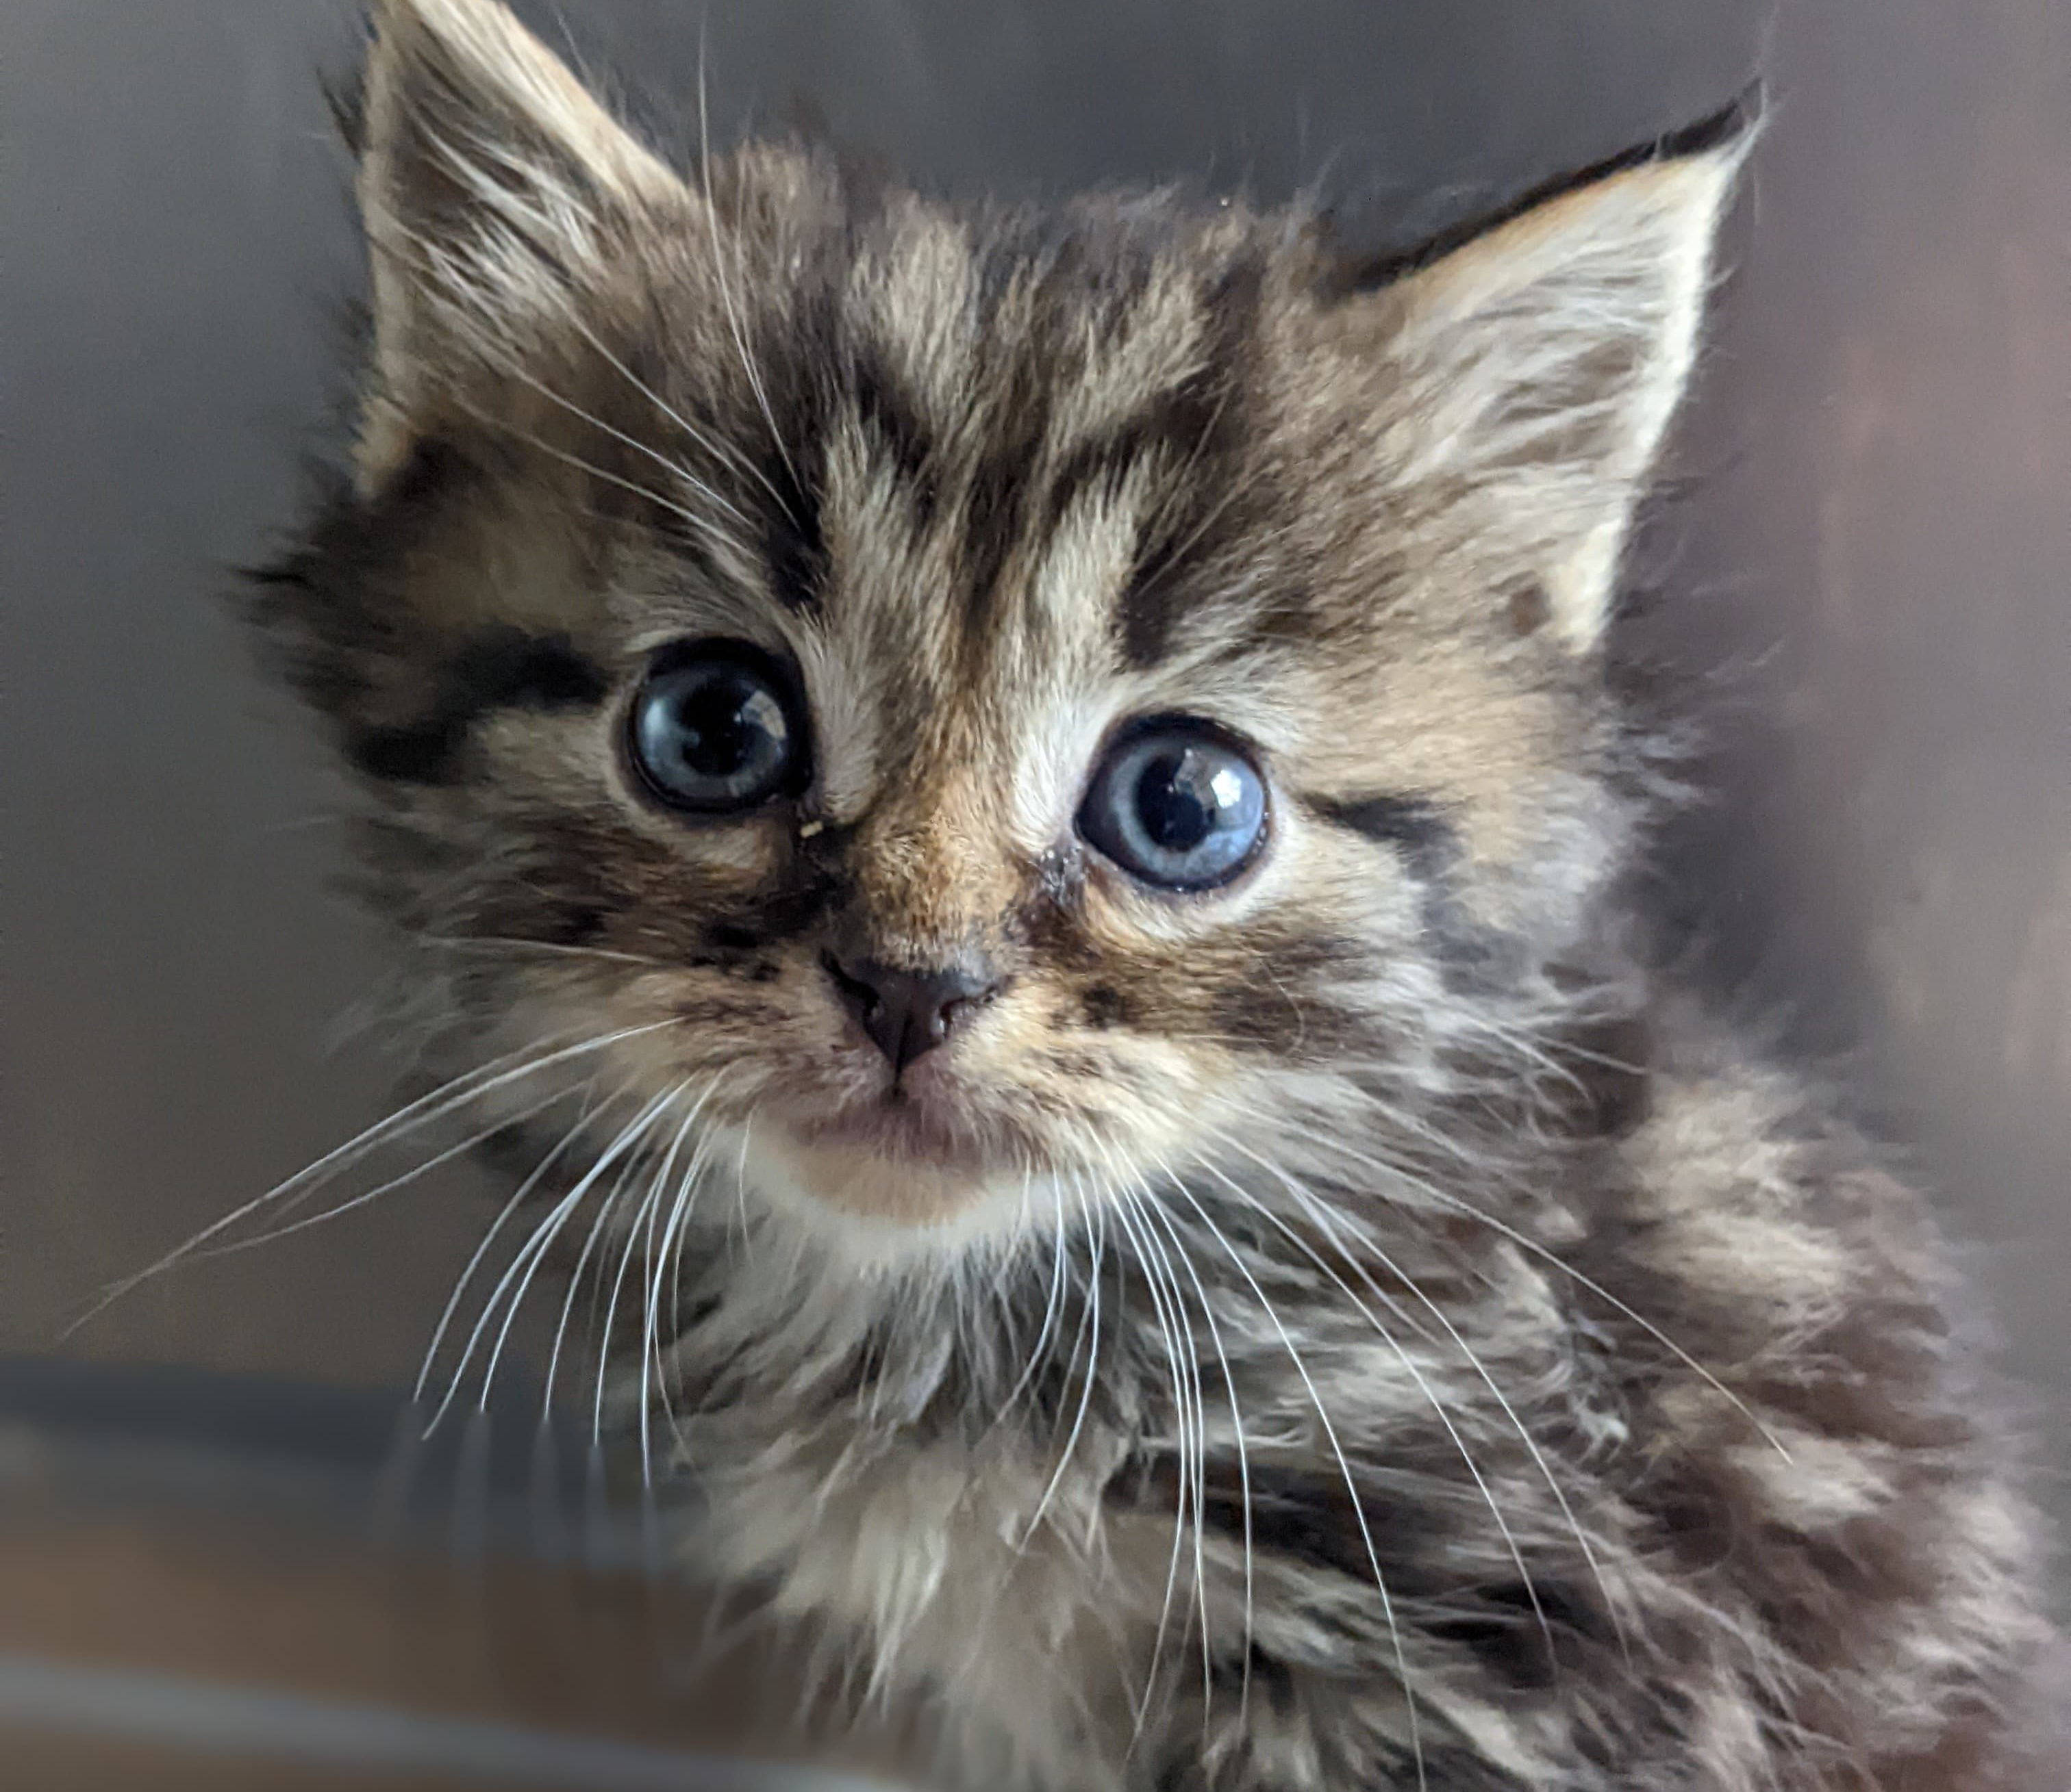
Lost and Found Pet Support
Real time Lost/Found Pet Reporting
Direct support for people who lost or found pets
Provided free computer access
Found Pet Door Hangers
Lost Pet Flyer Printing
Online Lost/Found report
Revised Reclaim Fee policy
Flexible Finder-to-Foster
Free leash/collar/ID tag for reclaimed pets
Notes:
Improvements prioritized getting pets home
Created/reinforced the assumption that 'strays’ are lost and someone is searching
Shelter’supportive response demonstrated commitment to HELPING pet owners

Slide 5
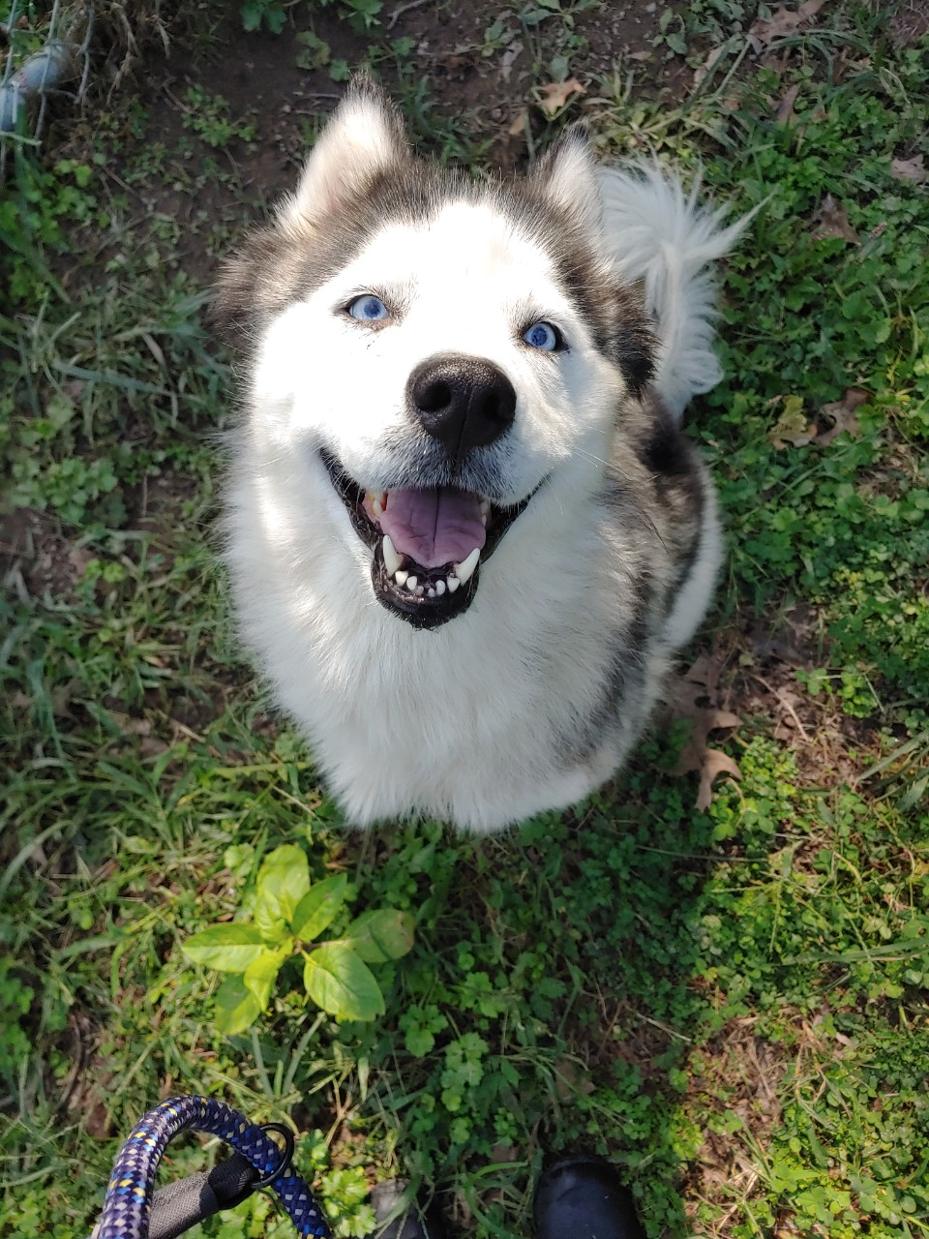
Effect on Organization
Opened the door for leadership to talk about how we care about the relationships between people and animals
Staff could practice providing resources and speaking empathetically in a situation where that was easy
Most can relate to the pain of losing a pet
Reuniting pets with their people is an exciting “win”

Slide 6
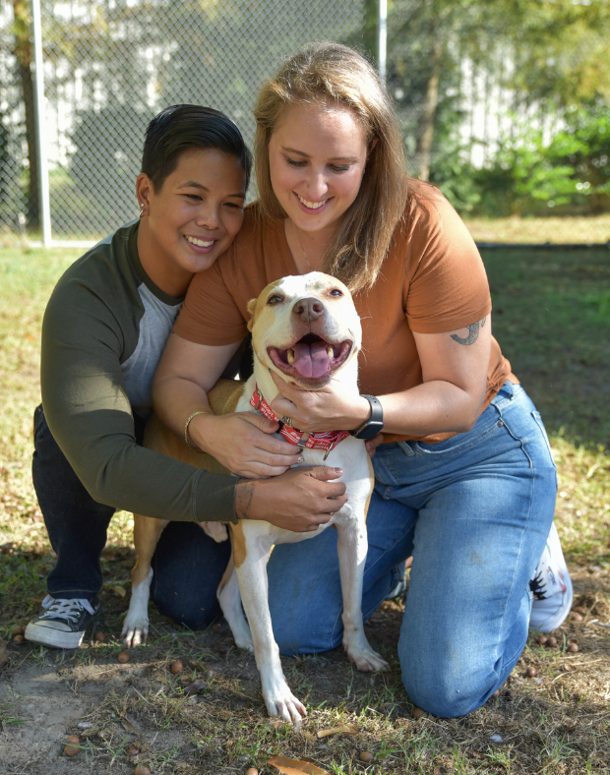
Creating a Culture Shift
How an organization behaves is reflective of its culture
Define what you want your culture to be, or your team will do it for you
Our leadership team set regular bi-weekly meetings to discuss our culture
Notes:
Shared beliefs and values shape team member behavior, policies, and marketing materials
Mark time for these big-picture discussions in your calendar, and it make it as much of a priority as animal care

Slide 7
Meeting Framework
Meeting model:
Brainstorming points provided in advance
Shared feedback and created draft documents together
Documents were reviewed independently before finalizing
Considered how we viewed:
Human Nature
Organization’s Relationship to its Community
Appropriate Workplace Emotions
Effectiveness
Notes:
Meeting framework was designed to create materials not discussion
A strong meeting leader that holds the team accountable to the topic is essential
Time limits are your friend – meetings should not exceed 1 hour
- Human Nature: Do we think people are good or bad? Caring or careless?
Organization’s Relationship to its Community: How do we define ourselves in the context of our city? Our field? What is our role in the ecosystem of social change?
Appropriate Emotions: What emotions and outlook do we encourage? Discourage?
Effectiveness: What metrics define our success?

Slide 8
Drafting a Culture Roadmap
To go somewhere new, you have to understand where you are
Example: Human Nature
Humans are careless and not trustworthy -> Humans love pets and want to do what’s best for them
Our policies protect animals from people -> Our policies will be based on the idea that people are trying to do what is right
It’s normal to complain about the public because we see so many terrible things -> We cannot allow team members to talk negatively about community members
If we don’t know an animal’s history, we assume the worst -> We choose to make positive assumptions
Notes:
We first defined what our culture was then what we wanted it to be
Once we knew where we were going, we created a list of values to provide the step-by-step directions from point A to point B

Slide 9
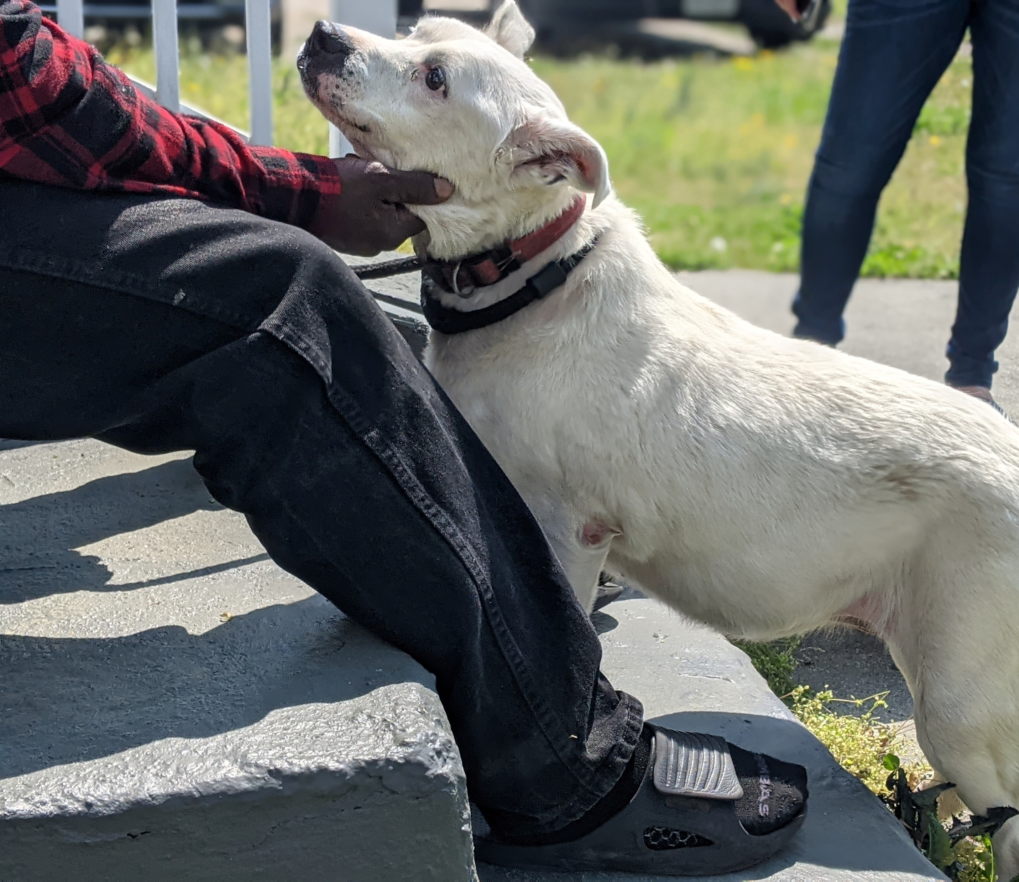
Rolling it Out
Share the plan (in bite-sized chunks)
Weekly Staff Huddle
Invite in stakeholders
Sharing Successes
Empower Staff
Solicit Feedback
Don’t relax – the work’s not done…ever hahaha!
Notes:
We first defined what our culture was then what we wanted it to be
Once we knew where we were going, we created a list of values to provide the step-by-step directions from point A to point B

Slide 10
Dyanna Uchiek
Development@portsmouthhumanesociety.org

