Slide 1
Pima Animal Care Center COVID-19 Relief Food Distribution
By: Liana Moss – PACC Community Outreach Specialist

Slide 2
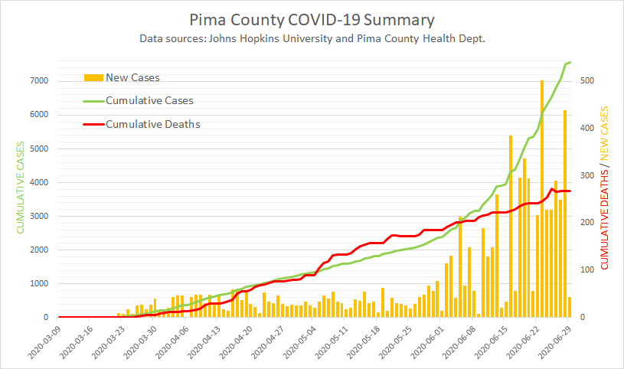
Why?
When catastrophic events, disasters, crisis, etc. occur, animal welfare organizations have a duty to respond and support the community
Spring 2020, the novel Coronavirus (COVID-19) deemed a Pandemic
Many Pima County residents fell sick and/or became unemployed.

Slide 3
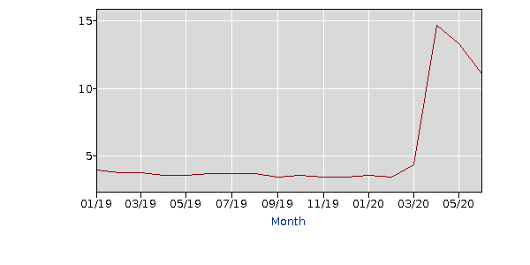
Why?
More than 33.5 million people in the U.S. filed for unemployment between March 19th and May 7th, 2020
U.S. Unemployment Rate (according to the U.S. Bureau of Labor Statistics):
April 2020 = 14.7%
May 2020 = 13.3%
June 2020 = 11.1%
Average 2019 = 3.7%

Slide 4
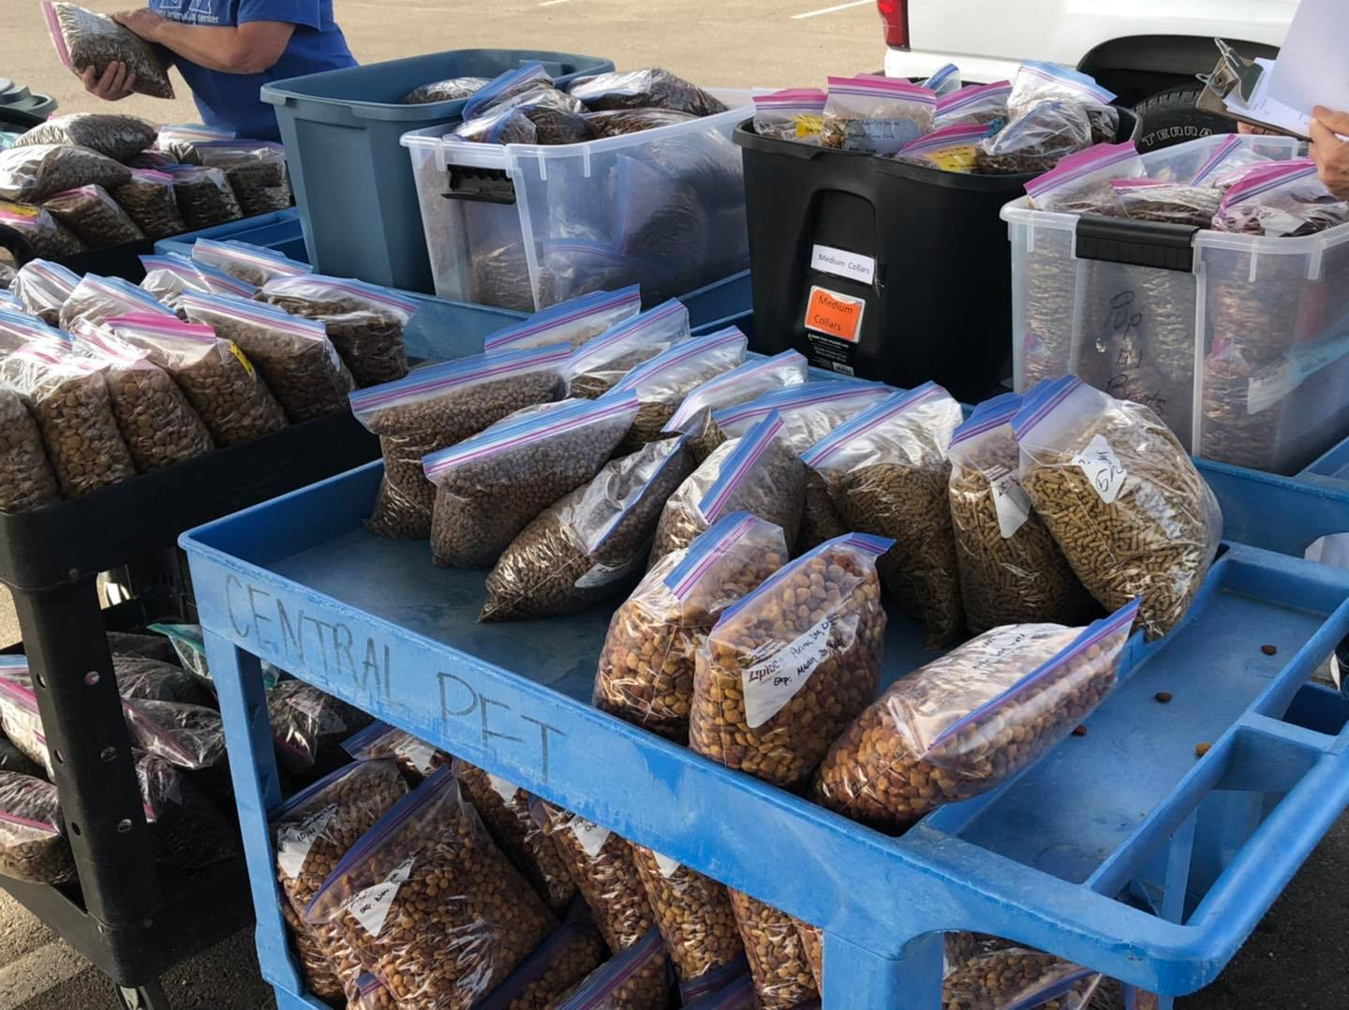
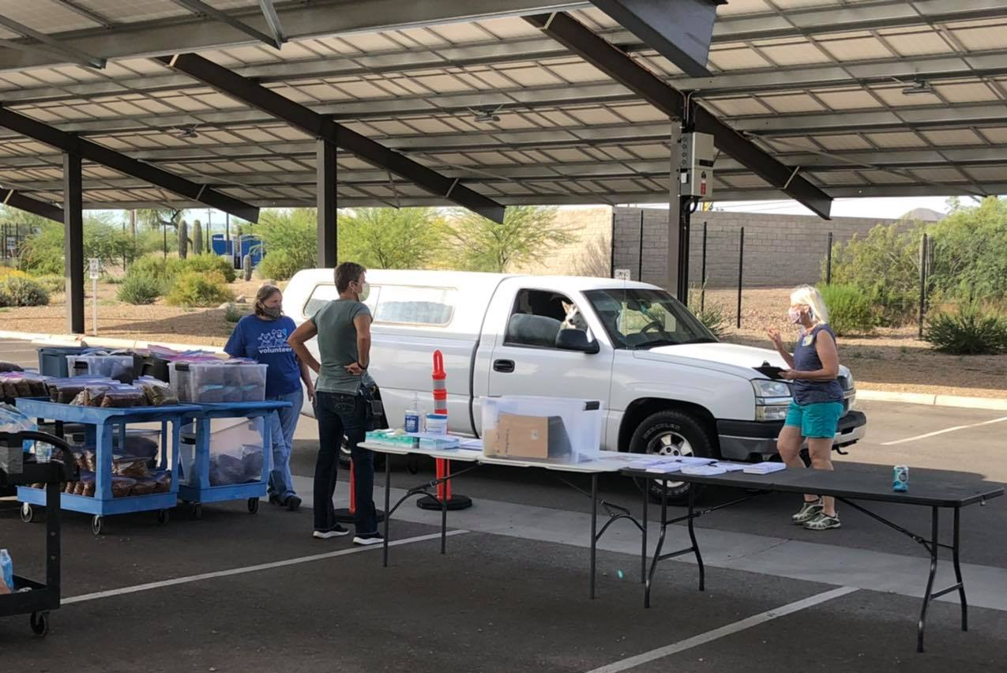
GreaterGood.org PACC Pet Program is Born
PACC distributes 1-gallon pre-packaged, labeled bags of dog food and cat food to people impacted by COVID-19.
Can be due to illness, job loss, financial insecurity, etc. We do NOT ask for proof of these hardships.
Distributed at drive-though on the PACC campus, at various social service agencies, and in parks.

Slide 5
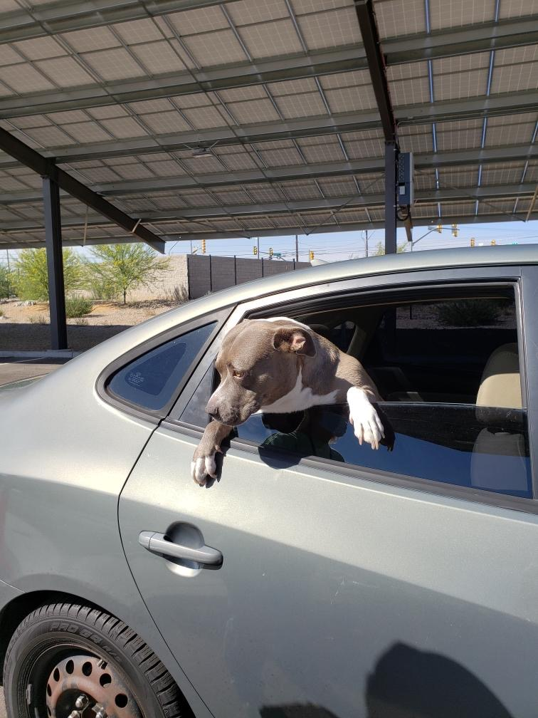
PACC Drive-Through

Slide 6
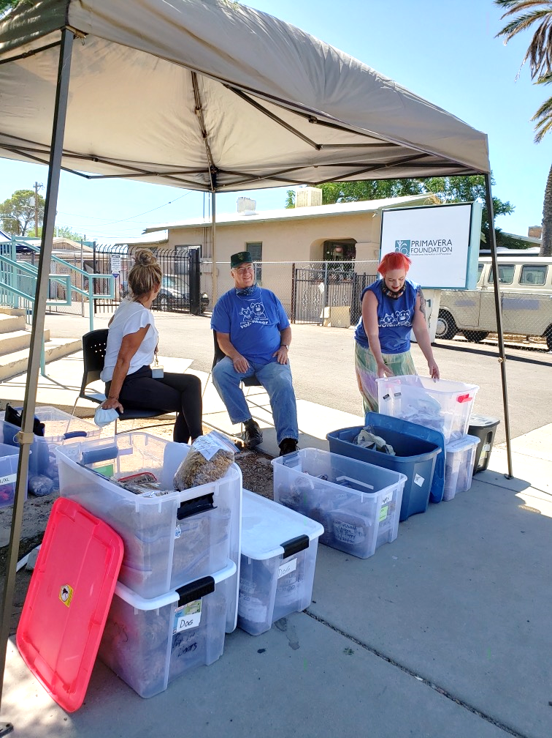
Partnering with Local Orgs/Agencies

Slide 7
Volunteers Make it Possible
“Fill the Pantry”
Distribution
One to two times a week
Bag, label, organize pet food
Accessible, safe, no animal experience necessary
KIDS
Record data
Physically hand out food
Connect with resources
Build community connections
~Innovation~
Shari and Jerri are SUPERSTARS

Slide 8
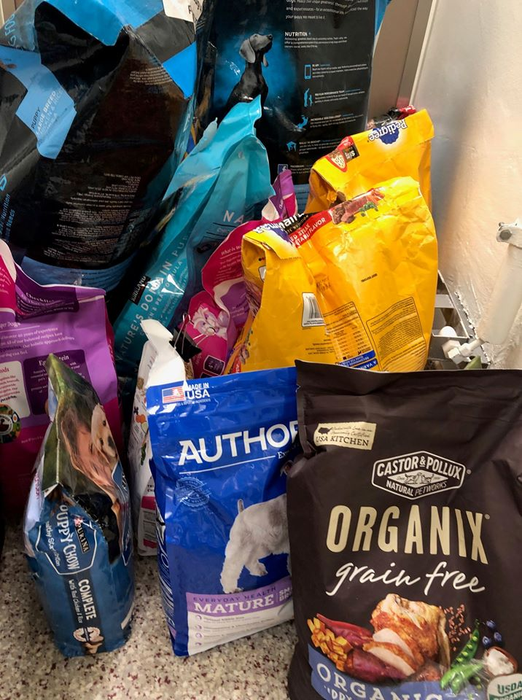
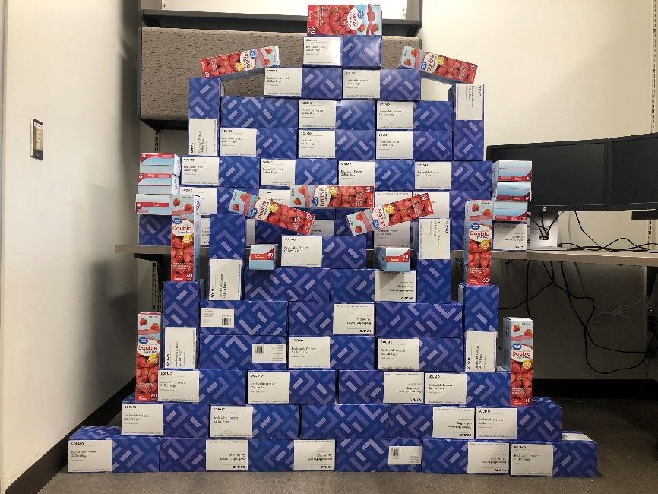
Donations Are Essential
Food
GreaterGood.org donated food to Friends of Pima Animal Care Center (non-profit partner)
The public donated food to PACC
Drop off on site or order through Amazon Wish list
Storage Bags
Plea to community for gallon size storage bags
Drop off on site or order on Amazon Wish list
In 2 weeks, community donated 105 boxes = 8,298 gallon size bags
Key to Donations
Ease
Affordability
Social Media

Slide 9
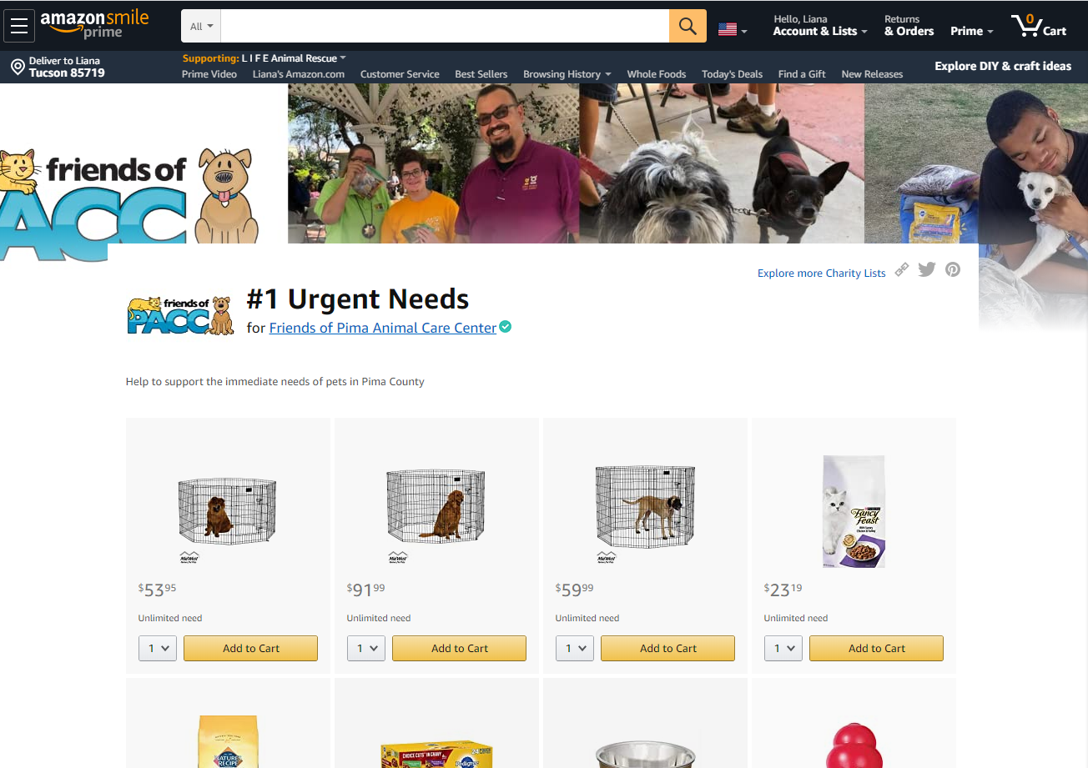
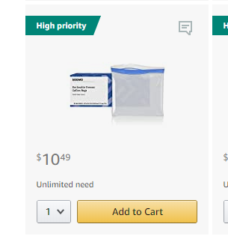
Amazon Wish list
You can create your own list here

Slide 10
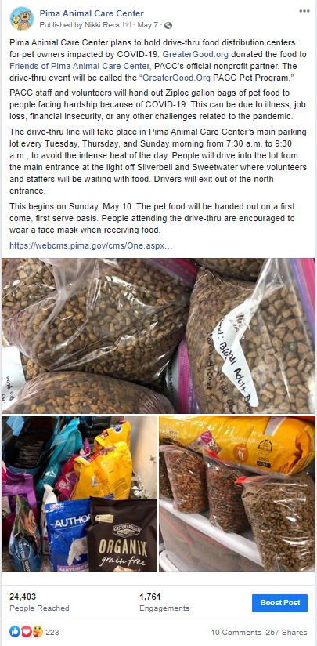
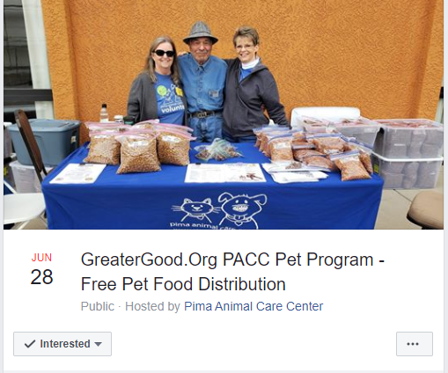
Social Media and Marketing
Facebook post
Advertise Schedule and Solicit Donations
Local Radio
Local TV/News
Facebook
Instagram
Twitter
Ticktock
Social media events
Posters
Press releases
Facebook event

Slide 11
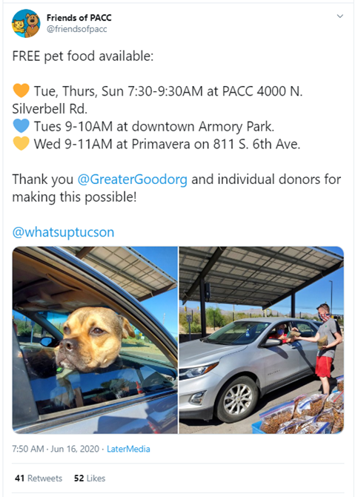
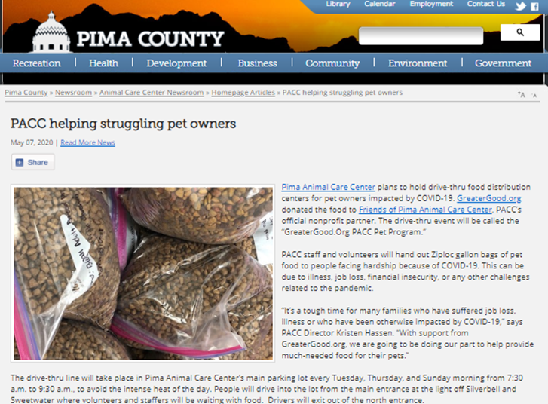
Tweet
County Press Release

Slide 12
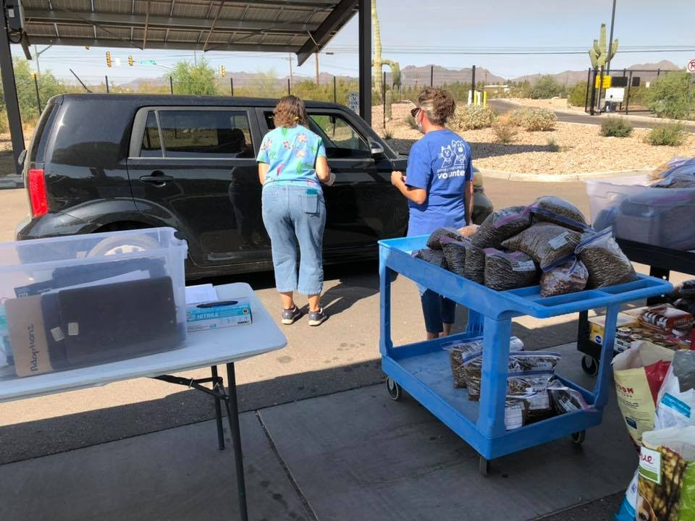
Data Collection
Questions We Ask Patrons:
Volunteer asking patron questions before loading food
How many dogs in the home?
How many cats in the home?
Zip Code?
Data We Record Through Observation:
Number of families served (there can be multiple families in one car)
Bags of dog food distributed
Bags of bags of cat food distributed
Clipboards with Data Keeping Forms

Slide 13
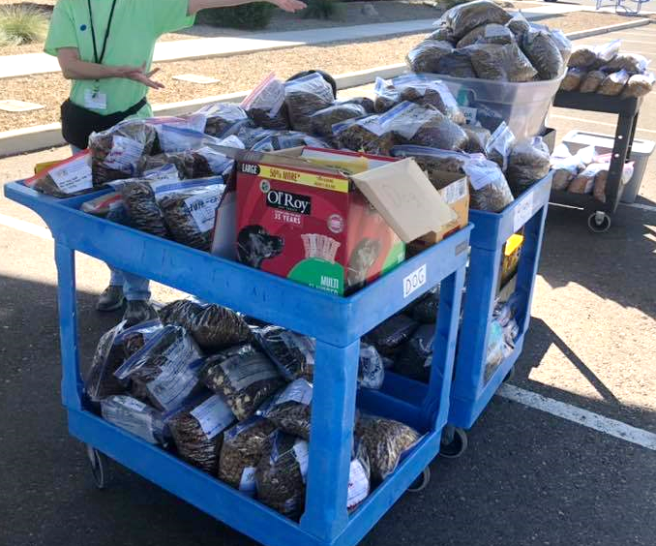
Storage and Efficiency
Storage For Off-Site Distribution
Storage for On-Site Distribution
Located in large 50 gallon bins/ garbage cans
Labeled by type
Load rolling carts with food from storage

Slide 14
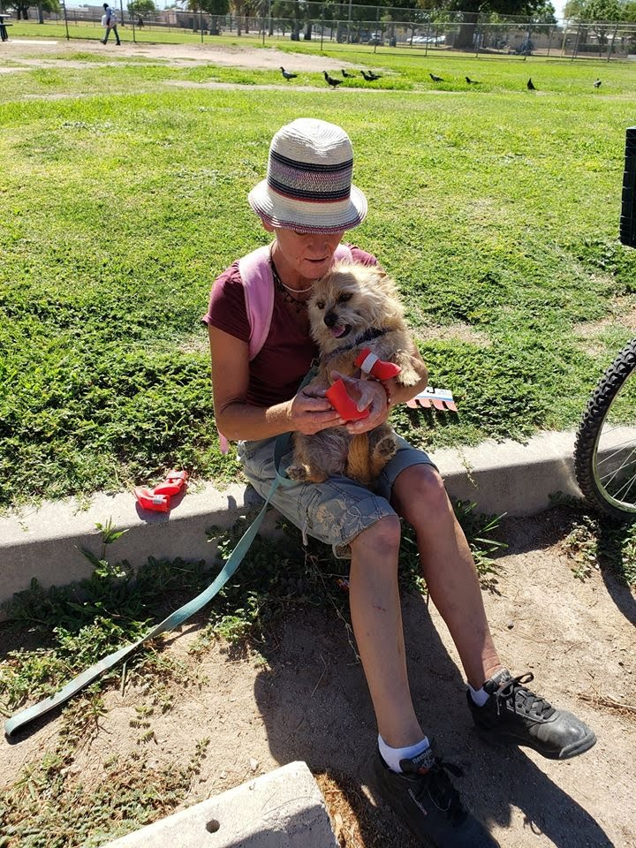
Connecting the Community With Further Resources

Slide 15
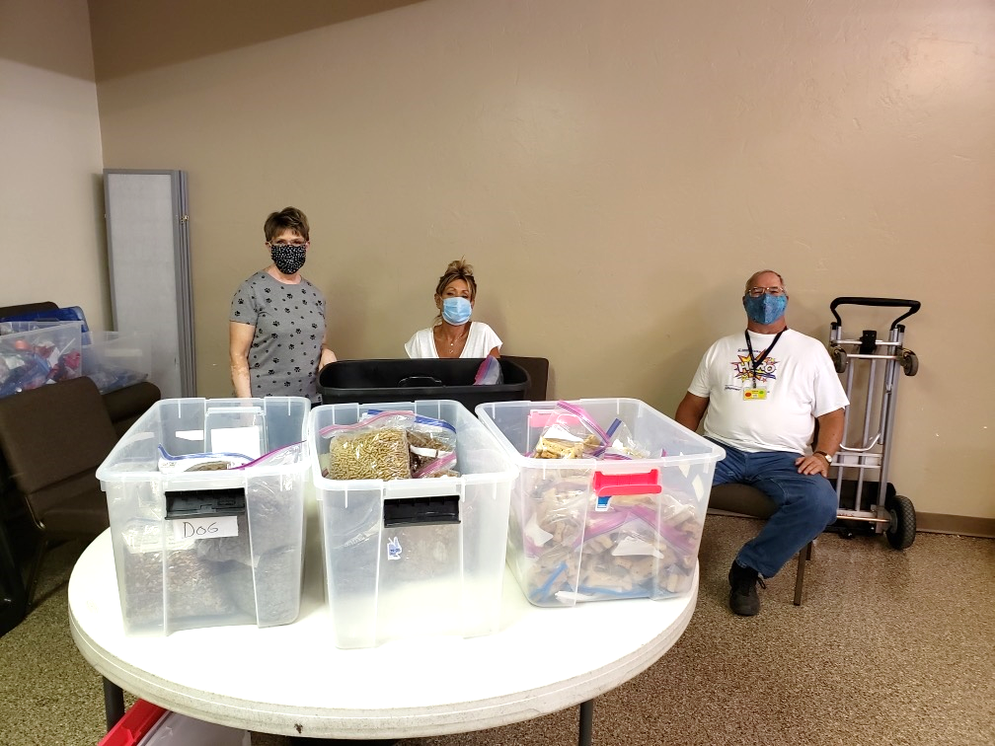
Results
As of 7/1/2020

Slide 16
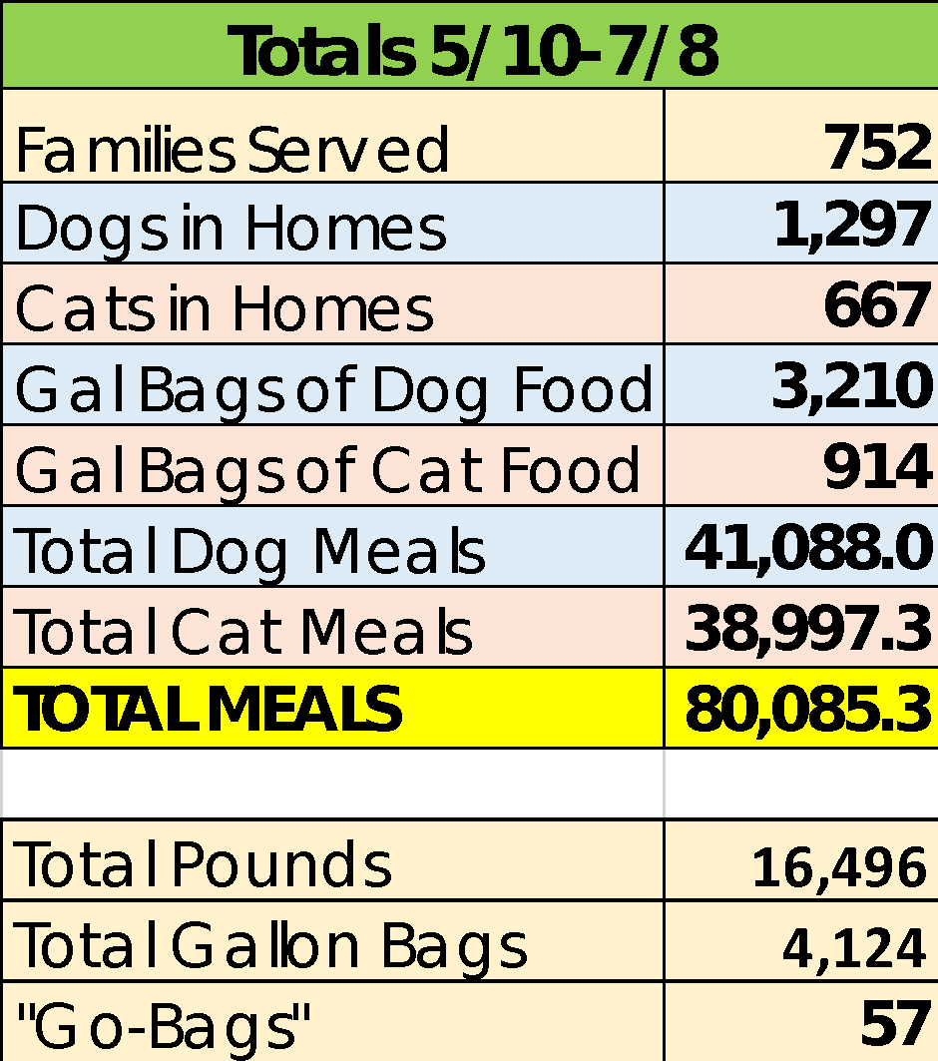

Slide 17
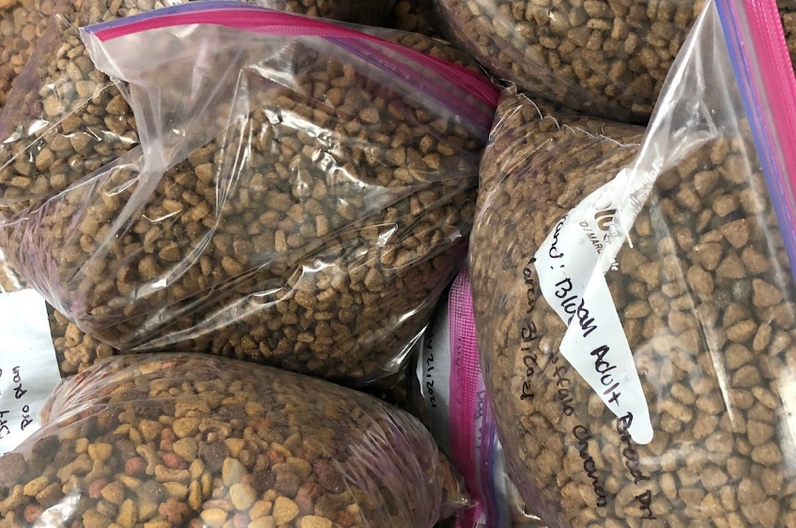
How to Calculate Meals Served
Formula Developed by Petsmart Charities
1 dog meal = 5 ounces
1 cat meal = 1.5 ounces
For Example:
Dog food given |  | 2,896 gallon bags | X 4lb each bag = | 11,584lbs | X 16 oz. = | 185,344 oz. | /5 oz. = | 37,069 meals
Cat food given |  | 7,82 gallon bags | X 4lb each bag = | 3,128lbs | X 16 oz. = | 50,048 oz. | / 1.5oz. = | 33,365 meals
 |  |  |  |  |  |  | Total = | 70,434 meals

Slide 18
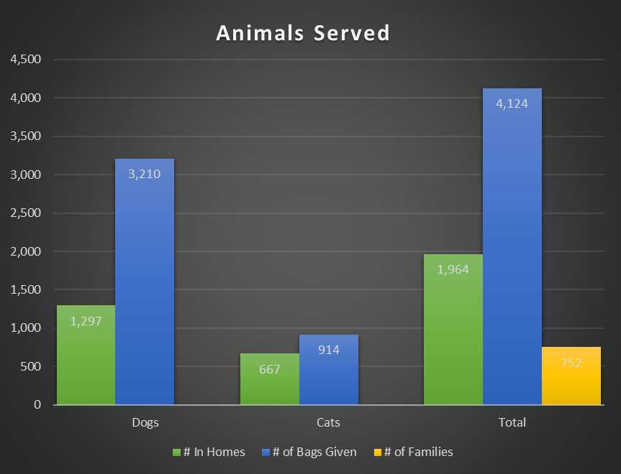

Slide 21
Questions???
Liana.Moss@pima.gov

