Slide 1
Dog Volunteer Orientation

Slide 2
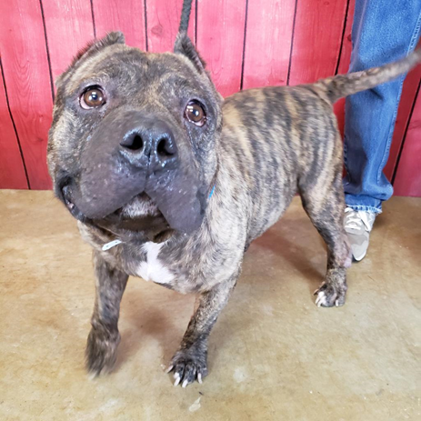
INTRO TO SHELTER DOG HANDLING
It is important to remember that animals in a shelter will not act like the pets in your home. Shelter animals come in to a brand new environment with unfamiliar smells, people, and noises. It takes time for dogs to adjust to new faces, new smells and the new sounds of a shelter with other dogs.
Keep these things in mind when handling shelter dogs…

Slide 3
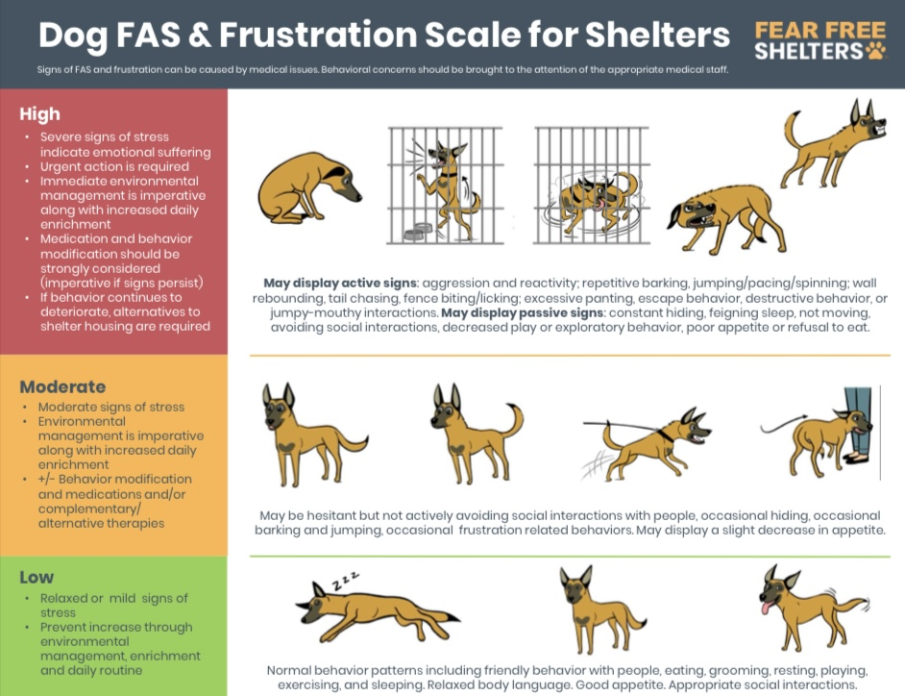

Slide 4
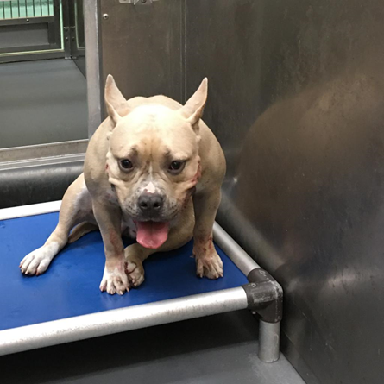
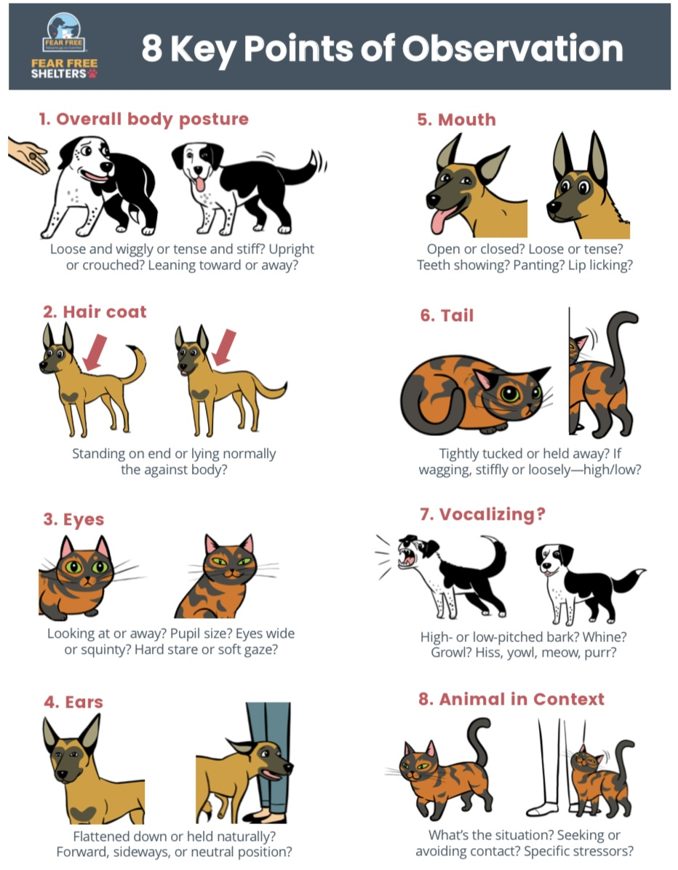
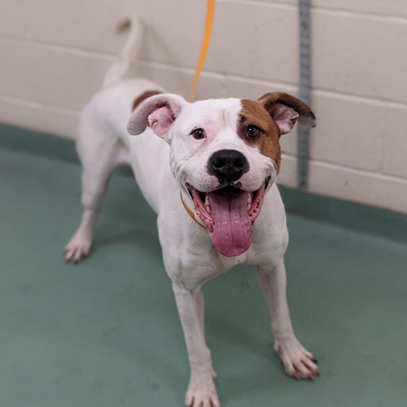
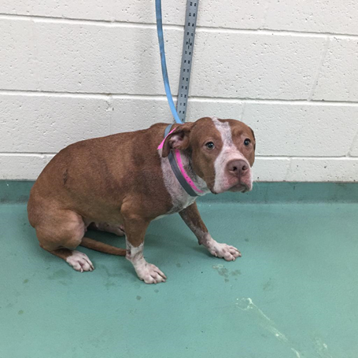
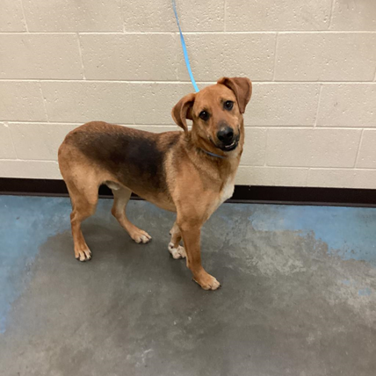

Slide 5
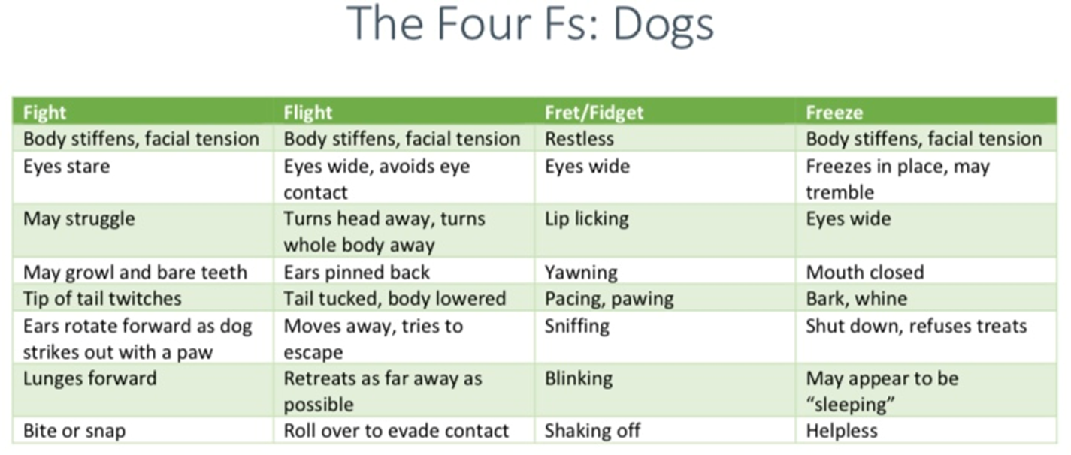

Slide 6
How to
Read a
Kennel
Card
Ask me about BLUE dots…

Slide 7
Photography/Videography/Bios
No volunteer photo/bio

Slide 8
Volunteer photo/bio!

Slide 9
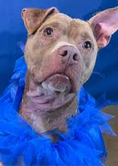
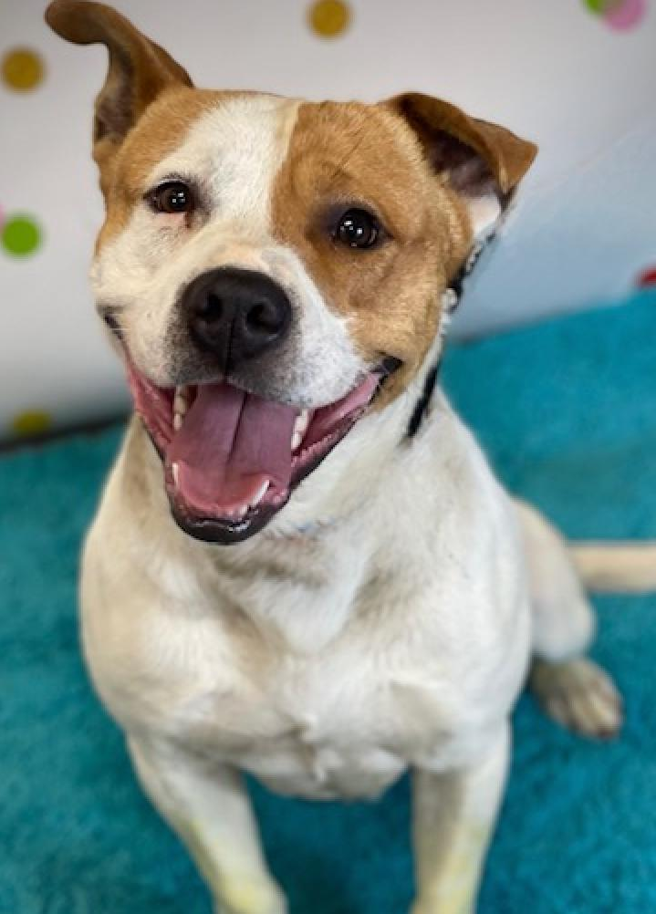
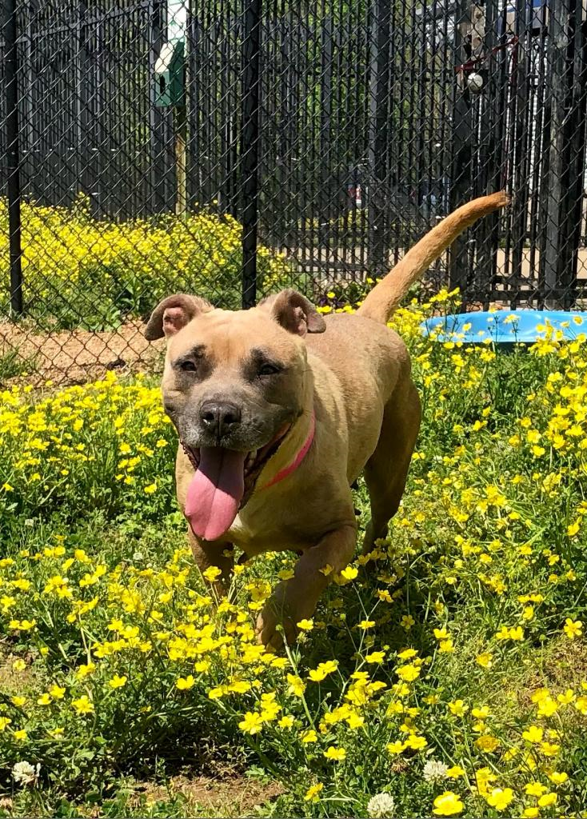
Photography & Videography
Allows better content for the pets Shelterluv profile
Allows the pet’s personality to be shown
Great for networking online
Form of enrichment for pets

Slide 10
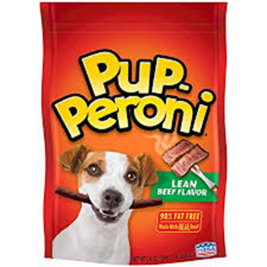
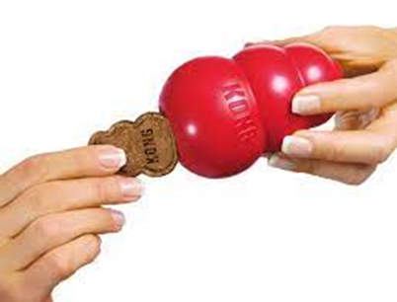
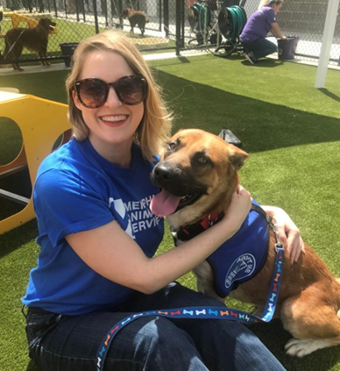
Enrichment, at its most basic level, is a means for meeting the emotional and mental health needs of animals in your care.
HAPPIER
HEALTHIER
MORE
ADOPTABLE
DOGS!!!

Slide 11
Benefits of Enrichment
Shelter dogs get the chance to burn off energy and counteract the stress of shelter life.
Exercise can make dogs feel relaxed and can help them have good kennel presentation when meeting potential adopters.
Shelters dogs will learn critical dog-to-dog social skills, can help them post-adoption in developing positive relationships with dogs outside of the shelter.
By observing a dog’s state of play and social skills off the leash, shelter staff will gain a better understanding of each dog as an individual. Including its behavior in non-threatening situations. This information can be used to make better decisions about animal outcomes and potential adoption matches.
Shy/fearful dogs can potentially learn to feel safer around humans with selective interaction

Slide 12
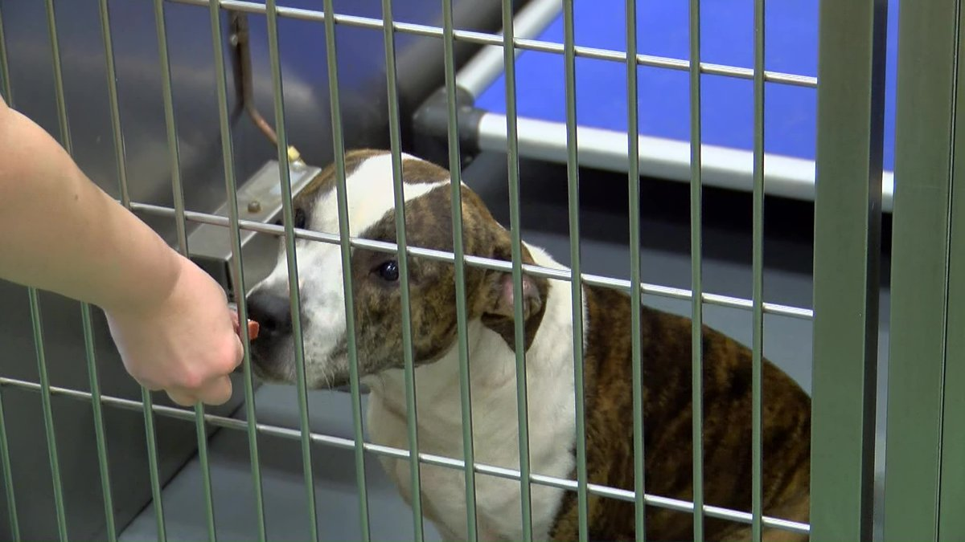
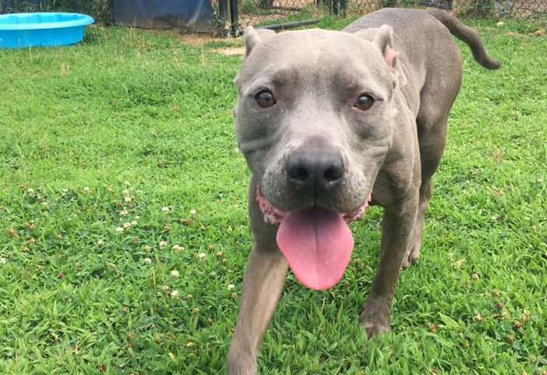
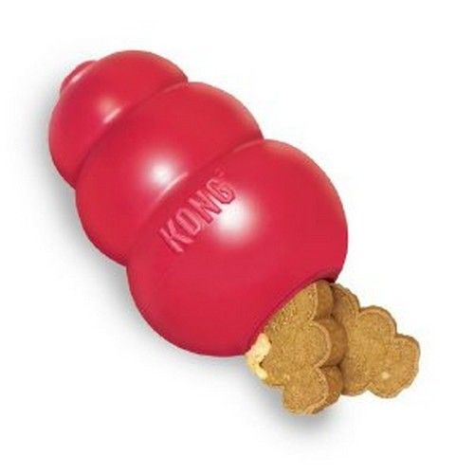
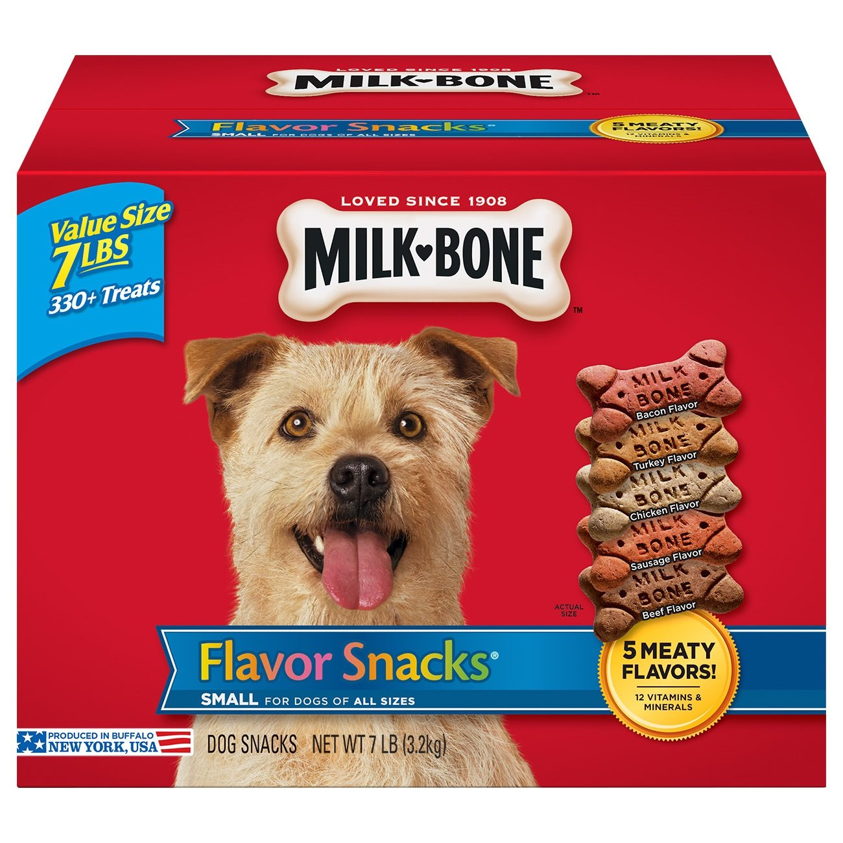
Enrichment
the action of improving or enhancing the quality or value of something.
In-Kennel Enrichment
Distributing treats through the kennel doors
Giving frozen Kongs
Great for shy/fearful dogs
Great for new volunteers or for time-sensitive days
Out of Kennel Enrichment
Taking dogs out in the play yards
Interacting with humans
Provides stimulating play time and fresh air
Great for high energy dogs or kennel stressed dogs

Slide 13
OTHER WAYS TO VOLUNTEER
. Laundry
. Volunteer at MAS events
. Foster Program Support
. Prep food pick ups for Pet Resource Center
. Delivery Driver (medications)
. Play Yard Maintenance

Slide 14
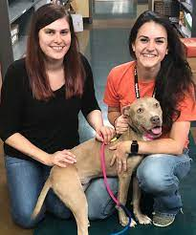
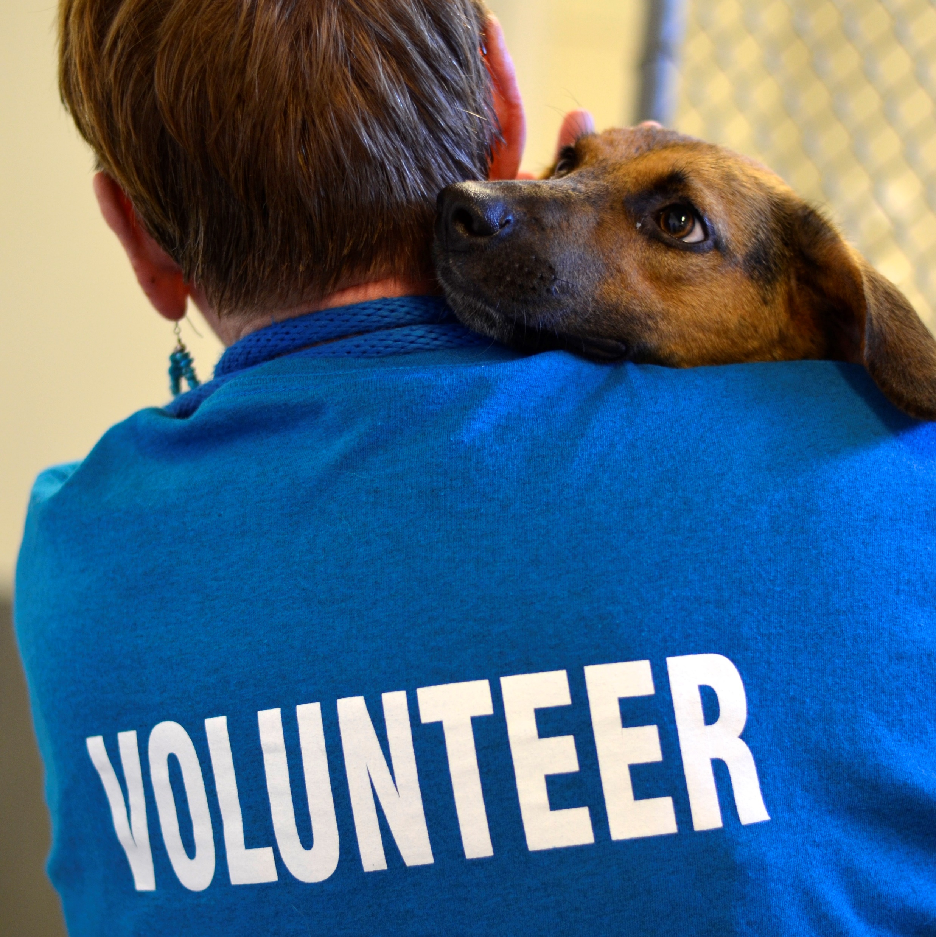
Other things
to remember
Use the whiteboards to make enrichment notes
Use sanitizer between pets
Read your kennel cards
Don’t be afraid to ask questions
Have fun and tell your friends about volunteering!

Slide 15
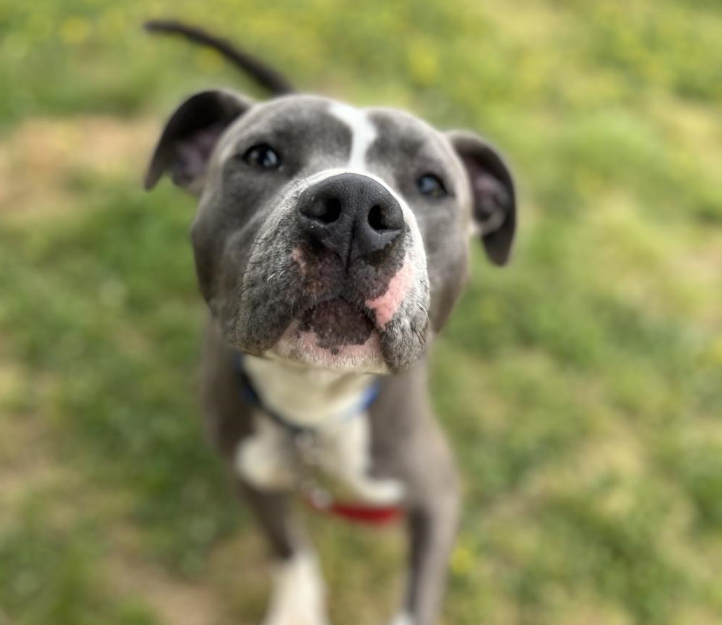
Questions?

