Slide 1
Lessons from a Leader
Anonymous Hamsters (Group 1)
Ariana Luchsinger, Christina Avila,
Erika Smart, Sheila McLalin,

Slide 2
Overall Themes
Communication & Transparency
Relationship Building
Developing Others
Celebrate Successes and Have Fun

Slide 3
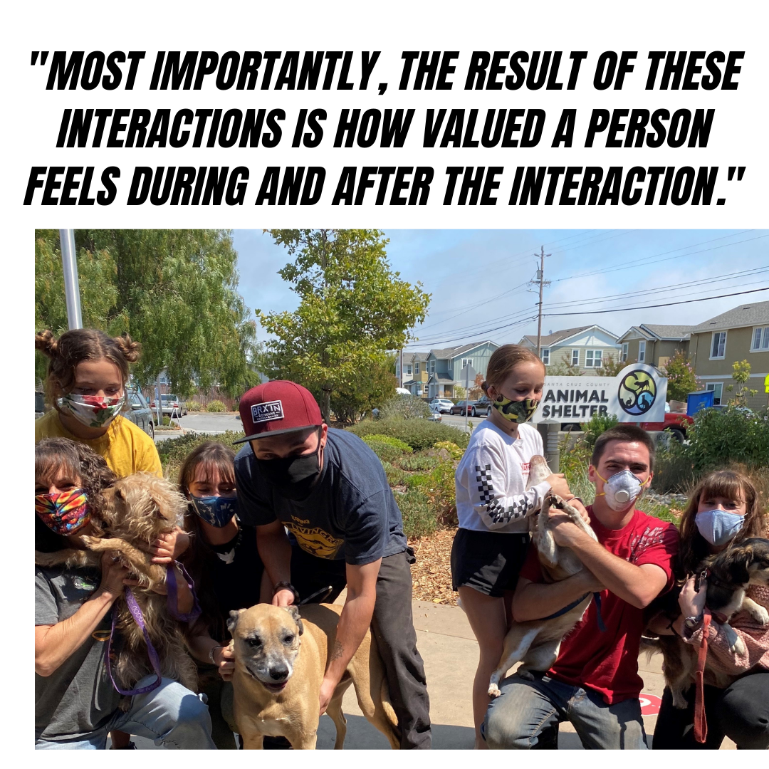
Organizational Communication & Transparency
The way in which members of an organization interact with each other and the people they serve.
Why is it important?
Employee engagement
Customer satisfaction
Public perceptions

Slide 4
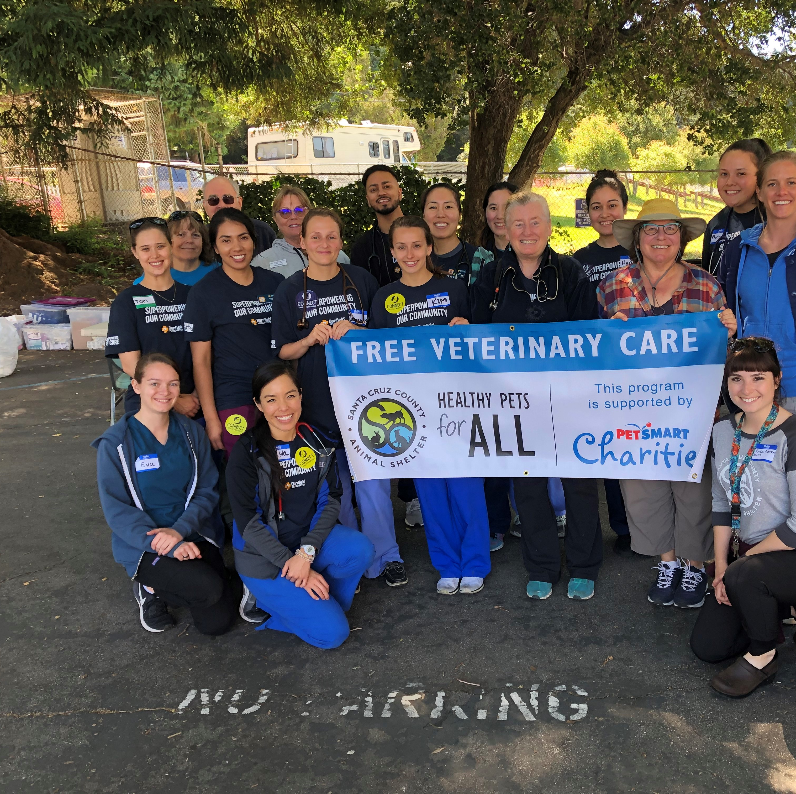
Organizational Communication & Transparency
Benefits of transparent communication:
Increases collaboration
Enhances trust
Increases innovation
Encourages people to communicate openly
Increases the sharing of ideas
Allows the workplace to be more informed
How to increase transparent communication in the workplace:
Inform employees or coworkers soon after learning the information
Answer questions promptly, honestly, and include reasons why
Align communication and actions with the unit and agency's mission

Slide 5
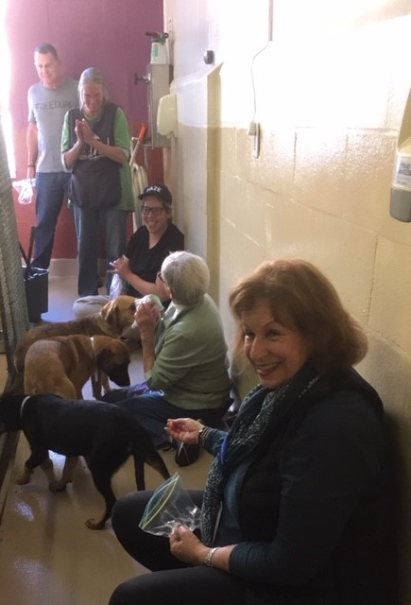
Intentional Relationship Building
"People don't care how much you know until they know how much you care."
Navigating change, bureaucracy, and policy requires building and sustaining relationships.
Shelter work revolves around people – our greatest resource
Get out of your comfort zone! Grab a coffee, make a new connection with someone influential in your locality, be intentional and authentic.
Show Your Humanity. People want to feel heard, valued. People want to look you in the eye and see who you are – then you can move forward together and collaborate for change.
Have Faith In People. Trust that vulnerability is an asset and have faith in those you see promise in as well. Become what you needed on your journey!

Slide 6
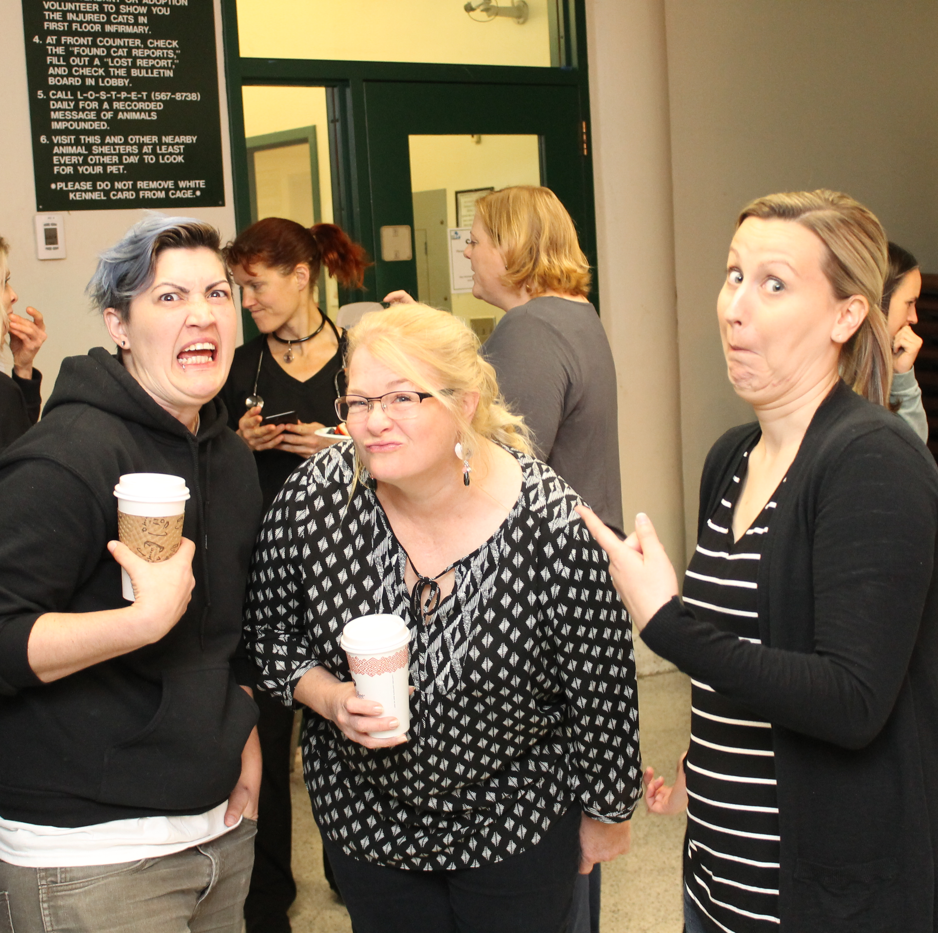
Take-Aways and Resources for Relationship Building
Prepare for meetings with those you'd like to connect deeper with and don't be afraid to be your authentic self
Attend professional conferences & events with the intention to connect (and bring your card!)
Give & Take: Why Helping Others Drives Our Success by A. Grant
Superconnector by S. Gerber & R. Paugh
The People Around You! Look for mentors, close counsel, and those that influence the community you serve

Slide 7
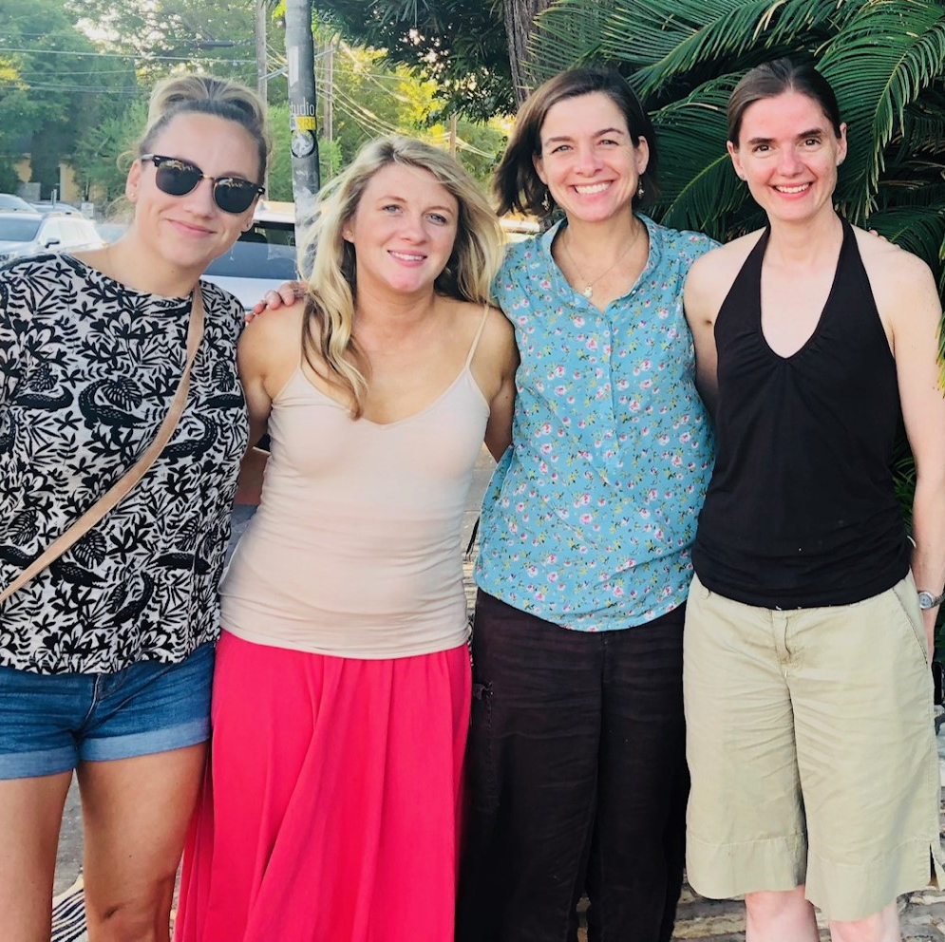
Why you should invest time in developing staff
Investment in your organization and industry's future
Did you know...a lack of career growth opportunities is one of the main reasons people leave their jobs
Employee retention
94% of employees will stay longer if offered professional development
Improves workplace culture
Notes:
Investment in your organization's future
Jane said it's important for leadership to recognize that by grooming staff it's an investment in not only your organizations future but also for the field as a whole.
A lack of career growth is a main reason people leave their jobs
Improves workplace culture
Skilled and engaged staff result in higher job satisfaction and perform better

Slide 8
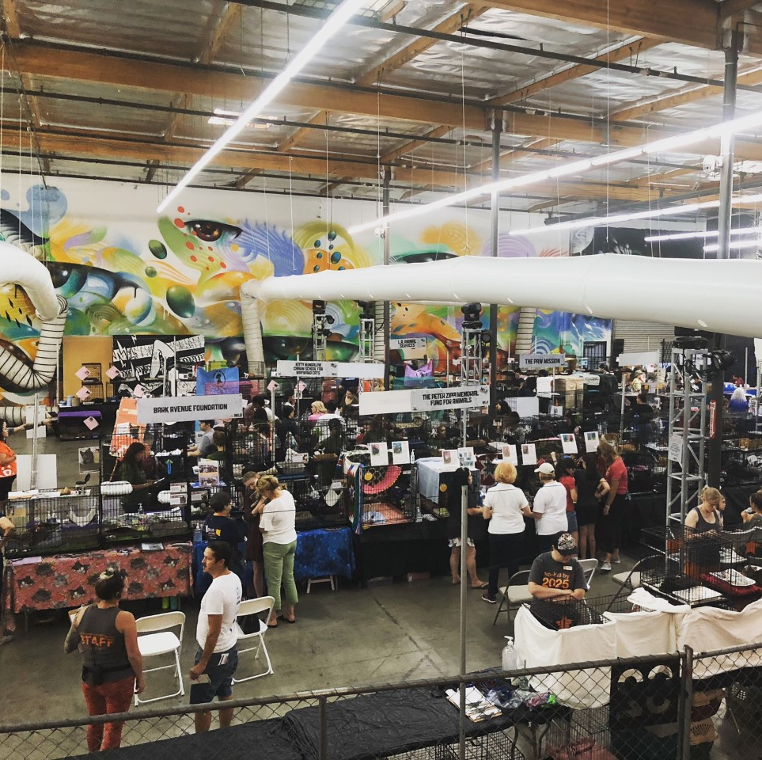
Ideas for developing staff
Empower staff
Encourage new ideas
Create opportunities
Mentorship / shadowing
Continuing education and training
Listening sessions
Constructive criticism is important but so is showing your appreciation!
Notes:
Empower your staff
Delegate with the intent to grow and develop your staff
Give employees autonomy over projects
Encourage ideas
Ask for input and include them in the decision-making process when possible
Create opportunities for staff to learn
Assist w/budget development, presenting at staff meetings
Mentorship / shadowing
Attend board meetings
My example of shadowing a commission meeting
Continuing education and training – allot time for your staff to participate
Conferences
Webinars
Certifications
Listening sessions
Allow staff to give feedback about a specific topic in which the leader engages in active listening
Great exercise for your leaders
It’s important for staff to know what they’re doing well

Slide 9
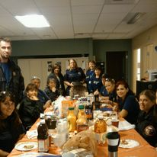
Have Fun!
Morale is high in our profession, but burnout can be higher!
Most animal welfare workers are in the profession because there is enjoyment derived from their daily activities
Being intrinsically social can be done through monthly birthday potlucks, yearly award acknowledgments, accepting each other as we are.

Slide 10
Celebrate Success
Acknowledge each other for your successes
Reflect! It is an important part of the learning process
Celebration creates a positive environment
Bring a cake, raise a glass, toast yourself, acknowledge the hard work done!

Slide 11
Why is it important to us?
Mission buy-in
Promoting a healthy work environment and culture
Cultivating lasting engagement with stakeholders
Change management

Slide 12
Contact Information
Ariana Luchsinger
ariana.luchsinger@sfgov.org
Operations Manager
San Francisco Animal Care & Control
Erika Smart
erika.smart@santacruzcounty.us
Program & Development Manager
Santa Cruz County Animal Shelter
Christina Avila
cavila@cityofperris.org
Senior Animal Control Officer
City of Perris
Sheila McLalin
sheilam@bestfriends.org
Senior Strategist, Pacific Region
Best Friends Animal Society

