Slide 1
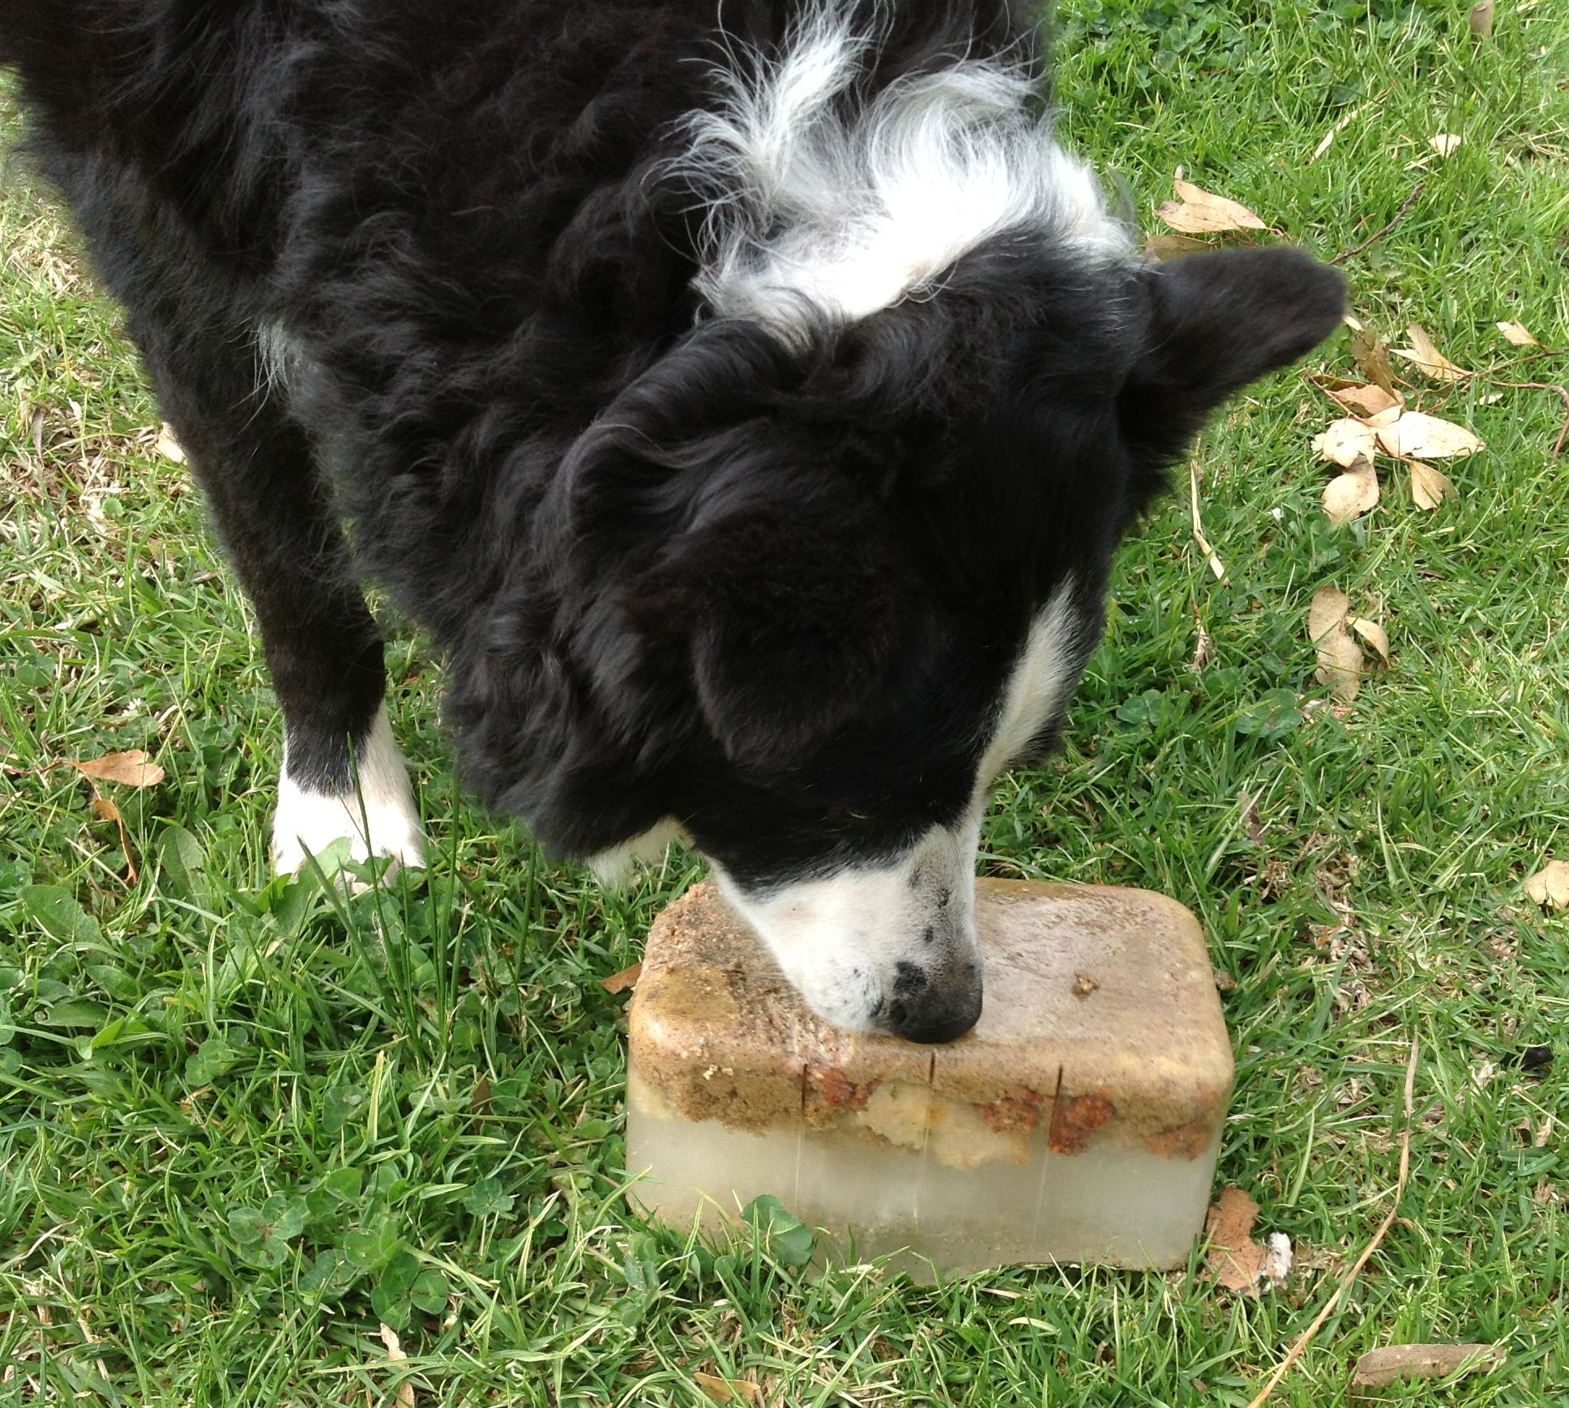
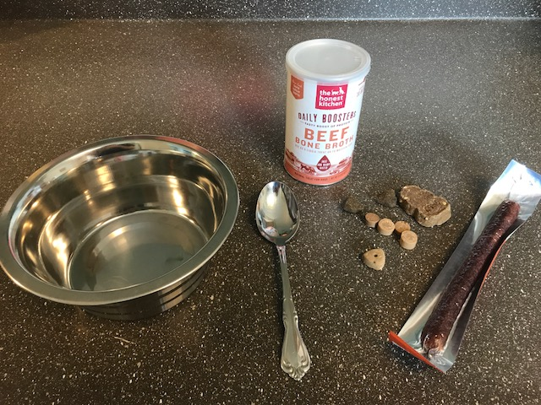
Frozen Bowls
Enrichment type: Feeding/Nutritional, Sensory
Allows dogs to work for their meals or snacks by making them lick at the bowl to get the treats frozen within it.
Supplies:
Bowl
Bone broth
Water
Spoon
Diet appropriate treats
Freezer
Peanut butter or spray cheese if appropriate

Slide 2
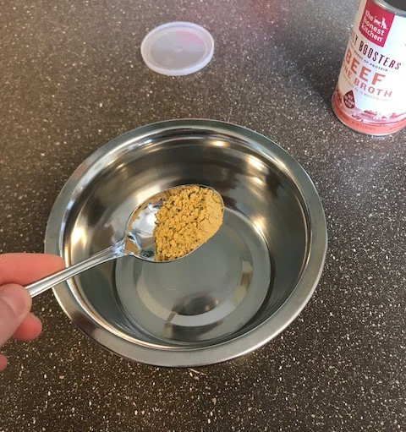
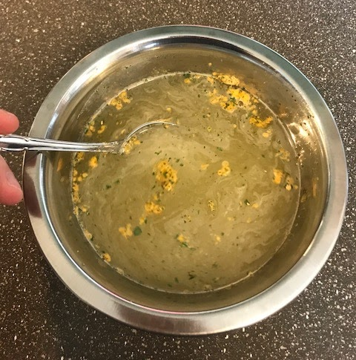
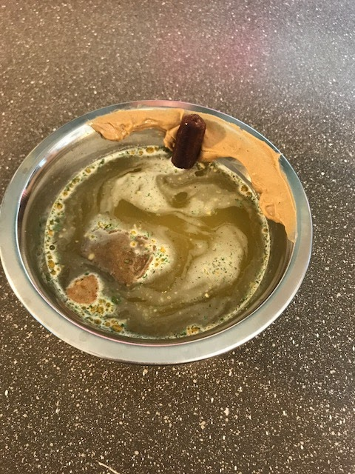
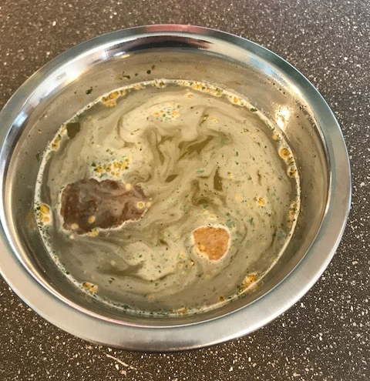
Frozen Bowls
Assembly:
Place about a teaspoon of bone broth mix in a bowl
Add warm water about ½ -⅔ to the top of the bowl and stir to dissolve the broth into the water
Once slightly cooled, add treats* to the bowl. Preferably a mix of some that float and some that sink to the bottom
Add some peanut butter and/or spray cheese* (or wet food) to the top exposed part of the bowl if desired
Place in the freezer and give it to a dog once frozen
*Make sure the food and treats you use are appropriate for special diets of dogs.
(It is helpful to prepare some regular ones and some for specific dogs who require special diets).

Slide 3
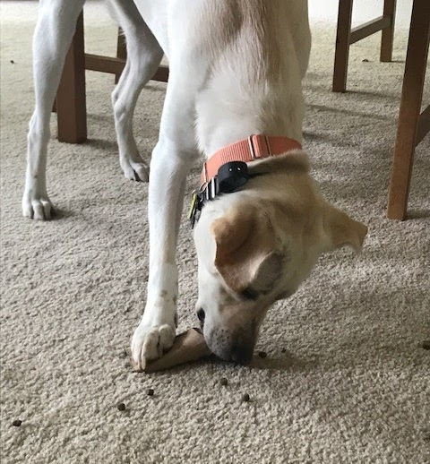
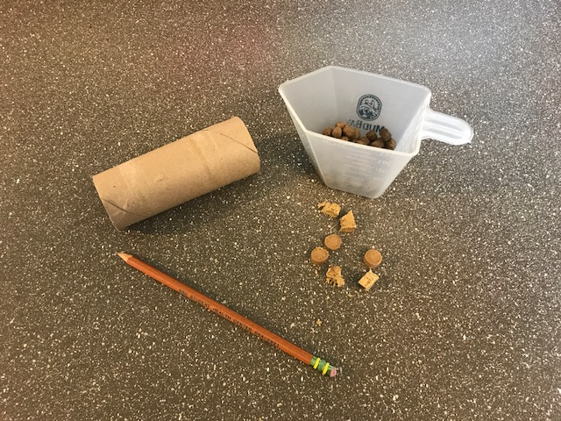
Food Tubes
Enrichment type: Sensory, Feeding/Nutrition, Toys/Puzzles
Allows dogs to work for their meals or snacks by making them either tear into the paper roll or roll it on its side to release the kibble. Great for mental stimulation and keeping a dog busy.
Supplies:
Toilet paper or paper towel roll tubes
Diet appropriate treats/kibble

Slide 4
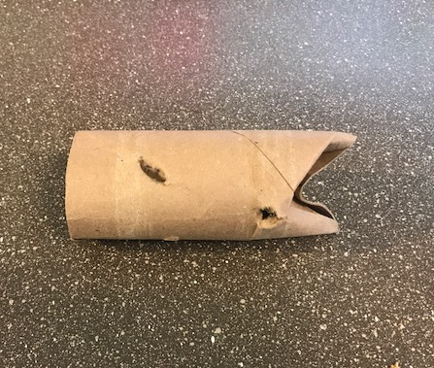
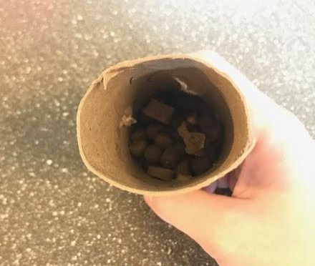
Food Tubes
Assembly:
Start with an empty paper tube and fold in one side so it is essentially closed
Put the kibble* into the tube and close the other end
To make it easier or to allow the tube to be rolled for food to come out, poke holes into the sides big enough for kibble to fall out
Higher value snacks and treats* can be used in the place of kibble if desired
*Make sure the food and/or treats you use are appropriate for special diets of dogs

Slide 5
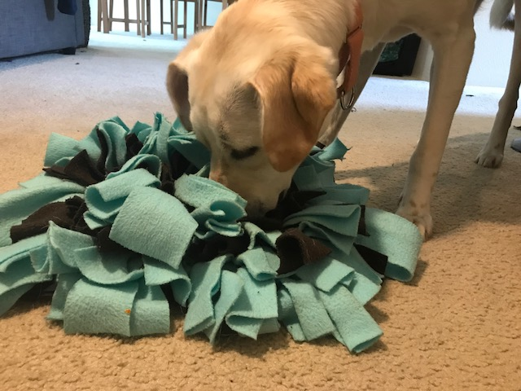
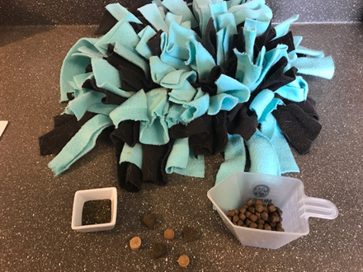
Snuffle mats
Enrichment type: Sensory, Feeding/Nutrition
Allows dogs to sniff and smell as a way of exploring a new item. It also allows the dogs to be rewarded with food that they find hidden within the fabric. Snuffle mats should not go to dogs that are “indestructible only” or dogs who are specifically “no snuffle mats.”
Supplies:
Size appropriate Snuffle mat
Herbs
Diet appropriate treats/kibble

Slide 6
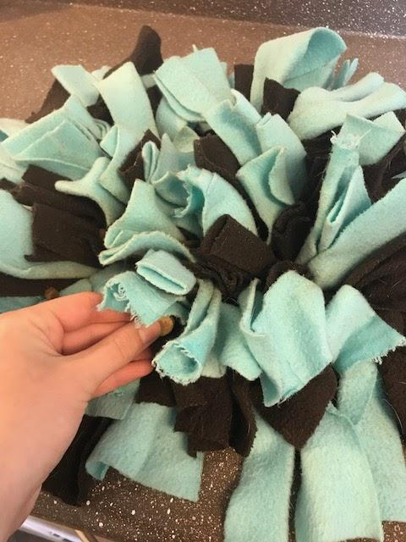
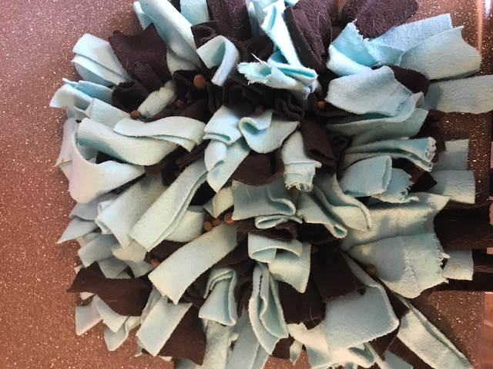
Snuffle mats
Assembly:
Spread the treats/kibble* throughout the strips of fabric. Make sure they are slightly hidden so the dog will need to sniff and move the pieces in order to find the treats
Sprinkle herbs throughout the strips of fabric
*Make sure the food and/or treats you use are appropriate for special diets of dogs

Slide 7
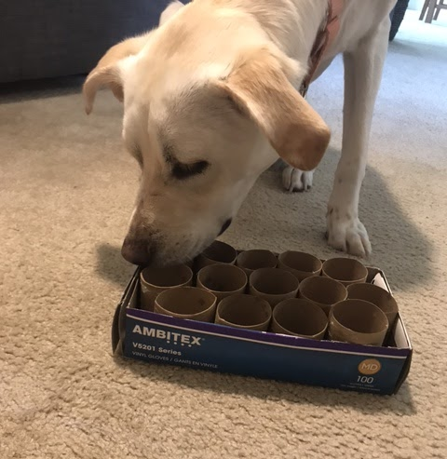
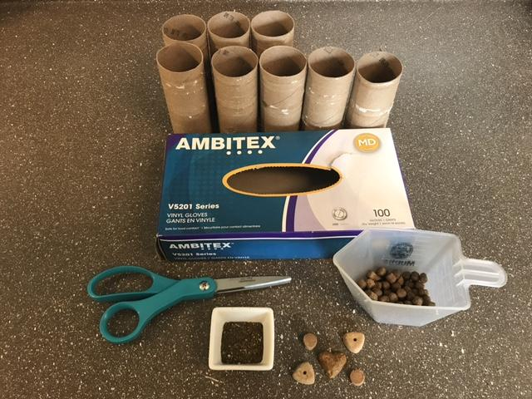
Tube Boxes
Enrichment type: Sensory, Feeding/Nutrition
Allows dogs to sniff and scavenge for food inside the box. Dogs can also destroy the box and tubes at the end if they want, which makes this a great toy as well.
Supplies:
Toilet paper or paper towel tube rolls
Small cardboard box
Herbs/spices
Diet appropriate treats/kibble
Scissors

Slide 8
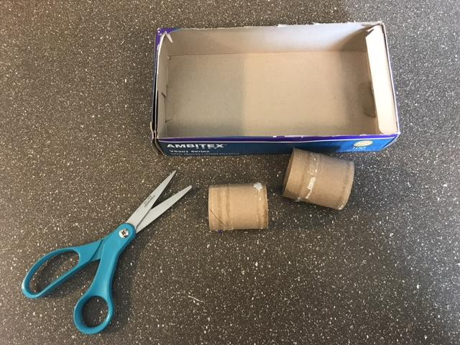
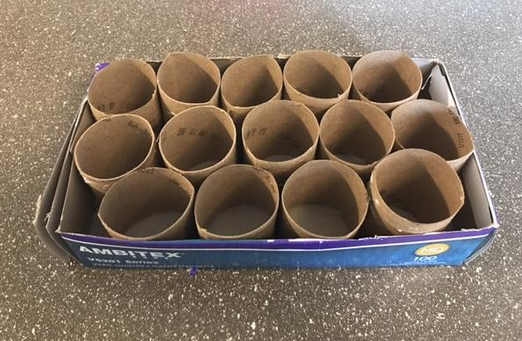
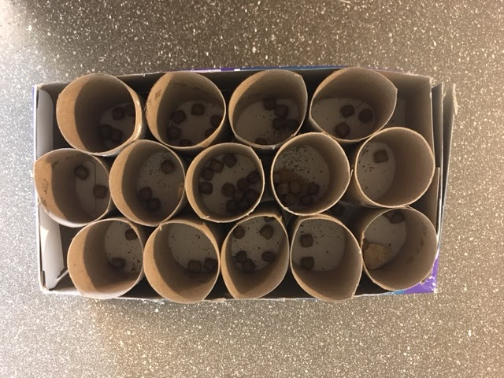
Tube Boxes
Assembly:
Cut paper tubes to fit inside the chosen box
Fill the box with these tubes
Place treats/kibble* and/or herbs/spices inside tubes
*Make sure the food and/or treats you use are appropriate for special diets of dogs

Slide 9
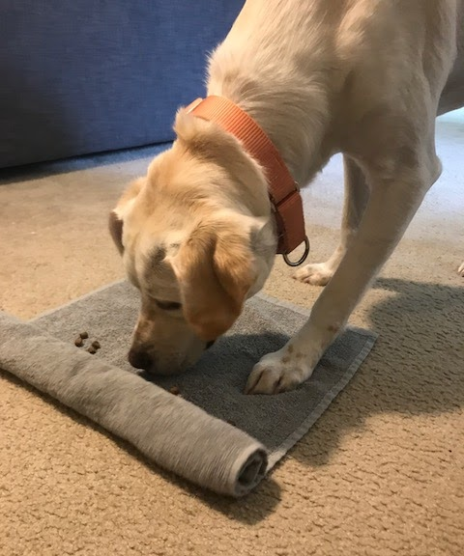
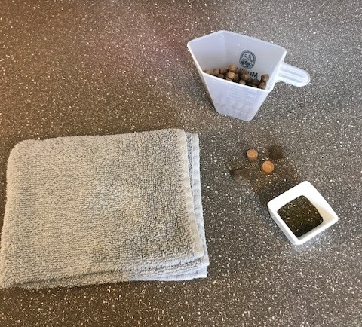
Towels
Enrichment type: Sensory, Feeding/Nutrition, Toys/Puzzles
The idea is that the dog will use its nose or paw to unroll the towel and reveal treats or new scents. Allows dogs to sniff and work to get what they want. It also allows the dogs to be rewarded with food that they find.
Supplies:
Size appropriate towel
Herbs/scent spray
Diet appropriate treats/kibble

Slide 10
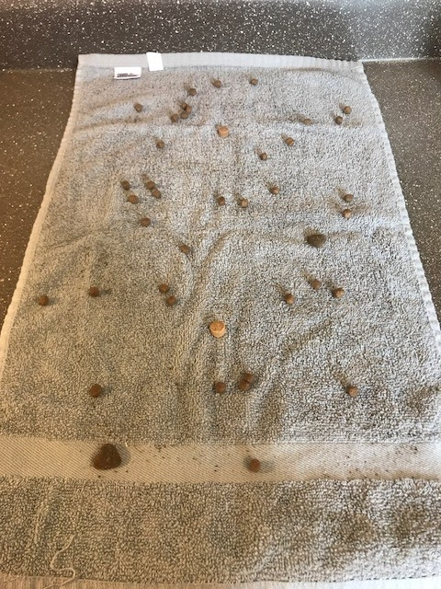
Towels
Assembly:
Start with the towel unrolled and place treats/kibble* and/or herbs across the whole towel. You can use scent spray if preferred
Roll the towel so that the items placed on it become wrapped inside
Leave the end unrolled just enough for some of the items to be visible/accessible. This will encourage the dogs to put their face close to it and enable them to unroll it further
*Make sure the food and/or treats you use are appropriate for special diets of dogs

Slide 11
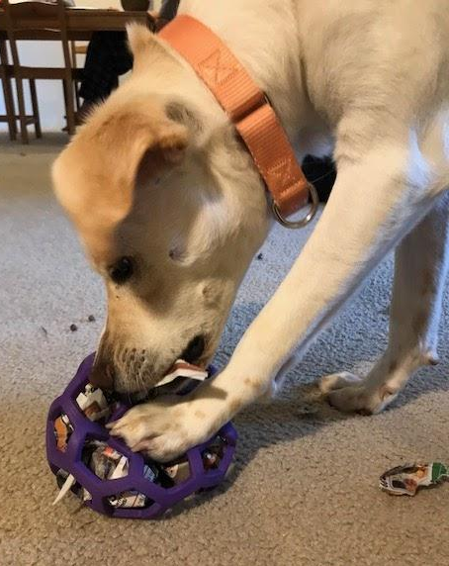
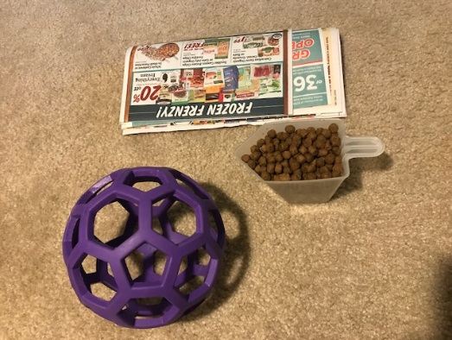
Treat Dispensing Balls
Enrichment type: Sensory, Feeding/Nutrition, Toys/Puzzles
Allows dogs to get a new toy or food. Hiding food in paper inside the ball or squeezing a stuffed toy into the ball encourages mental stimulation, as the dog must figure out how to get the items out of the ball.
Supplies:
Hol-ee Roller Ball or similar toy
Paper
Diet Appropriate treats/kibble
Appropriate stuffed toy

Slide 12
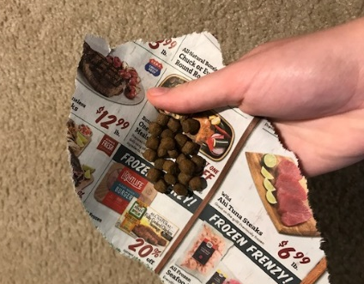
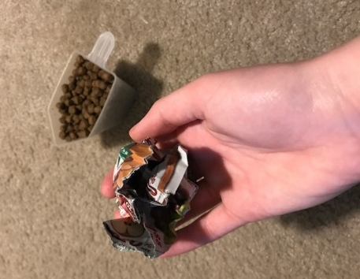
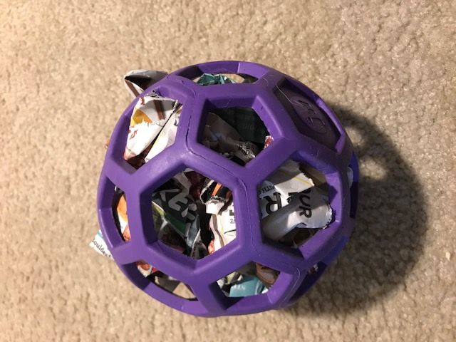
Treat Dispensing Balls
Assembly:
Wrap treats/kibble* inside small pieces of paper so they are somewhat contained
Put the paper wrapped treats inside this ball. Make sure there are some pieces sticking out
A stuffed toy can be used in place of paper wrapped treats if preferred
*Make sure the food and/or treats you use are appropriate for special diets of dogs

Slide 13
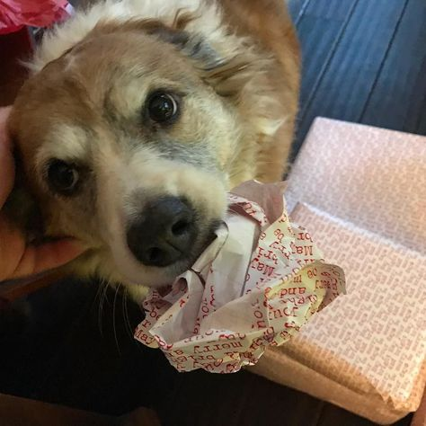
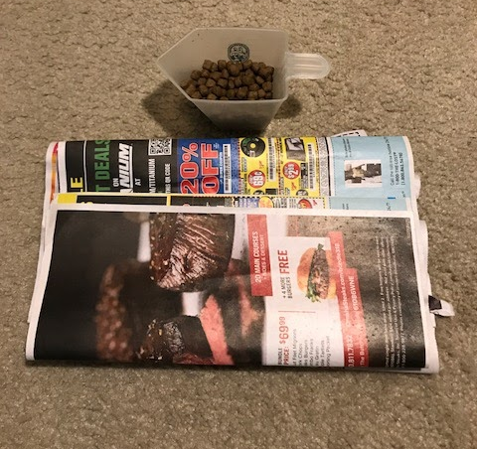
Paper Balls
Enrichment type: Sensory, Feeding/Nutrition, Toys/Puzzles
The idea is that the dog can bat around or tear apart the paper ball to get to the treats wrapped inside. The dog will have the opportunity for both play and destruction.
Supplies:
Paper
Diet appropriate treats/kibble

Slide 14
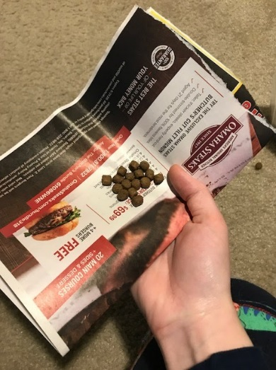
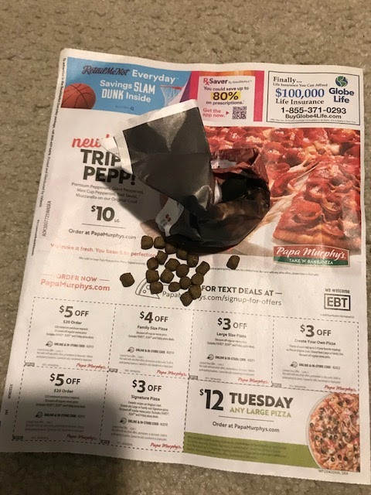
Paper Balls
Assembly:
Start with a piece of paper and wrap some treats/kibble* inside of it, forming a ball around food
Layer on more paper, trapping a few pieces of treats/kibble in each layer
Once the ball reaches an appropriate size for the desired dog you can stop layering and give it to the dog
*Make sure the food and/or treats you use are appropriate for special diets of dogs

Slide 15
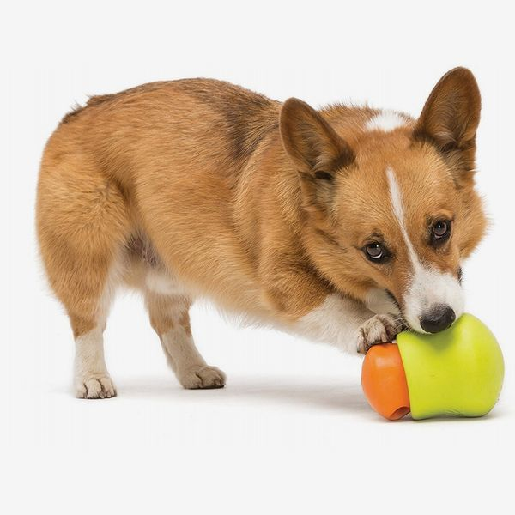
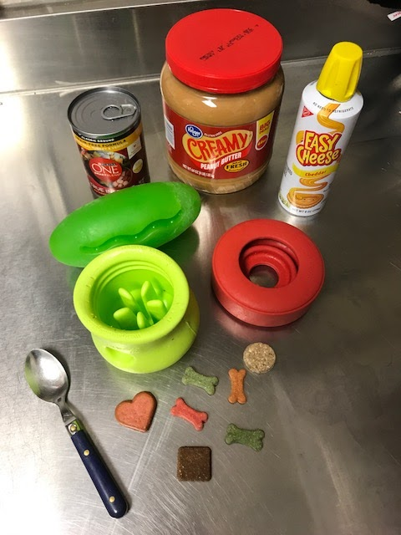
Food Dispensing Toys
Enrichment type: Sensory, Feeding/Nutrition, Toys/Puzzles
Allow dogs to interact with the toys in order to get the food from inside. Encourages mental stimulation, as dogs must figure out how to get the treats/food out of the toy.
Supplies:
Food dispensing toy
Spoon/knife
Diet Appropriate treats/food
Peanut butter or spray cheese if appropriate

Slide 16
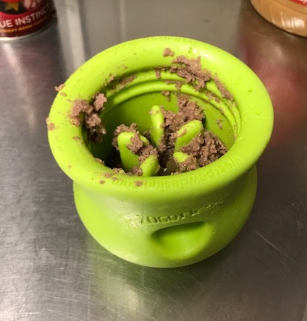
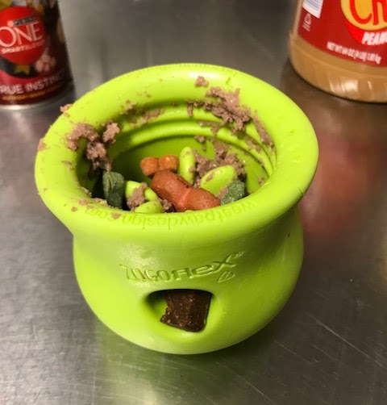
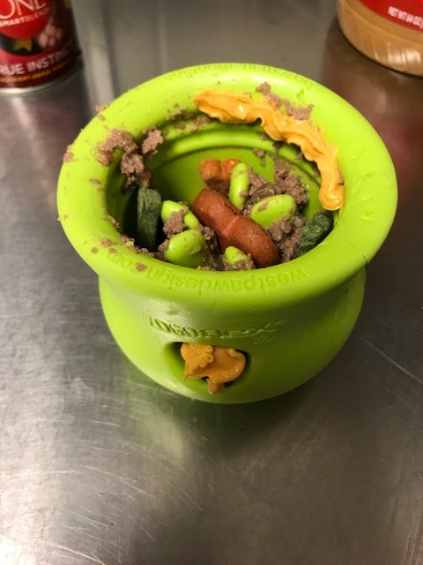
Food Dispensing Toys
Assembly:
Choose the desired food dispensing toy (some are dry food only, some are wet food only, and others work for both)
Fill the toy with wet and/or dry treats/kibble* depending on the toy you chose
Add some peanut butter and/or spray cheese* to the top if desired
*Make sure the food and/or treats you use are appropriate for special diets of dogs

Slide 17
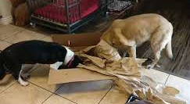
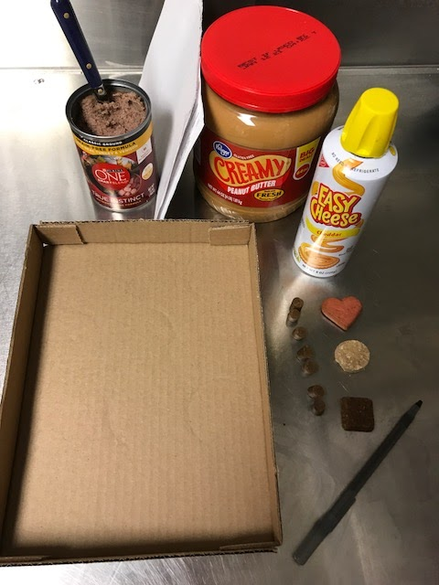
Boxes
Enrichment type: Sensory, Feeding/Nutrition, Toys/Puzzles
The idea is that the dog will try to get the treats/food from inside the box. Great for mental stimulation and keeping a dog busy and entertained. You can vary difficulty and intricacy based on the individual dog.
Supplies:
Cardboard box (shipping box, canned food flat, empty tissue/glove box, etc.)
Spoon/knife
Diet appropriate treats/food
Peanut butter or spray cheese if appropriate
Paper
Scissors/pencil

Slide 18
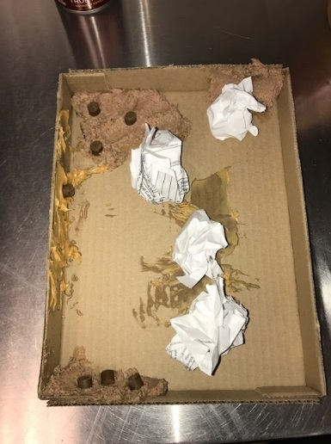
Boxes
Assembly:
Remove all tape remnants and other choking hazards from the carboard box
Smear wet food and/or peanut butter* on the sides or corners of the box
Wrap treats/kibble* in paper balls and place them in the box
For increased difficulty/intricacy, you can create holes for the dog to tear open to get inside the box, or you can poke holes in the box and string paper through them
*Make sure the food and/or treats you use are appropriate for special diets of dogs

Slide 19
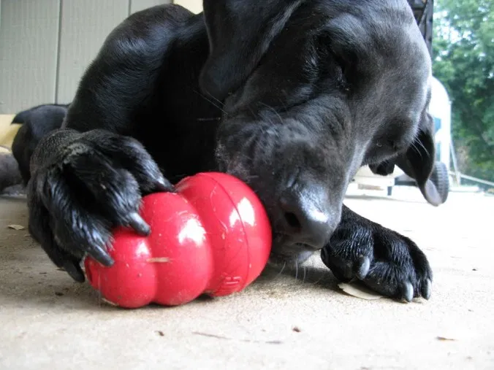
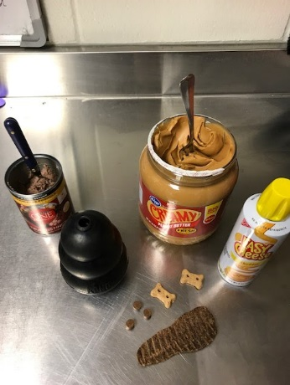
Kongs
Enrichment type: Sensory, Feeding/Nutrition, Toys/Puzzles
Allows dogs to work for treats/food. They can explore the toy before, during, and after eating all the treats/food inside and on top of the toy. Kongs should not go to dogs that are labeled “indestructible only.”
Supplies:
Size appropriate Kong
Spoon
Diet appropriate treats/food
Peanut butter or spray cheese if appropriate

Slide 20
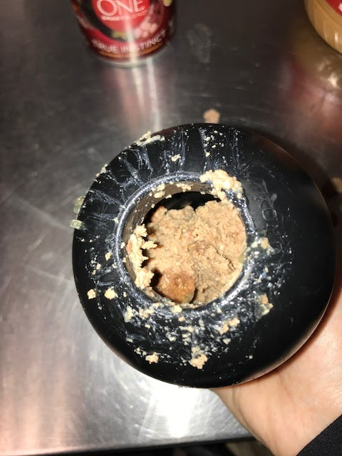
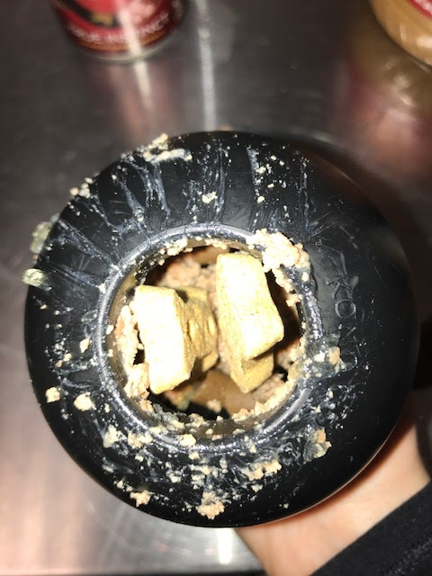
Kongs
Assembly:
Fill Kong with wet food/peanut butter/spray cheese* to form a base
Add treats/kibble* inside the Kong
Put a larger treat* inside the Kong with part sticking out to entice the dog (this is also helpful in identifying what diet is in each Kong)
Can be frozen if desired
*Make sure the food and/or treats you use are appropriate for special diets of dogs

Slide 21
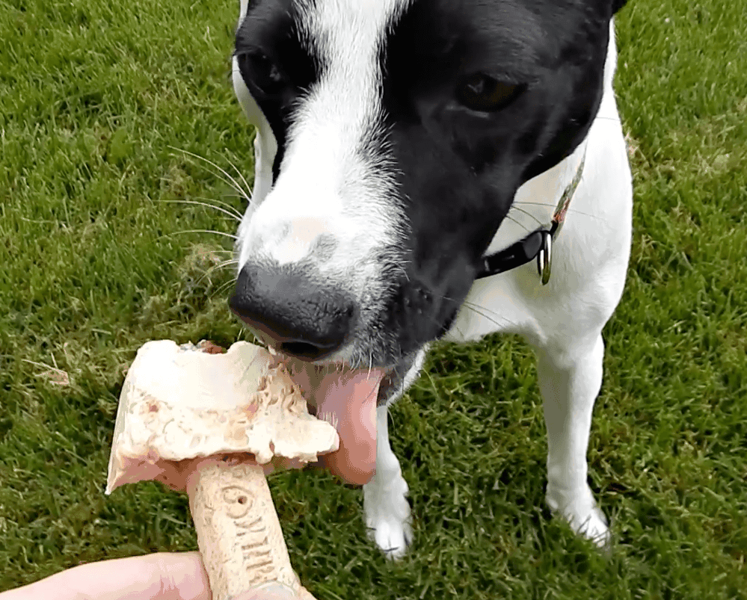
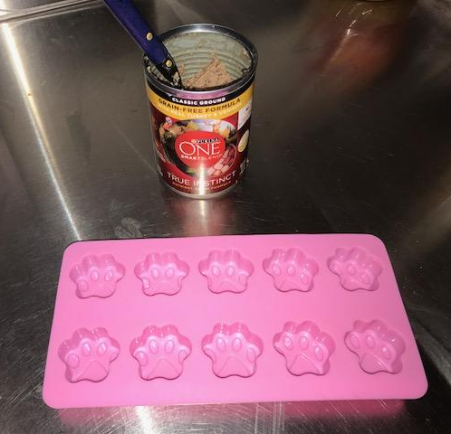
Ice Cubes
Enrichment type: Sensory, Feeding/Nutrition
The idea is to provide dogs with a treat they can enjoy that engages the senses and is different than the regular treats they receive all the time. Frozen treats may take dogs a little bit longer to eat, which makes it a more involved treat.
Supplies:
Ice cube tray(s)
Peanut butter, pumpkin puree, wet food, bone broth, and/or small treats that are diet appropriate
Freezer

Slide 22
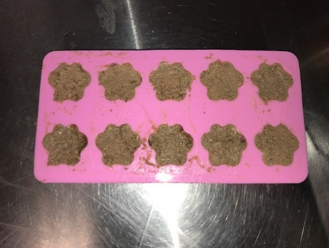
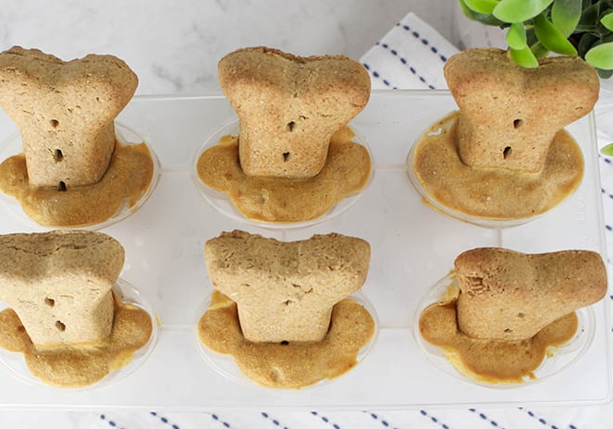
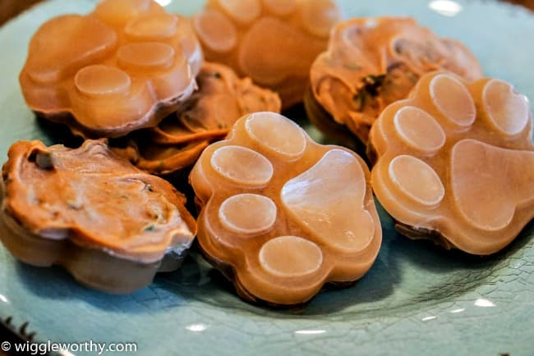
Ice Cubes
Assembly:
Put the desired wet ingredient* into an ice cube tray
Add treats* if desired
Put ice cube tray into freezer
Once the treats are frozen solid you can either give them directly to the dogs or remove them and place them into a labeled plastic bag to be kept in the freezer for later use
*Make sure the food and/or treats you use are appropriate for special diets of dogs

Slide 23
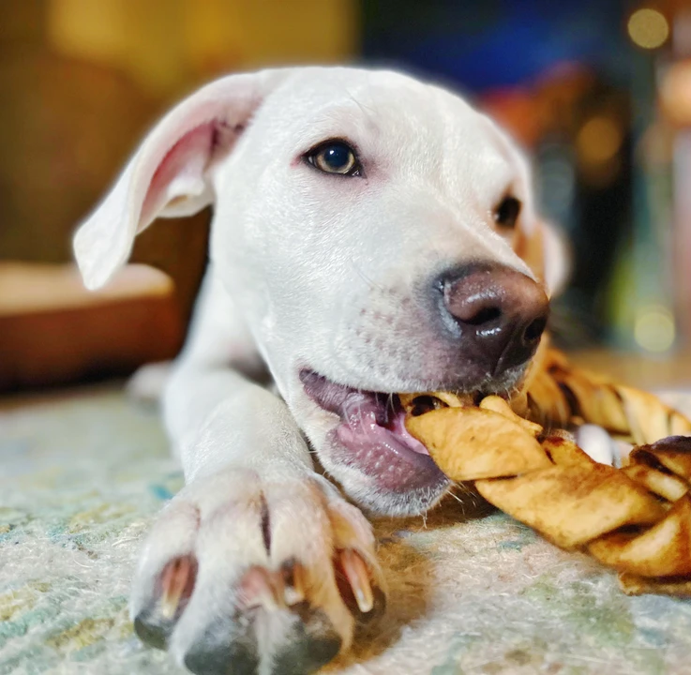
Braids
Enrichment type: Sensory, Feeding/Nutrition, Toys/Puzzles
Allows dogs to dig or pull at the braid to open it up, revealing various foods/treats inside. This enrichment provides mental stimulation through olfactory, auditory, and physical elements, as well as providing some sweet treats.
Supplies:
Butcher paper
Scissors
Diet appropriate treats/food

Slide 24
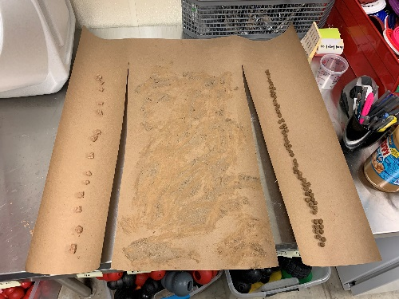
Braids
Assembly:
Cut the butcher paper into three equal strips about ⅔ up the paper (leaving about ⅓ at the top uncut, so they are all still connected)
Fill one strip with kibble, one with wet food, and one with treats*
Crumple each strip so the treats/food stay inside
Fold each crumpled strip into the others, creating a braid
Place inside the dog’s room or close it in the door
*Make sure the food and/or treats you use are appropriate for special diets of dogs

