Slide 1
Learn about the
ROANOKE VALLEY SPCA
with the Girl Scouts

Slide 2
Pet Badge Outline
Part 1: About the Roanoke Valley SPCA
Part 2: Introduction to Fear Free
Part 3: Importance of food
Part 4: Healthy and safe pets

Slide 3
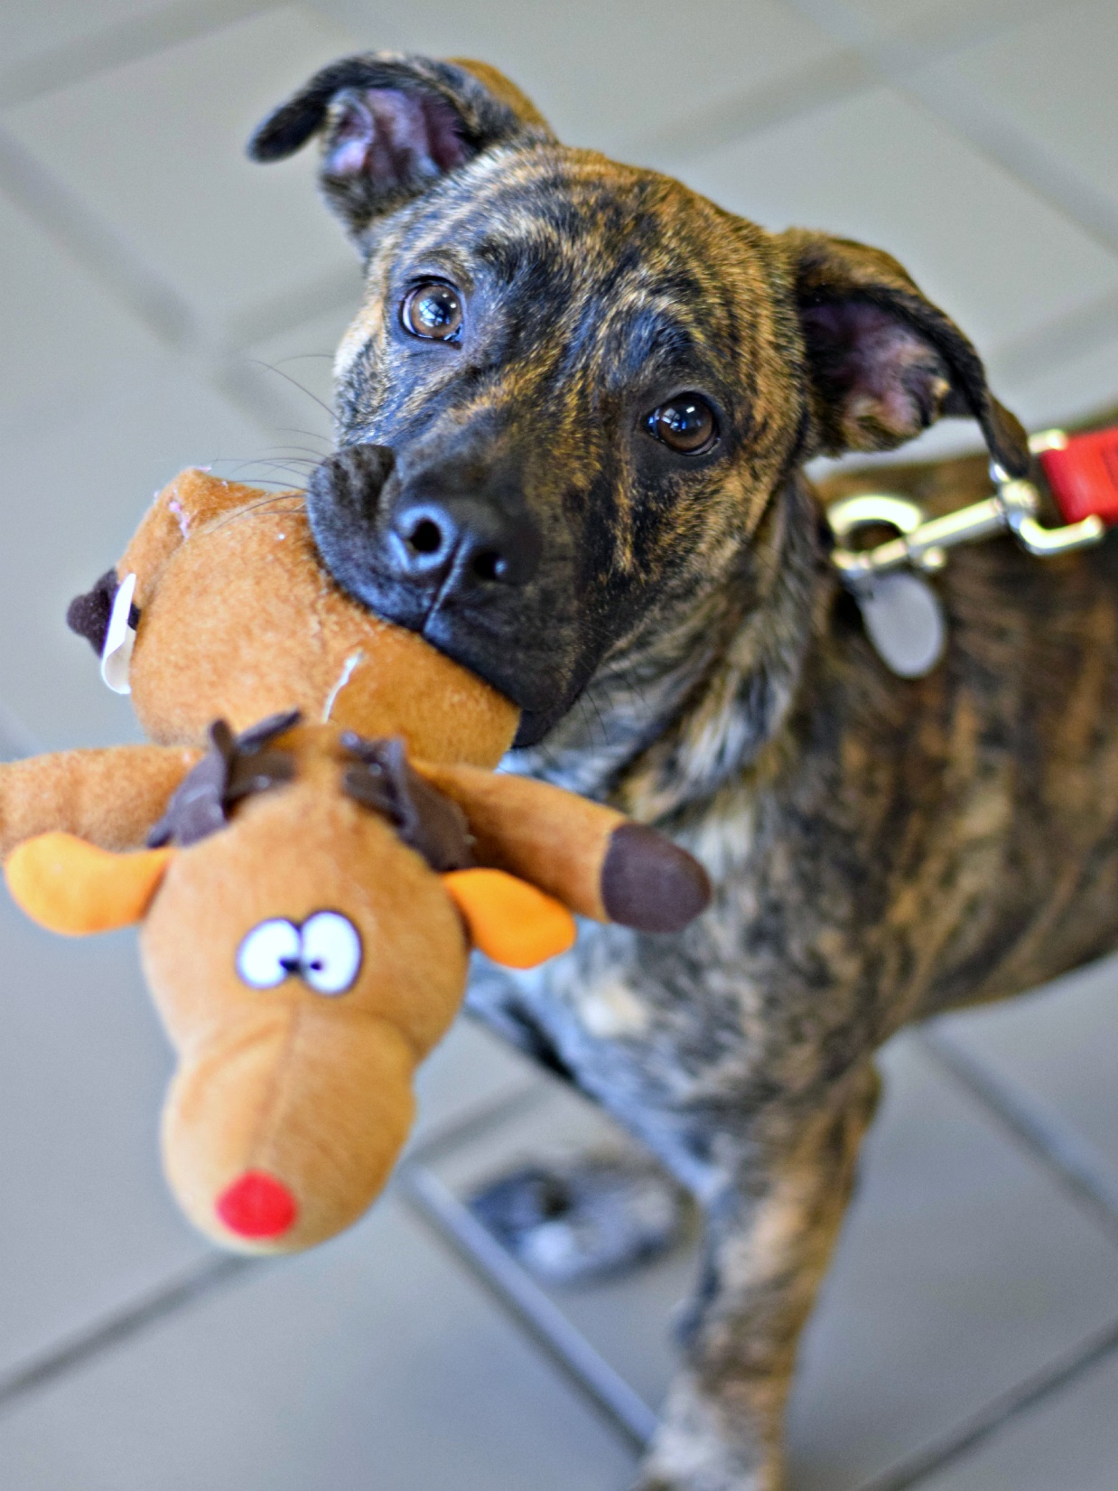
What is important to the Roanoke Valley SPCA?
• We are a kind organization that works to treat animals well.
• We are focused protecting homeless dogs and cat.
• We celebrate friendship between humans and animals.
• We use teamwork with people and other organizations.

Slide 4
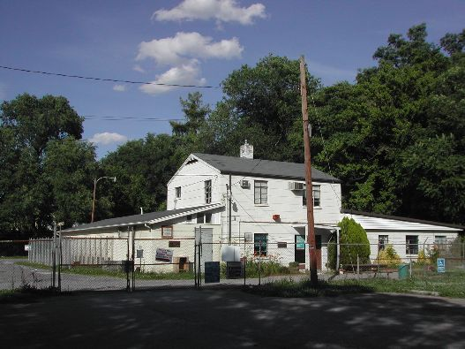
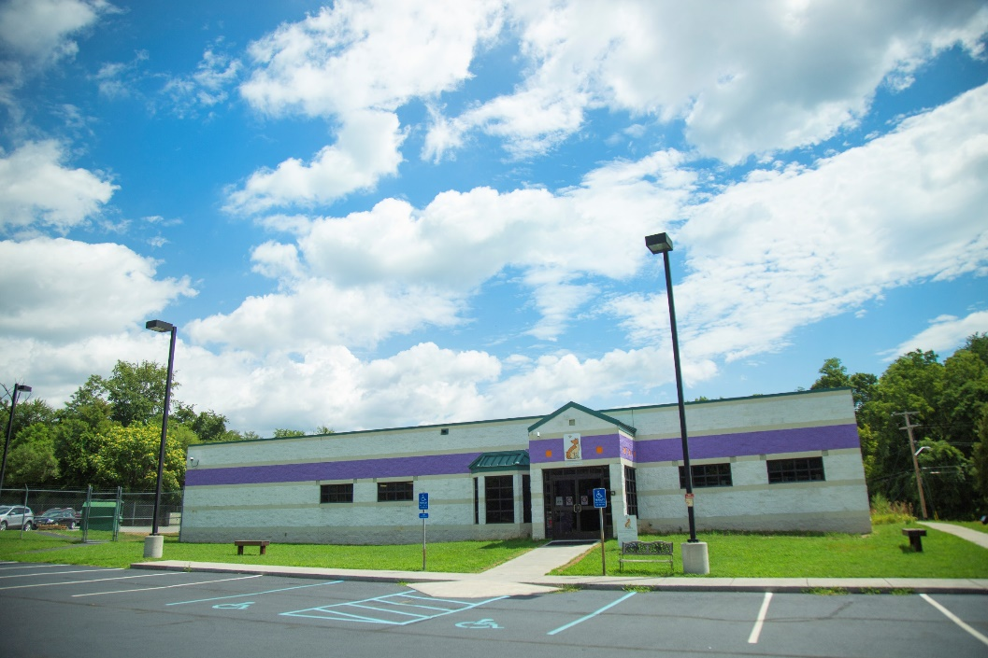
Our Facility
The Roanoke Valley SPCA has been helping animals in Roanoke for over one hundred years!
Our current building:
Barbara & Warner Dalhouse Adoption and Education Center
2004-today
Our old building:
1959-2004

Slide 5
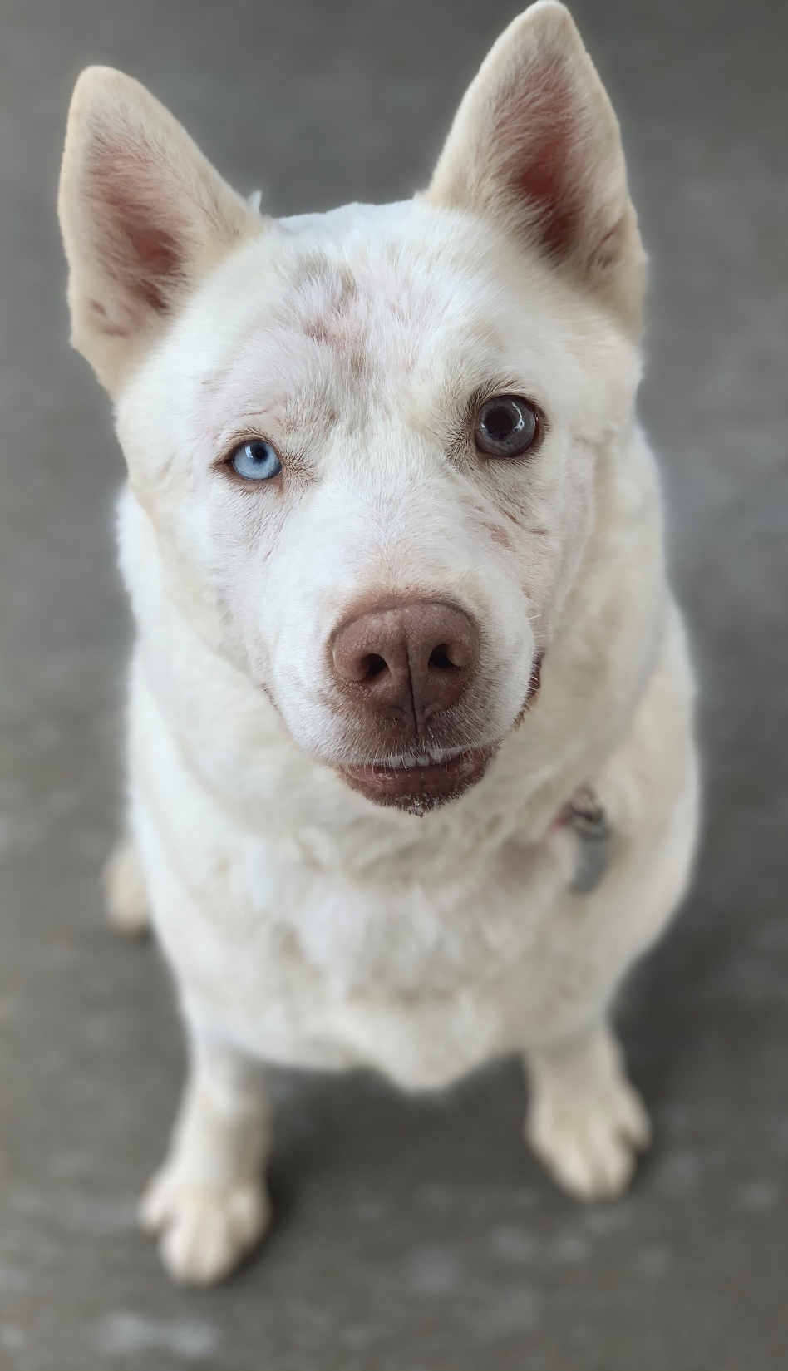
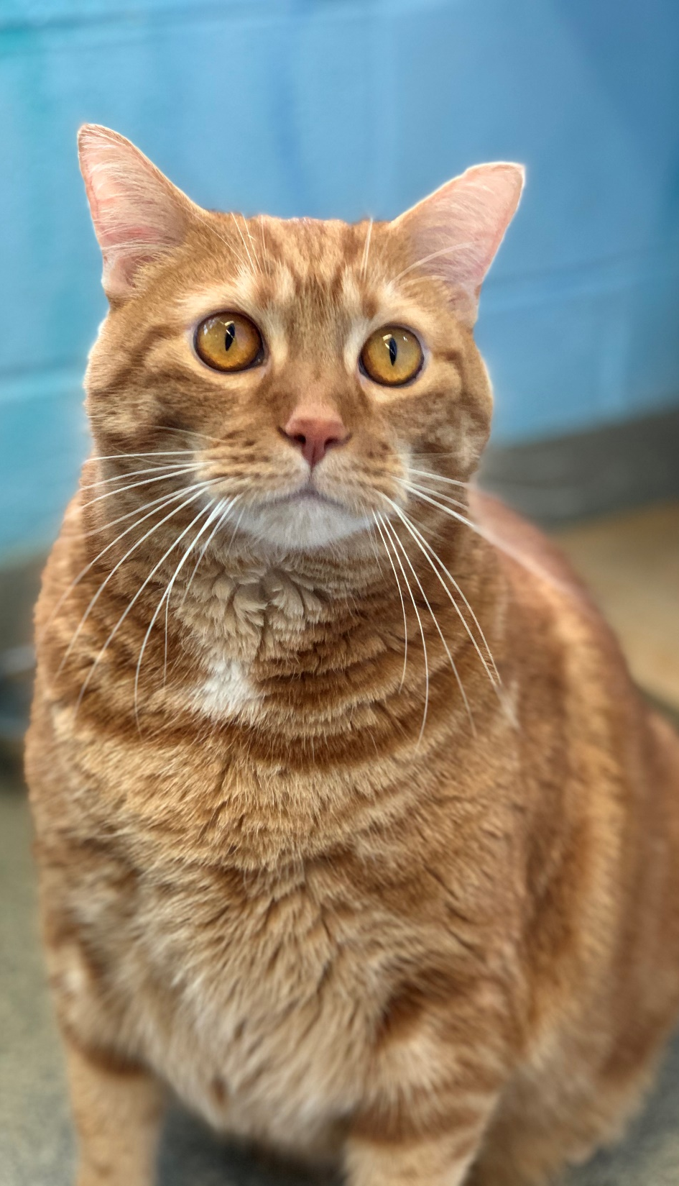
How Do Our Pets Get Here?
We are a private shelter.
This means we only take new animals when there is space for them at the shelter.
We get some animals from people who cannot take care of them anymore, but most of them are from other shelters who need help!
Some shelters that we help include:
RCACP (next door!)
Alleghany Humane Society
Floyd County Humane Society
Giles County Dog Pound
Pulaski County Humane Society
And many others!

Slide 6
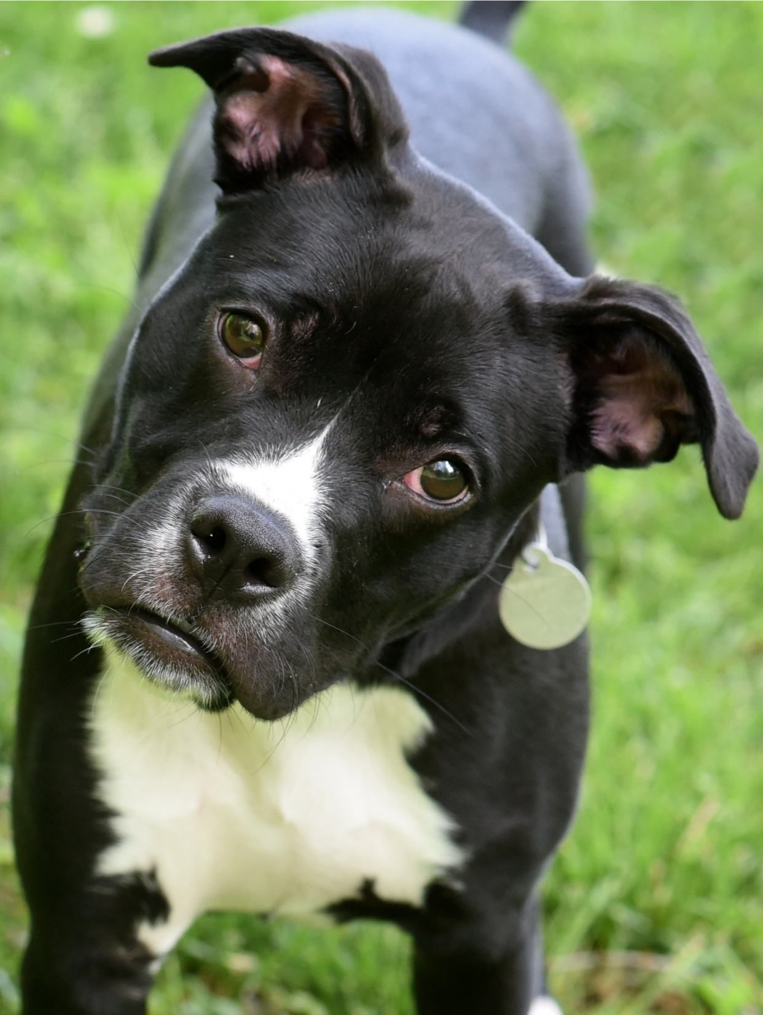
Why do other animal shelters need help?
Some shelters are public shelters, which means they have to take in any animal brought to them, even if they don’t have space.
The law says that all stray animals go to the public shelter. When all strays go to one building, it makes it easy for their families to find them!
But for some open intake shelters, that means they have to euthanize – or put animals to sleep – to make space.
It’s up to the community to help so they don’t get full! People help by fostering, adopting, or babysitting stray animals at home until their owner can get them.

Slide 7
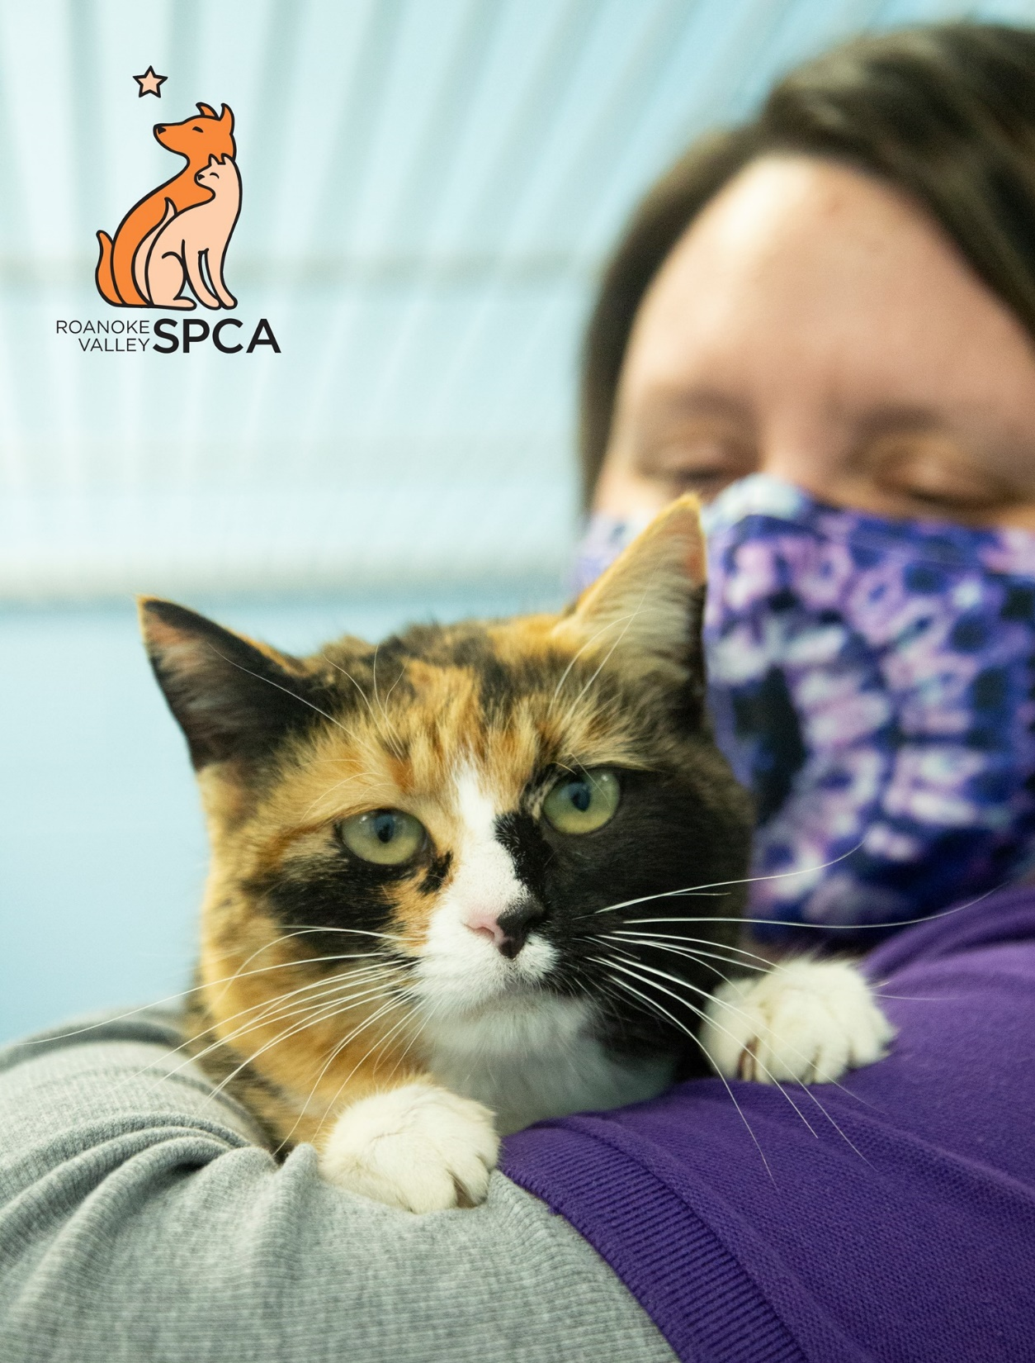
ADOPTION
We work to find loving home for animals.
PREVENTION
We teach people about animal behavior and care so that less animals come to the shelter.
INTERVENTION
We try to help people in hard situations so they don’t have to give their pet away.

Slide 8
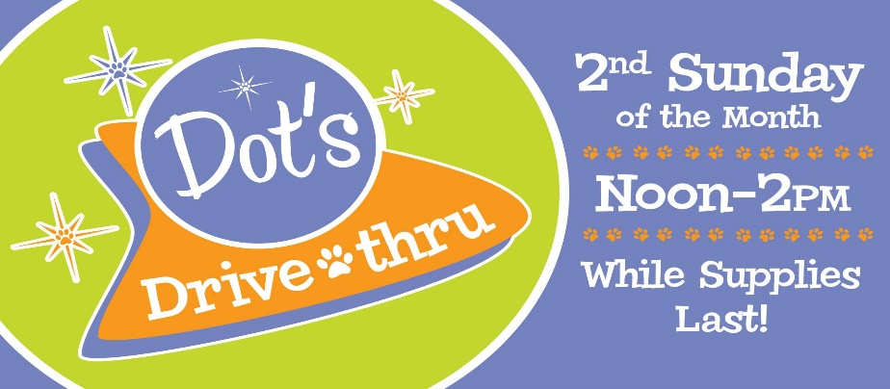
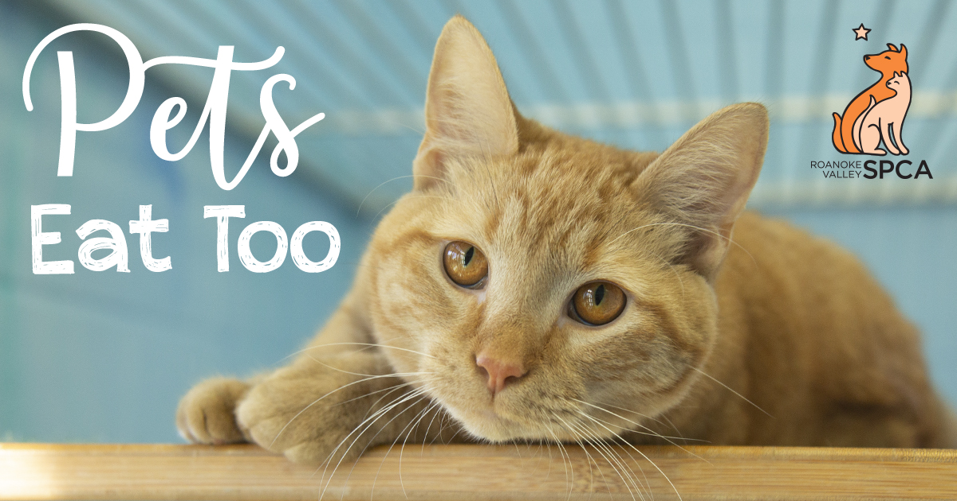
These are some of our Intervention programs that help people and animals in need, so the pets can stay with their owner who loves them and do not need to come to the shelter.
Dot’s Drive Thru and P.E.T. are programs that give food to families who can’t afford to feed their dogs and cats

Slide 9
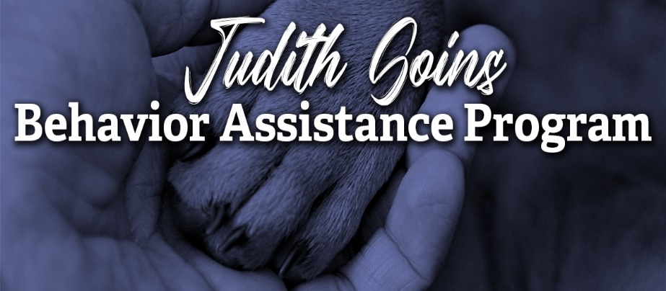
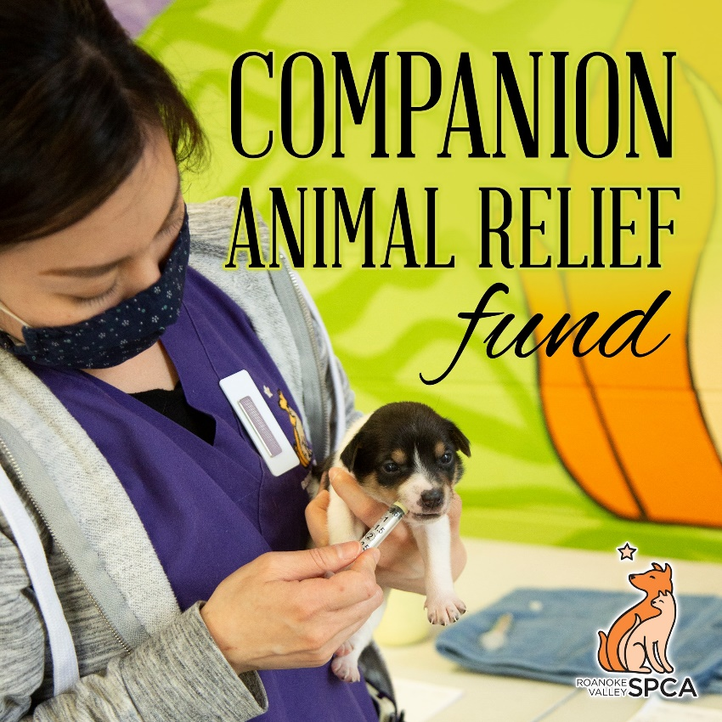
These are some of our Intervention programs that help people and animals in need, so the pets can stay with their owner who loves them and do not need to come to the shelter.
The C.A.Re Fund and Judith Goins Fund help pay for vet appointments and dog training for families who can’t afford it, and would have to surrender their pet without it

Slide 10
Part 2
Introduction to Fear Free

Slide 11
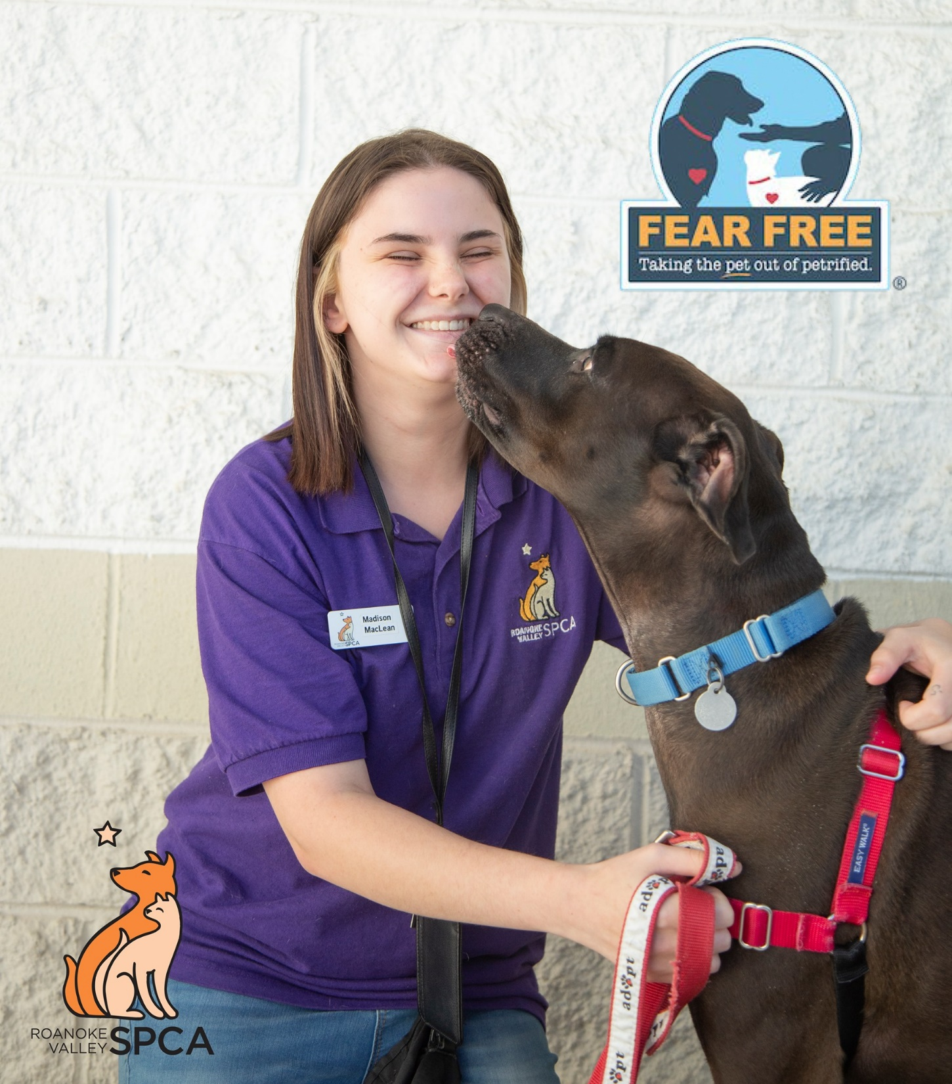
Everyone who works at the Roanoke Valley SPCA is Fear Free Certified with Fear Free Shelters.
Animals don’t understand why they’re here, and the shelter can be scary for cats and dogs.
The goal of the Fear Free Shelter Program is to make it less scary and more fun for them!

Slide 12
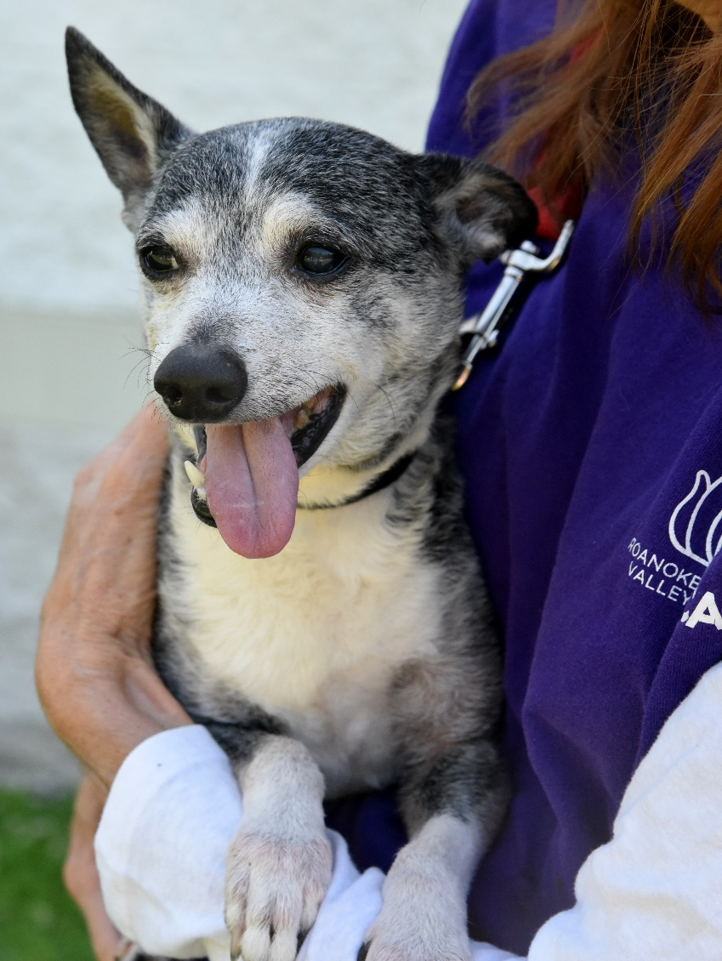
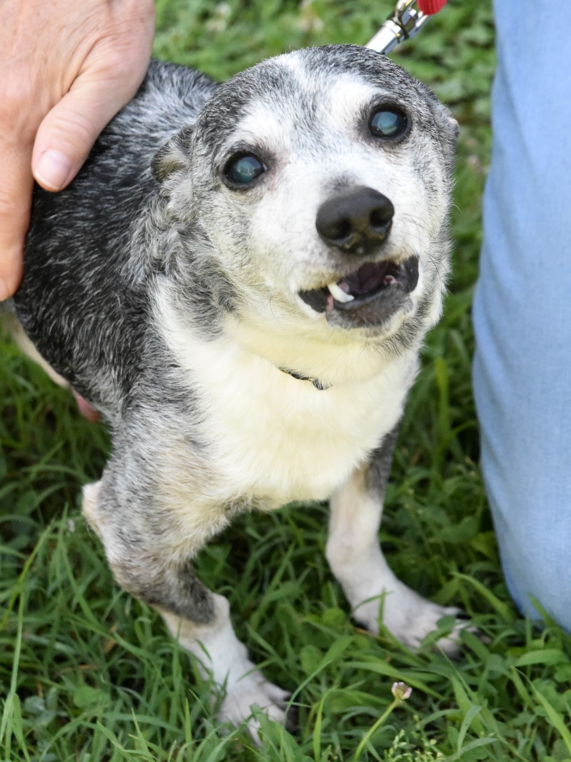
We are trained to watch small changes in a dog or cat’s body to see if they are uncomfortable or scared. This helps protect them and protects us, because a scared animal might scratch or bite.

Slide 13
What to watch with cats
Eyes
A relaxed cat has thin pupils – or the black part of the eye
A cat who is upset… or really hyper… has big circular pupils. Look at the rest of their body language to figure out if they’re hyper or upset.
Ears
Ears forward like triangles means a cat is alert and interested.
Ears to the side means they are nervous or unsure.
Ears pinned back means they are really upset! Give them space!
Mouth
Hissing or Growling can be a sign that a cat is scared and needs space
Purring is usually a sign that a cat is happy
Tail
A puffy or bushy tail can mean a cat is nervous. As a cat gets more scared, they will raise the puffy tail higher and higher!

Slide 14
What to watch with dogs
Eyes
Wide eyes where you see the white around their eyeball means a dog is nervous. We call this “whale eyes”!
Ears
Ears forward like triangles means a dog is alert and interested.
Ears to the side means they are nervous or unsure.
Ears pinned back means they are really upset! Give them space!
Even dogs with floppy ears will move the part attached to their head!
Mouth
An open mouth dog is usually more relaxed than closed mouth dog.
Dogs sometimes yawn when they are nervous! Look at the rest of their body language to figure out if they’re tired or nervous.
Tail
A wagging tail is usually a sign of a happy dog…. But… some scared dogs will hide their tail between their legs and still wag it nervously.

Slide 15
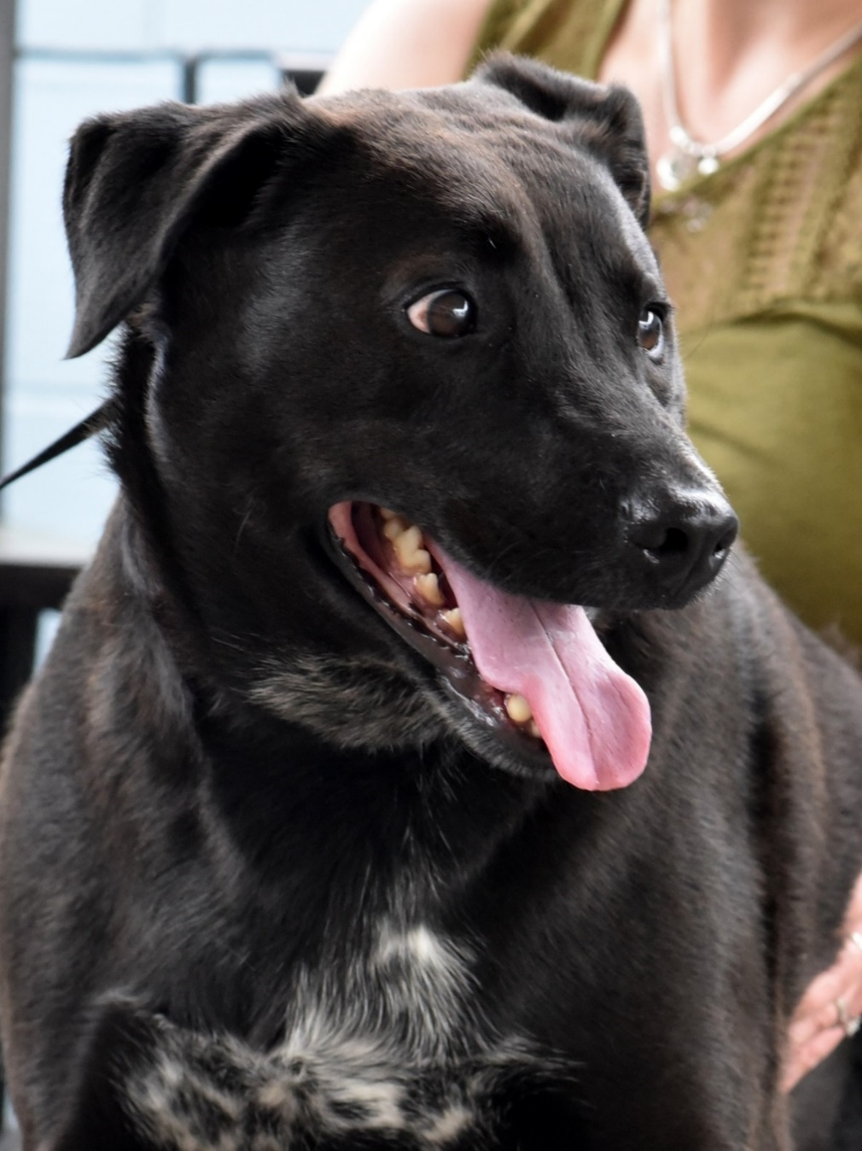
Choose a side!
Walk to the side of the room you think has the right answer.
Is this dog Happy or Scared?
Notes:
Answer: Scared
This dog is giving us “whale eyes” and yawning!

Slide 16
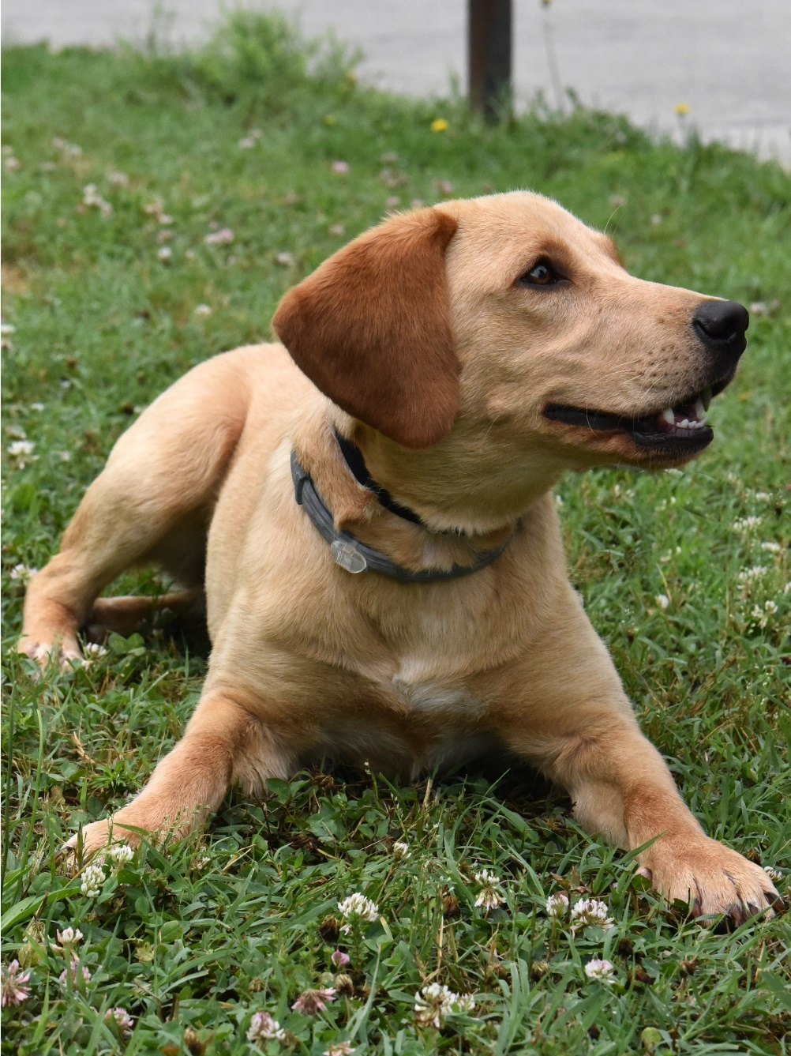
Choose a side!
Walk to the side of the room you think has the right answer.
Is this dog Happy or Scared?
Notes:
Answer: Happy
This dog has a relaxed open mouth and is not making “whale eyes”

Slide 17
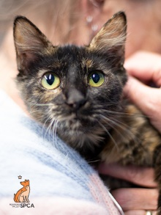
Choose a side!
Walk to the side of the room you think has the right answer.
Is this cat Happy or Scared?
Notes:
Answer: Happy
Her eye pupils are thin and her ears are up!

Slide 18
Choose a side!
Walk to the side of the room you think has the right answer.
Is this dog Happy or Scared?
Notes:
Answer: Scared
This dog is barking and his ears are pinned down, which means he is very scared right now.

Slide 19
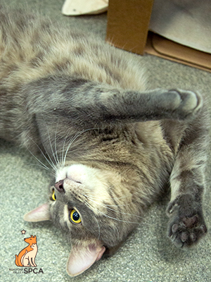
Choose a side!
Walk to the side of the room you think has the right answer.
Is this cat Happy or Scared?
Notes:
Answer: Happy
His ears are up and he is rolling!
His eye pupils are “medium”… maybe he is playing or excited!

Slide 20
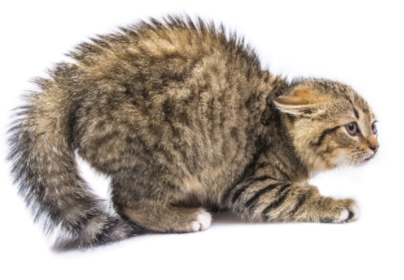
Choose a side!
Walk to the side of the room you think has the right answer.
Is this cat Happy or Scared?
Notes:
Answer: Scared
This cat’s ears are pinned down and they have a BIG poofy tail

Slide 21
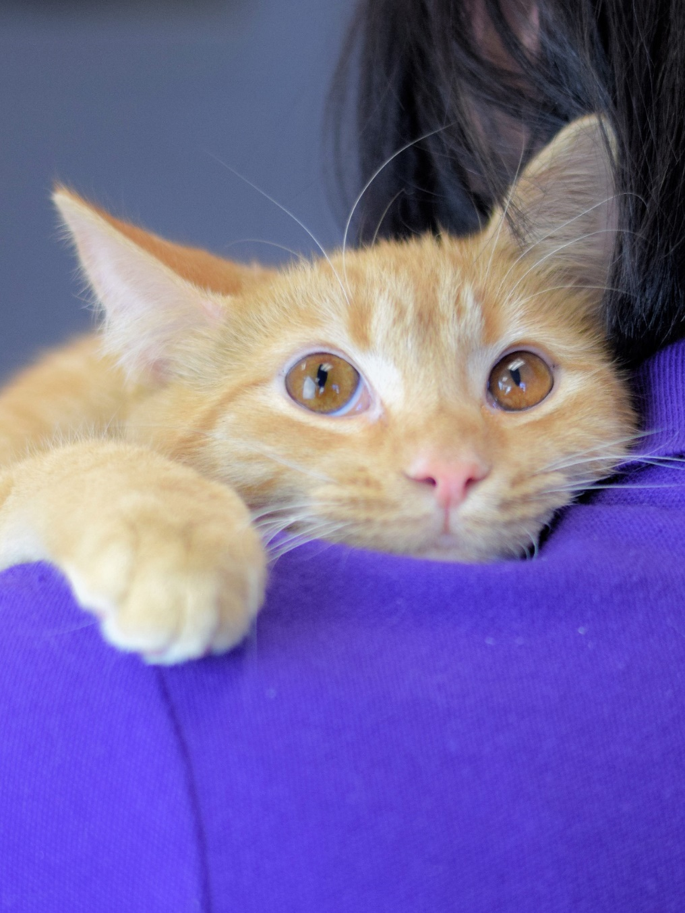
It’s fun for us to visit the animals at the shelter, but it’s not always fun for the animals to be here.
It is important to pay attention and be patient when an animal shows you they are uncomfortable.
Remember that the animals deserve to have their personal space too!

Slide 22
Part 3
Healthy pets need the right food

Slide 23
Can my pet eat human food?
The answer is…. sometimes!
Some “human food” is healthy for our pets when given to them the right way. But some human food makes pets very, very sick. If you don’t know the answer, you should not let your pet have that food until you can talk to your vet!
If you are going to give your pet a snack like a carrot or green bean, make sure you are not feeding them from the table or your plate… that will teach them bad habits! Instead take the snack to their food dish or a Kong toy and place it there for them.
Make sure there aren’t seasonings on the food, like garlic – seasonings usually are bad for pets.

Slide 24
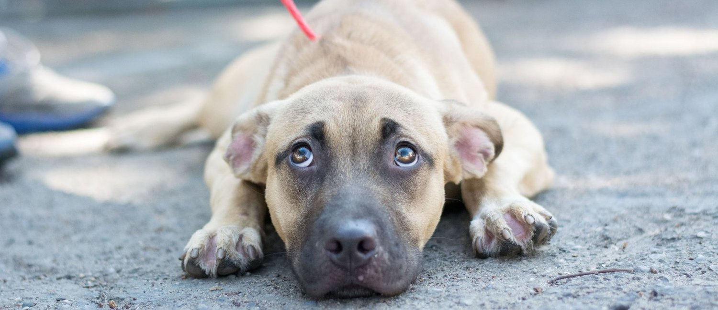
Do you know what your dog can eat?
Let’s do an activity to find out!

Slide 25
Part 4
Healthy pets need exercise

Slide 26
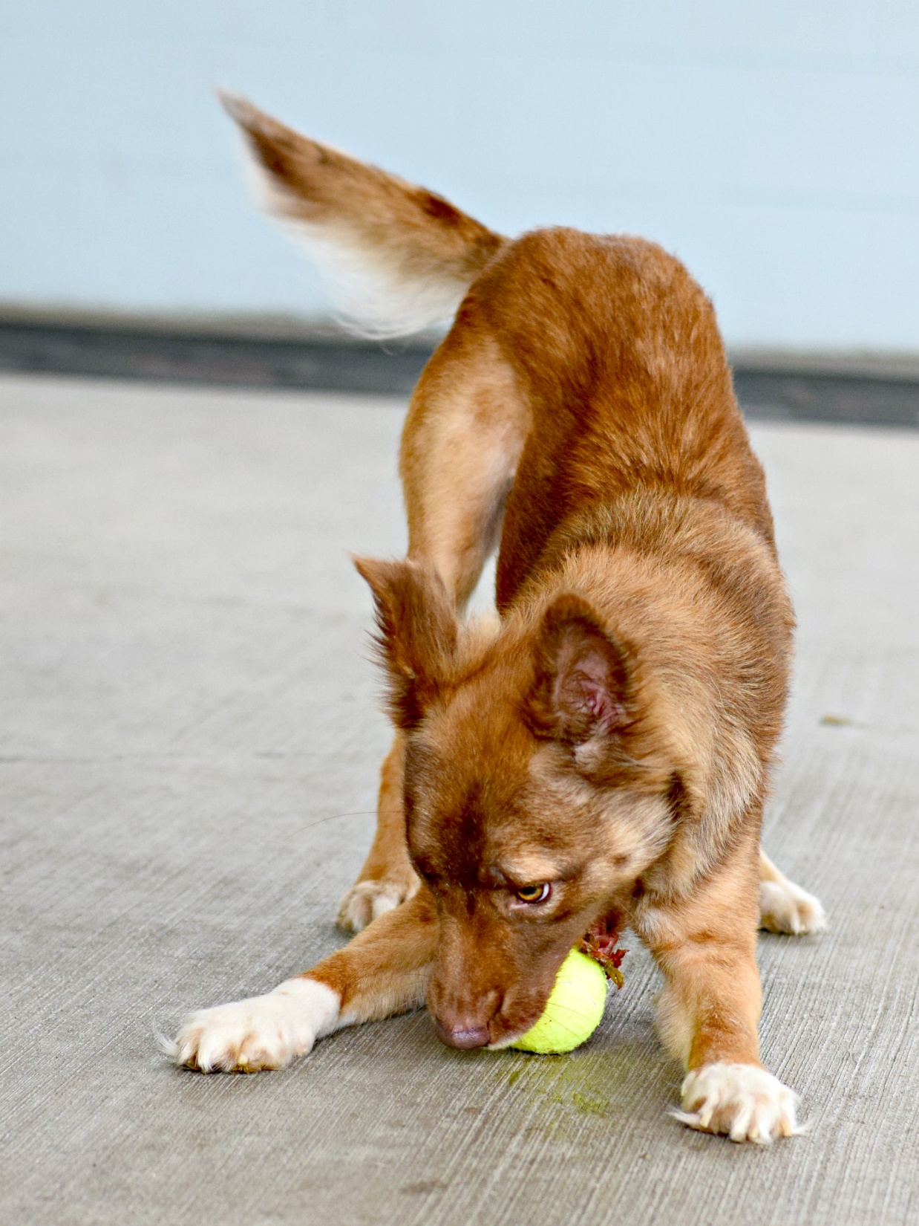
Dog Enrichment
‘Enrichment’ is Play with a Purpose! Depending on the dog’s personality, they might do different activities with staff or volunteers. This can include
Reading to dogs
Playtime
Learning commands like ‘sit’
Practice getting groomed if they have long fur that needs brushing

Slide 27
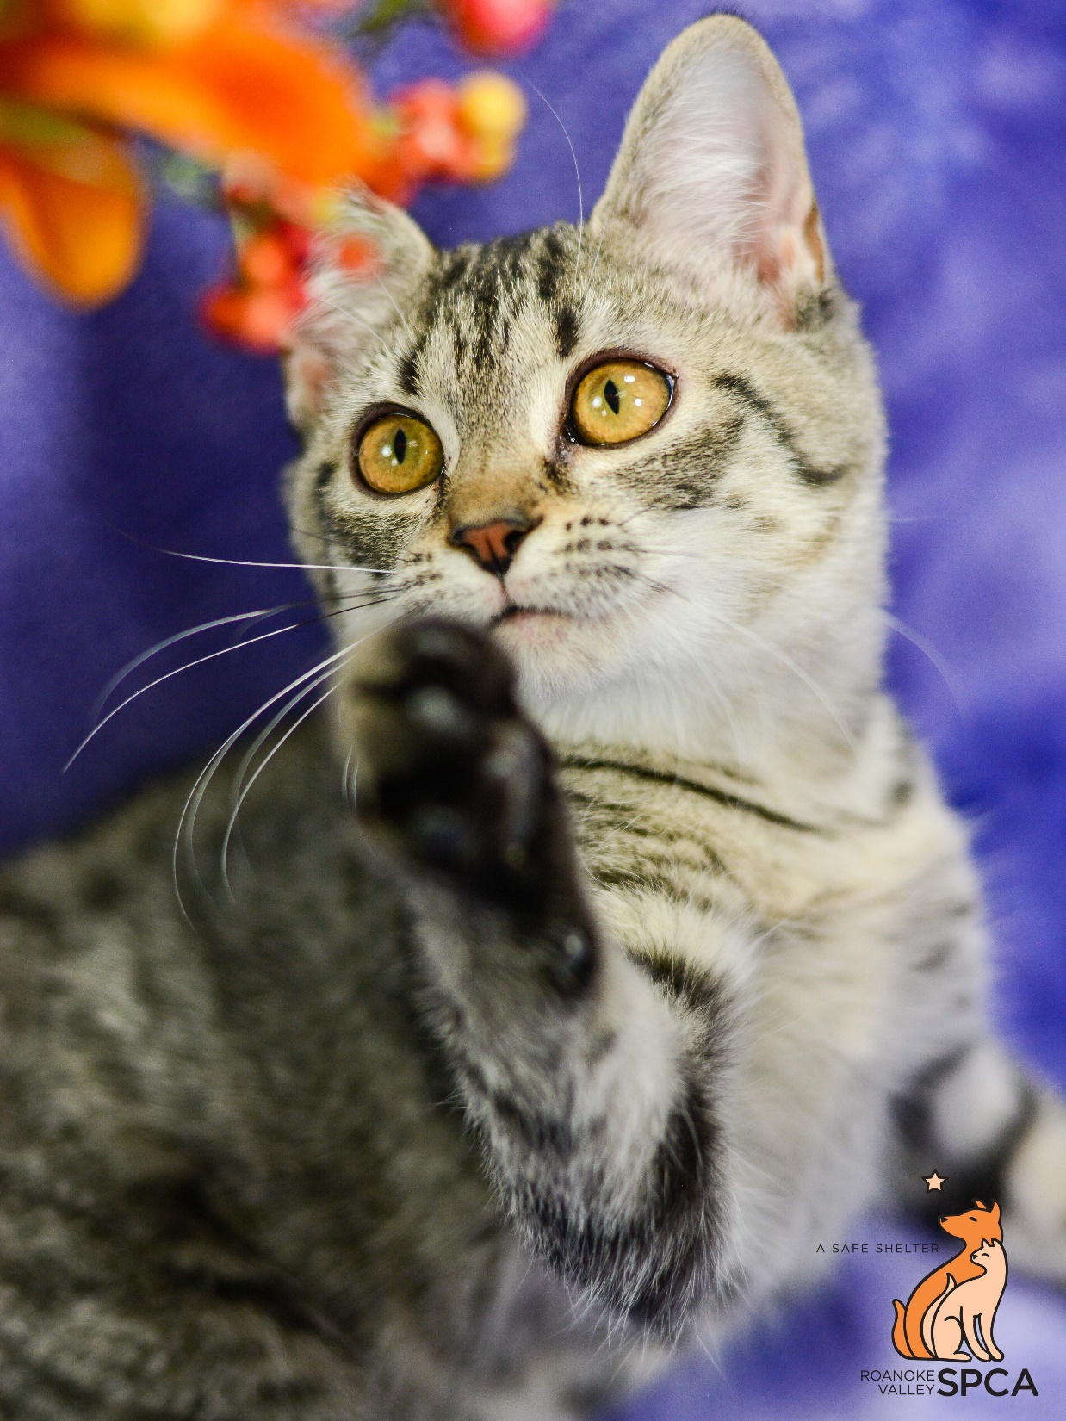
Cat Enrichment
‘Enrichment’ is Play with a Purpose! Depending on the cat’s personality, they might do different activities with staff or volunteers. This can include
Reading to cats
Playtime
Learning that hands are not toys to attack!
Practice getting groomed if they have long fur that needs brushing

Slide 28
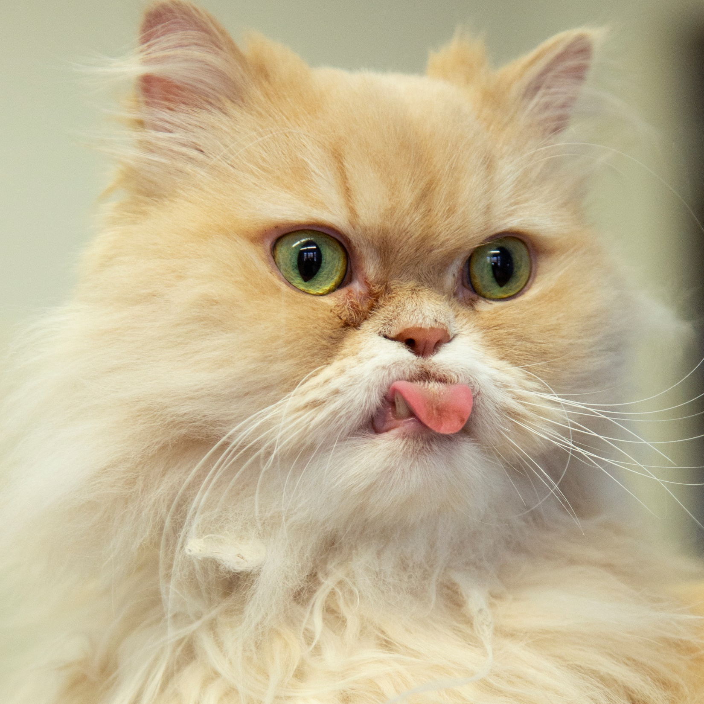
Time for a tour!

Slide 29
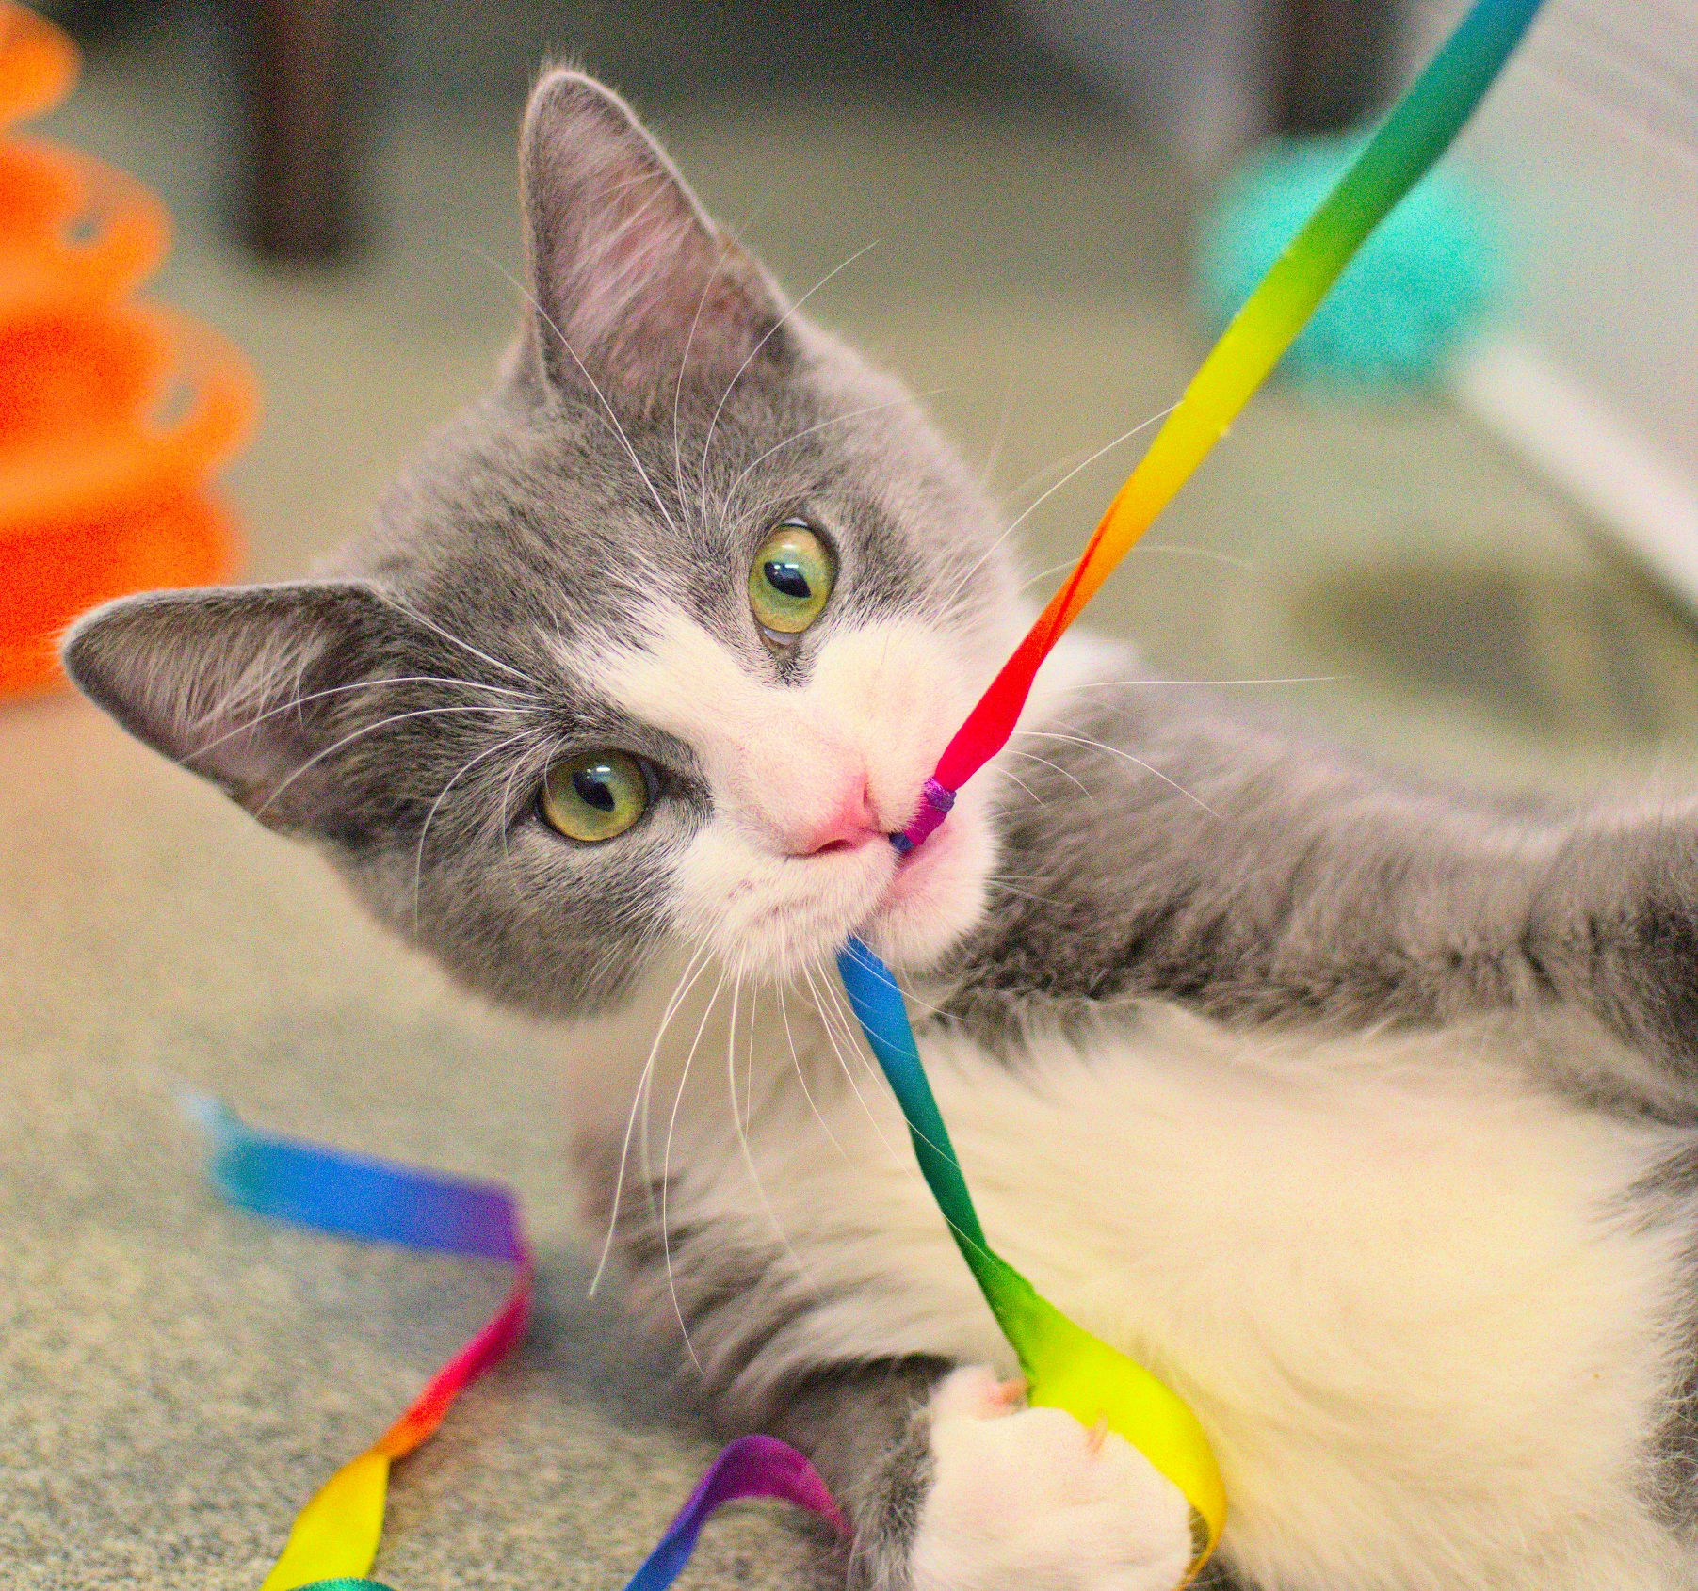
Now let’s make a cat toy!

Slide 30
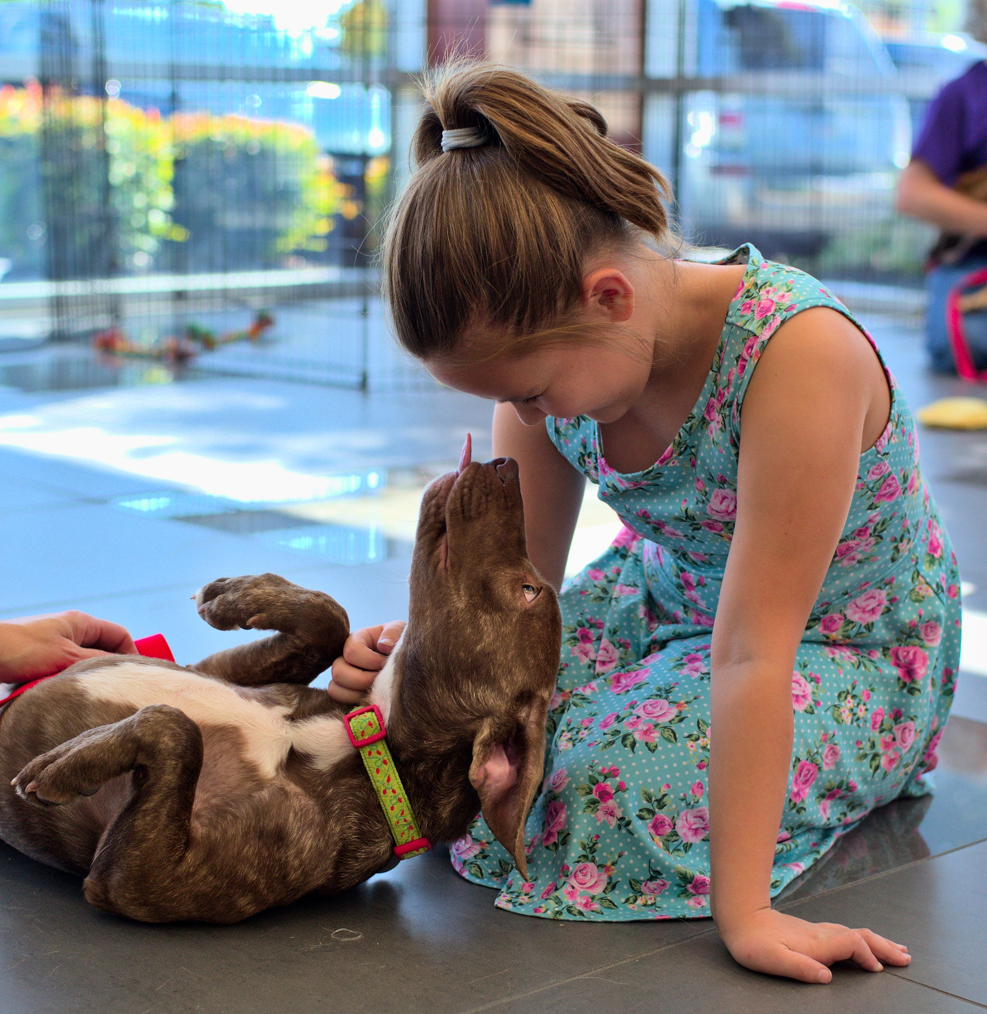
Time to meet an adoptable friend!

