Slide 1
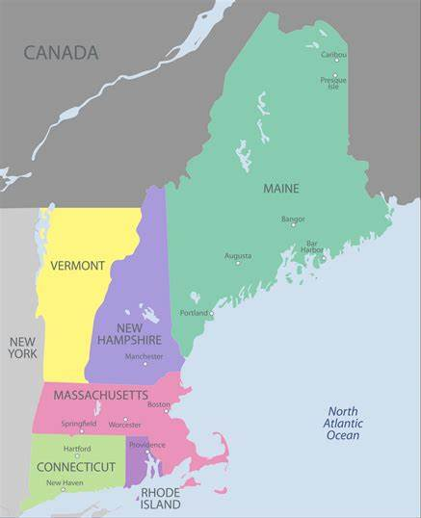
What’s Up New England?
With Brad and Mike

Slide 3
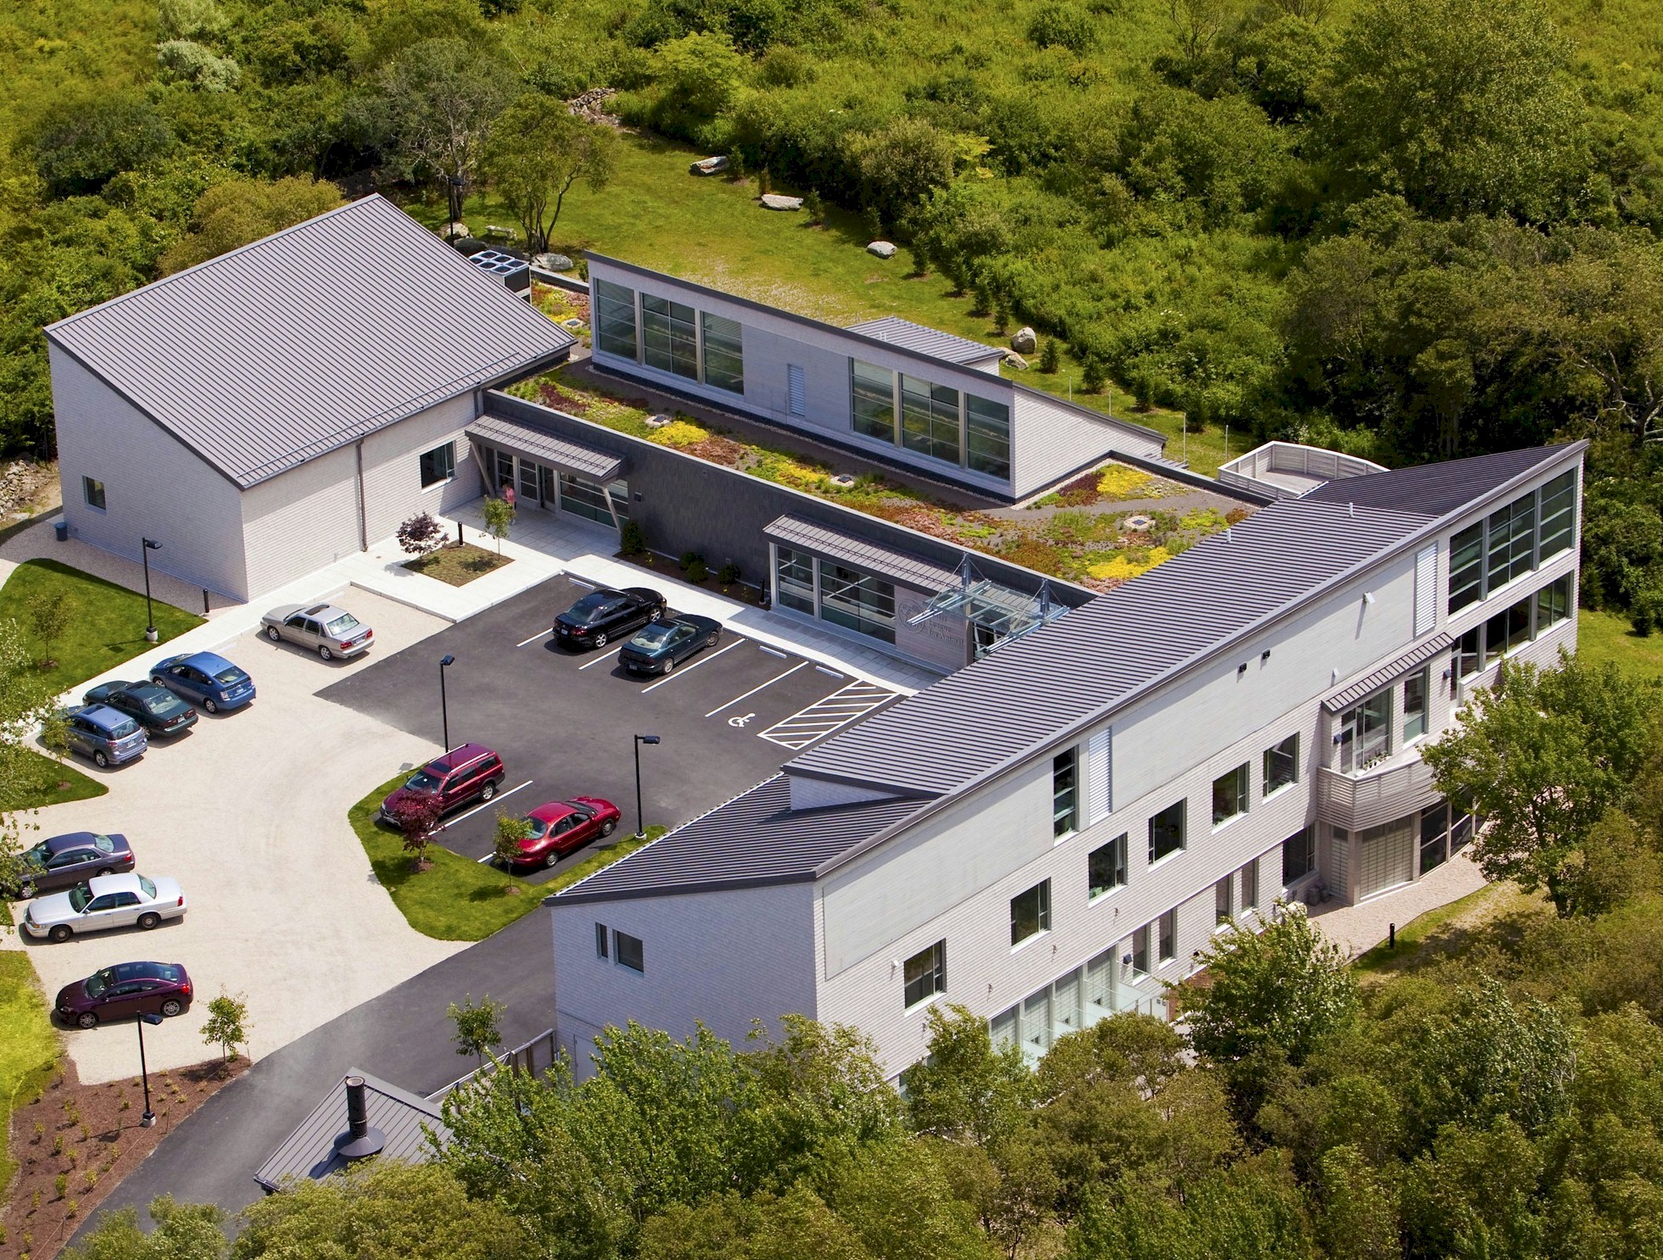

Slide 4
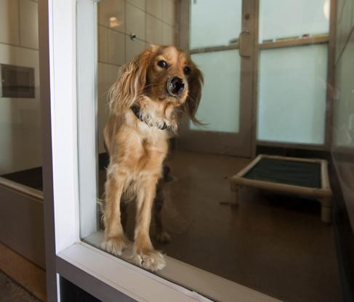
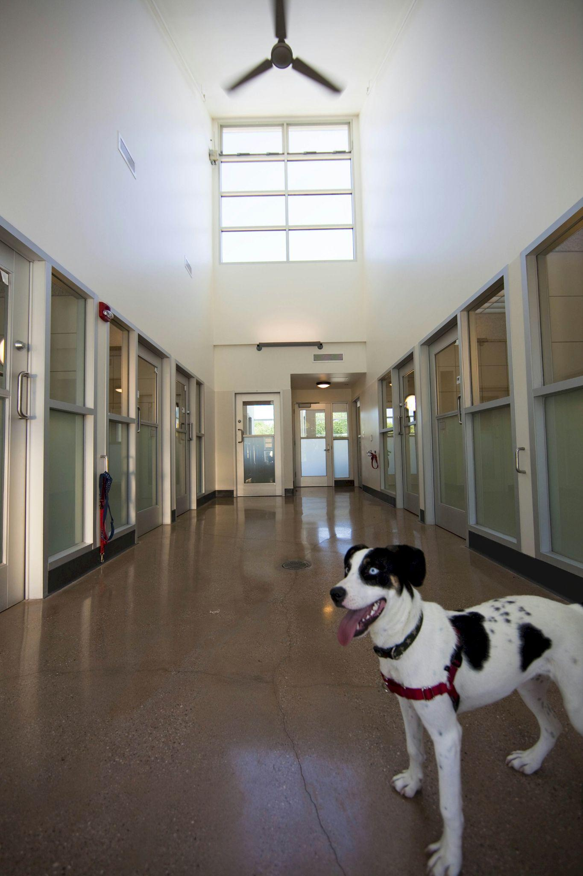

Slide 5
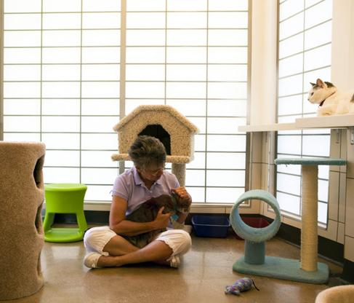

Slide 6
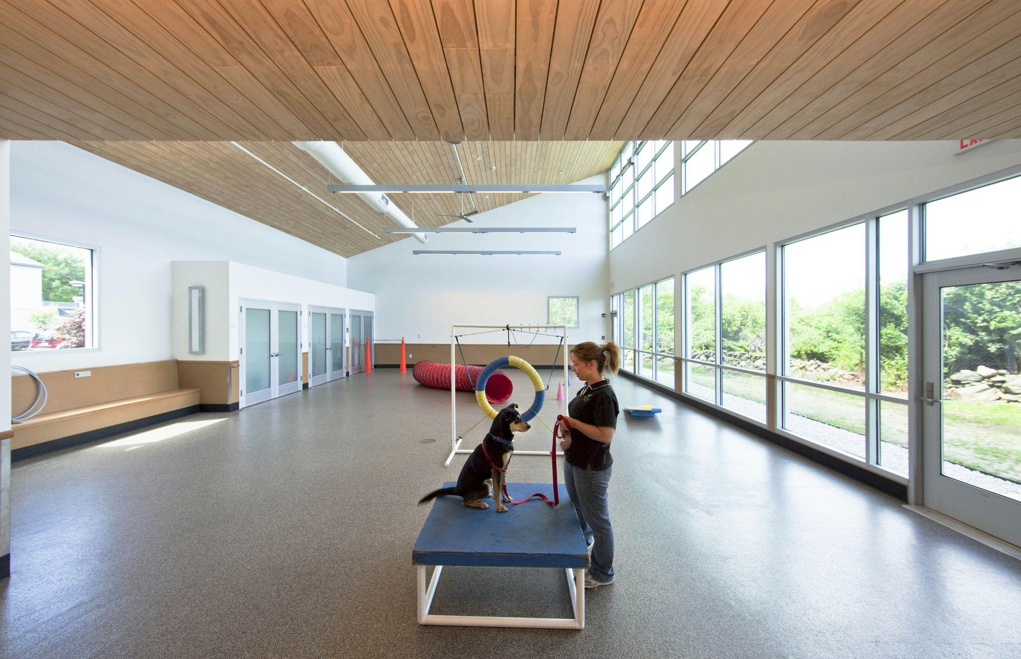

Slide 7
Founded in 1929
Started transport in 1995 ‘Fetching Friends’
Behavior Help Line
Pet Safe boarding
CARE Program
1st Full-time Veterinarian 2017
Public Wellness
Food Pantry
Length of stay drops, transport increases by 30%
2019 Potter League Spay/Neuter Clinic
2020 Pets In Need Clinic
2022 Community Navigator

Slide 8
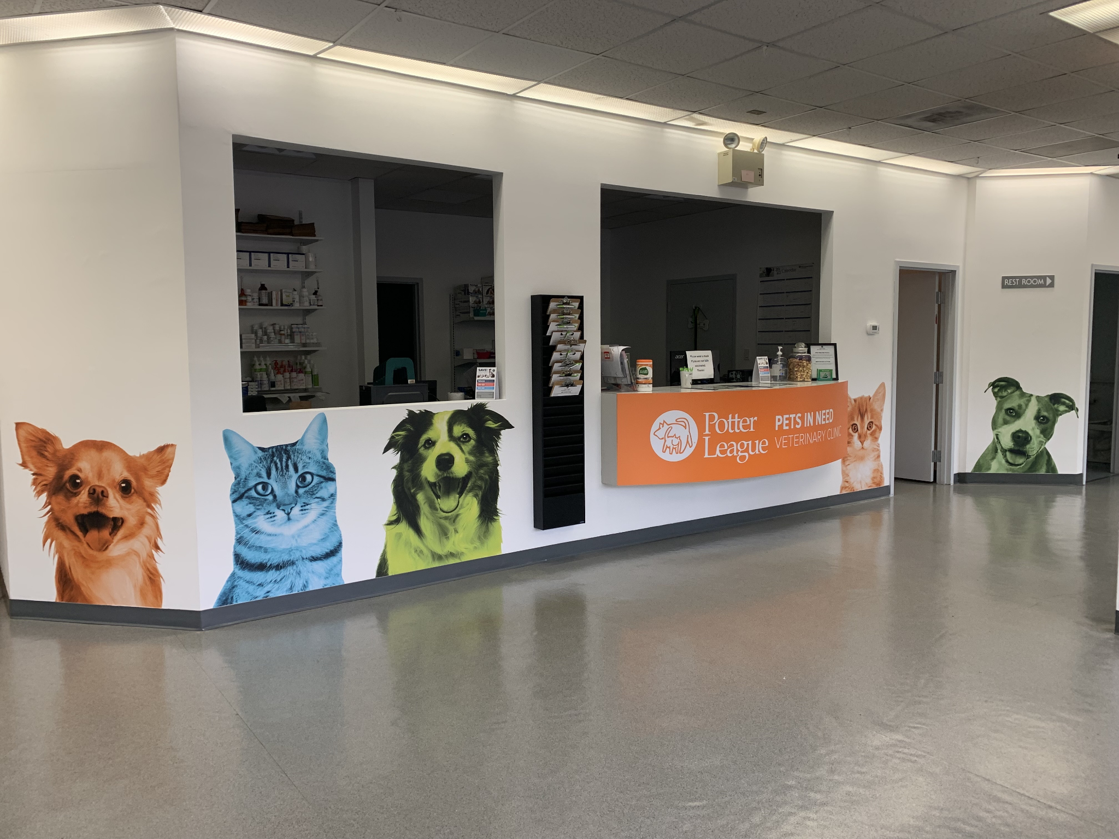

Slide 9
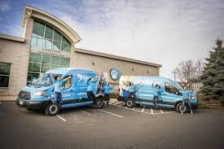
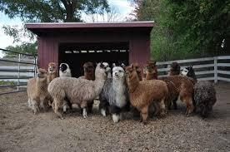
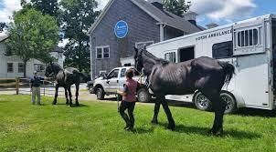
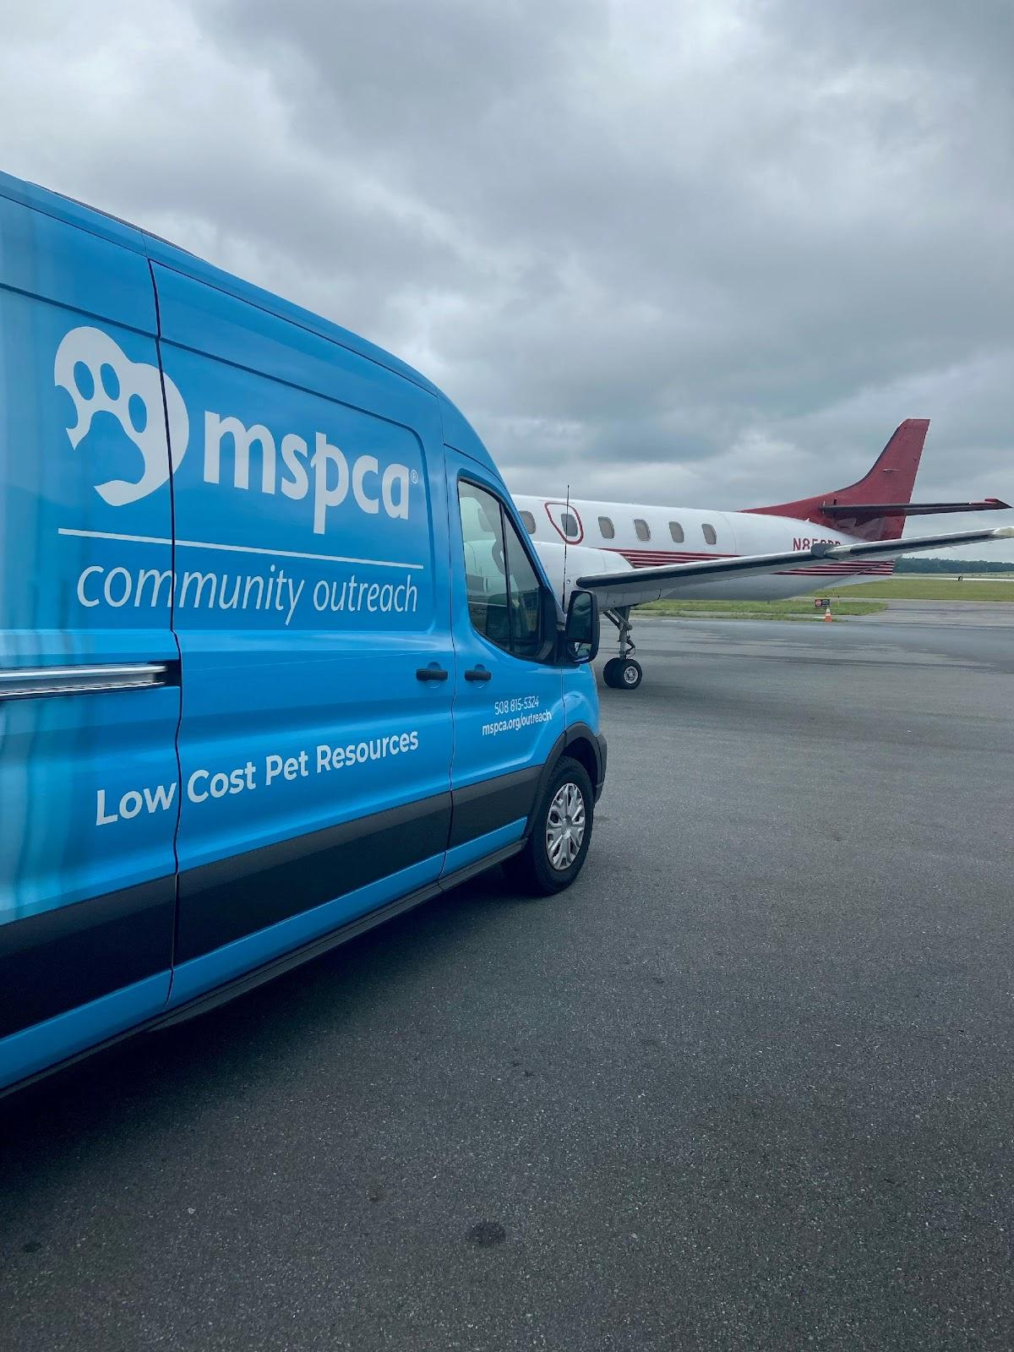
MSPCA-Angell
Founded in 1868
Hospital division
Angell AMC – Boston
Angell West
2 clinics connected to high school technical schools
Animal Protection Division
Advocacy
Humane Law Enforcement
3 Adoption Centers –including equine and farm animal center
Affiliated shelter Northeast Animal Shelter
Community Outreach(4 communities)
3 Community Clinics

Slide 10
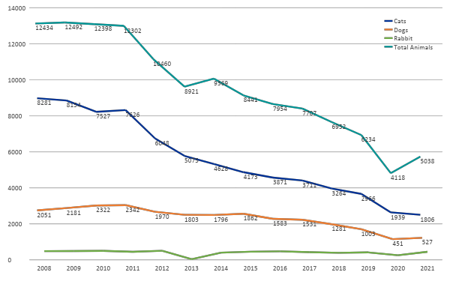
MSPCA Intake – Without Relocation
Includes 440 mice intake

Slide 11
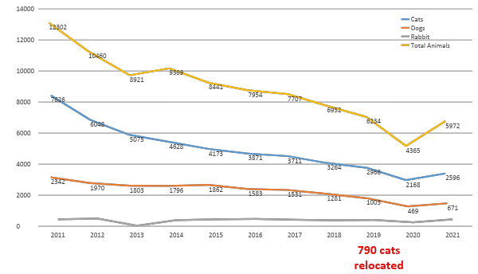
MSPCA Intake – All Locations, 2011-2021

Slide 12
MSPCA strategic planning
2017
Due to overpopulation no longer being a main issue to combat, we shifted from a reactive to a proactive state to address animal issues
Formed Community Outreach
Developed Community Clinics
Affiliated with NEAS for relocation of animals
2022
Preserve families - expand community outreach and community clinics
Continue relocation but expand to direct support in communities overwhelmed with overpopulation - ex. collaboration with Berkeley Animal Center in SC

Slide 13
MSPCA Core Stats 2021
28,015 animals served between our four adoption centers, community outreach and community clinics
Adoption Center
10,354 new animals taken into care
8,546 animals adopted
3,715 dogs and cats relocated from outside of New England
86% LRR for local dogs
99% LRR for relocated dogs
MSPCA Angell Community Clinics (3 clinics)
10,033 subsidized medical care treatments provided for low income families
Community Outreach
7,567 new animals supported by our Community Outreach teams
2,705,080 pet meals and 113,648 pounds of litter given to families in need

Slide 14
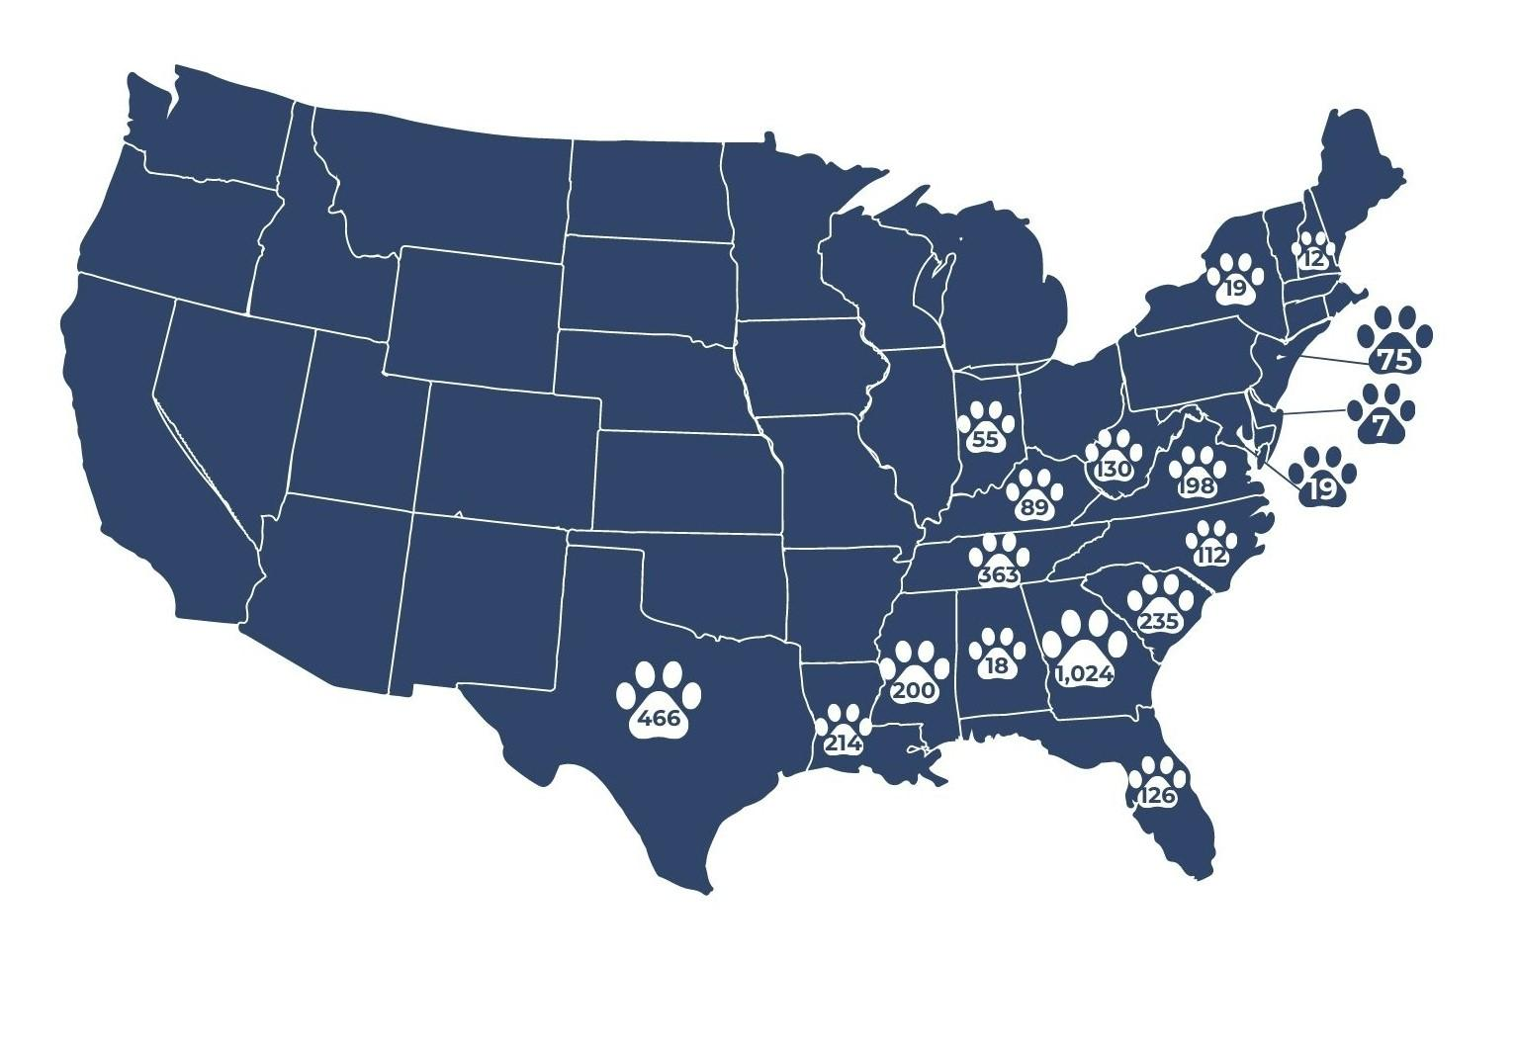
MSPCA/NEAS relocation map

Slide 15
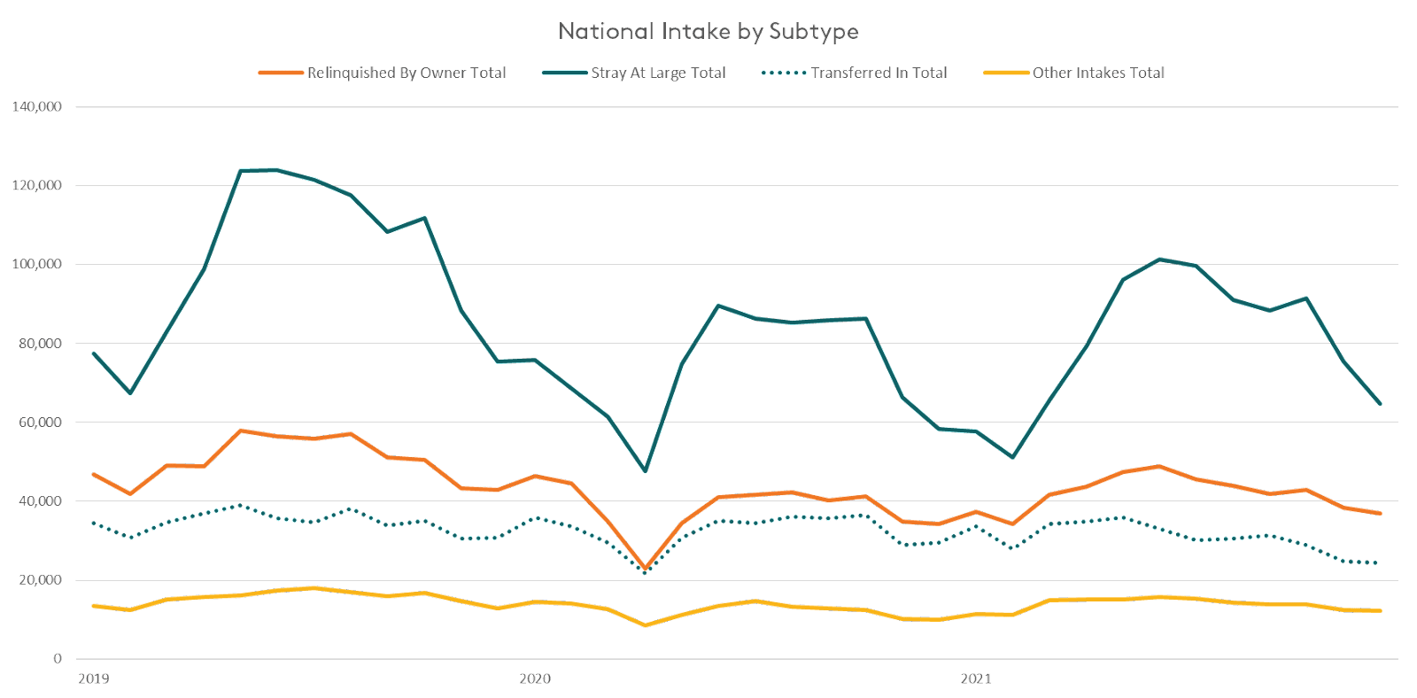
Data source: 1,233 organization locations with full 2019-2021 data in The National Database

Slide 16
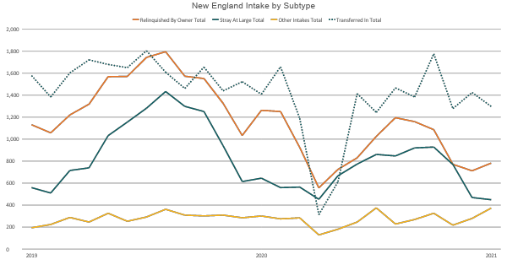
Data source: 59 organization locations in New England (CT,ME,MA,NH,RI,VT) with full 2019-2021 data in The National Database

Slide 17
Data source: 1,233 organization locations with full 2019-2021 data in The National Database
Data source: 59 organization locations in New England (CT,ME,MA,NH,RI,VT) with full 2019-2021 data in The National Database

Slide 18
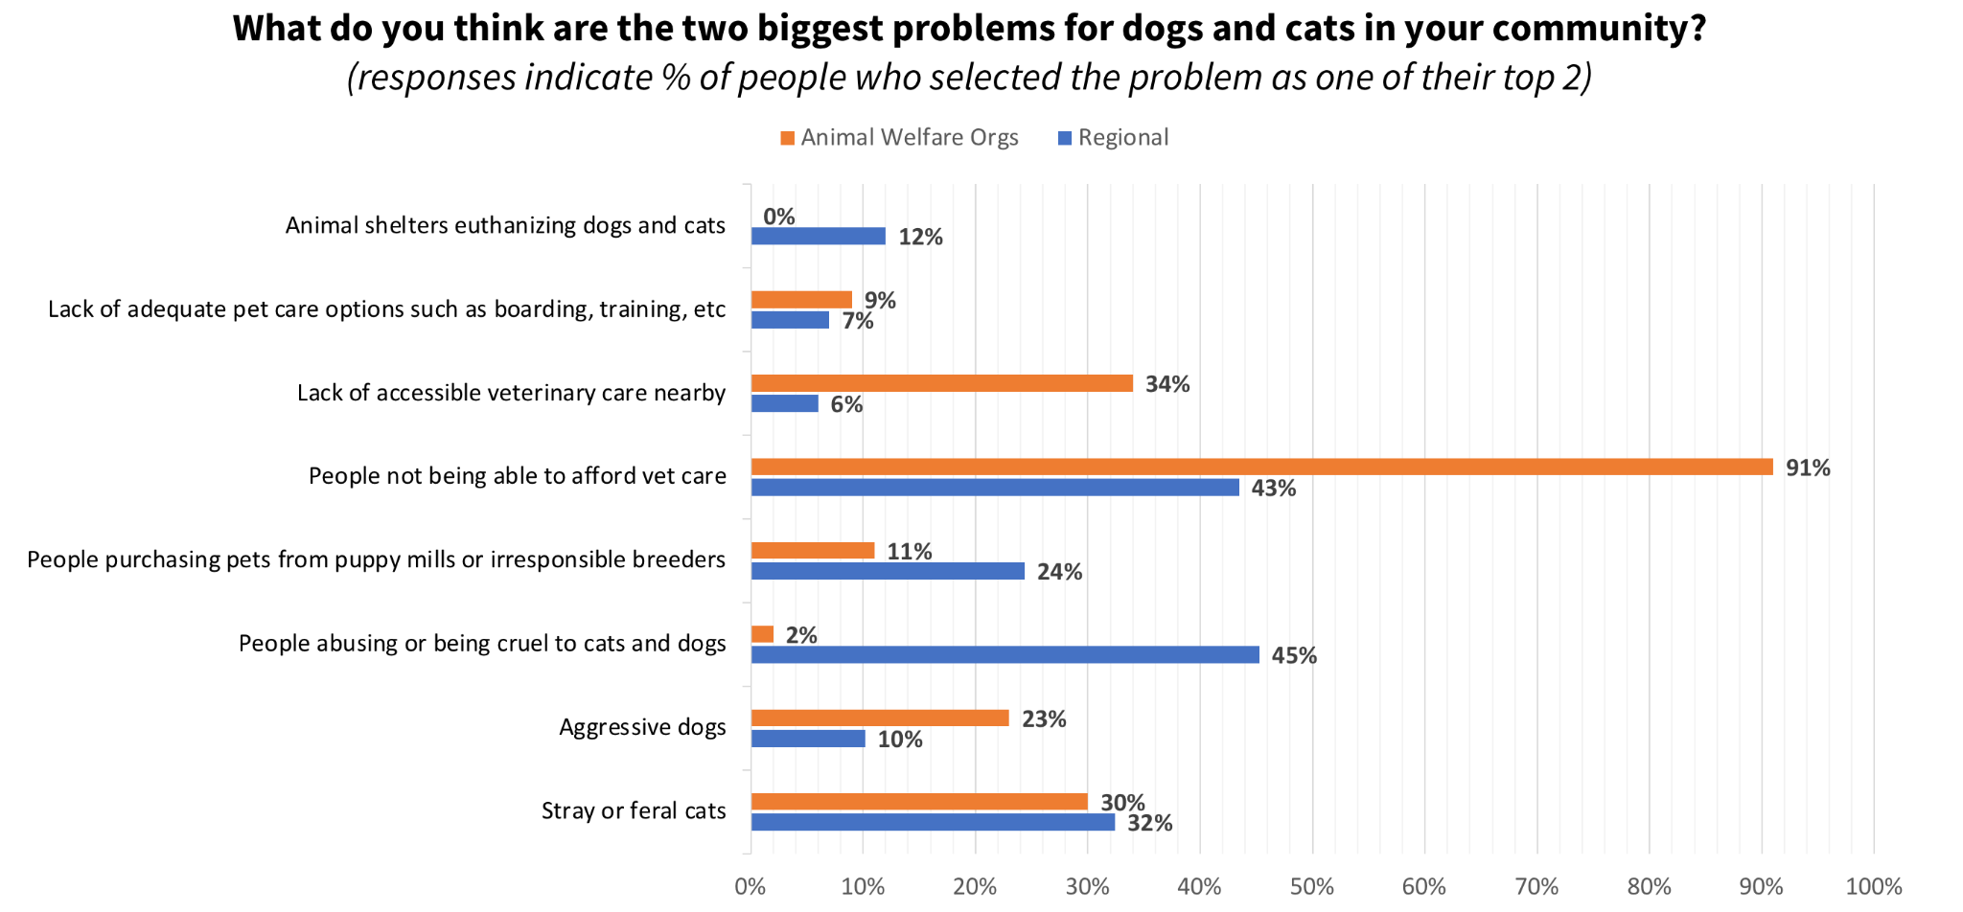
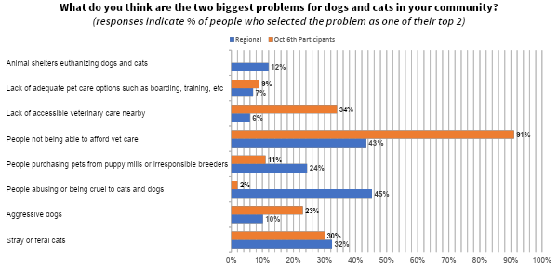
Public & Industry Perception of Problems In New England
New England Future of Animal Welfare Coalition, 2020
Notes:
Here we compare the public’s thoughts with those of animal welfare professionals in New England. Animal welfare professionals identify veterinary care affordability to be the biggest problem.
They didn’t view euthanasia in shelters as a problem. That’s because euthanasia due to space isn’t happening in New England shelters. Spay and neuter, as well as efforts to keep pets in homes, have reduced shelter populations over the past few decades. We do see a high level of consistency in the number of people reporting stray/feral cats as an issue.
Discussion with audience: Why do you think there are these differences between what the public views as problems and what shelters view as problems?
Why do you think the public views cruelty as such a large problem?

Slide 19
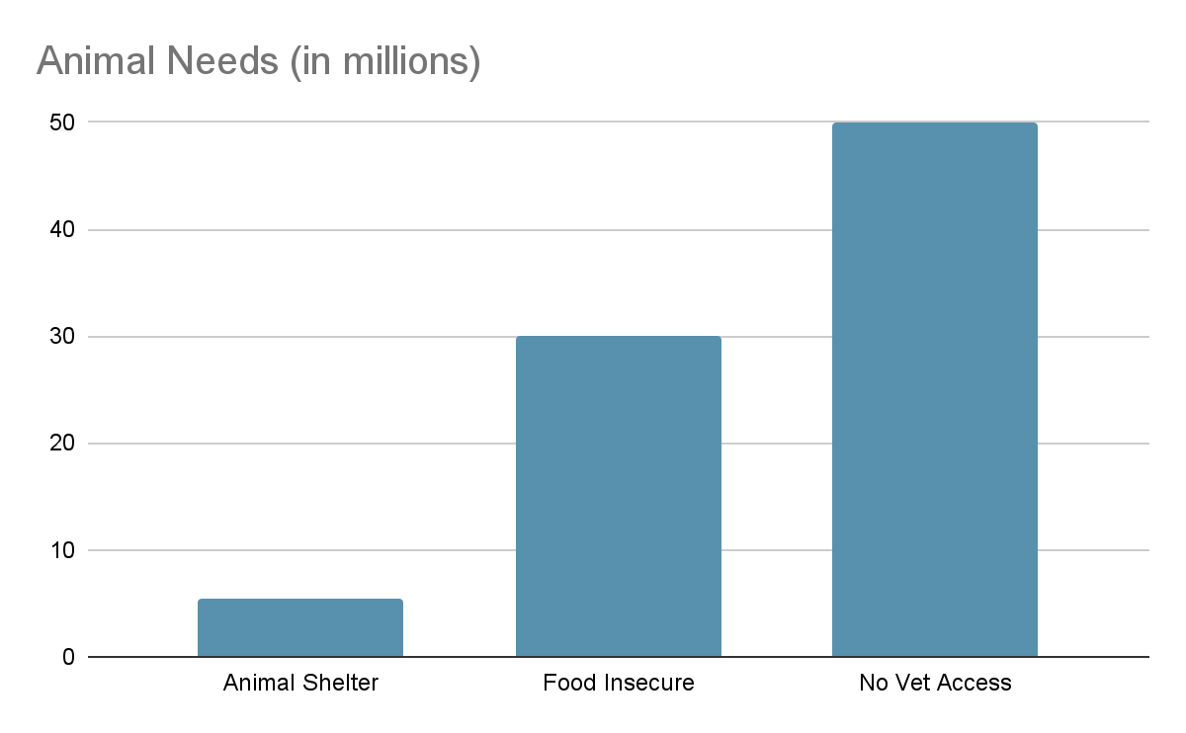
⅓ of animals are in homes with household income under $35,000/year
½ of animals are in home with household income under $50,000/year

Slide 20
Are New England Shelters planning to breed?

Slide 21
Are we concerned about pet acquisition?

Slide 23
Discussion we are having or have had
Do we need to rethink our spay/neuter policies?
Where will people get pets from humane sources if they can’t adopt them from shelters?
Is there something in between adoption and puppy mills that is humane?
Do we need to rethink our relationship with breeders in some way?
Where will families in subsidized housing get dogs they are allowed to have?

