Slide 1
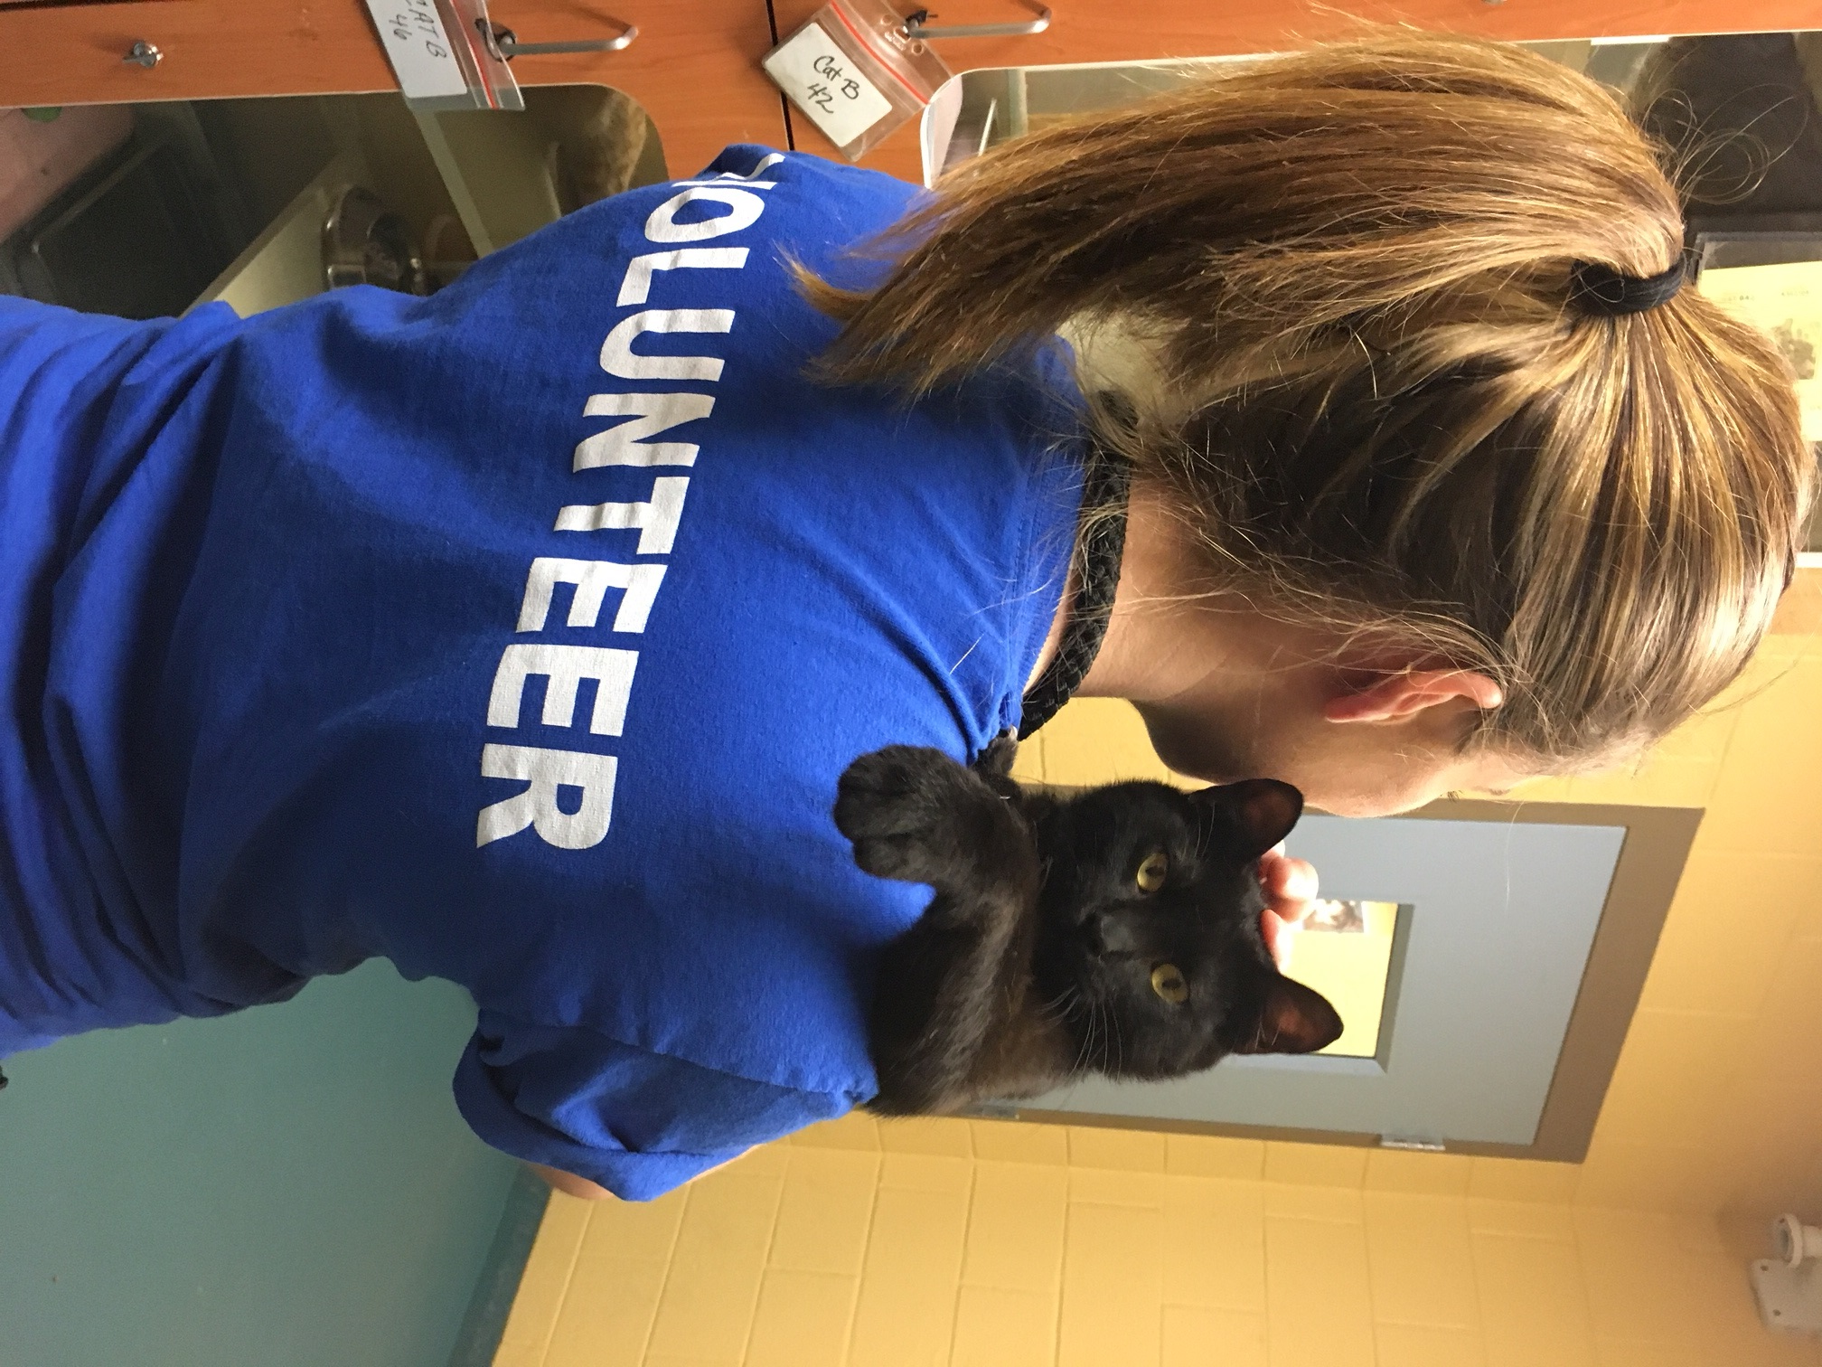
Cat Volunteer
Orientation

Slide 2
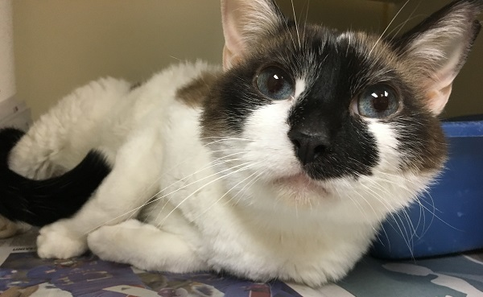
INTRO TO SHELTER CAT HANDLING
It is important to remember that animals in a shelter will not act like the pets in your home. Shelter animals come in to a brand new environment with no familiar smells, people, or noises. It takes time for cats to adjust to new faces, new smells and the new sounds of a shelter with other cats.
Keep these things in mind when handling shelter cats…

Slide 3
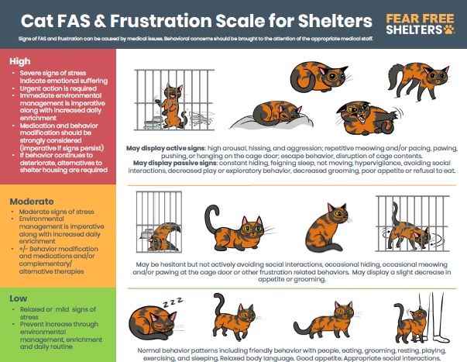

Slide 4
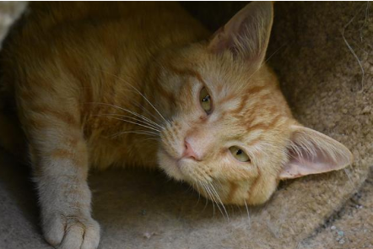
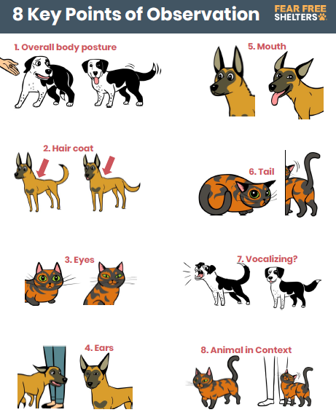
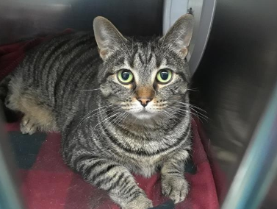
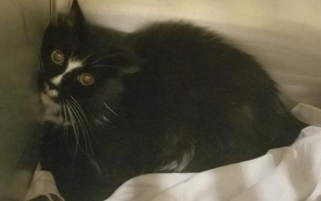
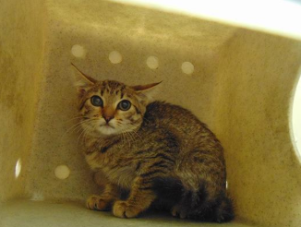

Slide 5
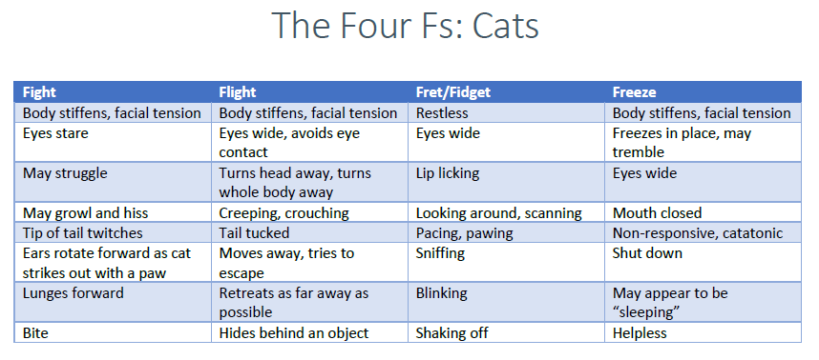

Slide 6
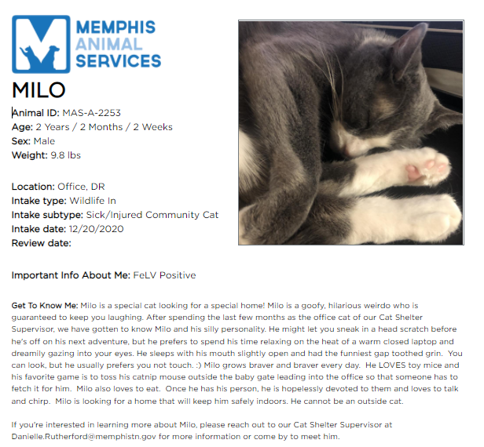
How to Read a Kennel Card

Slide 7
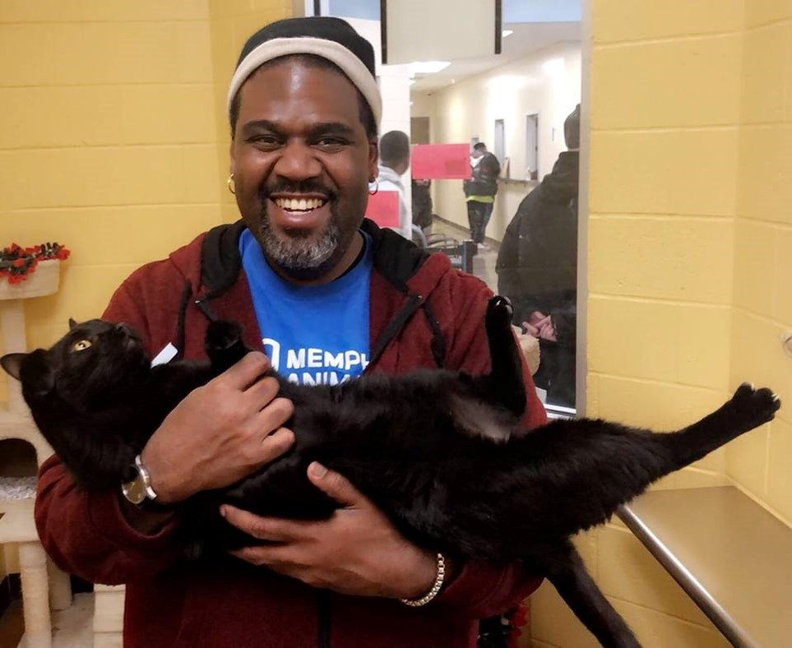
WITHIN KENNELS
Cats in a cage need additional consideration and attention because they can not walk away when they’ve had enough.
Your ability to accurately read the cat’s behavior is crucial to keep them comfortable and you both safe.
1.) OBSERVE the cat in its cage – if it is defensive or frightened, do not attempt to handle the cat
2.) Let the cat adjust to your voice, smell, presence
3.) Open the door to the cage
4.) Extend your knuckles for a cat to smell you
5.) Take a moment to scratch the cat’s head, and ears.
6.) Observe the reaction to continue, or leave while the cat shows the early stages of asking for space.
If the cat is against the back of the cage
- Do not go into the cat’s safe zone, instead allow the cat the option to approach you in the front of the cage
- Do not pick up or try to corner a cat who chooses to remain in the back of their cage

Slide 8
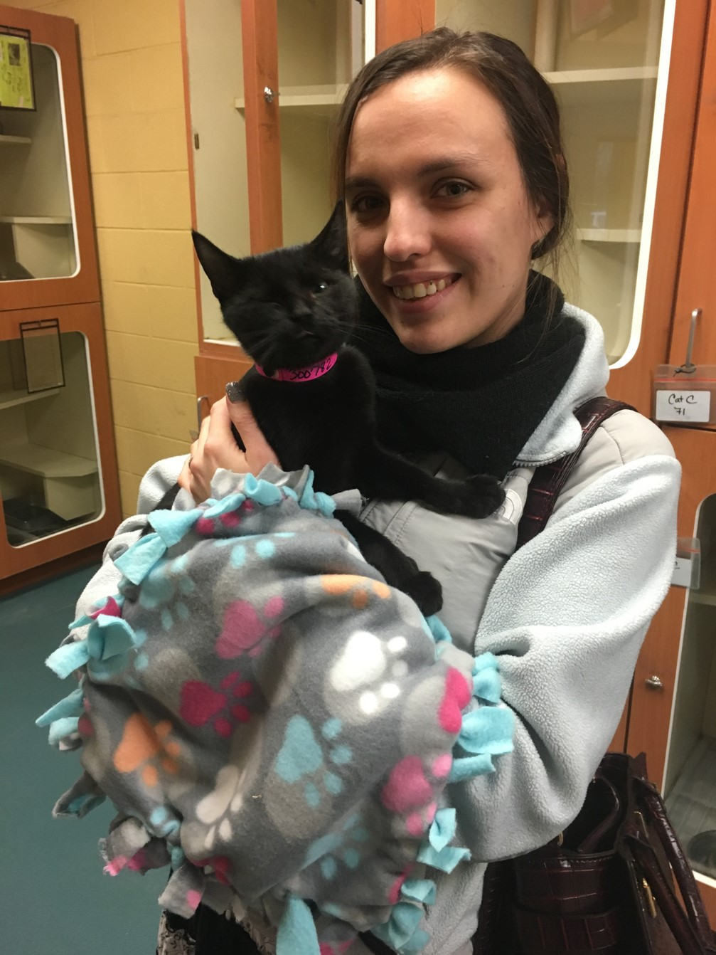
Things to Remember!
Make sure the door to the cat room you are in is closed before opening any cat kennel doors.
Cats will hide under kennels – if you get a cat out of its kennel, it will probably go under the kennels.
Don’t panic!
Calmly inform adopters that a cat is out
Instruct them not to grab the cat themselves
Use treats/toys to try and entice them out
Notify staff if you are unsuccessful
No hugging/kissing - Do not put a cat’s face in your face.
Use sanitizer or wash hands between pets you handle
Only take out one cat at a time unless they are kenneled together
Do NOT handle blue dot cats

Slide 9
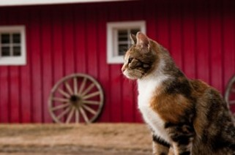
What to do if a bite occurs
Stay calm
Do not attempt to re-kennel
Have all others exit the room
Let others know not to enter the room
Contact a supervisor and the volunteer and outreach specialist

Slide 10
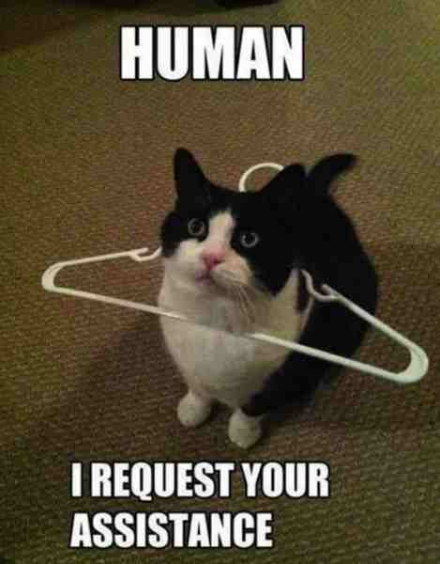
Ways you can help the MAS kitties
Cat enrichment
Photography
Foster program
Kitten Care

Slide 11
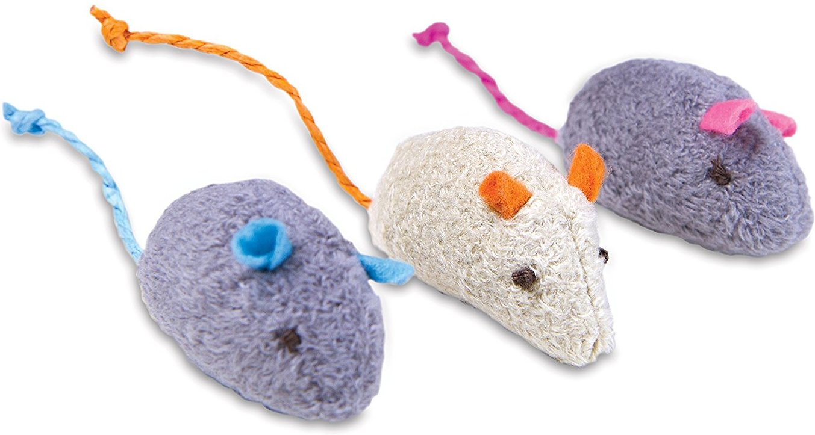
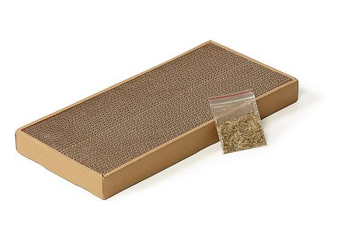
What is Enrichment?
Enrichment, at its most basic level, is a means for meeting the emotional and mental health needs of animals in your care.
HAPPIER
HEALTHIER
MORE ADOPTABLE
CATS!!!

Slide 12
Can you commit to a BI-WEEKLY shift to help our cats?
What does a shift look like?
1.) Sign In!
2.) Complete your Daily Enrichment Task (for 2-4pm shift)
3.) Socialize Cats/Assist Adopters/Take Photos or Bios
4.) Closing Shift Task
- sweep a floor, clear a counter, put up a load of laundry, or refill water bowls
5.) Sign out!

Slide 14
Digital Volunteer Feedback for Cats
Digital Feedback forms can be accessed through the QR code or by the link.
Cat Feedback QR Code
Cat Picture QR Code
http://bit.ly/MASCATFB
http://bit.ly/MASCATPIX

Slide 15
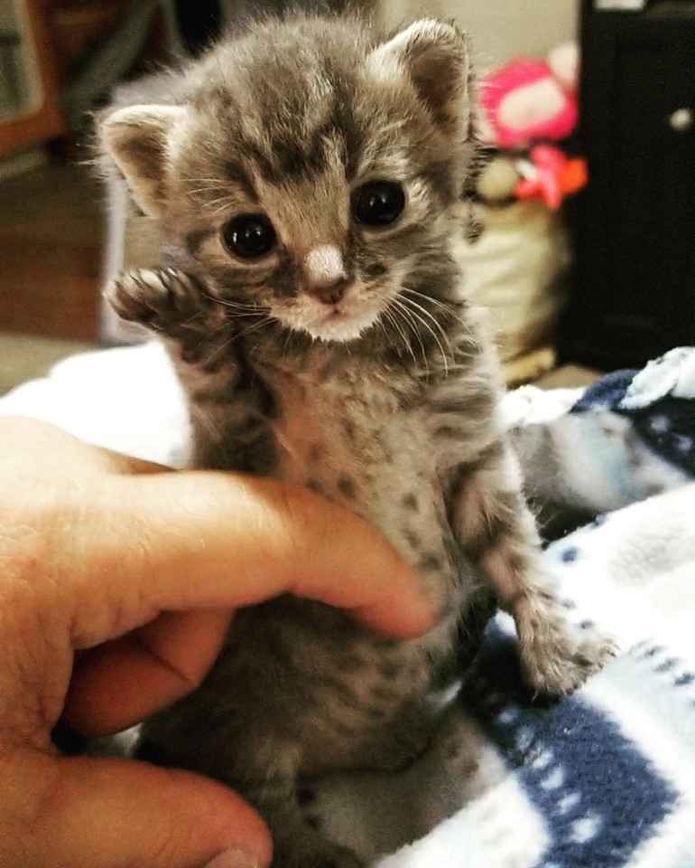
Help our most vulnerable cat population
Foster kittens
Foster medical kitties
Foster long stay cats
Kitten Care
Help with the foster program
Onboarding
Placement
Outreach
Events

Slide 16
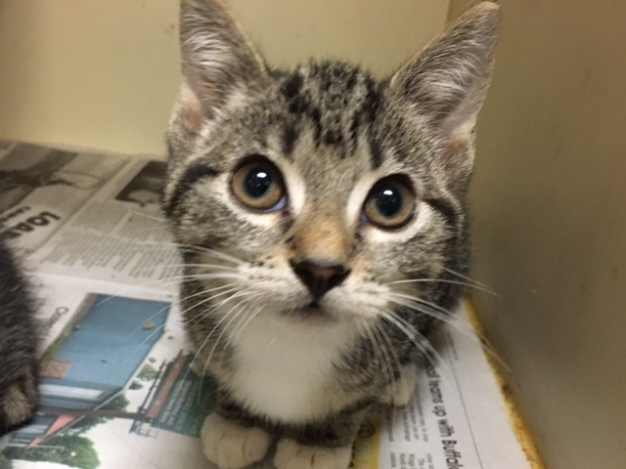
Join our Facebook Group – Search Memphis Animal Services Volunteers
Sign Up for a shift!
HELP CATS!! <3
What’s next?

Slide 17
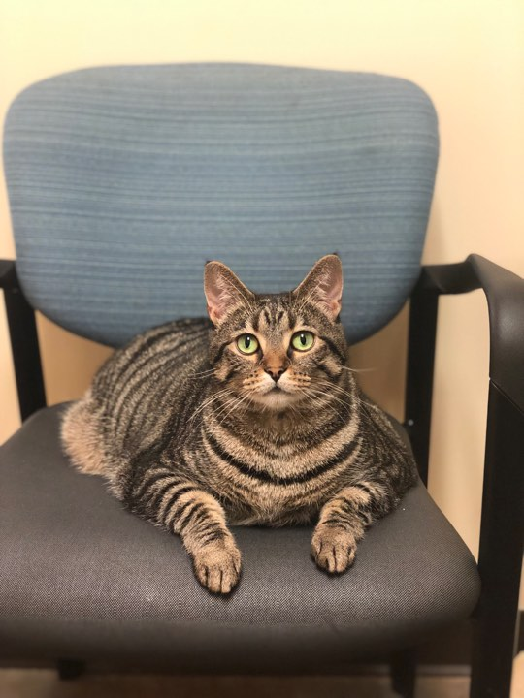
Questions?

