Slide 1
Vision for the Future
Pod 6 - Soaring Penguins
Lauren Hamlett
Courtney Stone
Tanessa Higgs
Raul Rodriguez
Notes:
Lauren Introduction

Slide 2
Topics
Resume Building
Presentation Skills
5 Levels of Leadership

Slide 3
Resume Building
Why is creating a strong resume important?
Employers first impression of you
Highlights your strongest skills and assets
Important element in obtaining an interview
Types of resumes
Chronological
Functional
Combination

Slide 4
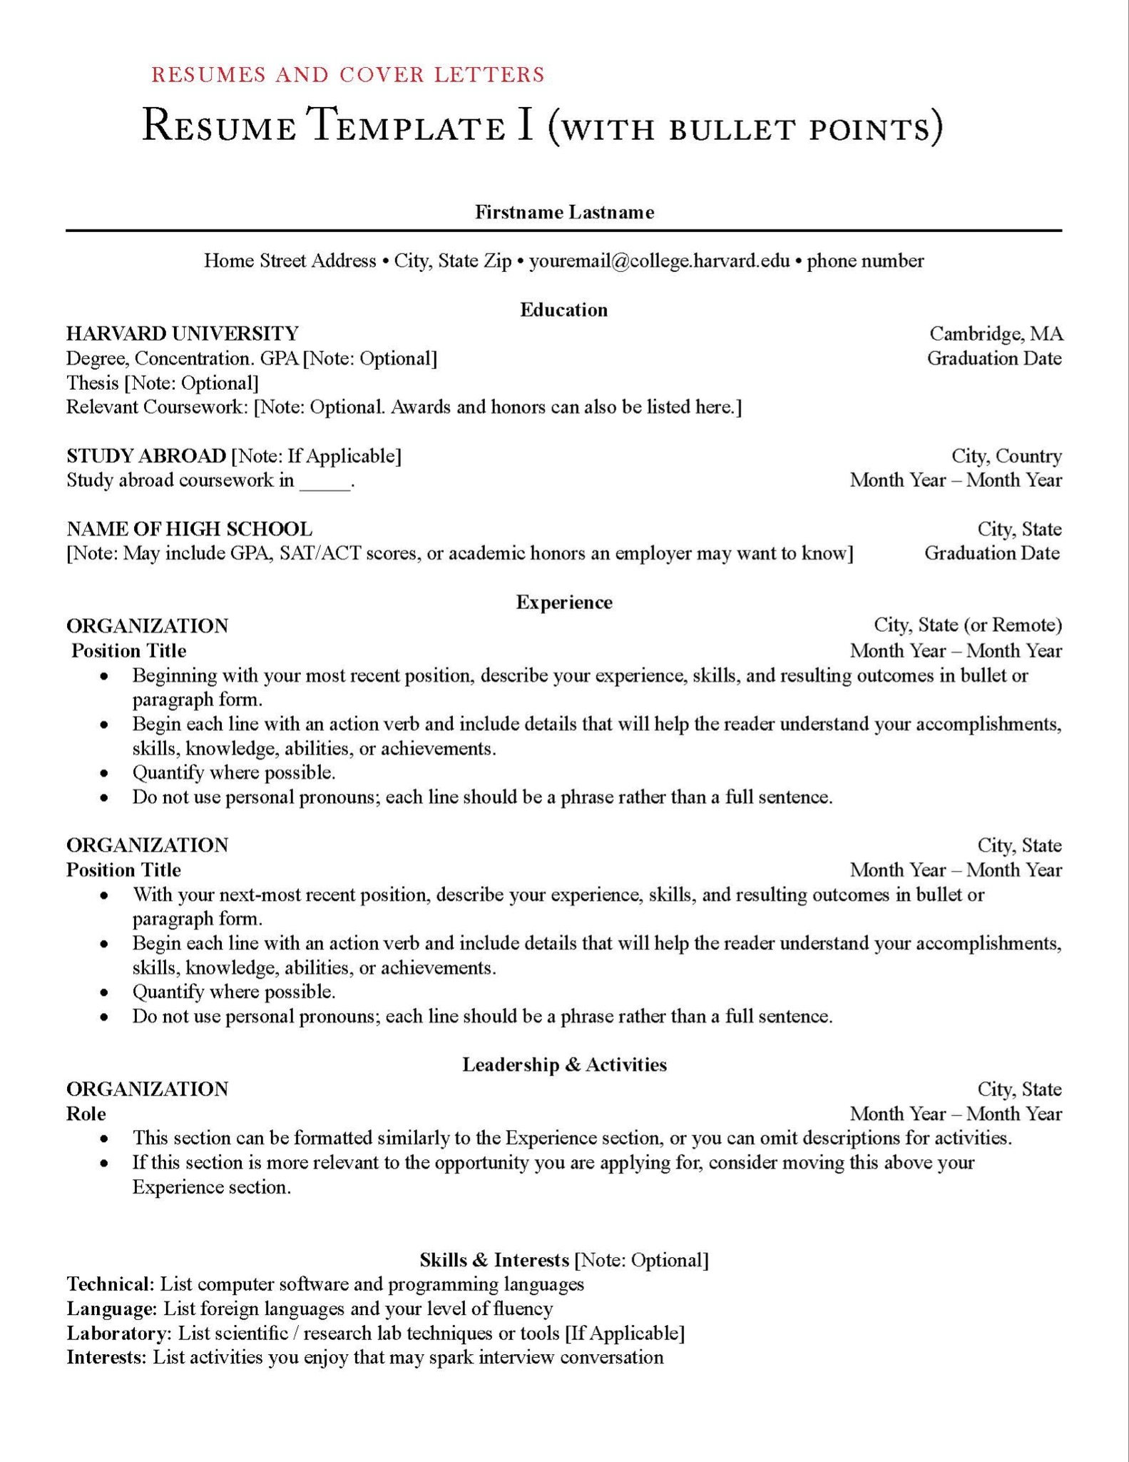
Resume Building
What should a resume consist of?
Name and contact information
Professional history
Company name
Date of tenure
Description of role and achievements
Education
Experiences & Activities
Skills

Slide 5
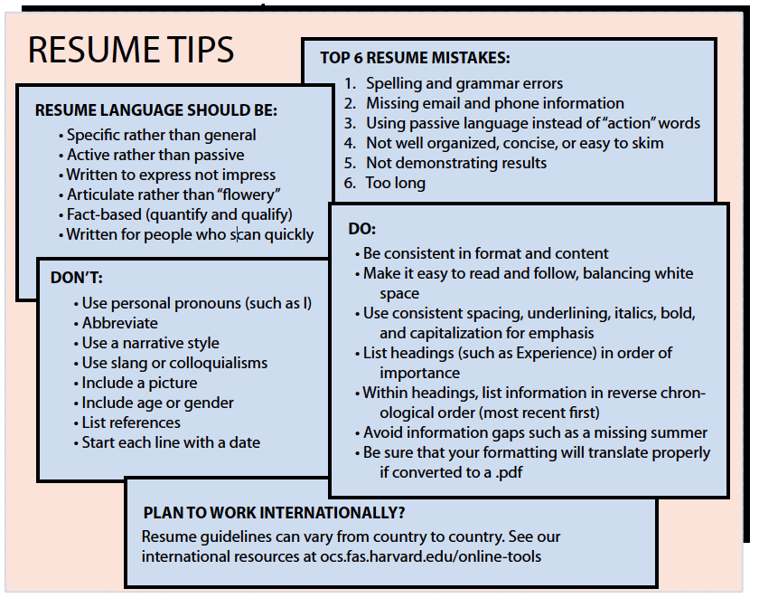
Resume Do’s & Don'ts
Do:
Be only 1-2 pages
List information in reverse chronological order
Make it easy to read and follow
Use active language and be specific
Use professional font
Be consistent in format
Spell check
Don’t:
Use personal pronouns
Be general in descriptions or use passive language
Use slang or a narrative style
Be too lengthy
List references (provide references upon request instead)

Slide 6
Presentation Skills
Why are they important?
The 4 P’s
Plan
Prepare
Practice
Present/perform
Glossophobia

Slide 7
Why are they important?
Individual success
Business/organization success
Stress reducer
Better communicator
Time Management
Leadership

Slide 8
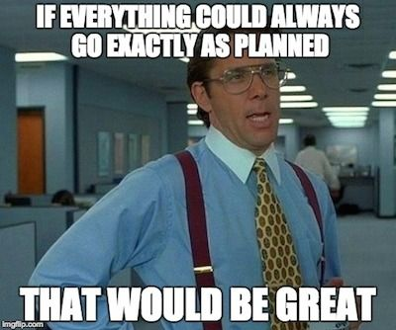
Plan
Brainstorm
Who is your audience?
What is the purpose of the presentation?
What do you want do you want the audience to take away?
How long will the presentation be?

Slide 9
Prepare
Structure
Introduction →Grabs the audience attention
Content → information relevant to the topic
Conclusion → Key message, takeaways
Questions → Leave time to answer questions
Prompt
Bullet points, Keys words, talking points
Help guide you through the presentation
Visual Aids
Use colors, graphs, pictures, clip art
Limit the bullet points per slide 3-7
Don’t over crowd

Slide 10
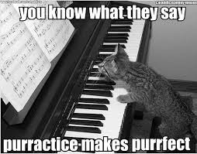
Practice, Practice, Practice

Slide 11
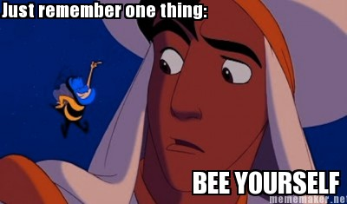
Perform
Show your passion
Make eye contact
Smile (subject appropriate)
Be honest, genuine, be yourself
Tell stories
Tone of voice
Body language

Slide 12
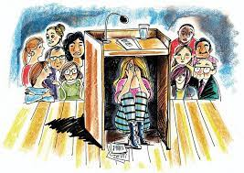
Glossophobia
75% of people have a fear of public speaking
Helpful tips when presenting
Know Your Subject
Be Organized
Practice
Think Positive

Slide 13
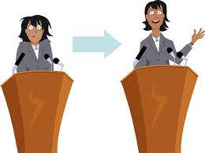
Glossophobia ctd.
Take Deep Breaths
Focus on the Material, Not the Audience
A Moment of Silence
Recognize Your Success

Slide 14
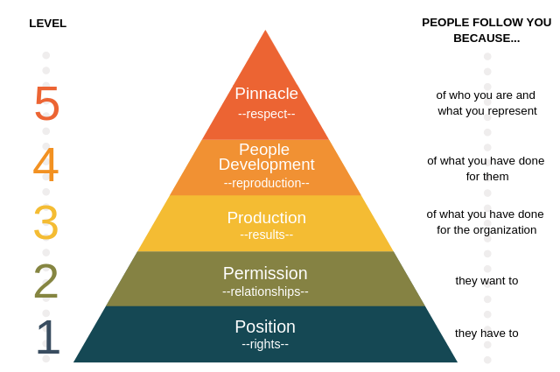
The 5 Levels of Leadership

Slide 15
The 5 Levels of Leadership
Level 1 - Position (Rights)
People follow because they have to
Upside: It gives you an opportunity to lead
Downside: People will give you little effort and low energy

Slide 16
The 5 Levels of Leadership
Level 2 - Permission (Relationships)
People follow because they want to
People give you their energy - their time - their heart
People don’t care how much you know - ‘till they know how much you care
To be effective: Listen / Learn / Lead - Observe - Serve

Slide 17
The 5 Levels of Leadership
Level 3 - Production (Results)
People follow because of what you have done for the organization
The leader creates credibility by bringing results
Credibility comes from Success
Lead by example - Creates Momentum - Attracts better people

Slide 18
The 5 Levels of Leadership
Level 4 - People Development (Reproduction)
People follow because of what you have done for them
When you start developing people - you make the people better
Recruitment - Position people well - Equip people well
5 steps to equip people well:
I do it
I do it & you are with me
You do it and I’m with you
You do it
You do it and someone is with you

Slide 19
The 5 Levels of Leadership
Level 5 - Pinnacle (Respect)
People follow because of who you are and what you represent

Slide 20
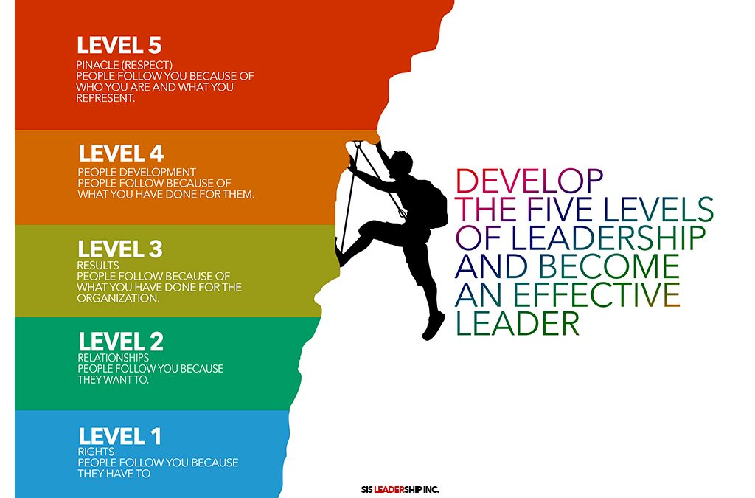
The 5 Levels of Leadership

Slide 21
Resources
Leadership
Leadership Program - UC Davis Graduate School of Management
Associate of Animal Welfare Advancement - MindEdge; Certificate in Leadership
Resumes
Resumes & Cover Letters - Harvard Office of Career Services 2020
Presentation Skills
Why Are Presentation Skills Important? George Torok executive speech coach. May 27, 2015 https://www.linkedin.com/pulse/why-presentation-skills-important-george-torok
Fear of public speaking: How I overcome it. Craig N Sawchuk, PH.D.,L.P. May 17, 2017
https://www.mayoclinic.org/diseases-conditions/specific-phobias/expert-answers/fear-of-public-speaking/faq-20058416
Top tips for Effective Presentations https://www.skillsyouneed.com/present/presentation-tips.html

Slide 22
Questions?
Courtney Stone - Wallis Annenberg PetSpace
cstone@annenbergpetspace.org
Lauren Hamlett - Pasadena Humane
lhamlett07@gmail.com
Raul Rodriguez - Los Angeles Department of Animal Care and Control
rrodriguez@animalcare.lacounty.gov
Tanessa Higgs - San Diego Humane Society
thiggs@sdhumane.org

