Slide 1
Bringing people and pets together for over 100 years!
Sensory Friendly Bags

Slide 2
Introductions
Alex Levine Clardy
(She/her/hers)

Slide 3
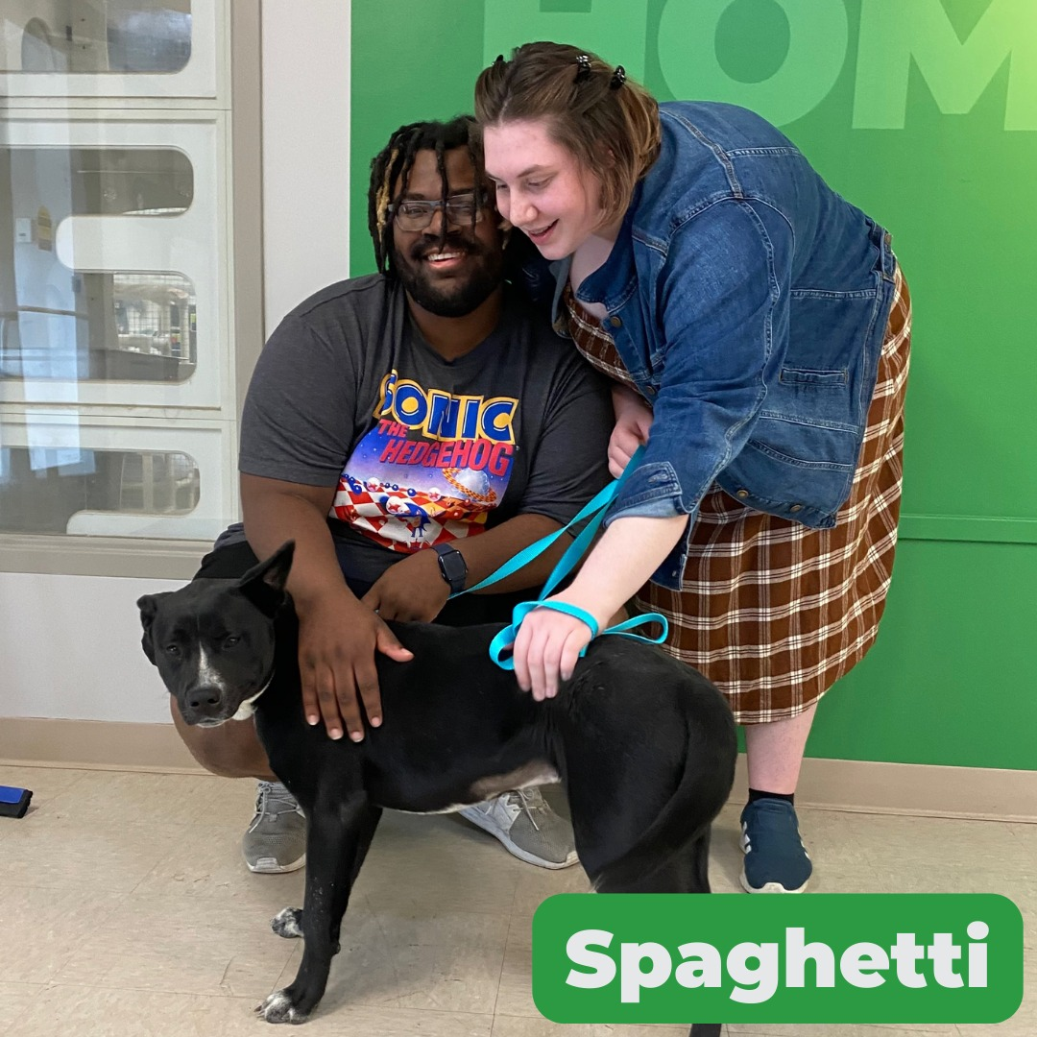
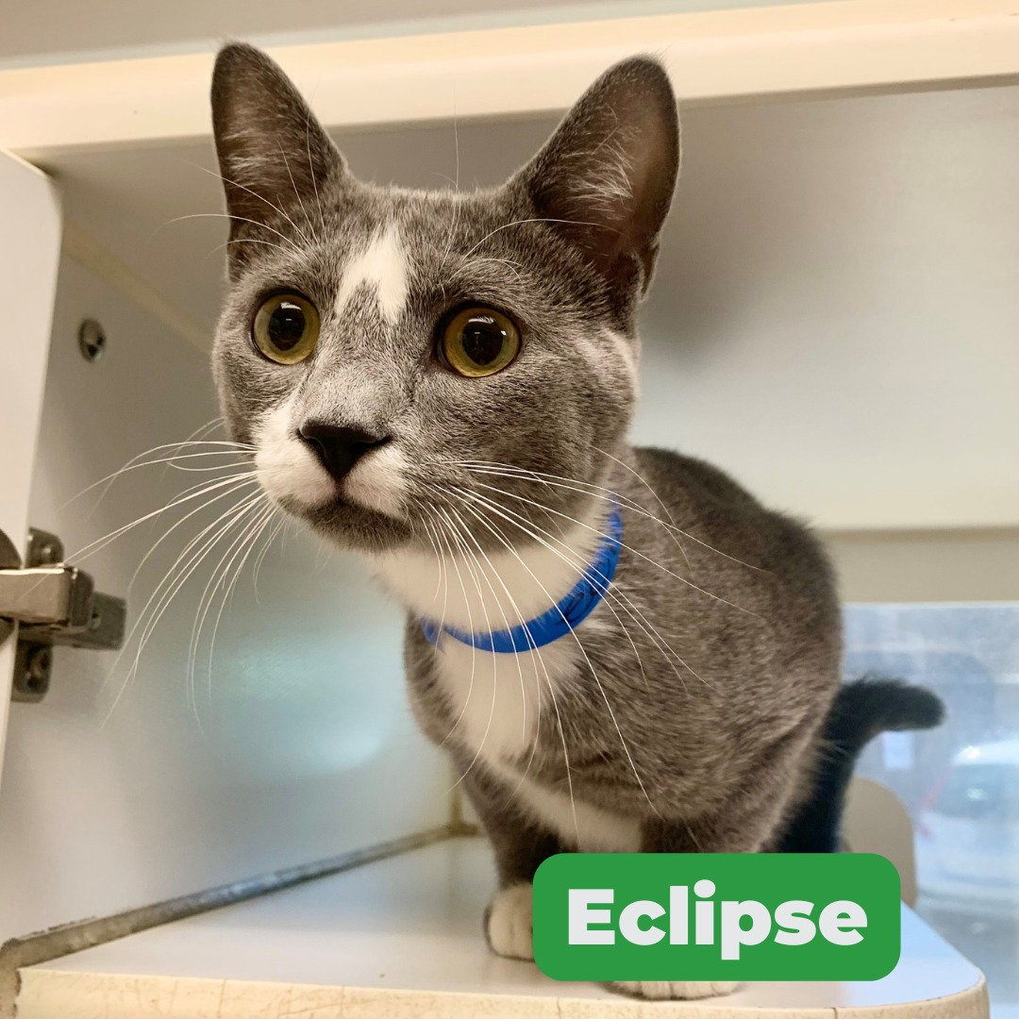
Objectives
APA’s Commitment to DEI
Certification Process
Implementation at Shelter(s)
Questions/Answers

Slide 4
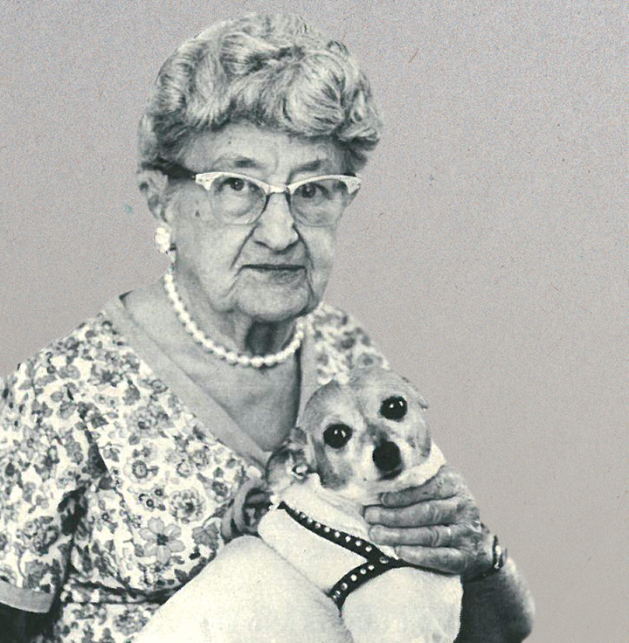
The APA’s Commitment to DEI
The APA strives to create an inclusive, diverse, and equitable workplace for all employees, volunteers, and community members. We know across the country, animal welfare is lacking in diversity. Several animal welfare organizations are working to change that, including us.
The APA’s work is intentional and ongoing.

Slide 5
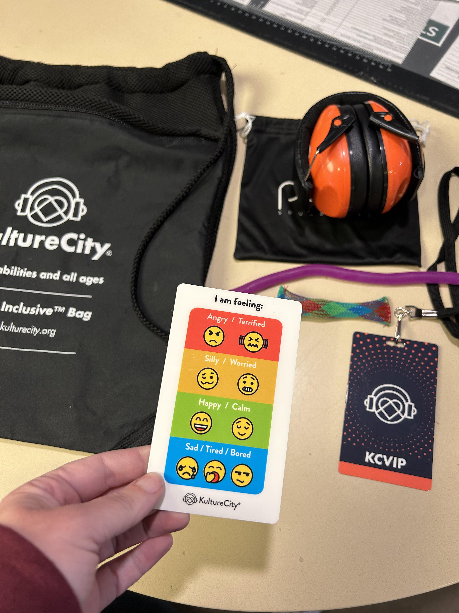
Certification Process
KultureCity partnership
https://www.kulturecity.org/sensory-bags/
Requirements and expectations
Minimum of 50% of staff complete training
KultureCity App – Sensory friendly place of business
Low-cost annual commitment
Thank you Maddie’s Fund!
What’s included in each bag?

Slide 6
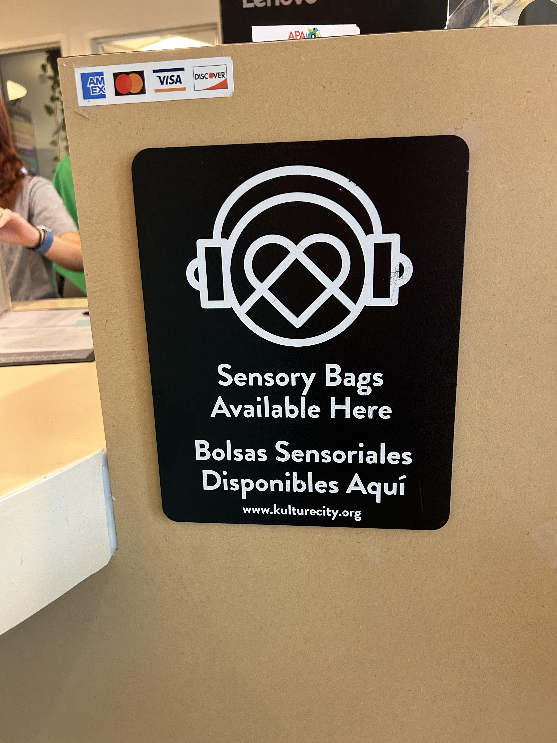
Implementation at both APA locations:
Signage placed strategically around both APA Adoption Centers
- Meet and greet rooms
- Dog kennels
- Adoption desk
APA Tuesday Tales
- One day designated per month
APA Summer Camps
Sensory-friendly adoption process

Slide 7
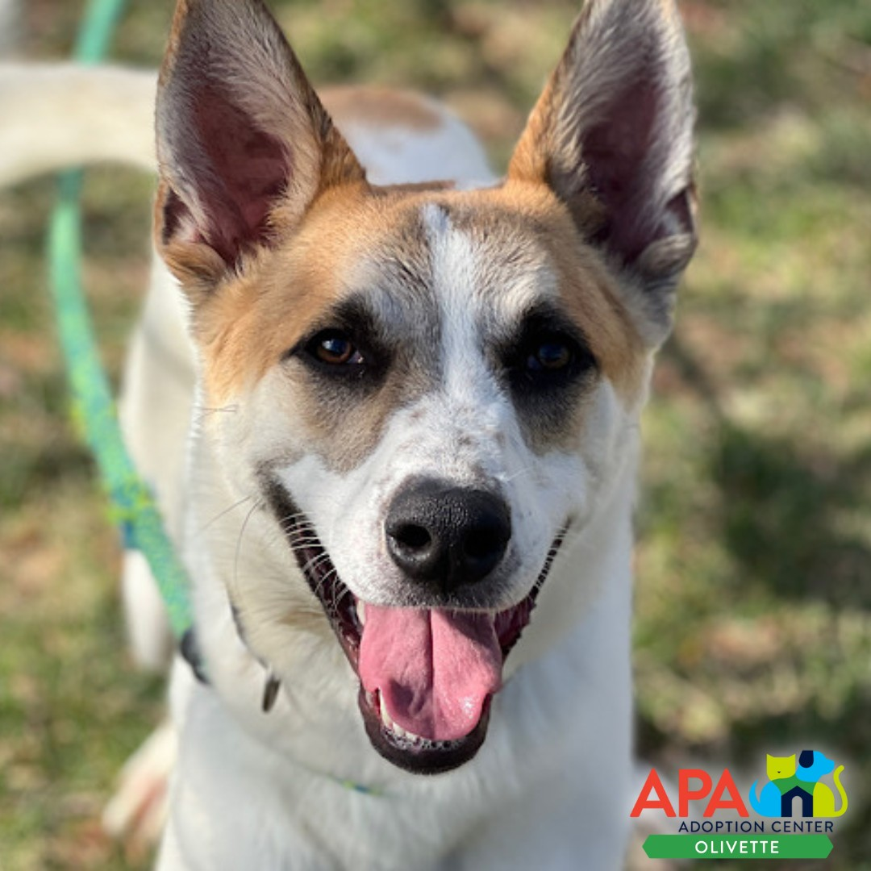
Questions?

Slide 8
THANK YOU!
Alex Levine Clardy Alex@apamo.org 314-645-4610, ext 134

