Slide 1
Principals of Financial Management
How Collaborative Connections Influence Financial Management

Slide 2
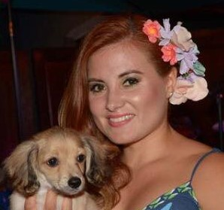
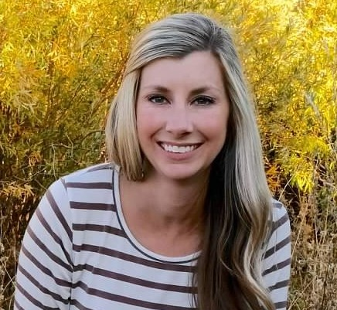
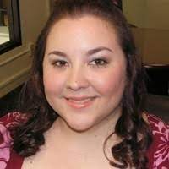
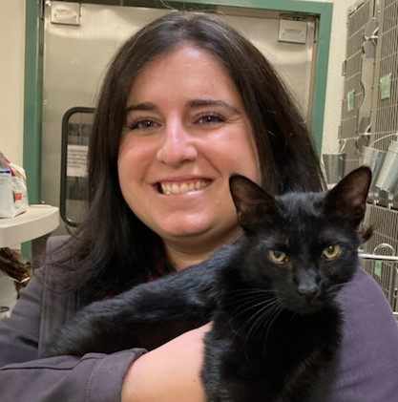
Our Team
Emma Perez-Singh
Erin Ellis
Laura Mullen, CAWA
Riverside County Animal Services
Veterinary Services, Community Support & Homeless Outreach Operations Manager
Humane Society of Truckee-Tahoe
Community Engagement Director
San Francisco SPCA
Shelter Medicine Outreach Programs Manager
Lisa Hammock
Jessica Wiebe
East Bay SPCA
Shelter Manager
Santa Barbara County Animal Services
Community Programs Manager

Slide 3
Collaborative Connections
=
Community Engagement
Community engagement is involving your community in as many ways as possible through raising awareness, engaging volunteers, keeping a proactive approach and most importantly, through education to promote care and protection for pets and their people. Through engagement, people adopt, spay/neuter their pets, volunteer their time, donate financially and spread awareness within their network.

Slide 4
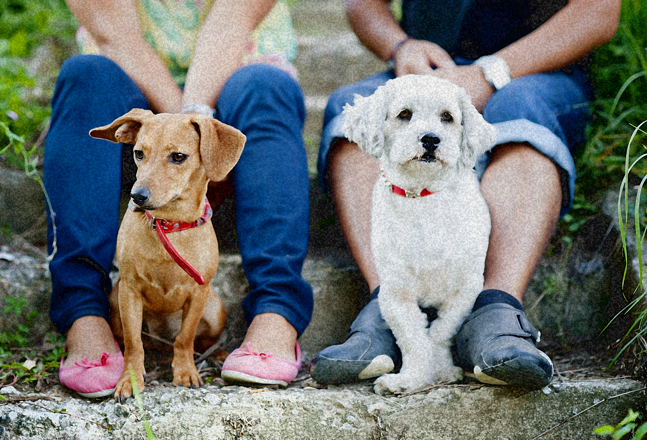
Partnerships play a vital role in every sector of animal welfare

Slide 5
It Takes a Village!
Inclusivity
Financial Sustainability
Finding ways to include all aspects of your community helps us fully serve the needs of their community. If we want people to adopt , support financially and get involved, shelters and rescues must become more inclusive and welcoming to all types of people and the varied lives they lead
It is important that we not only continue to look for new funding sources, but that we nurture and cultivate relationships with current financial and in-kind supporters, taxpayers, elected and government officials, board of directors, individuals with bequests and investments with long term goals in mind
Building Programs
Community Trust
If your shelter is aware of the needs of the communities served, you can provide important programs that help fulfill your mission. Programs can include: Spay/neuter programs, vaccine clinics, medical assistance, community cat program, pet food programs
In order to build community trust, your organization needs to exhibit humility and vulnerability, organizational transparency, ask questions with genuine interest and curiosity, take the time to get to know your community, share important vital information and gather input from all groups within the communities you serve
Education
Community Partnerships
Use every opportunity you have to educate! The more your community knows about your mission and operations the more they are willing to support you financially
Business partnerships, shelter tours, speaking engagements, PR opportunities

Slide 6
Municipal Funding
FY 20-21 Santa Barbara County Budget

Slide 7
Municipal Agency Funding
01
02
03
Budgeting
Property Taxes
Program Fees
Municipal agencies rely on government budgets to disperse funds
Property taxes fund important programs and services for Animal Control/Service departments
There are numerous fees that community members pay for that help generate funds

Slide 8
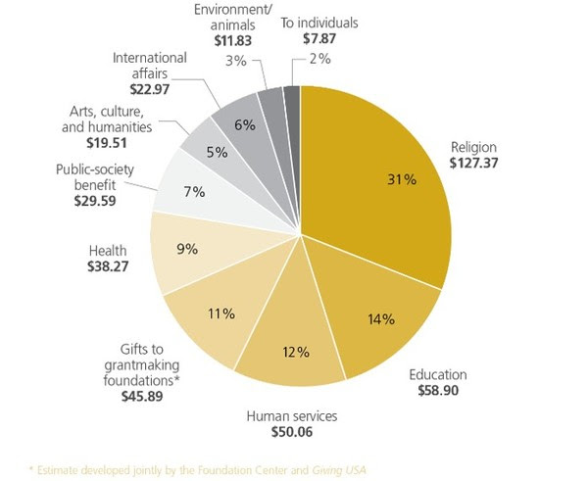
Nonprofit Funding
US Annual Donor Giving
*Estimate developed jointly by the Foundation Center and Giving USA

Slide 9
Nonprofit Agency Funding
01
02
03
Grants
Events & Programs
Donor Support
Many nonprofits write a number of grants each year to fund certain vital programs/services
Events and programs are important for two reasons: raising funds and raising community awareness while providing vital services
Nonprofit orgs are run 100% on donations. Nonprofits rely on individual donations as well as business partnerships and fundraising opportunities to raise funds

Slide 10
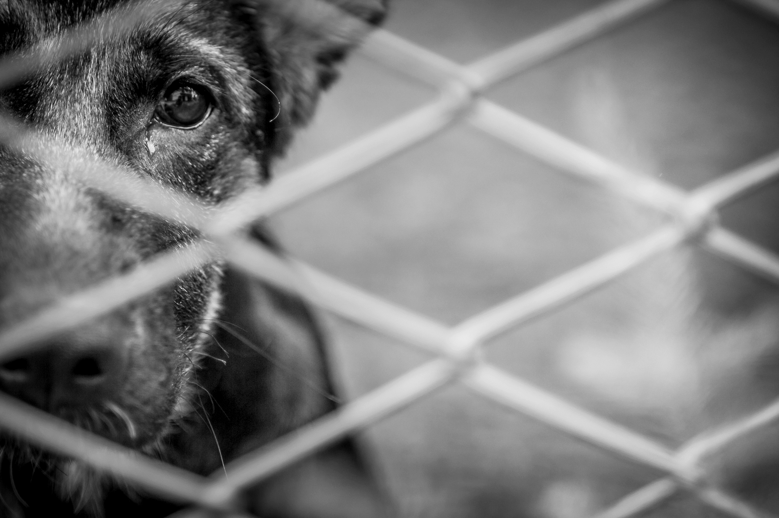
Challenges
Constant Changes
Relationships = Work
Animal welfare is a very fluid field, but our budgets aren’t. With changes that happen constantly, it can be challenging to keep our budgets in line with those changes
(i.e. keeping pets out of shelters).
Just like any relationship, it takes constant work. In a field where most staff are already stretched thin, keeping those important relationships healthy can be challenging, especially when time and money are not always on our side.
Standard of Care
Allocation of Resources
Unlike human standards of care, animal welfare does not have any minimum standard of care that is established across the board. It can make funding challenging when organizations have to create this on their own.
We are constantly relying on heroics when it comes to funding. Most of us in animal welfare have to work on funding constantly since it’s never a guarantee year after year. We can lose a donor or contract, etc. at any time.

Slide 11
Personal Development Strategies
Get involved! Look into different professional organizations
i.e. CalAnimals, HSUS, American Pets Alive
Join or present to different community based organizations
i.e. Rotary Clubs, Chamber of Commerce, Schools, etc.
Look for a mentor – Identify someone in your field that can become a mentor to provide you with support and professional/personal growth and development
Know who your local community leaders are and cultivate relationships with them
Take advantage of professional development opportunities
i.e. CAWA, Maddie’s Fund staff development, NACA, etc.
Ask about how to get involved in the budget process or ask to sit in during finance meetings

Slide 12
Further Resources
Websites:
Fundamentals for the 21st Century Grant Seeker (maddiesfund.org)
https://www.countyofsb.org/hr/organizational-and-talent-development.sbc
https://learning.theaawa.org/cawa
Books:
Nonprofit Financial Management: A Practical Guide, by Charles K Coe
Achieving Excellence in Fundraising (Second Edition), by Henry “Hank” Rosso
Good to Great for the Social Sector, by Jim Collins
Solving the People Problem, by Brett M. Cooper and Evans Kerrigan

Slide 13
THANK YOU
Emma Perez-Singh
emmasingh@rivco.org https://www.rcdas.org
Erin Ellis
erin@hstt.org
https://www.hstt.org
Lisa Hammock
lhammock@eastbayspca.org https://eastbayspca.org
Jessica Ortega-Wiebe
jessicaortegawiebe@sbcphd.org
https://www.countyofsb.org
Laura Mullen, CAWA
lmullen@sfspca.org
https://www.sfspca.org

