Slide 1
(Internal) Foster Pleas
Kelly Duer, Foster Care Specialist, Maddie’s Fund

Slide 2
Internal vs. external foster pleas
Internal
Audience: fosters who have already been onboarded
Lead with the good stuff!
Divulge important information on a continuum
External
Audience: general public
Lead with the good stuff!
Avoid mixing adoption counseling & marketing

Slide 3
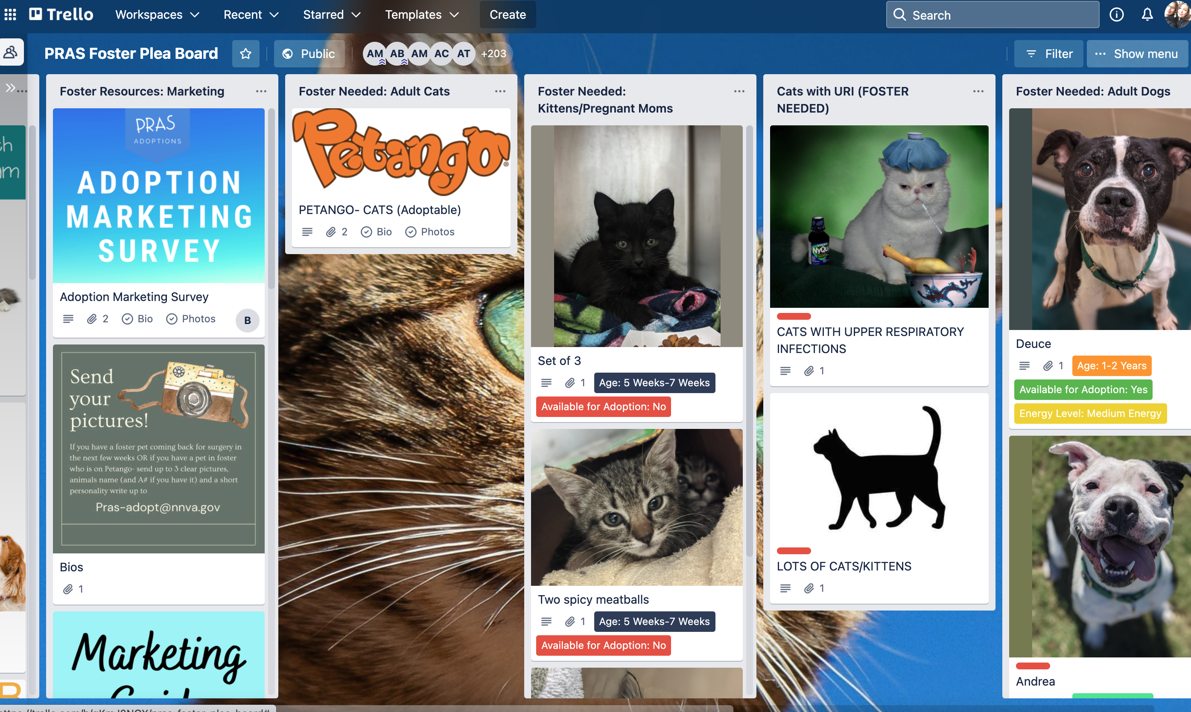
Types of internal foster pleas
Email
Regular email or Constant Contact, MailChimp, etc.
Private social media group
Trello, ClickUp, etc.
Website
Word of mouth
Text
Call
In-person ask
1-on-1 matchmaking
Foster-on-Deck
???

Slide 4
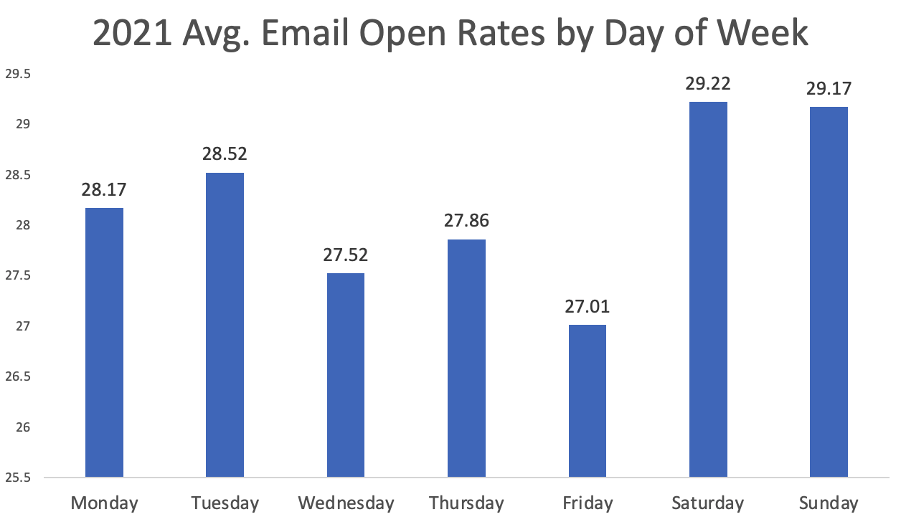
Email pleas
47% of emails are opened on mobile devices
Industry-wide open rate is ~21%
Most emails opened on weekends
Your subject line is VERY important
Notes:
Data from APA!’s Dog Foster Program

Slide 5
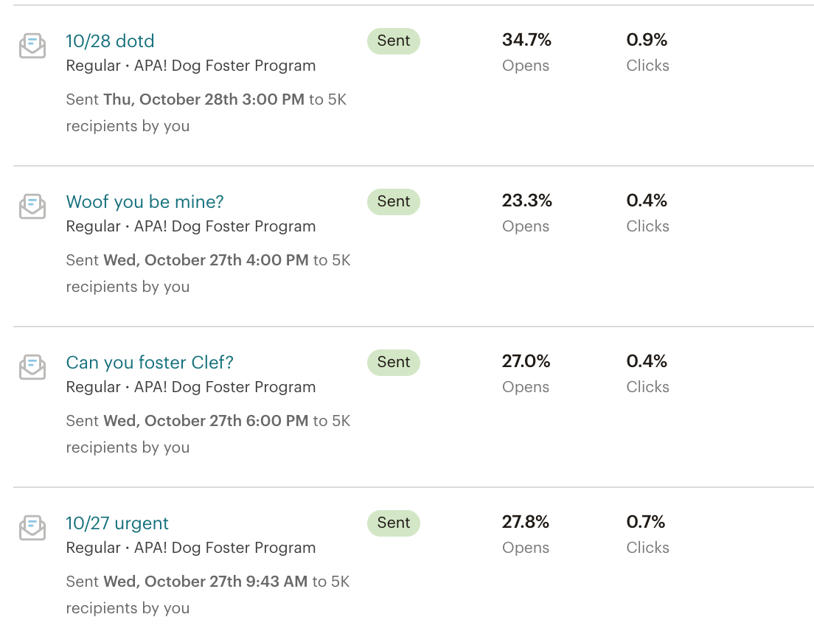
MailChimp & Constant Contact
Segment your audience
Present information in an eye-catching way
Mobile-friendly
It’s not awkward for people to unsubscribe
DATA

Slide 6
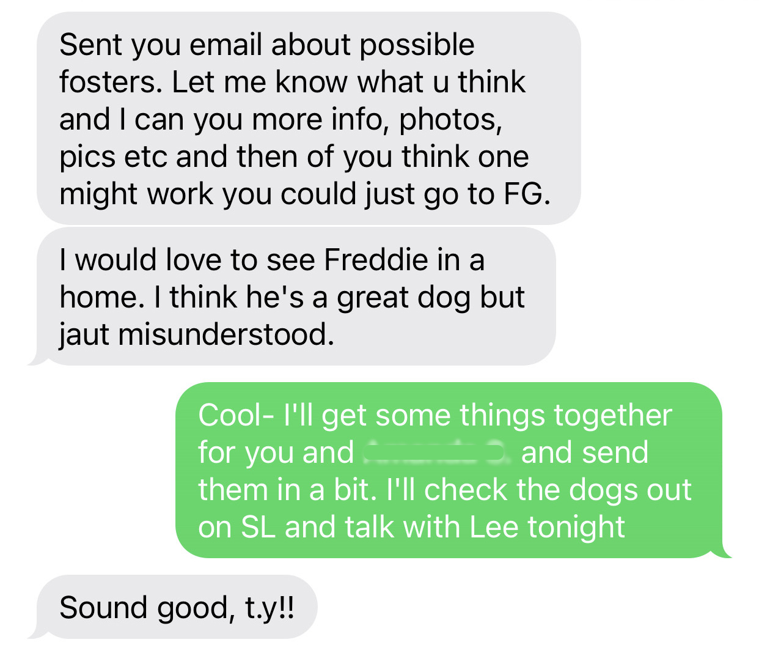
The personal touch
Research on persuasion: Face-to-face is more effective than email
70% vs. 10%
Many foster coordinators are reporting success with texting 1-on-1

Slide 7
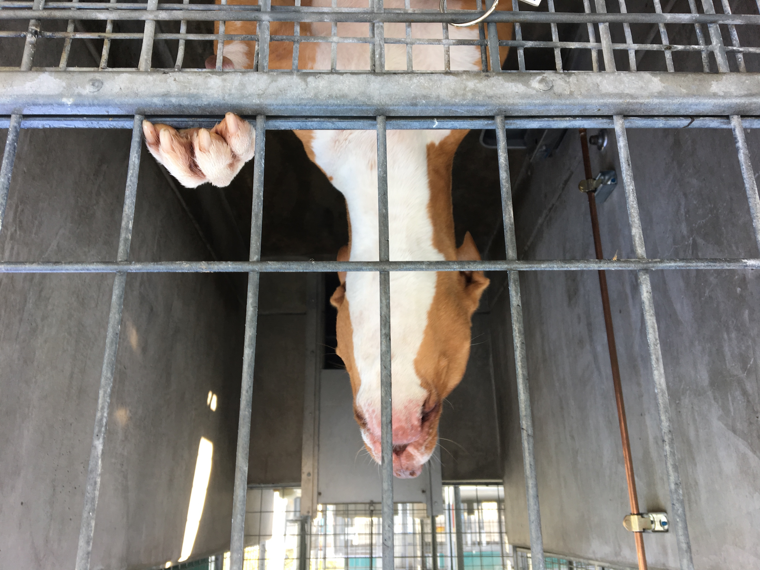
Pleas for pets who are harder to place
Think outside the box.
Individual matchmaking or 1-on-1 asks seem to work well
Get more information about how they act outside the kennel
Short-term foster
Office pet
Make foster VIP

