Slide 1
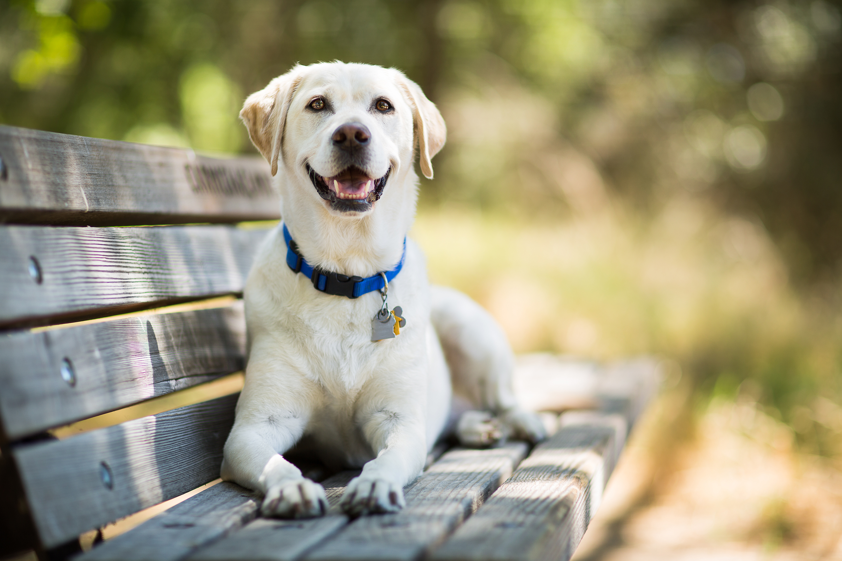
Return to Home

Slide 2
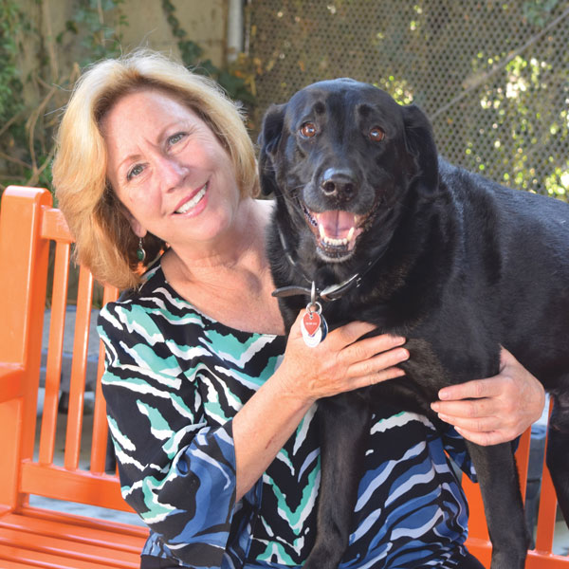
Hello!
Gina Knepp National Shelter Engagement Director
g.knepp@foundanimals.org
916-230-4533

Slide 3
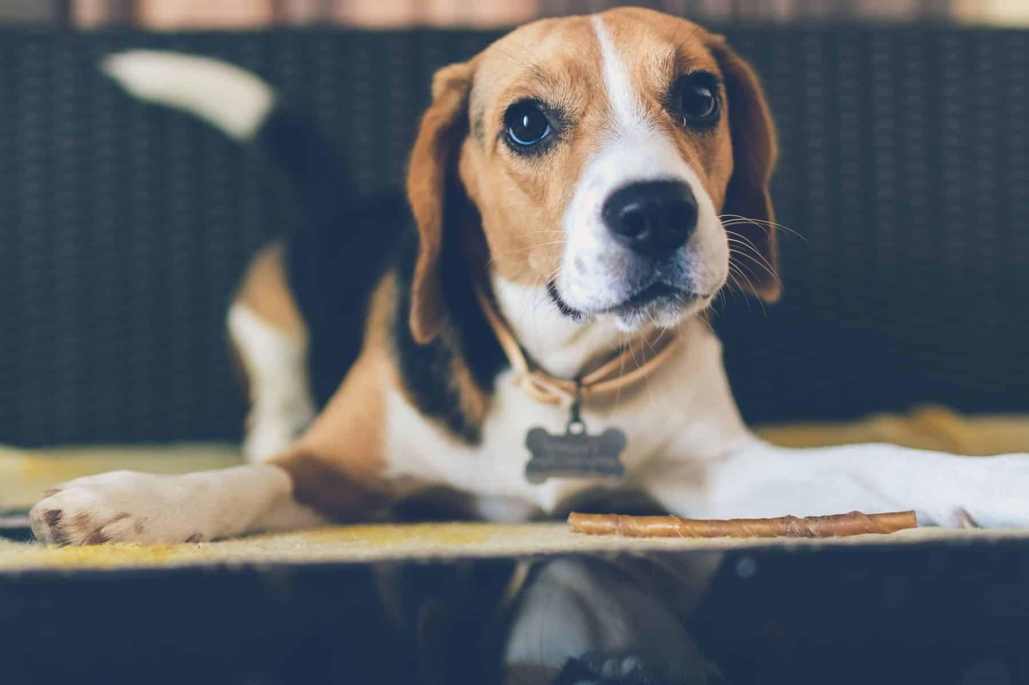
RTH – Why is it important?
Demonstrates our commitment to the human animal bond
Decreases length of stay
Improves customer satisfaction
Minimizes the number of animals in the shelter
Enhances morale within the shelter
Saves money
Reduces intake
Allows us to focus more on the animals that need us most
A great way to involve volunteers
It’s the right thing to do
.

Slide 4
RTH to do list:
Culture
Website: Clear, thorough, actionable, friendly
Prevention: Tag and chip
Technology
Lost/Found reports: public facing
Marketing the pet ID –a lot
Field Services – let them be amazing
Data (and more data)
Let the community help you
Utilize volunteers
Model the behavior we want to see

Slide 5
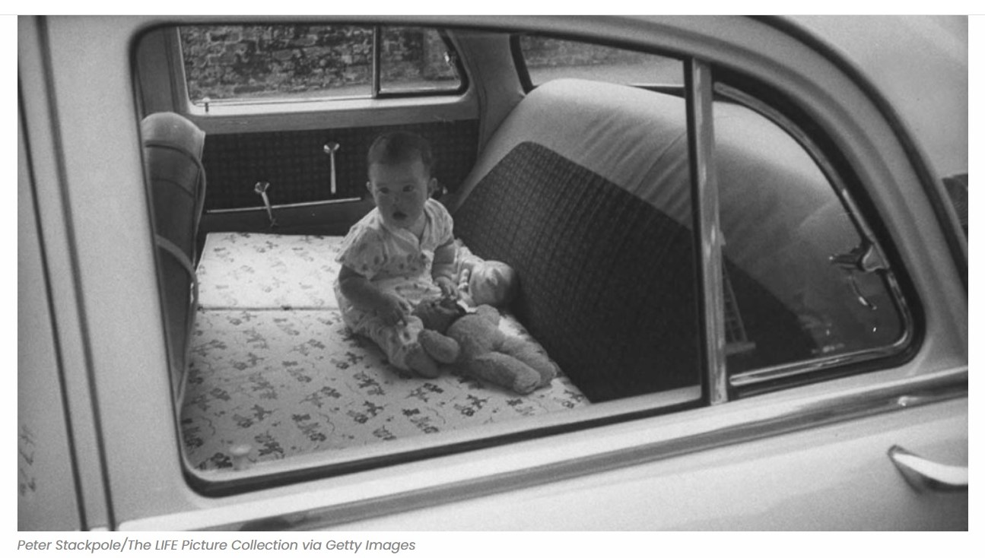

Slide 6
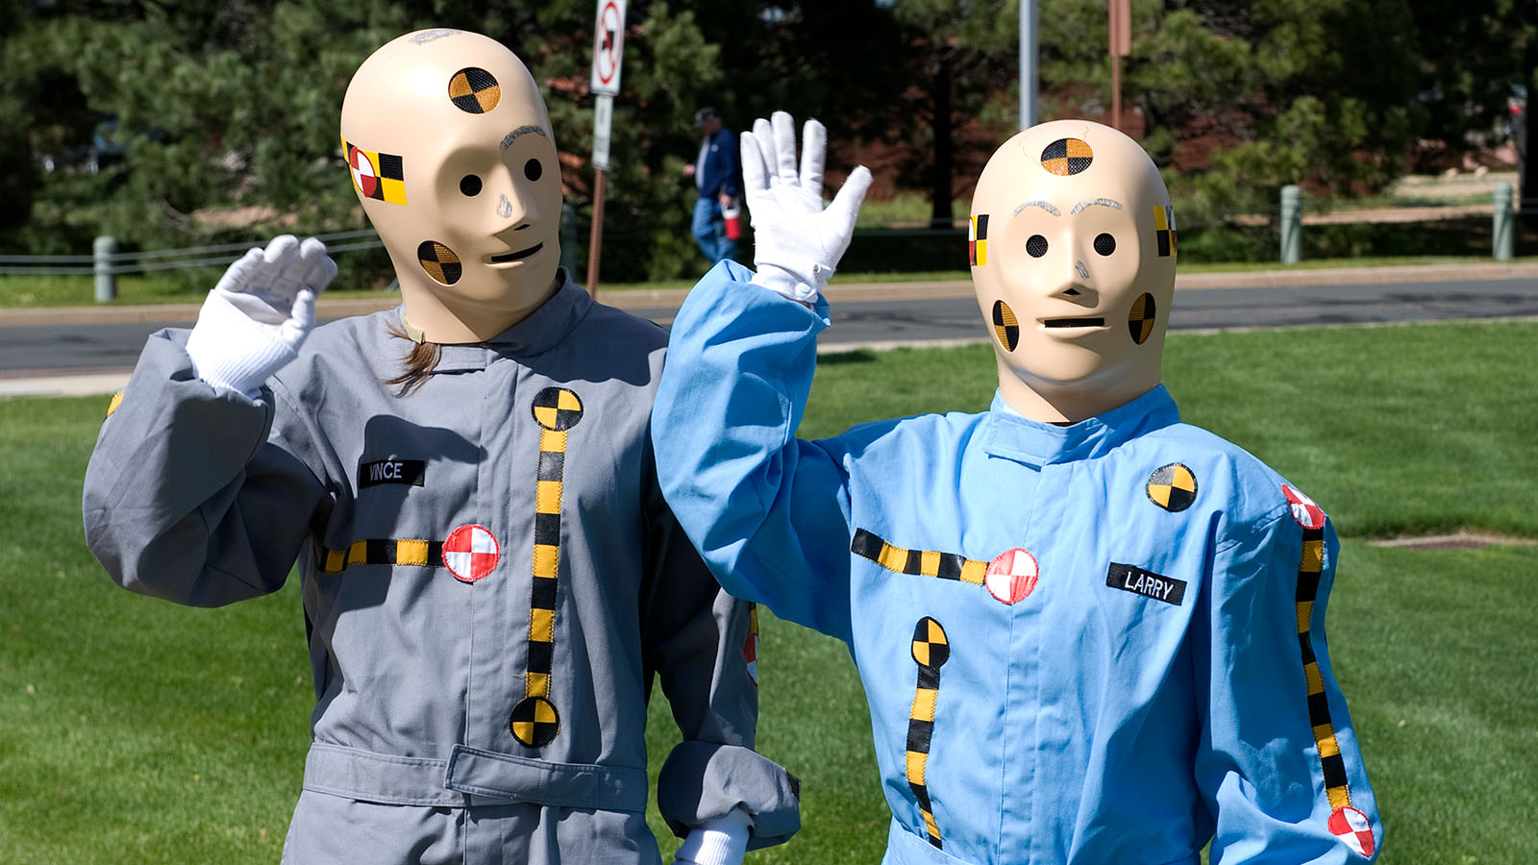
Vince and Larry

Slide 7
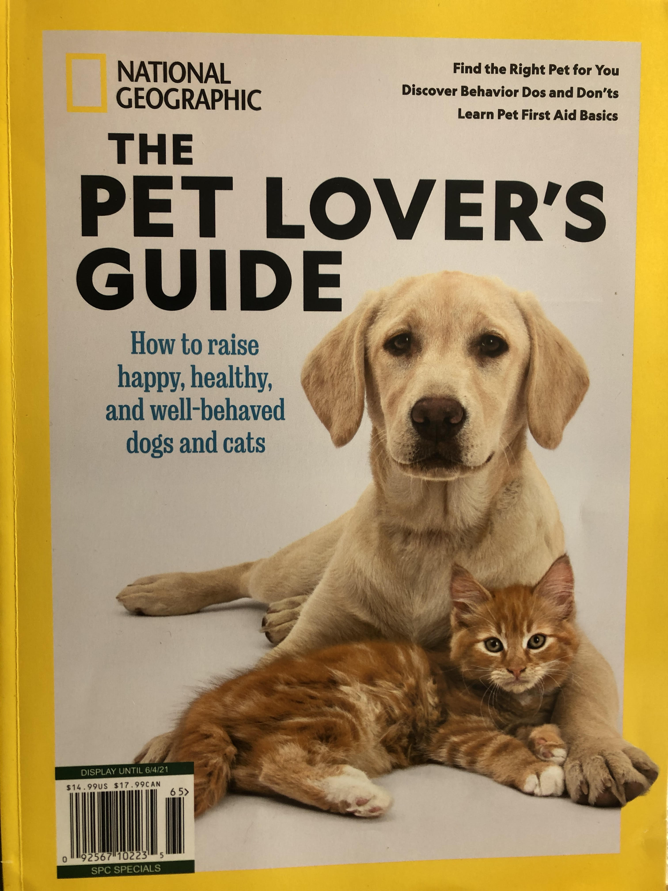
Influencing Behavior
17% of U.S. Adults under 25 surveyed say they read National Geographic Magazine regularly. That's a huge reach for a magazine. Even for older generations, about 1 in 10 U.S. adults who are 55 or older regularly reads the magazine.

Slide 8
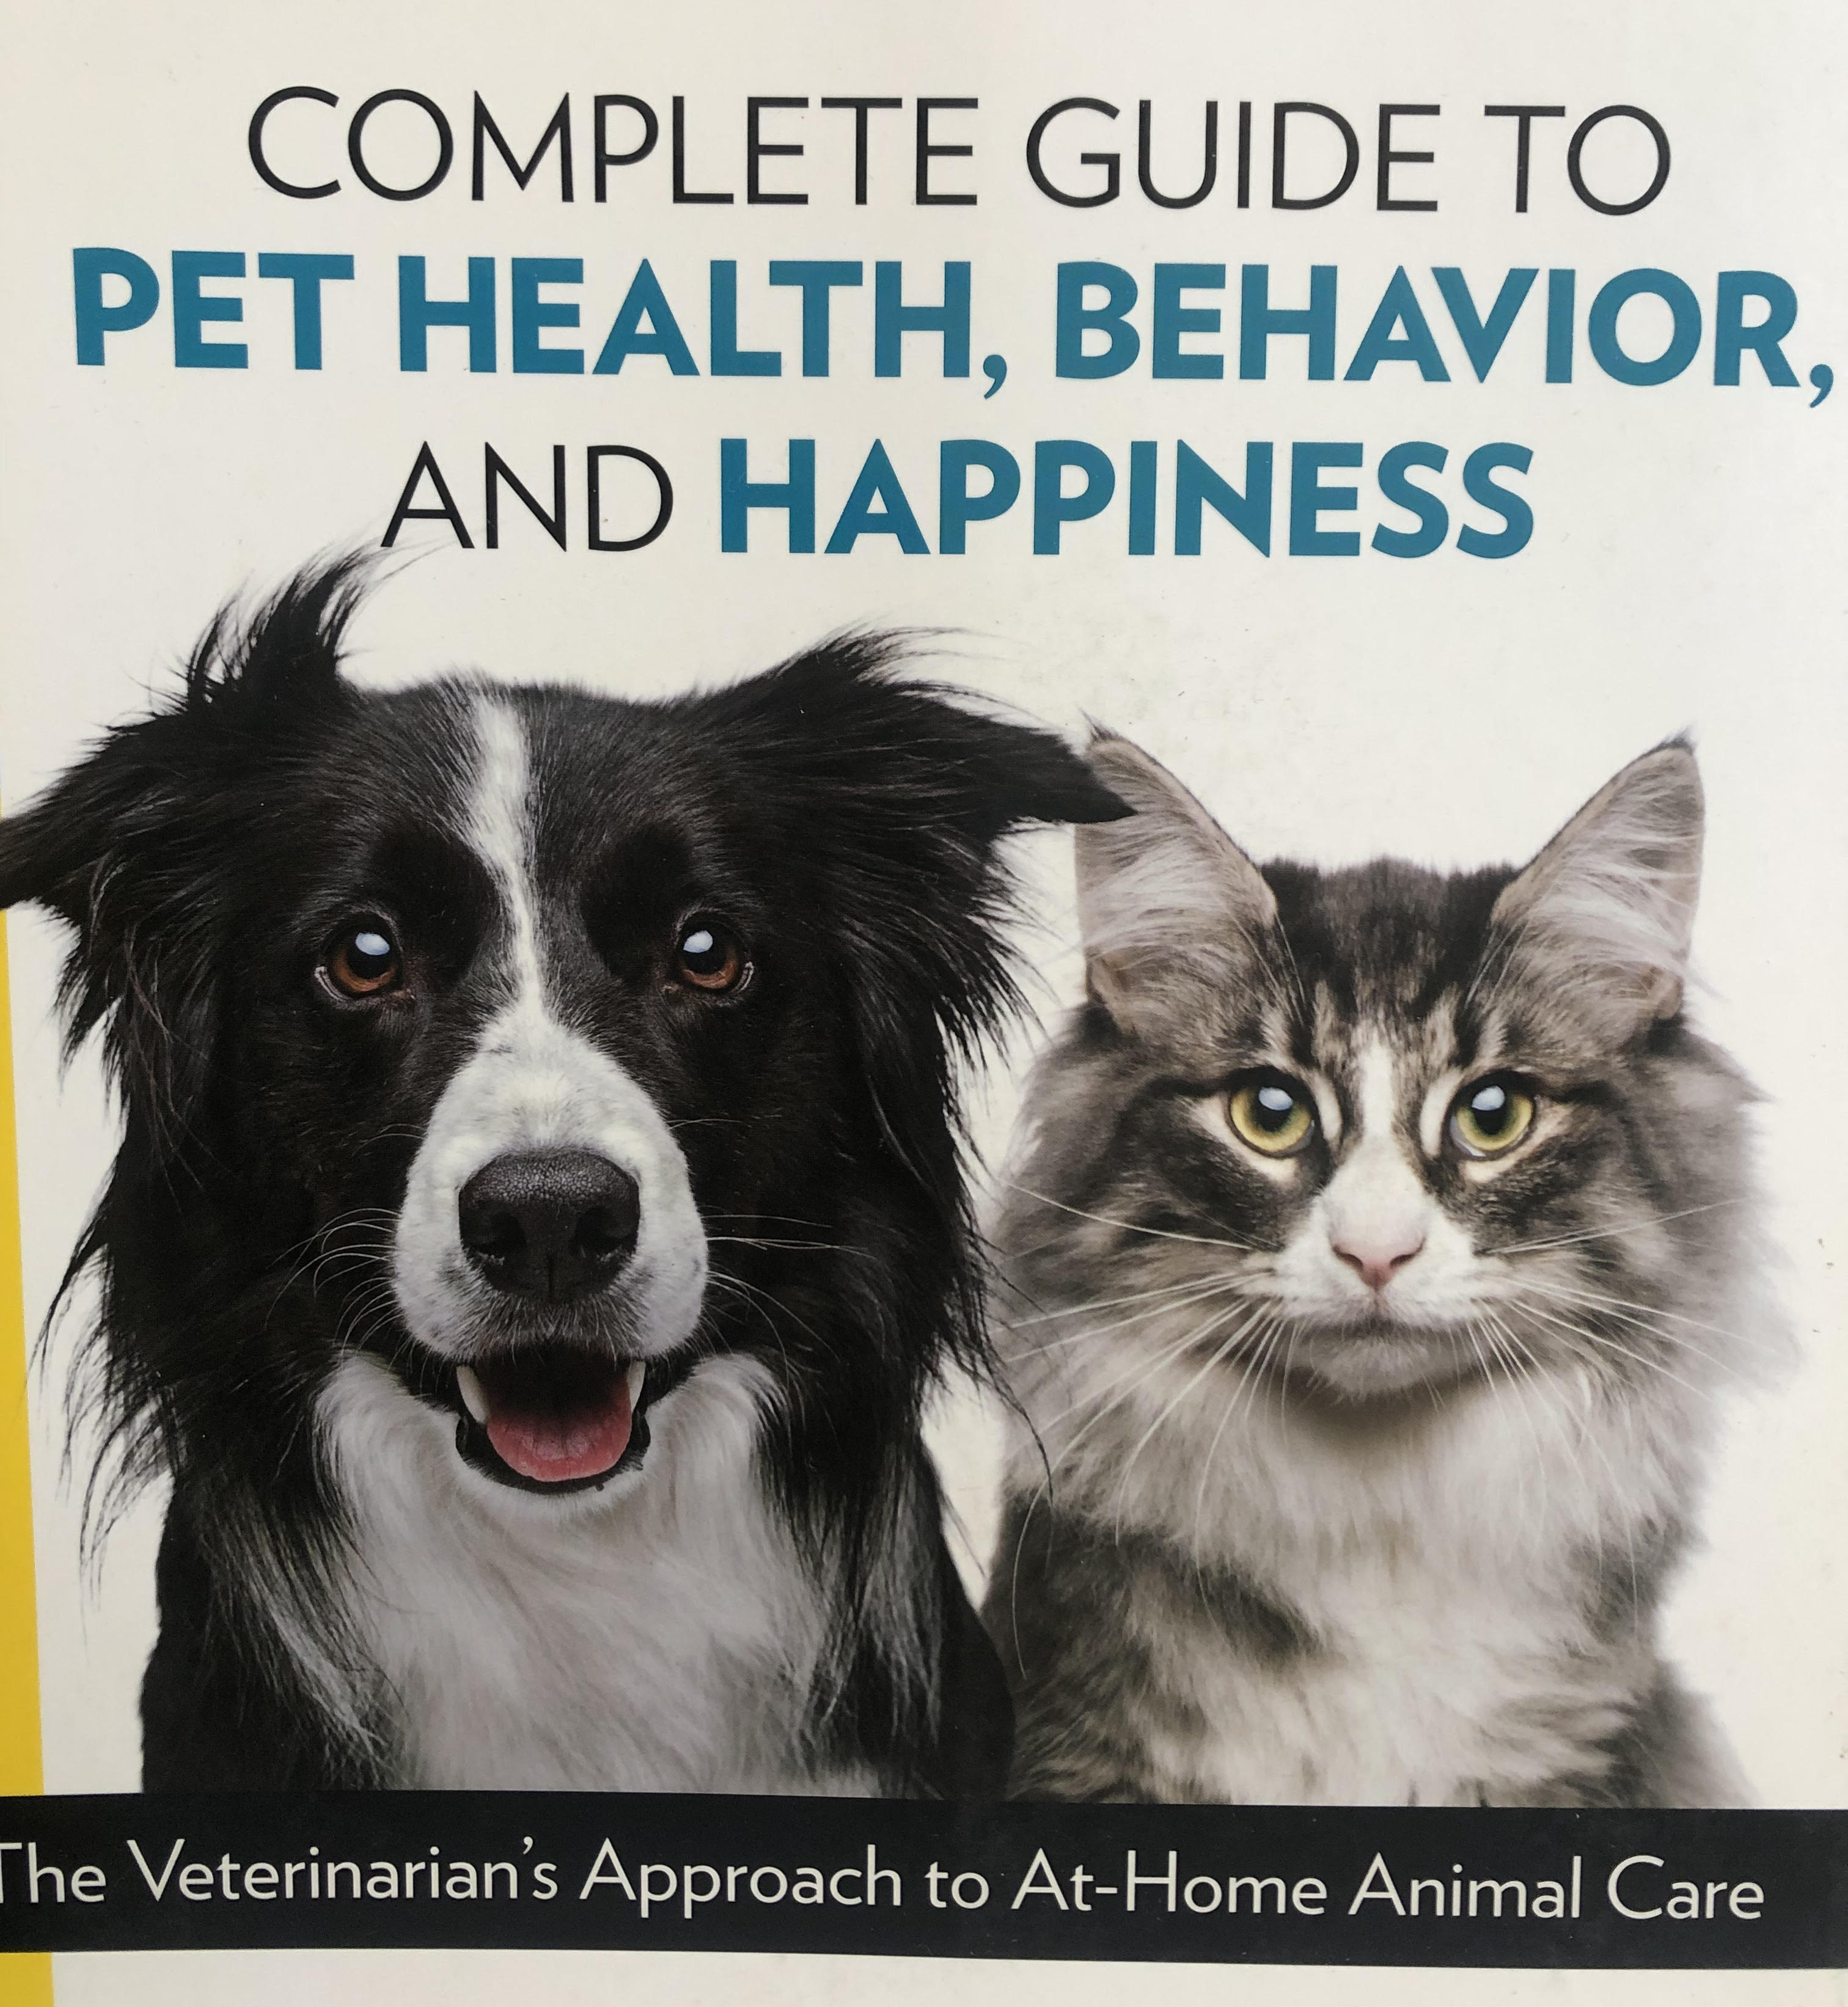
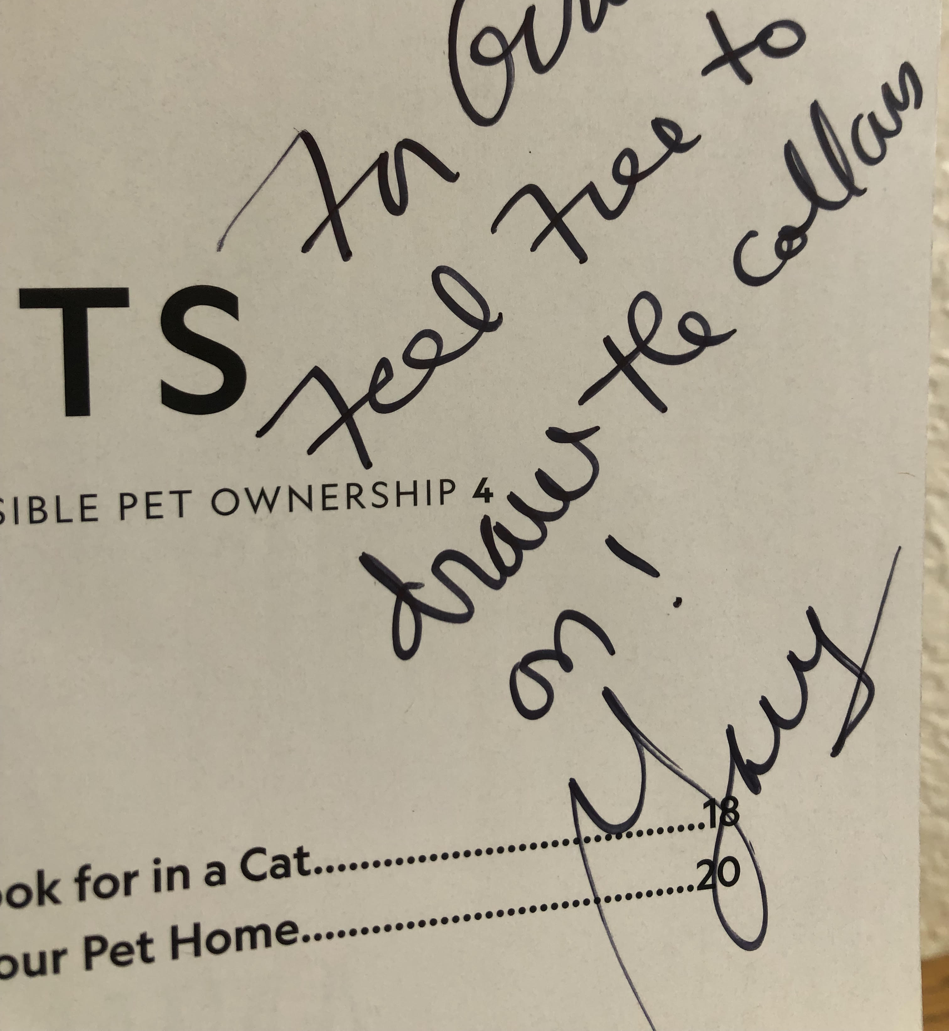

Slide 9
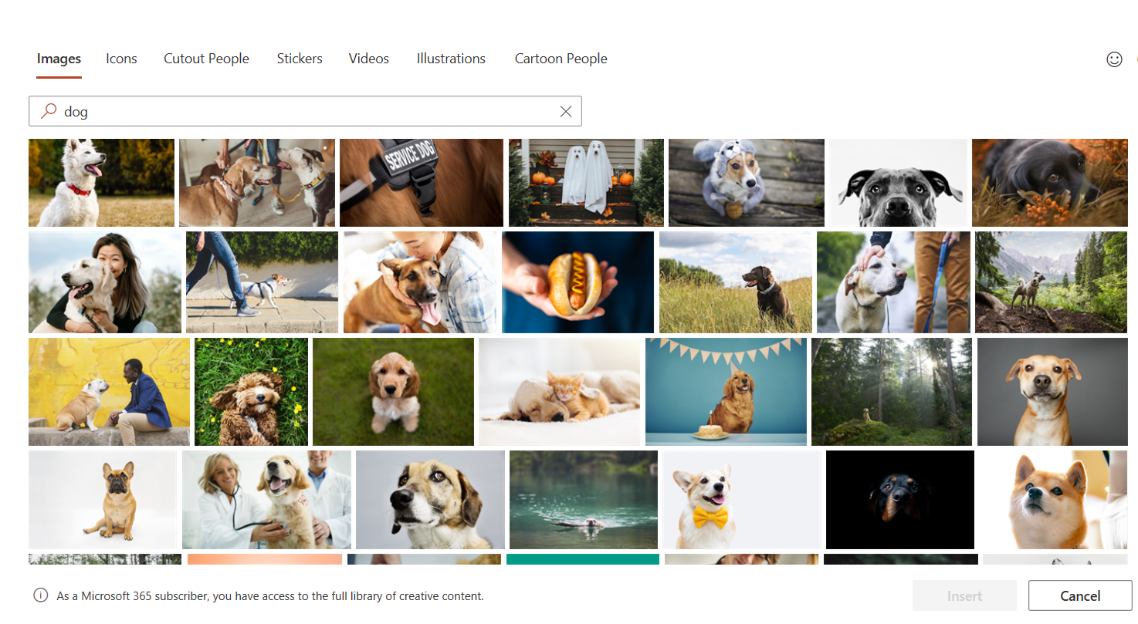
Design Images

Slide 10
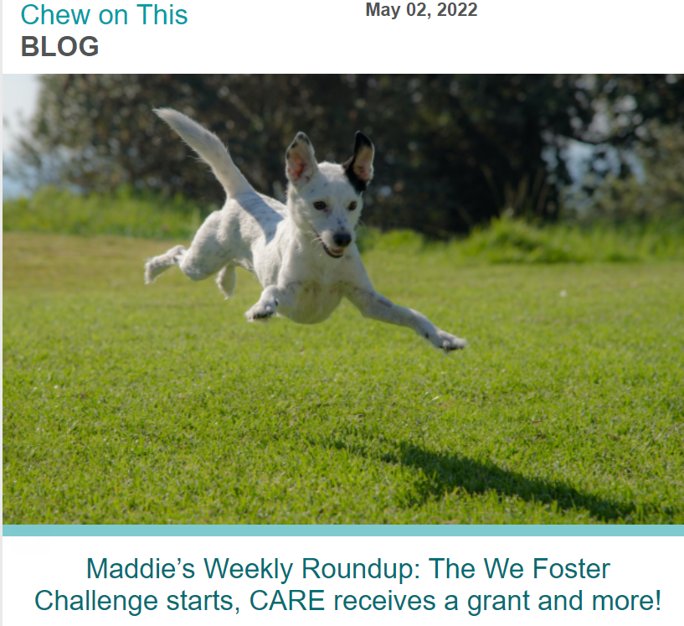
Naked Dogs Everywhere

Slide 11
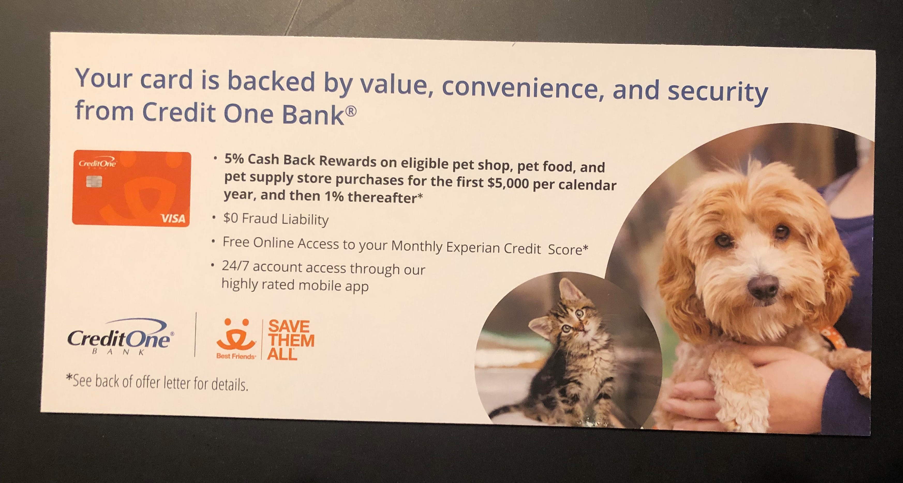
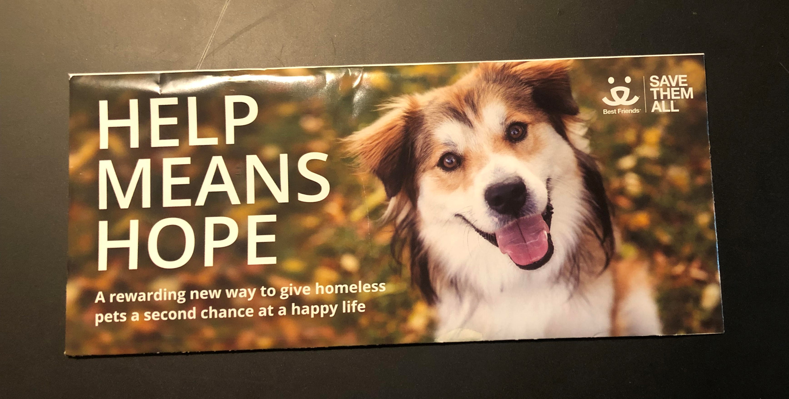
Oops
Notes:
Julie Castle story

Slide 12
This makes my heart sing

Slide 13
Are we marketing the right message?

Slide 14
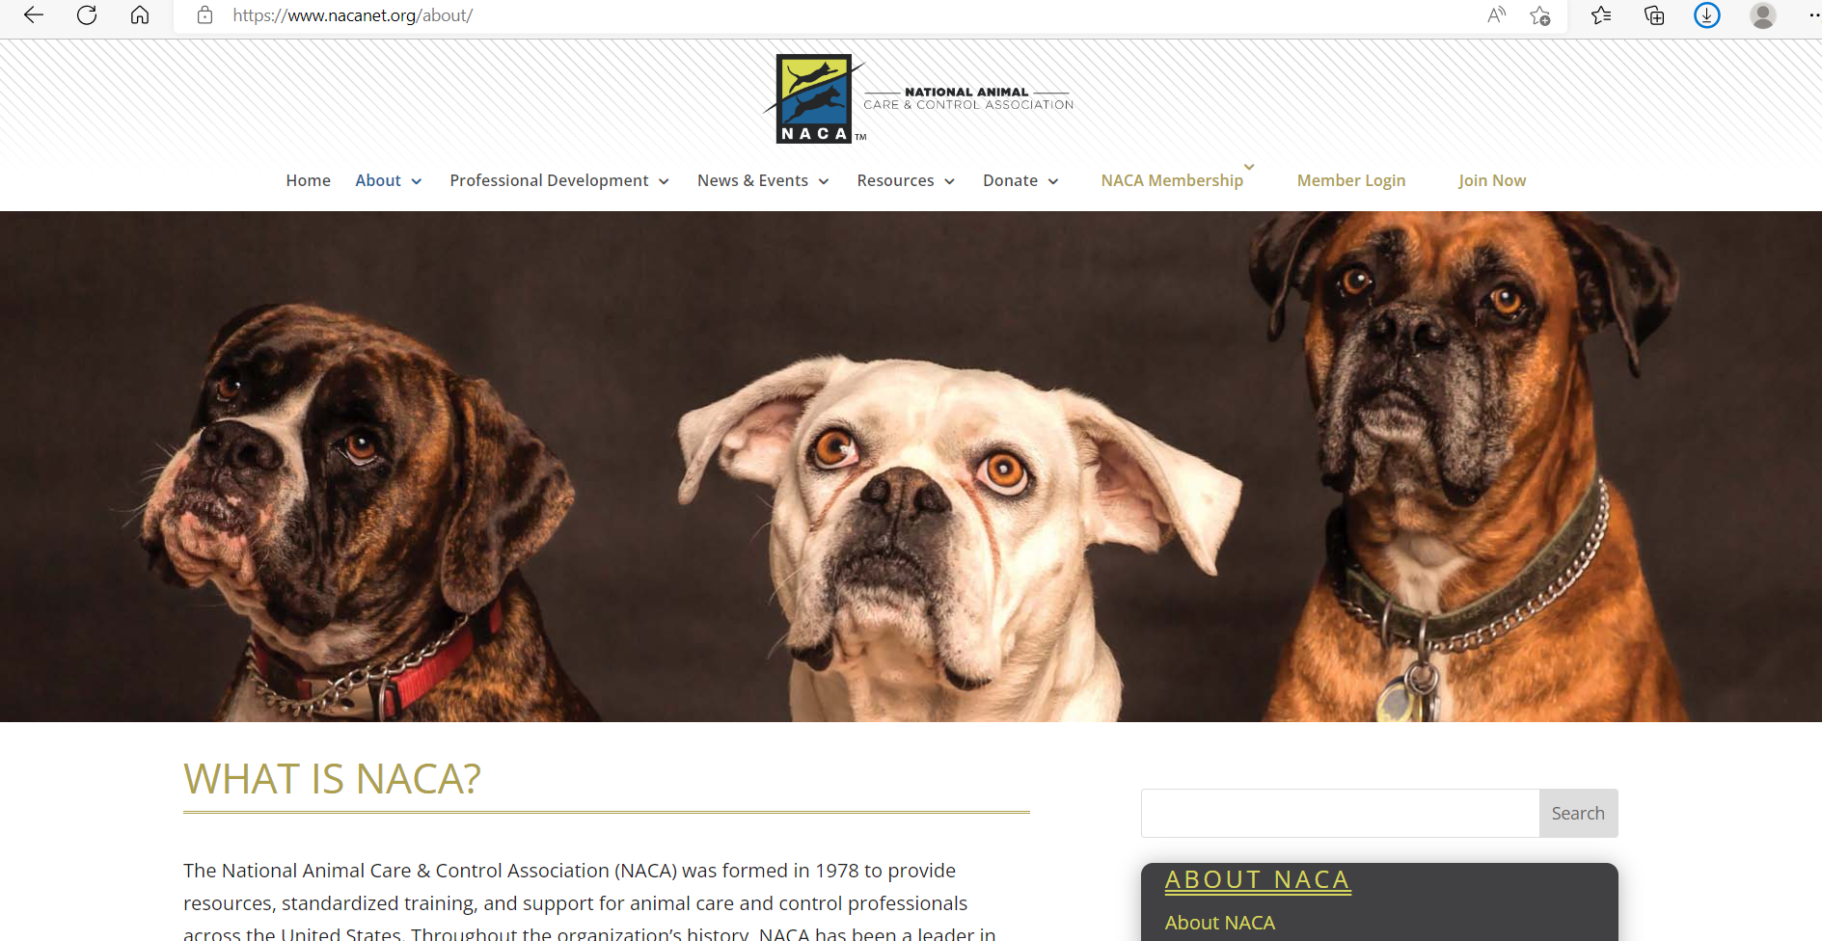
Animal Welfare Organizations doing it right!

Slide 15
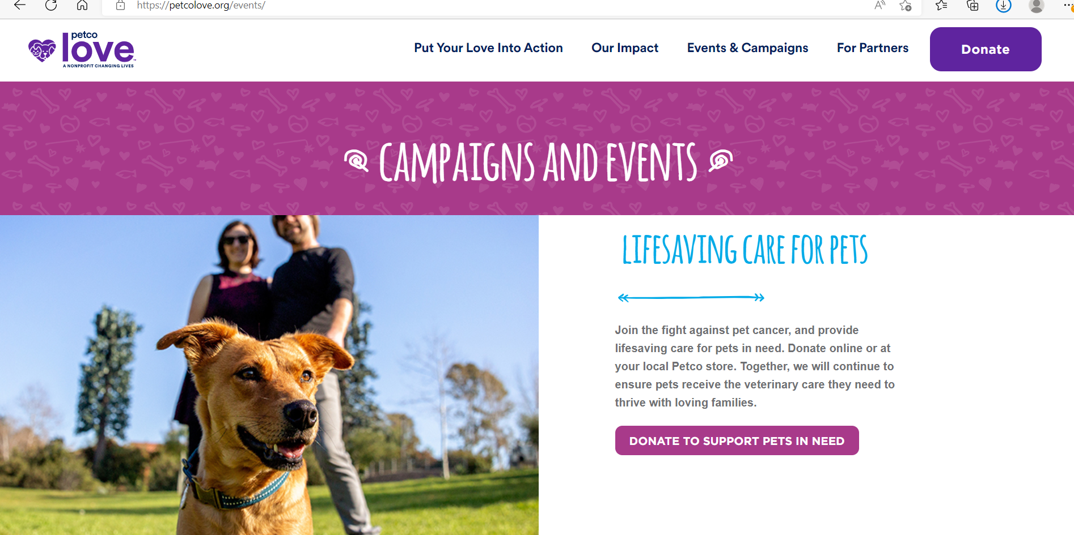
Doing it right!

Slide 16
Website Wizardry

Slide 17
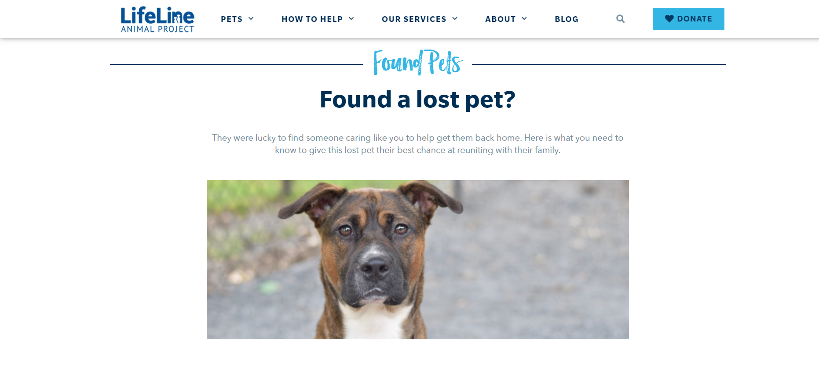

Slide 18
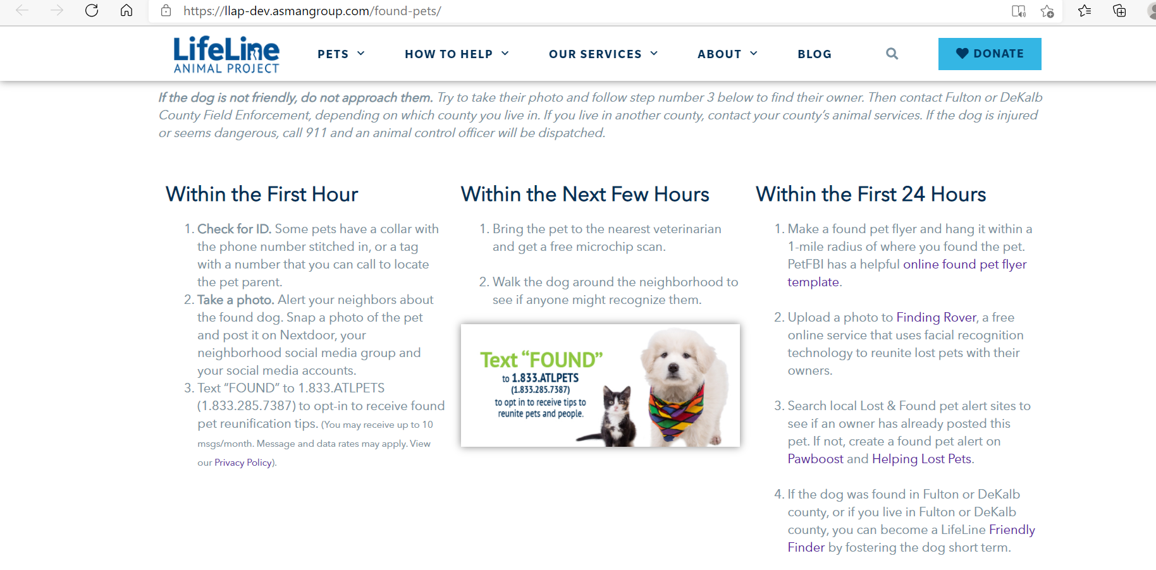

Slide 19
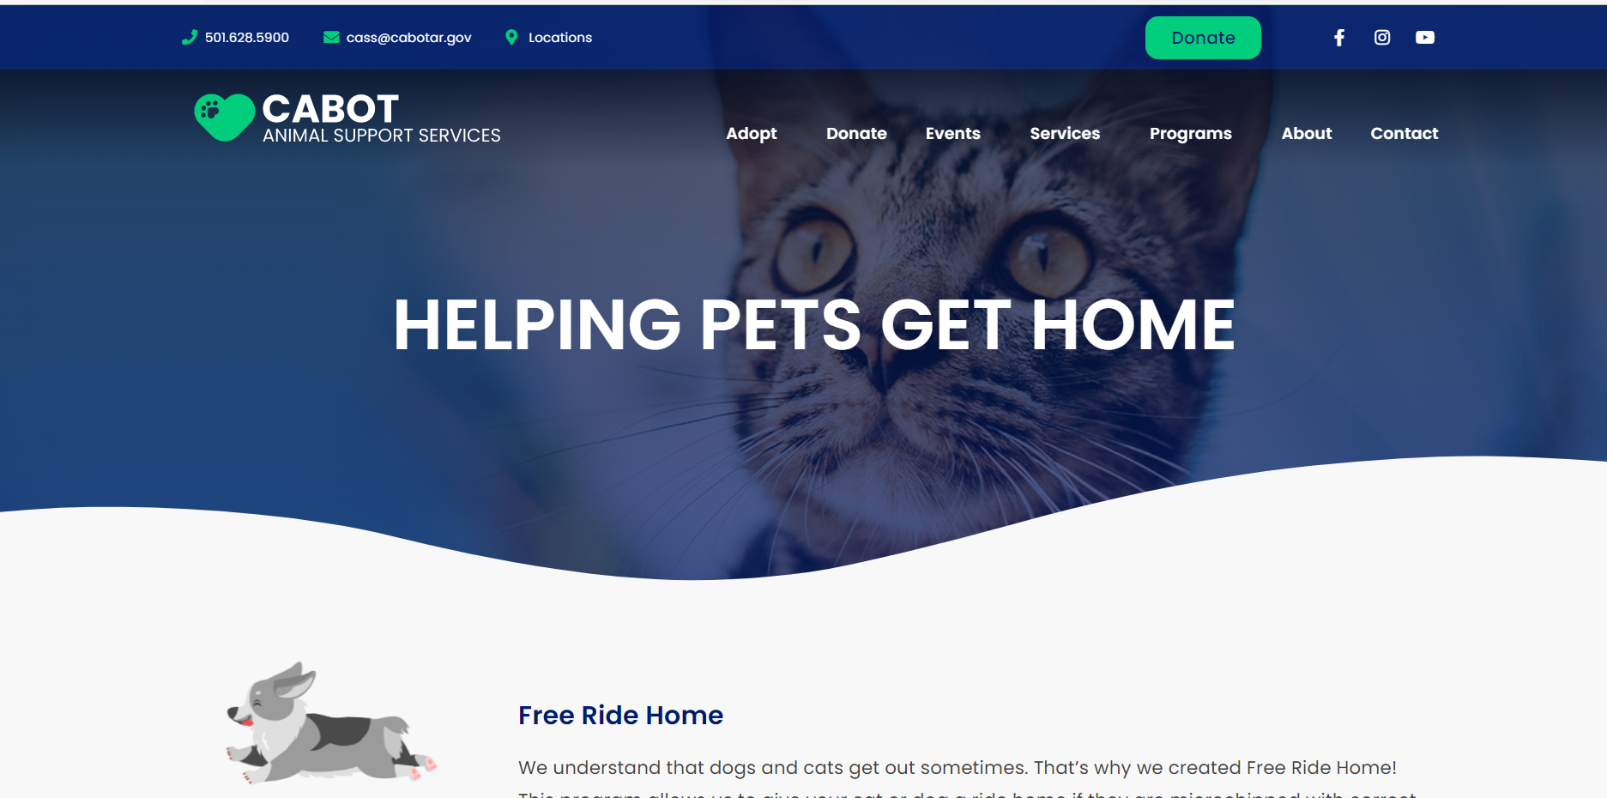
Cabot Animal Support Services
Arkansas
Step by step instructions, making it easy

Slide 20
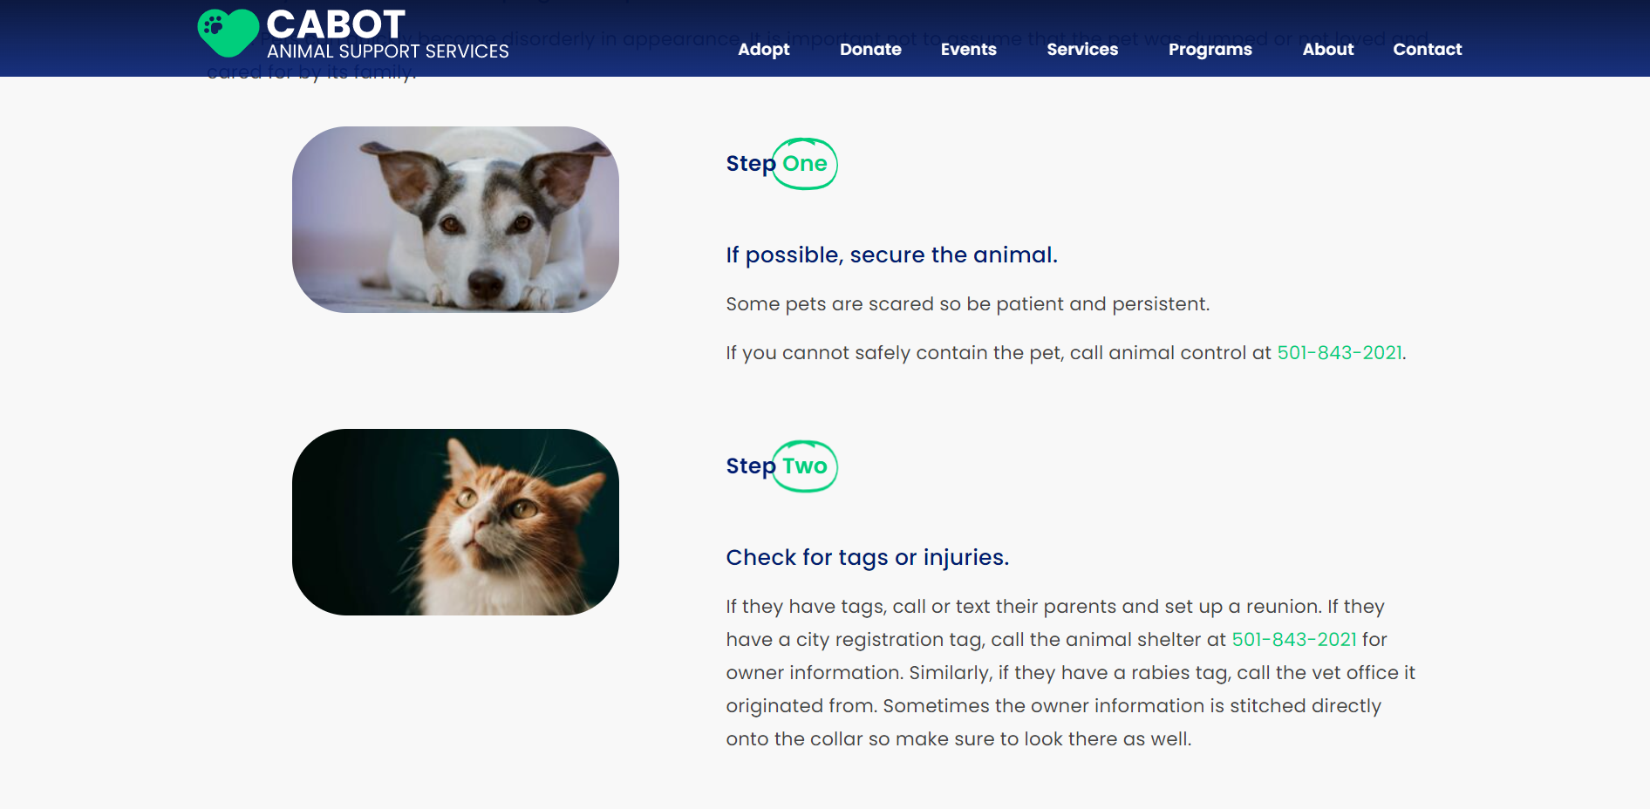
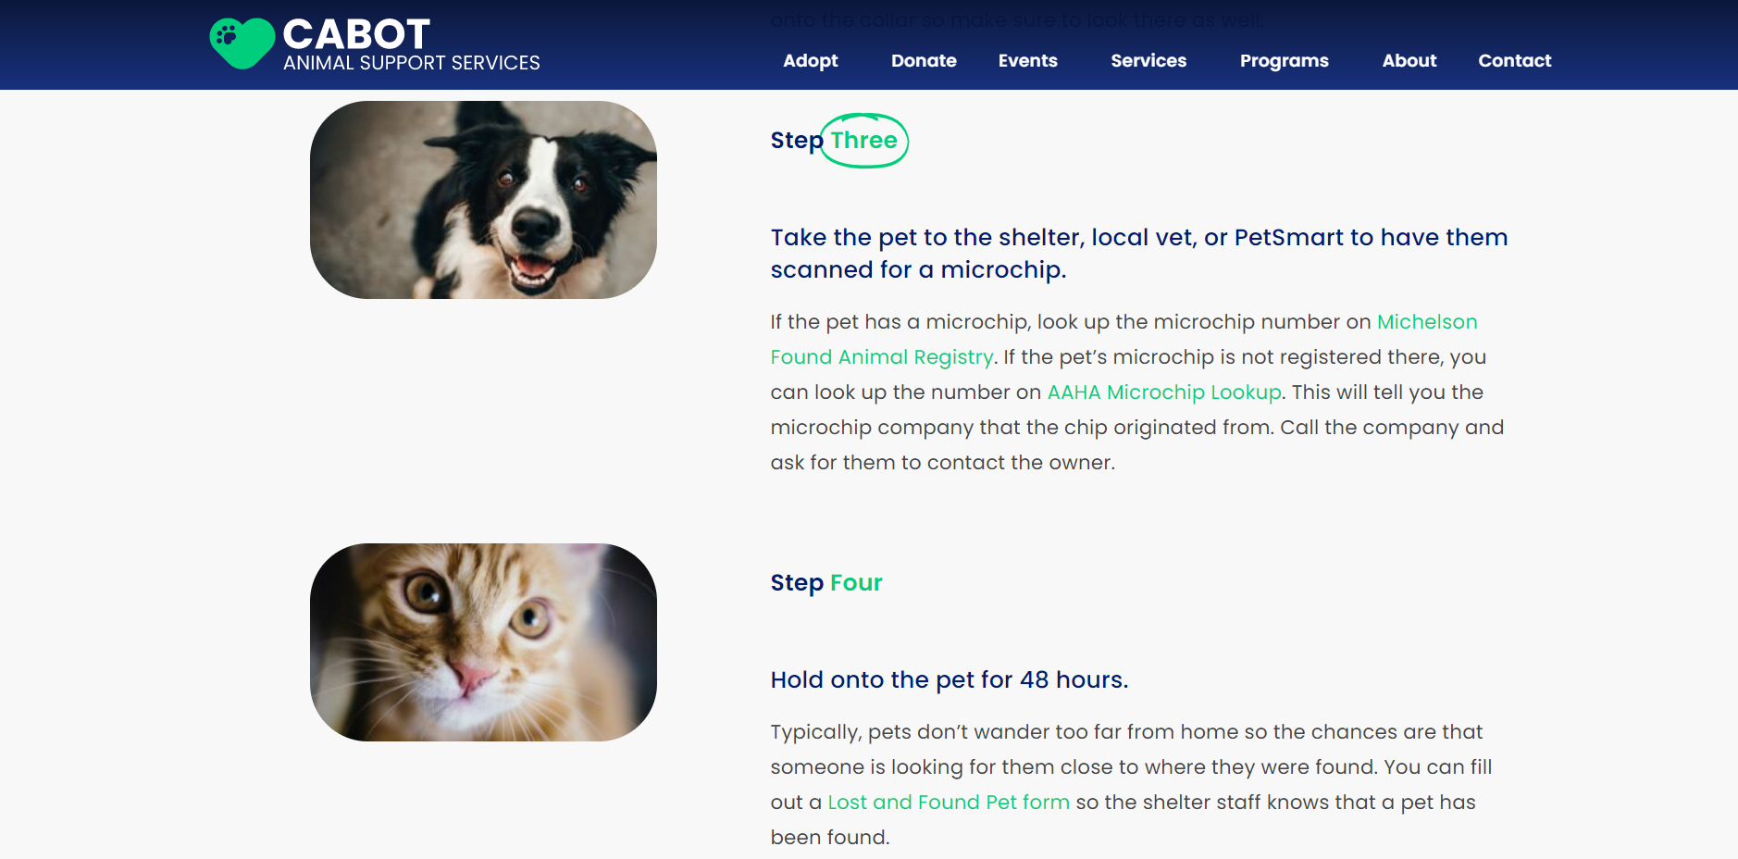
Steps 1, 2, 3, 4

Slide 21
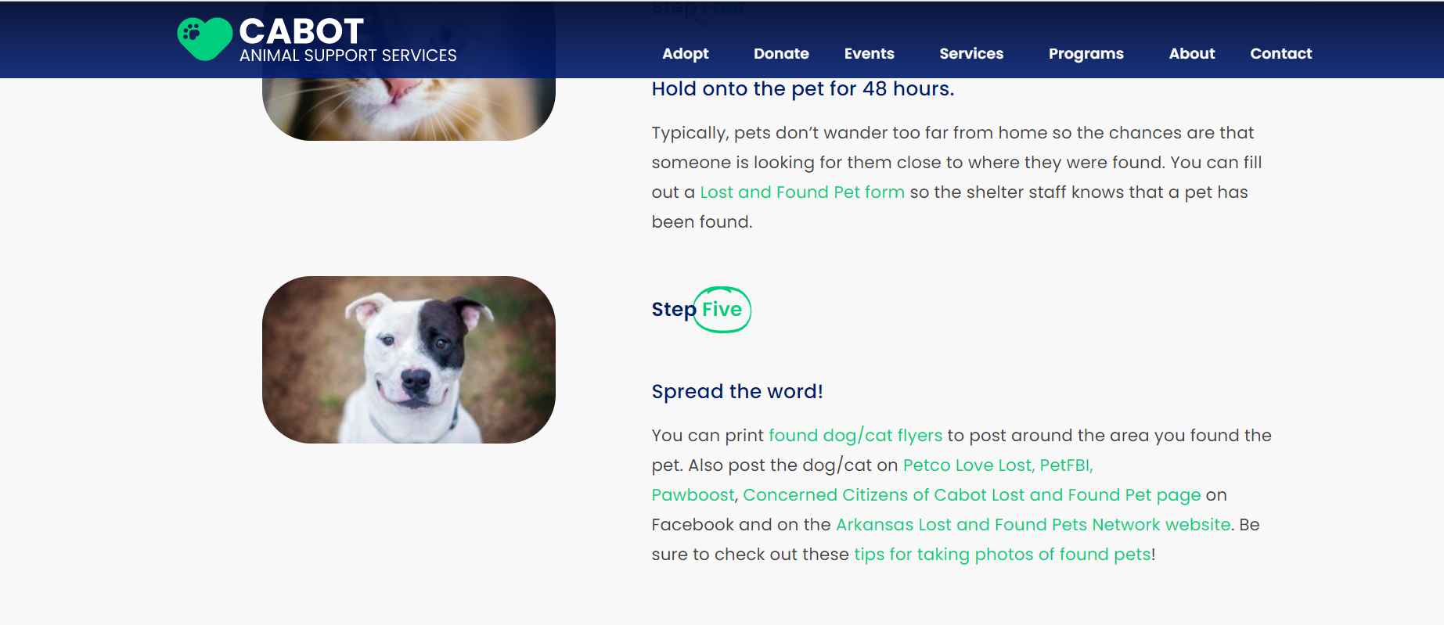
In 2021, 771 people were asked to participate
594 agreed (77%)
387 (65%) were able to reunite the animal with their owner
186 (31%) animals were relinquished to the shelter
4% were kept, given away, or did not respond (1%).
First 48: 2021 Data

Slide 22
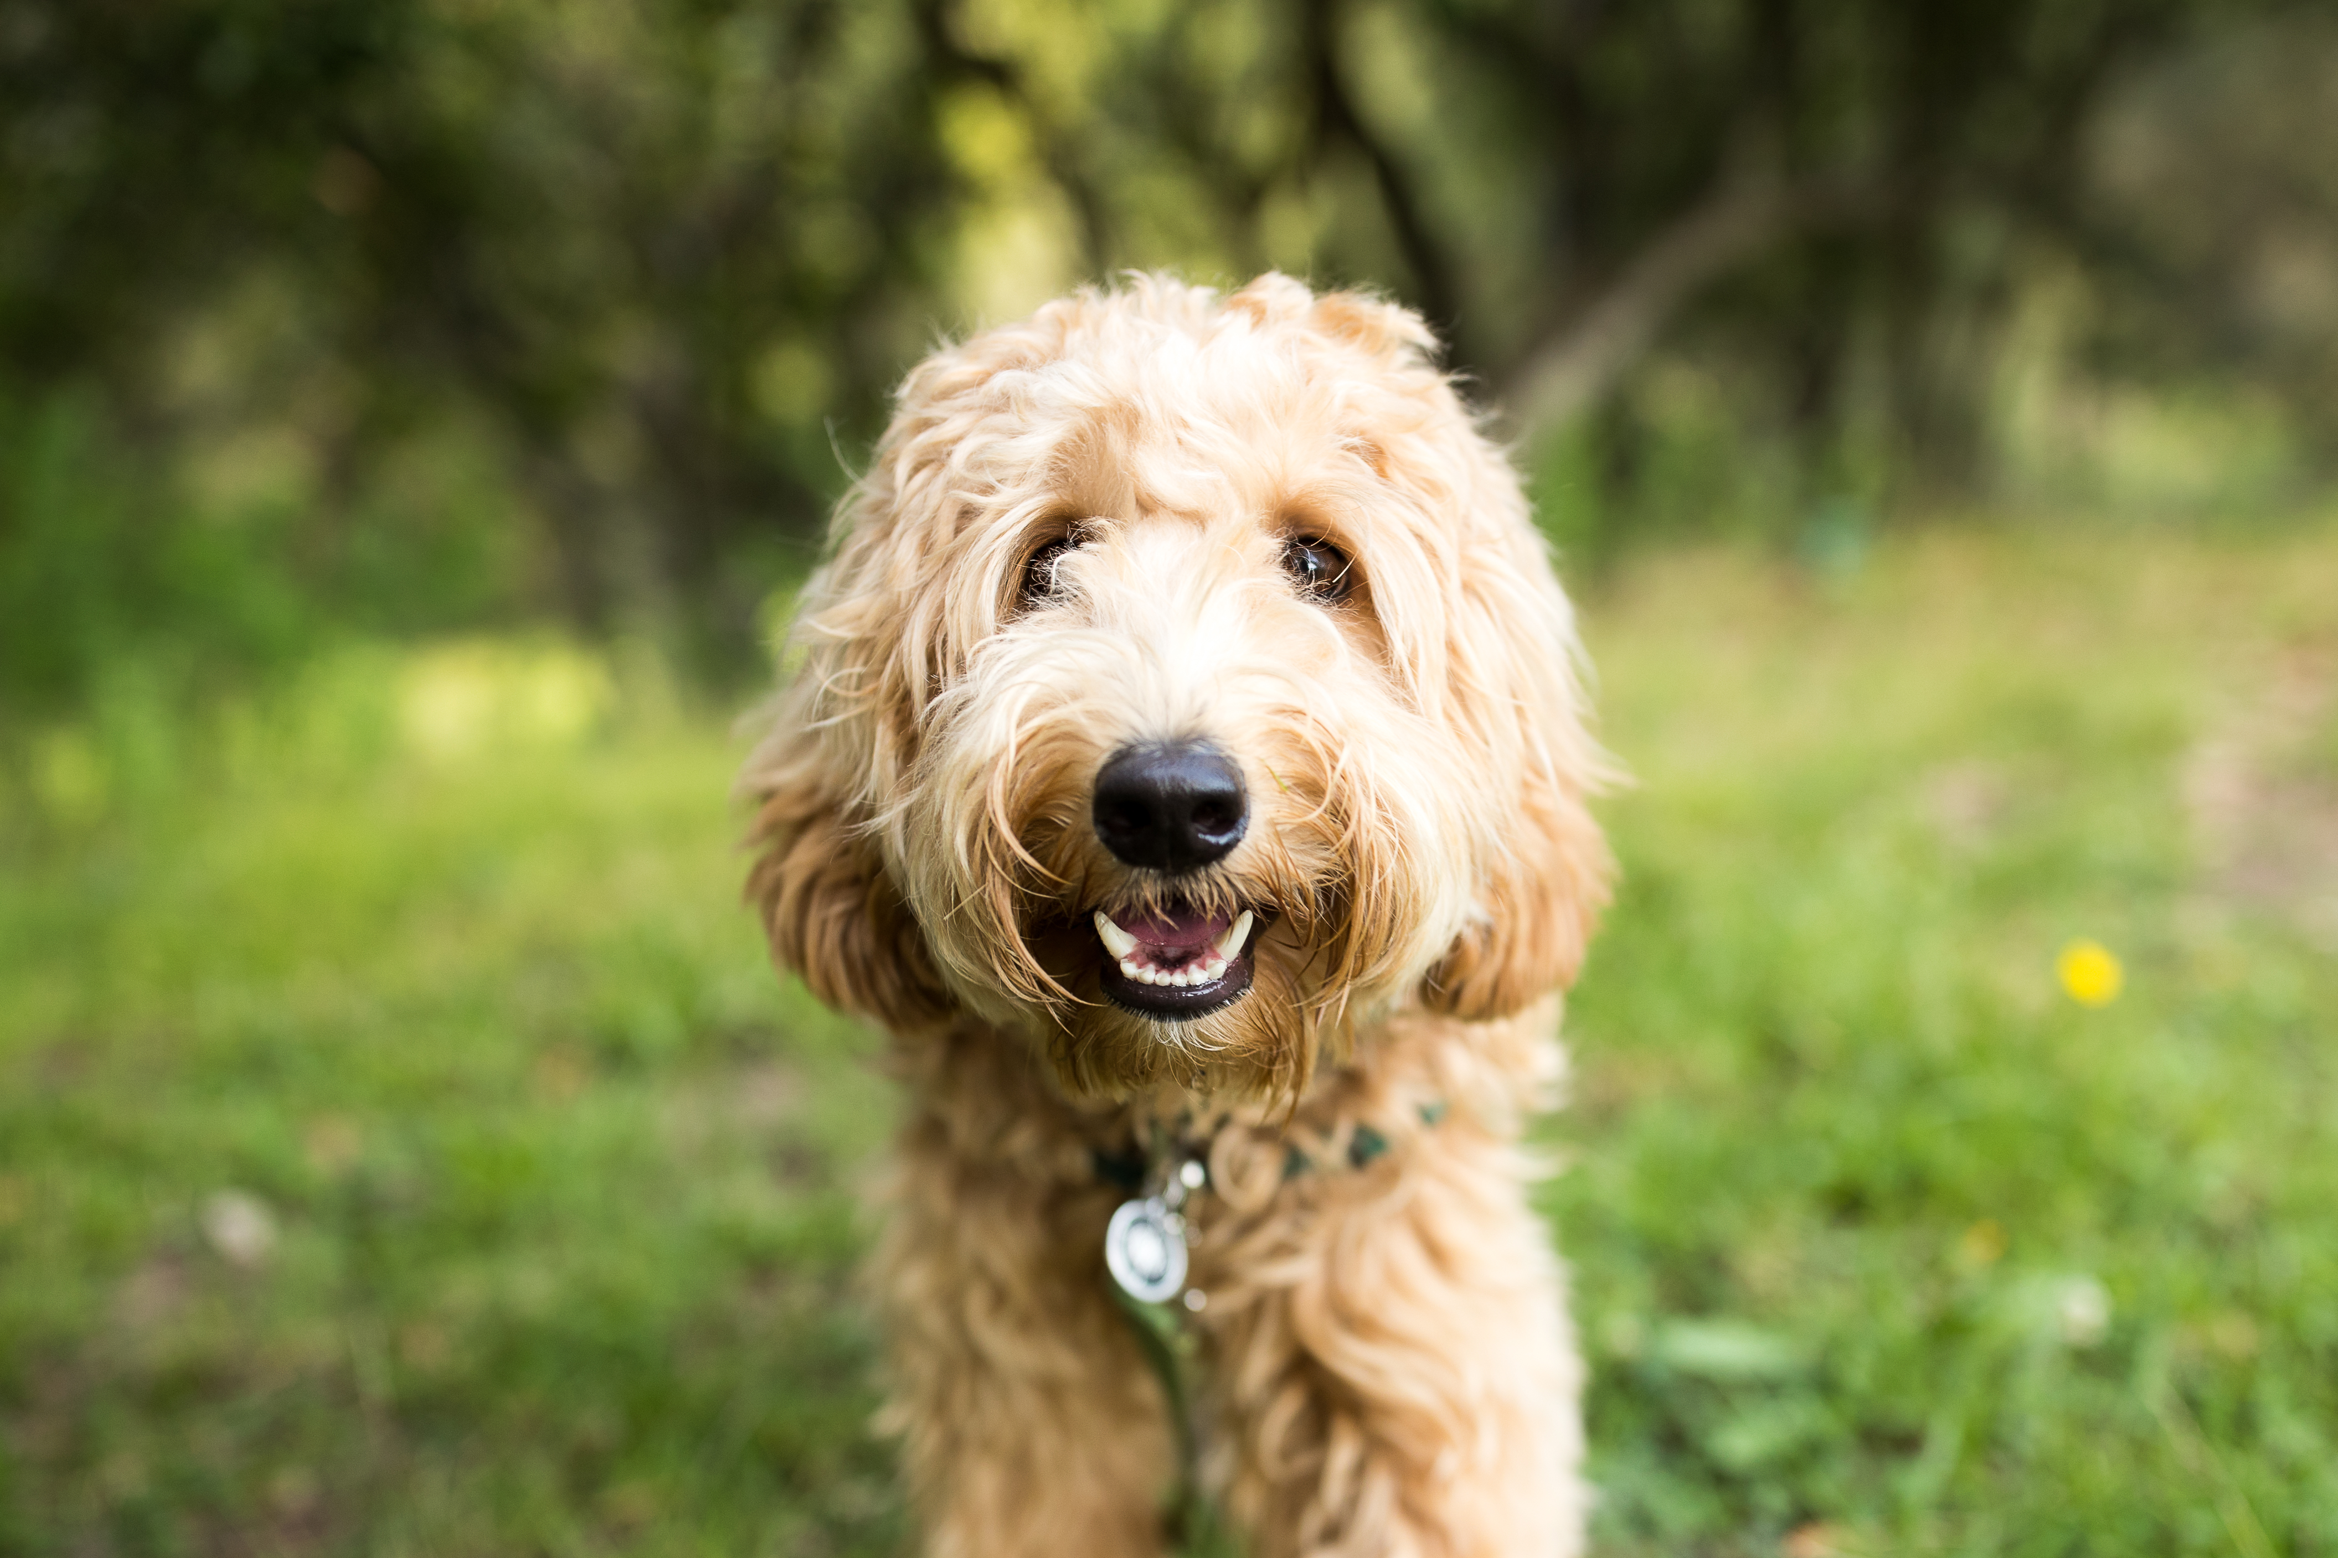
First 48: 2021 Data
Of the pets who were reunited with their owner, 71% were medium or large-breed dogs
49% returned home the same day that they entered the First 48 program
87.3% returned home in the first 48 hours

Slide 23
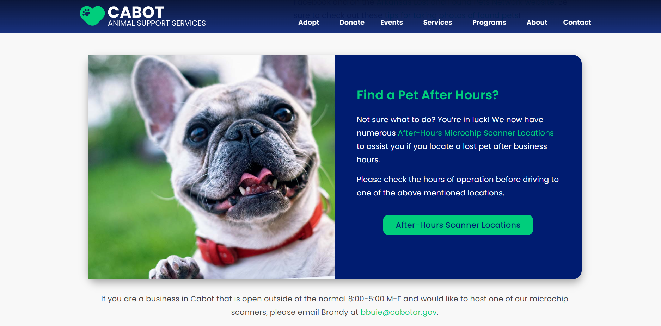

Slide 24
Cabot took it one step further

Slide 26
We can no longer expect pet people to know what to do

Slide 27
Partnership

Slide 28
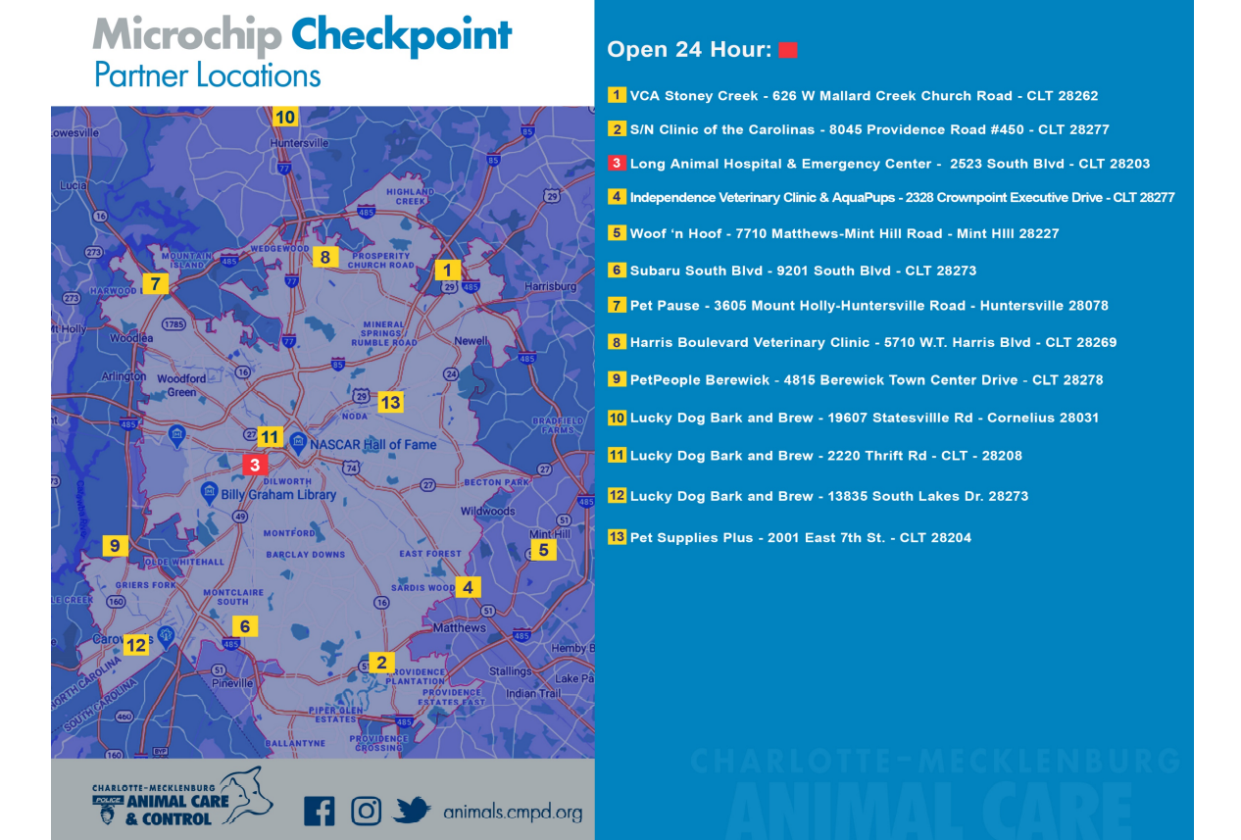
Better
than
DUI
checkpoints

Slide 29
Marketing the message often and loudly changes behavior

Slide 30
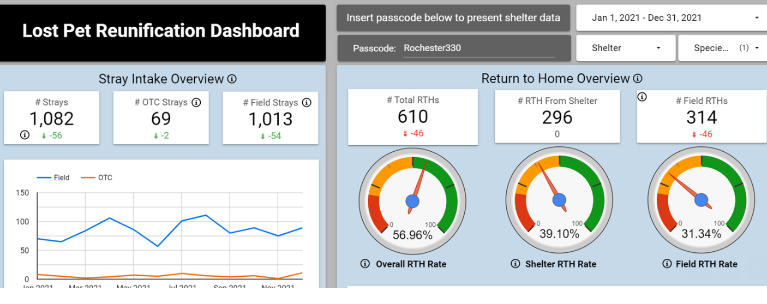
Rochester Animal Services

Slide 31
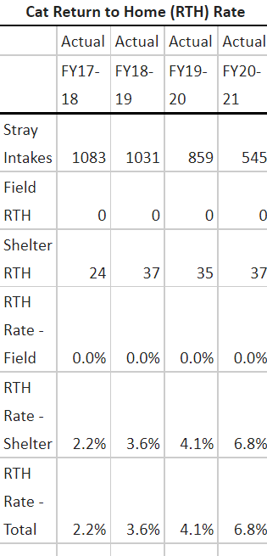
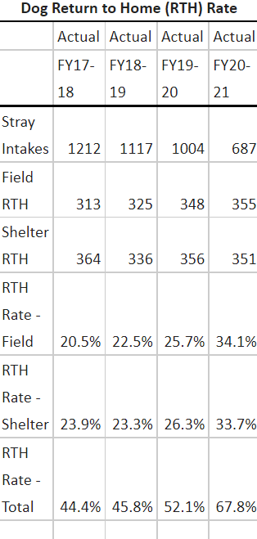
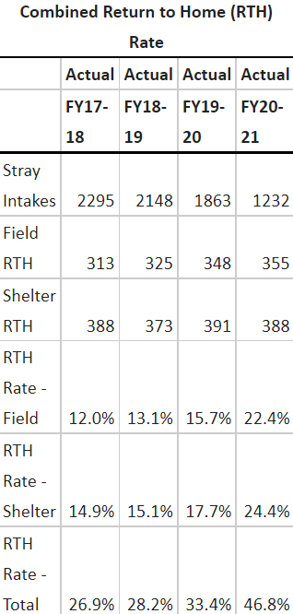
Data tells a story

Slide 32
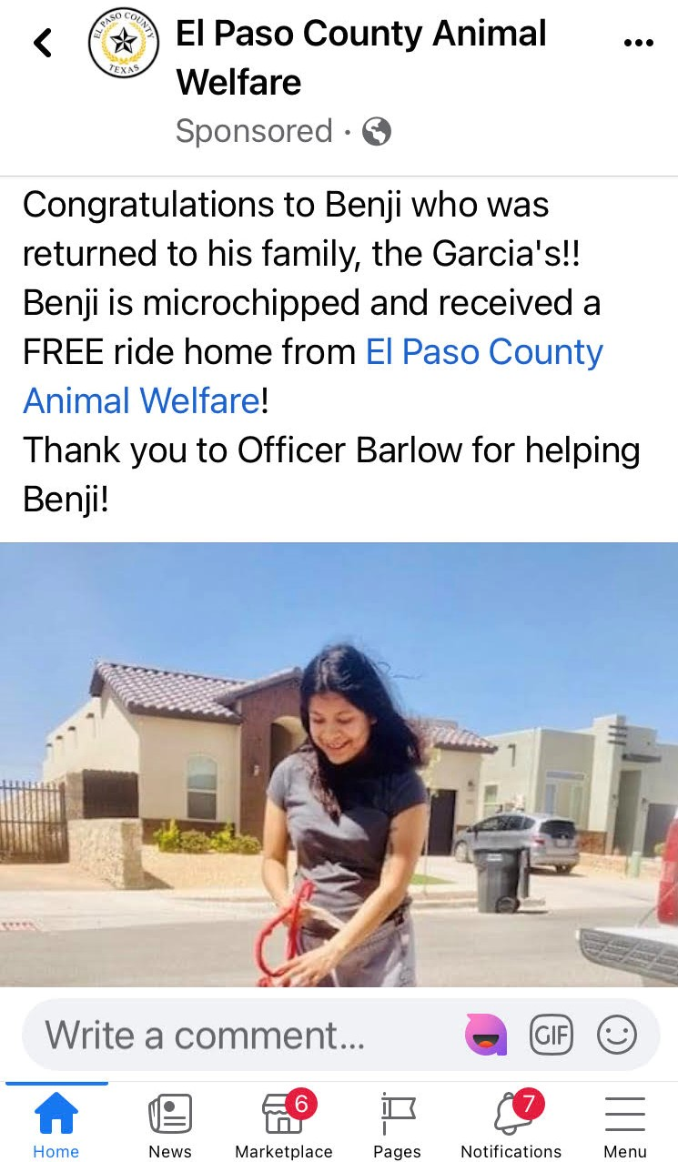
Are you celebrating reunions?
Are you recognizing your Officers?
Are you promoting pet identification?
El Paso is doing it all!

Slide 33
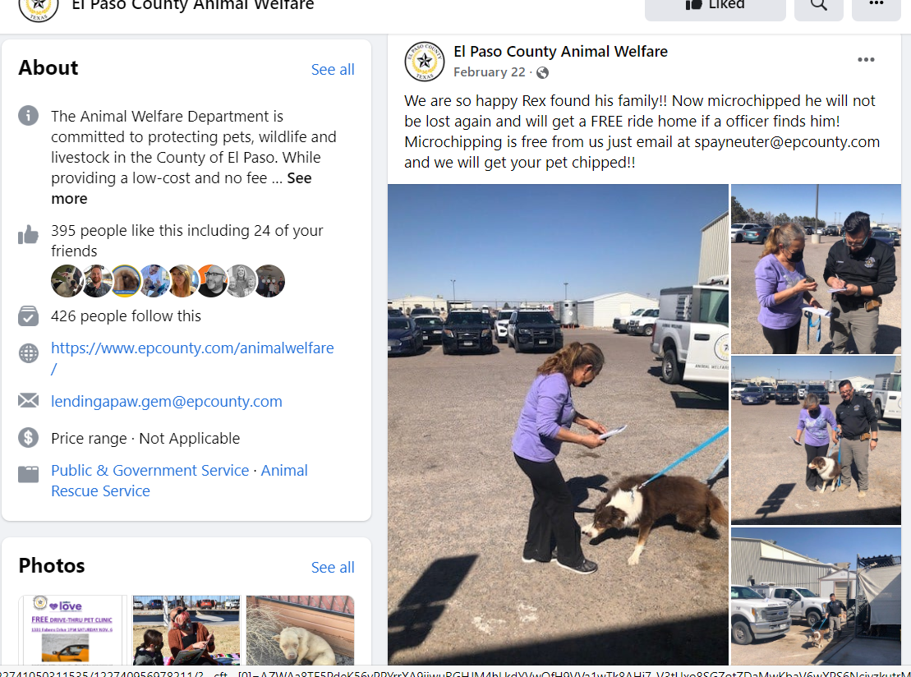
More than just a Facebook post
Free chips
Action
Results

Slide 35
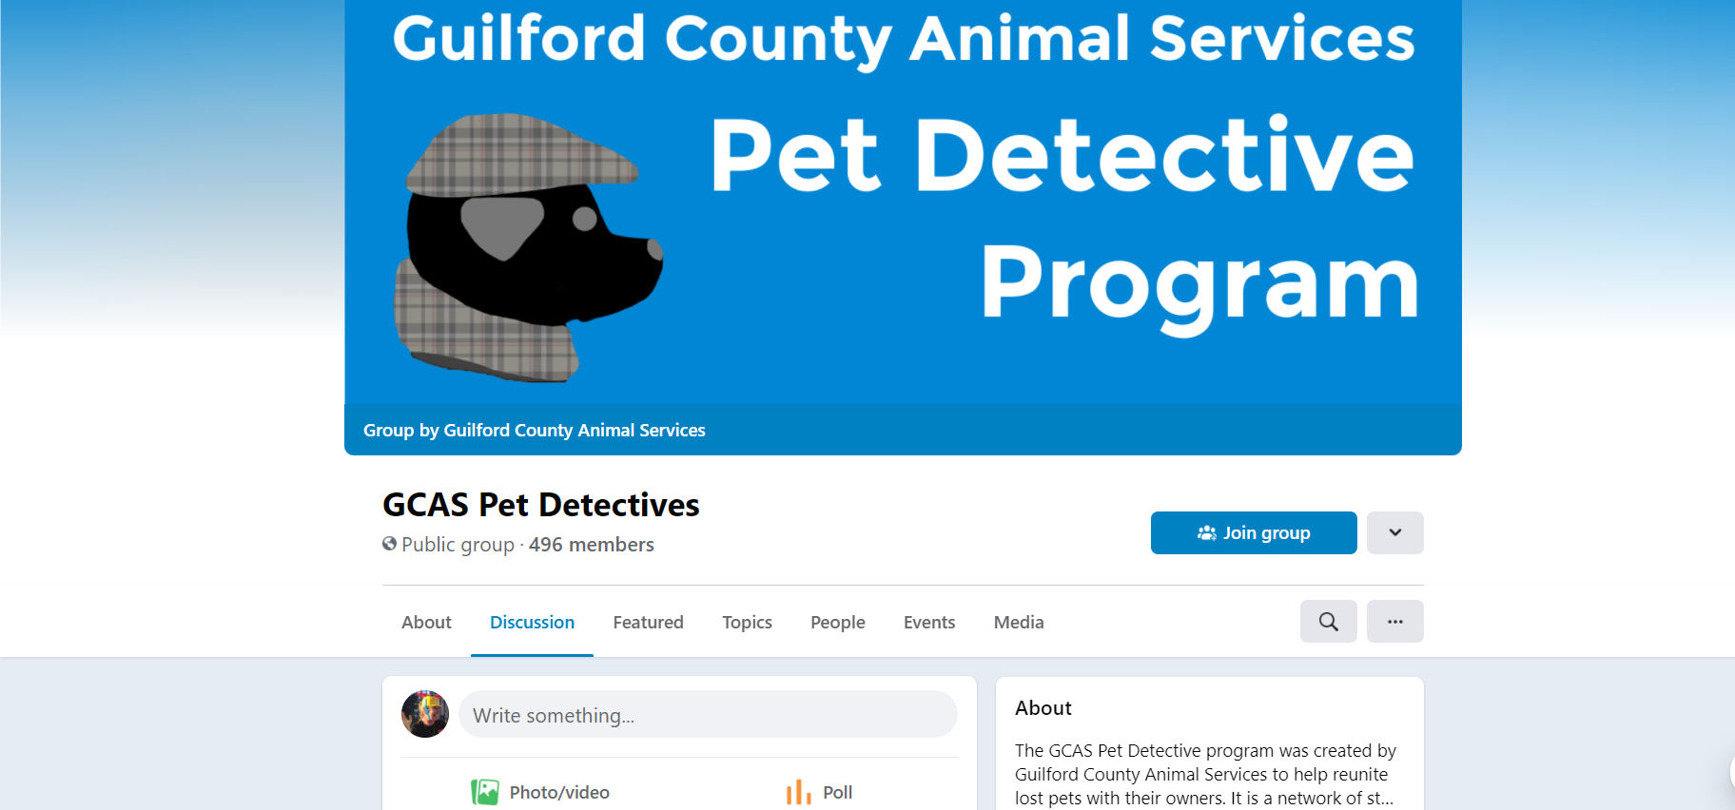
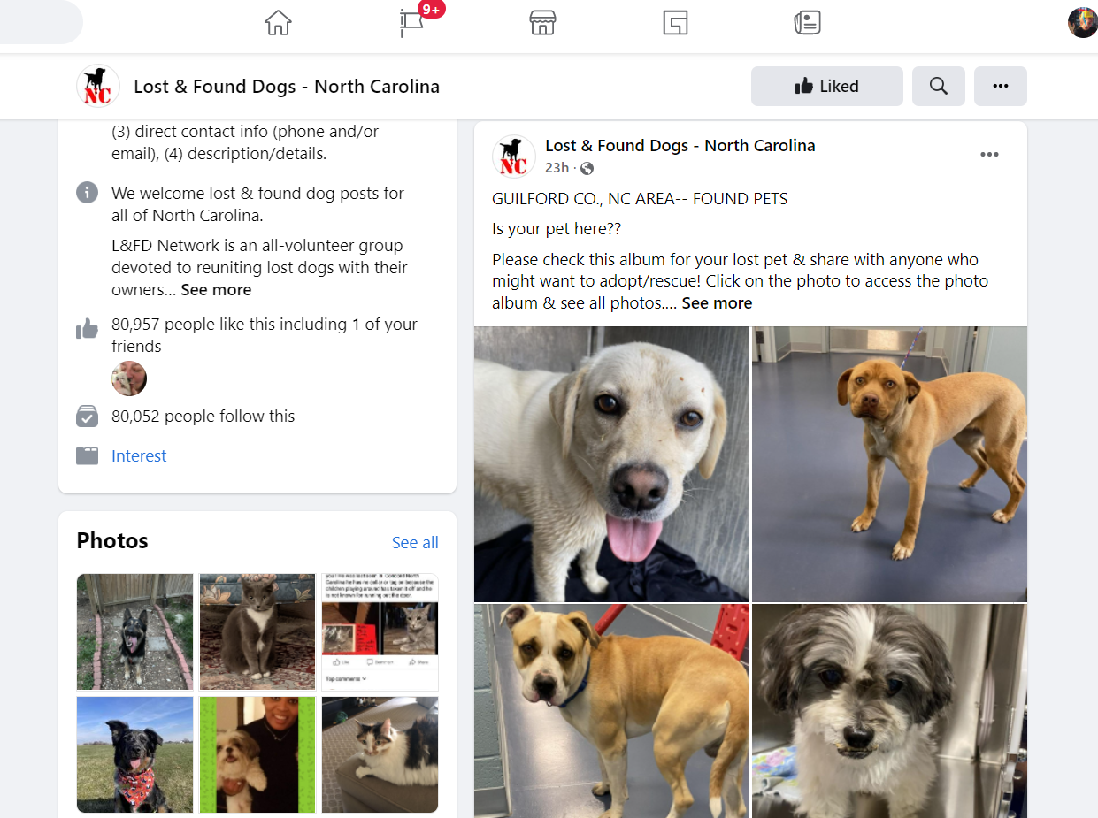
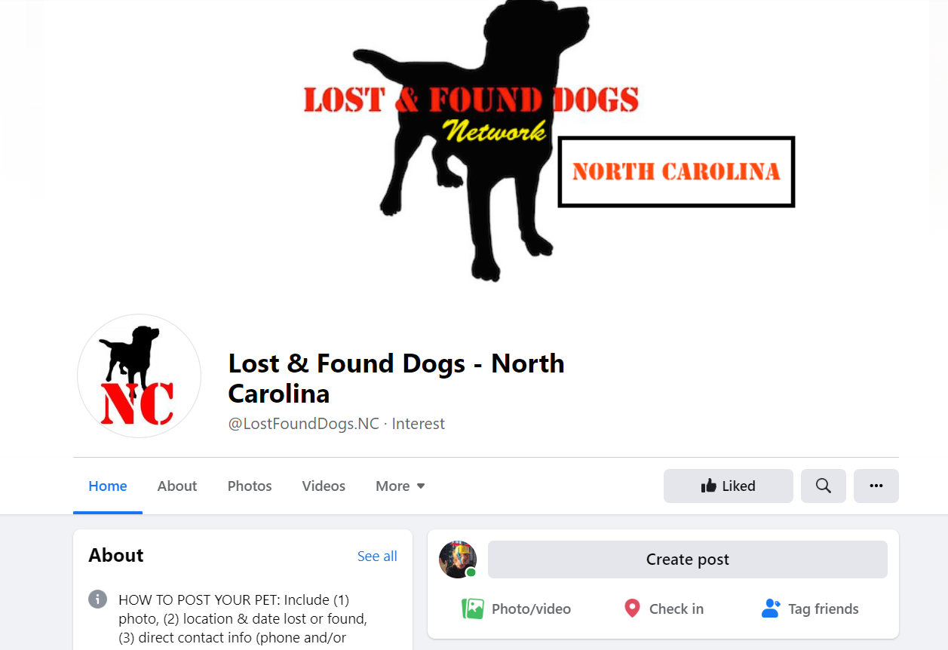
Partnerships

Slide 36
Celebrating ACO’s & spreading the message

Slide 37
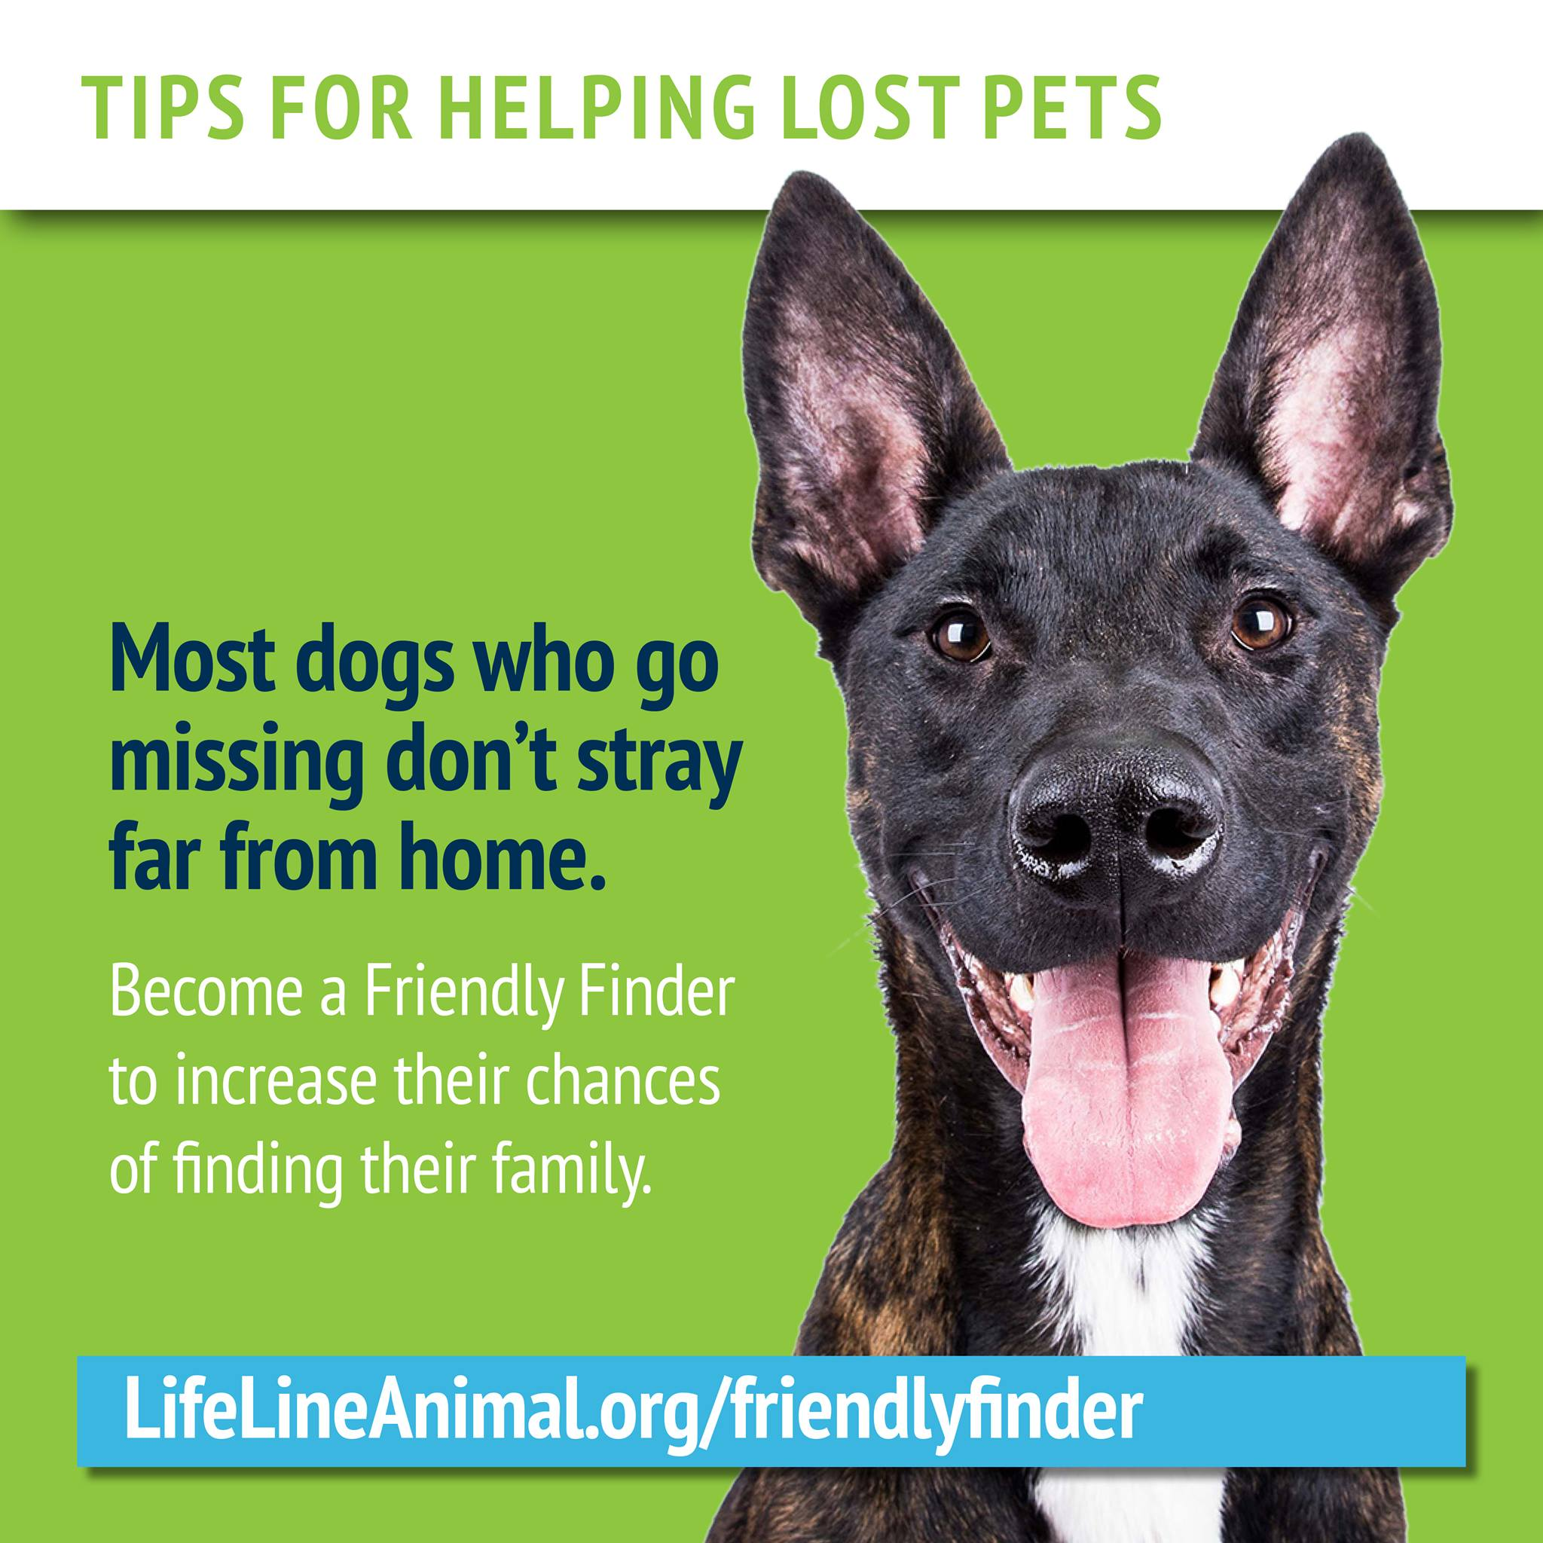
Low-cost messaging with big impact

Slide 38
Marketing The Message

Slide 39
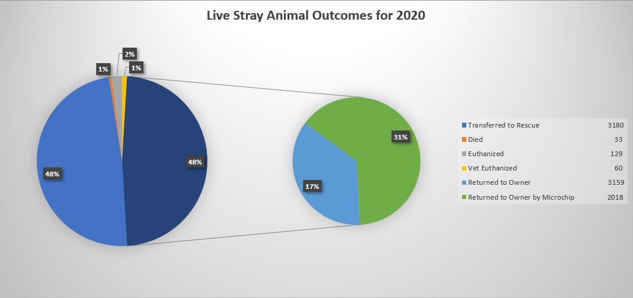
Investing on the front end, to save money on the back end.
Washoe County Regional Animal Services, Reno Nevada

Slide 40
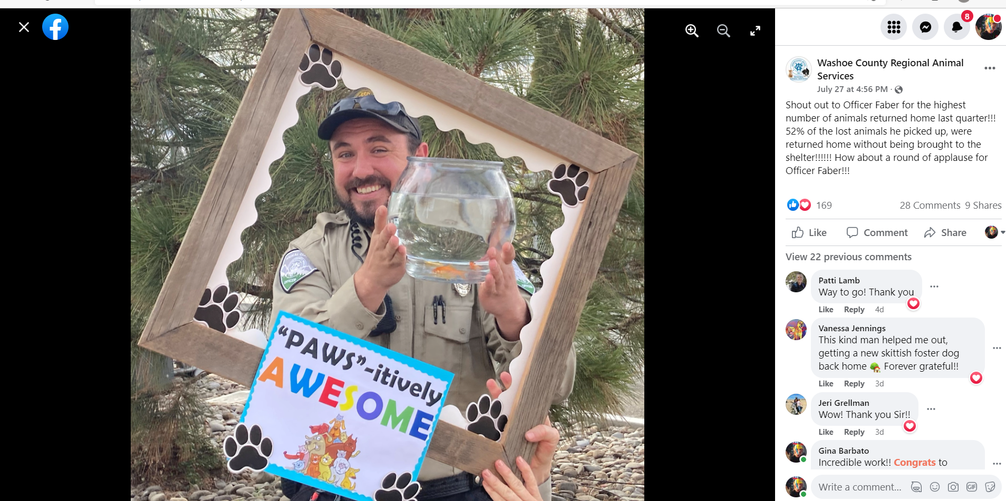
Are you telling these stories?

Slide 41
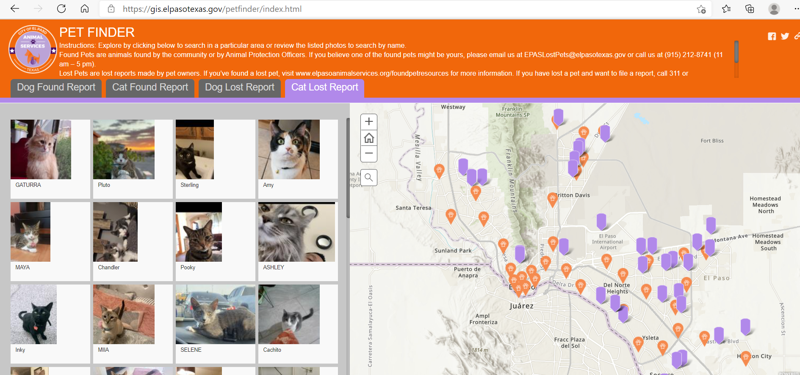
El Paso: Using technology for good

Slide 42
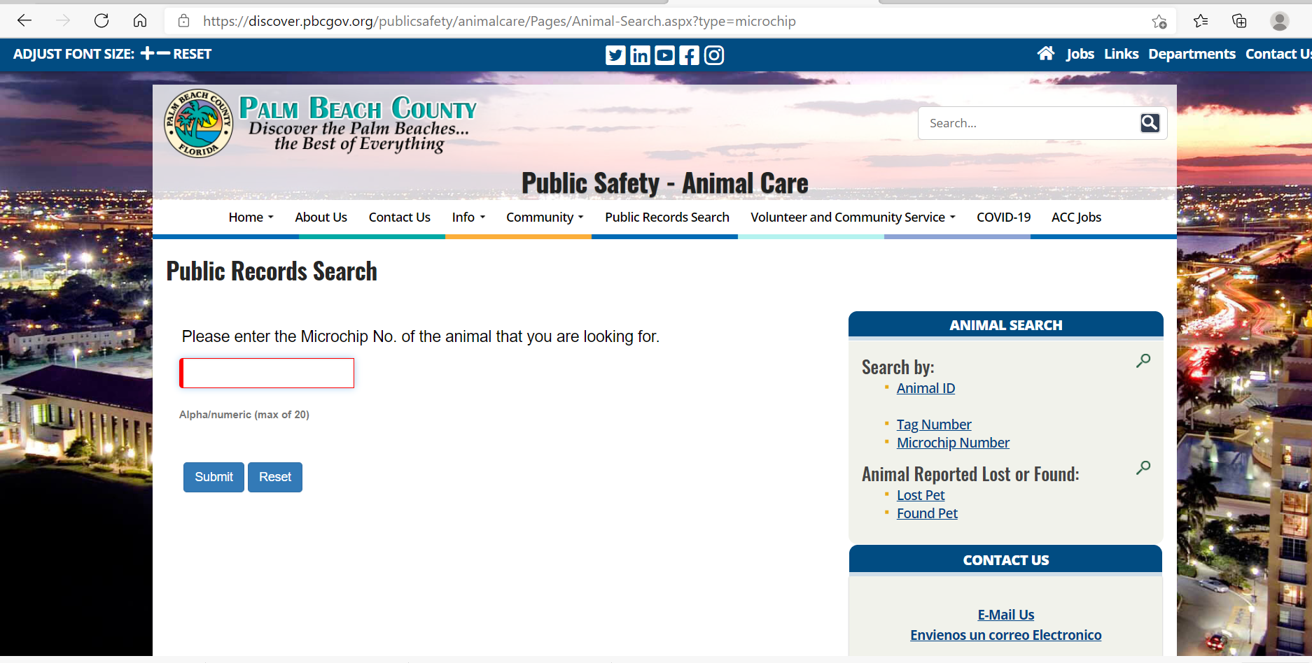

Slide 44
What else can
we be doing?

Slide 45
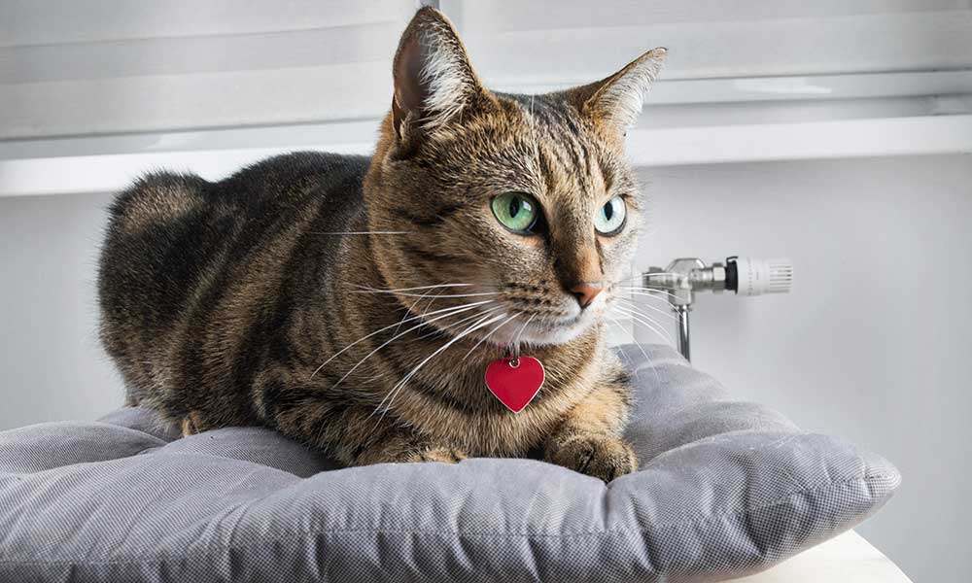
Don’t forget about the cats!

Slide 46
Partner Spotlight

Slide 47
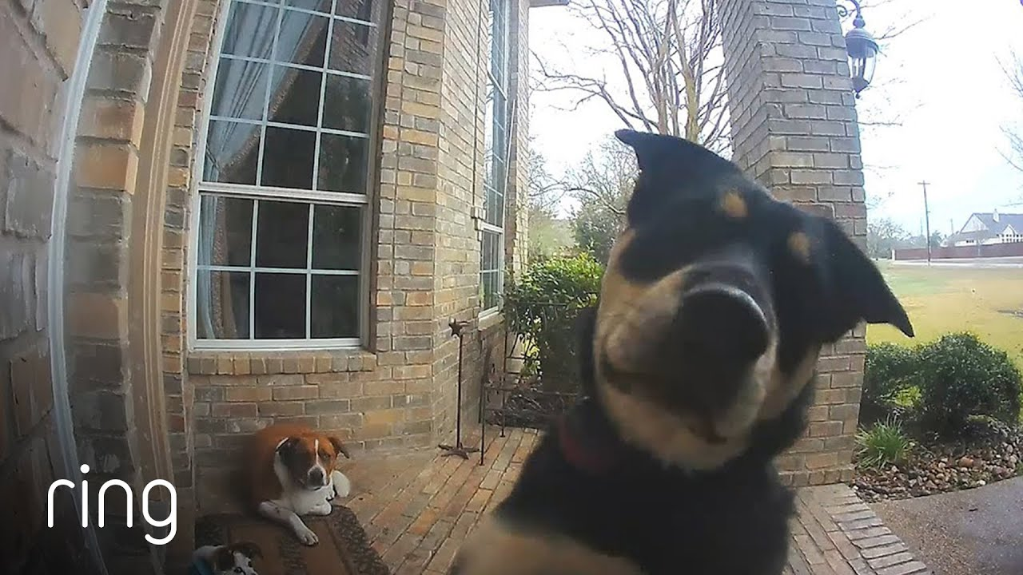

Slide 48
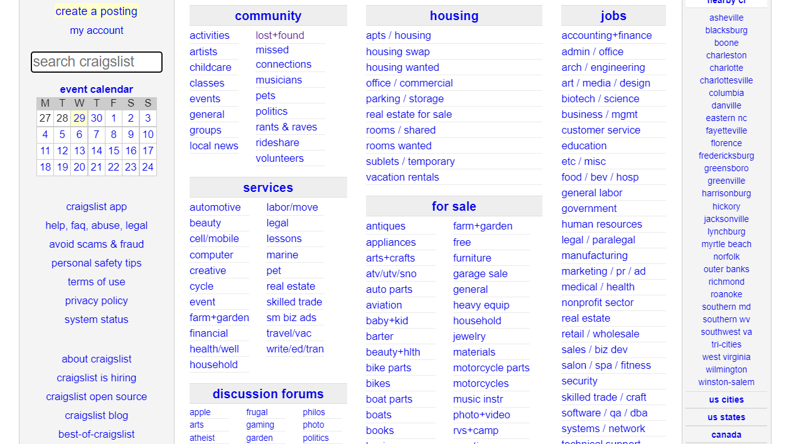

Slide 49
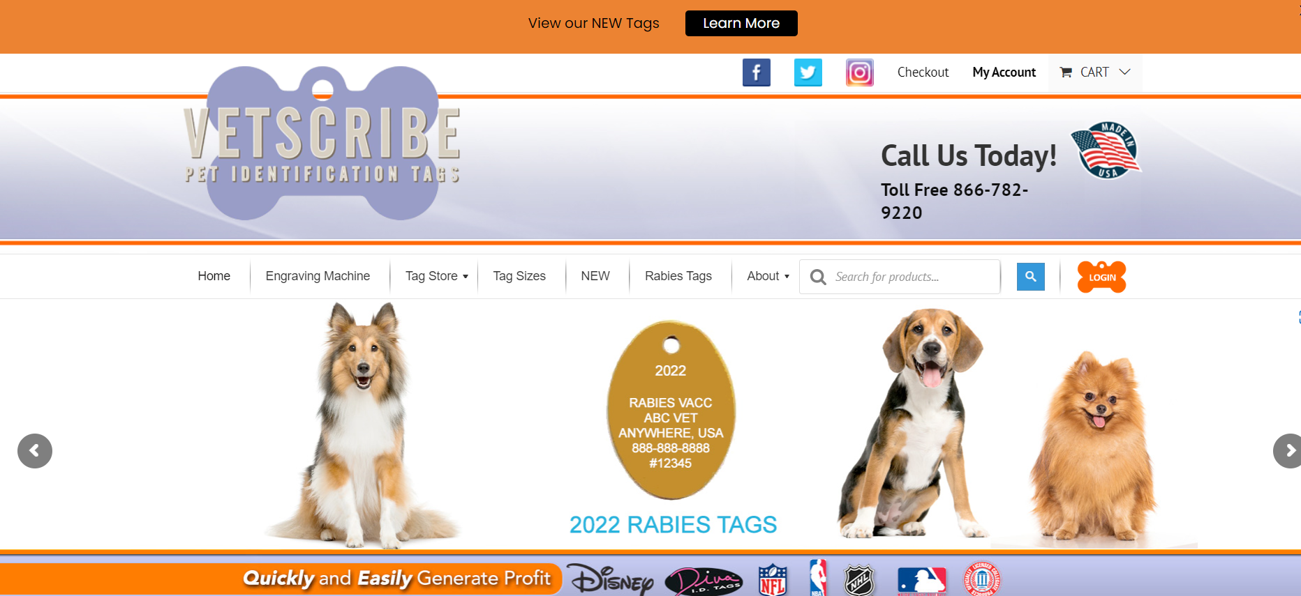
What about this?

Slide 50
If only Dorothy had put an ID tag on Toto

Slide 51
I am here to help!
g.knepp@foundanimals.org
916-230-4533

