Slide 1
Building Bridges to Inclusive Foster Programming:
An Incremental Change Approach

Slide 2
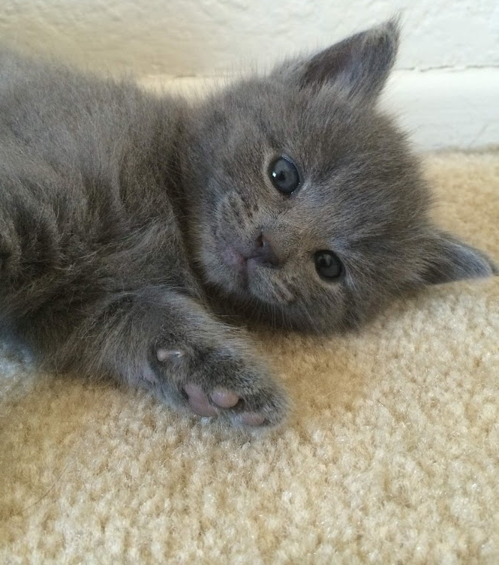
Nadia Oseguera
The original Jack & Britney
Panorama City, CA - 2008
Luna & Molly
Rialto, CA - 2014
The Pizza Co. “colony”
Baldwin Park, CA - 2015
My Lived Experience

Slide 3
About My Work
Feline foster and adoption program in partnership with LA County DACC
9,000+ felines fostered
by 1,000+ foster caregivers collaboratively
Ongoing efforts to remove barriers and create a racially diverse and economically accessible foster program

Slide 4
Welcoming Practices in Foster Programming
Increase inclusivity through recruitment, accessibility and continued training
Keep people and pets together by soliciting and accepting help from your community
Provide a welcoming environment in your sign-up and onboarding process

Slide 5
Scanning Operations for Barriers
Reflect by asking specific questions
Collaborate with teams outside the foster program
Seek feedback from colleagues, other orgs or existing fosters/volunteers
Avoid replacing removed barriers with new ones

Slide 6
Breaking Down Barriers Through Incremental Changes
Why Incremental?
Areas of Focus
Starting point is clear (not everything happens at once)
Allows you to create your own pathway
Small wins along the way!
Easier to adjust behaviors, address challenges and identify lessons learned
Defined metrics to collect and analyze along the way
Foster Recruitment
Foster Program Accessibility
Foster Sign-Up Form
Foster Onboarding Process
Foster Development and Retention

Slide 7
Assessing Operations: Sample Questions
Broad Questions Elicit Yes/No Answers
Specific Questions Elicit Action
Are our recruitment tactics inclusive?
Which community members are we leaving out with our current recruitment tactics?
Is our foster program accessible to everyone?
How can we make fostering accessible to anyone who wants to help?
Is our foster application welcoming?
What information do we need to know about applicants?
Is our onboarding process streamlined?
What steps do people need to take to onboard with our program?
Are we providing opportunities for development and retention?
What tools/resources can we provide to support foster development and promote retention?

Slide 8
Determine most commonly-spoken languages
Identity target recruitment spaces across your community, including non-animal related spaces (virtual and physical)
Set translation priorities, both priority languages & materials to translate
Use explicitly welcoming language in all recruitment materials (e.g., website, shelter, flyers, social media)
Understand, define and accept the help you need (e.g., emergency fosters)
Foster Recruitment
Guiding Question: Which community members are we leaving out with our current recruitment tactics?
Possible Incremental Changes
Determine most commonly-spoken languages
Set translation priorities, both priority languages & materials to translate
Understand, define and accept the help you need (e.g., emergency fosters)
Identify target recruitment spaces across your community, including non-animal related spaces (virtual and physical)
Use explicitly welcoming language in all recruitment materials (e.g., website, shelter, flyers, social media)

Slide 9
Seek feedback from former or one-time fosters
Explicitly define the purpose and definition of “fostering”
Offer and advertise various forms of support and resources, for example:
Supplies
Preventative and medical care (plus, telehealth)
Transportation support
Facilitating community-building between fosters
Be flexible with guidelines and norms
Offer various communication options: Text, phone call, video call, Facebook, email
Foster Program Accessibility
Guiding Question: How can we make fostering accessible to anyone who wants to help?
Possible Incremental Changes
Explicitly define the purpose and definition of “fostering”
Offer and advertise various forms of support and resources, for example:
Supplies
Preventative and medical care (plus, telehealth)
Transportation support
Facilitating community-building between fosters
Seek feedback from former or one-time fosters
Be flexible with guidelines and norms
Offer various communication options: Text, phone call, video call, Facebook, email

Slide 10
Foster Sign-Up Form
Guiding Question: What information do we need to know about applicants?
Possible Incremental Changes
Review each sign-up form question and determine what you plan to do with the information collected
Keep your application as concise as possible; ask only what you need to know
Remove any questions aimed at denying people from helping your organization
Ask questions aimed at learning about people’s self-reported preferences
Offer various sign-up form options (e.g., online, in-person, phone call)
Explain the reason you need specific information

Slide 11
Foster Onboarding Process
Guiding Question: What steps do people need to take to onboard with our program?
Possible Incremental Changes
Make training materials as concise as possible and offer supplemental materials
Explicitly mention how the information shared in the onboarding will help the foster caregiver
Ensure that new foster caregivers are not expected to retain 100% of the information and welcome any questions
Provide on-demand, self-paced training materials
Offer alternative onboarding options (e.g., in-person, by phone)
Be flexible with foster finders by focusing the onboarding on the animal(s) in front of them

Slide 12
Foster Development and Retention
Guiding Question: What tools/resources can we provide to support foster development and promote retention?
Possible Incremental Changes
Make continued learning opportunities optional and/or relevant to the individual
Offer variety of training opportunities (e.g., on-demand, roundtables, Q & A format, reading, instructional videos, hands-on)
Offer supplemental materials and support (e.g., Foster Resource Hub, handouts, videos, 1:1 coaching)
Move to a learner-centered approach (e.g., growth mindset, 70/20/10 model of learning & development)

Slide 13
Measuring Success with Data
Don’t let an adverse situation overshadow your wins!
How / where did they hear about your program
Preferred language for communication
Preferred communication method
Whether transportation assistance is needed
Where foster caregivers live (zip codes)
Continued trainings people are interested in and trainings attended
Populations of animals supported (e.g., age, eating ability, medical and/or behavior)
Feedback from foster caregivers

Slide 14
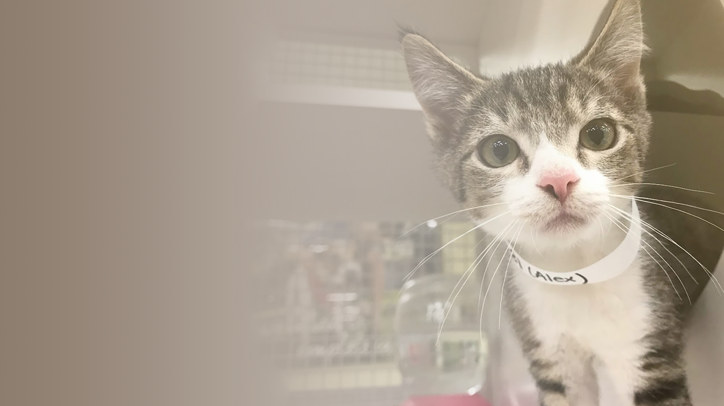
Reflections
Non-municipal organization
Majority of foster base White and in affluent areas
Tech-heavy program (webforms, online trainings)
Important to spread DEI lens across teams

Slide 15
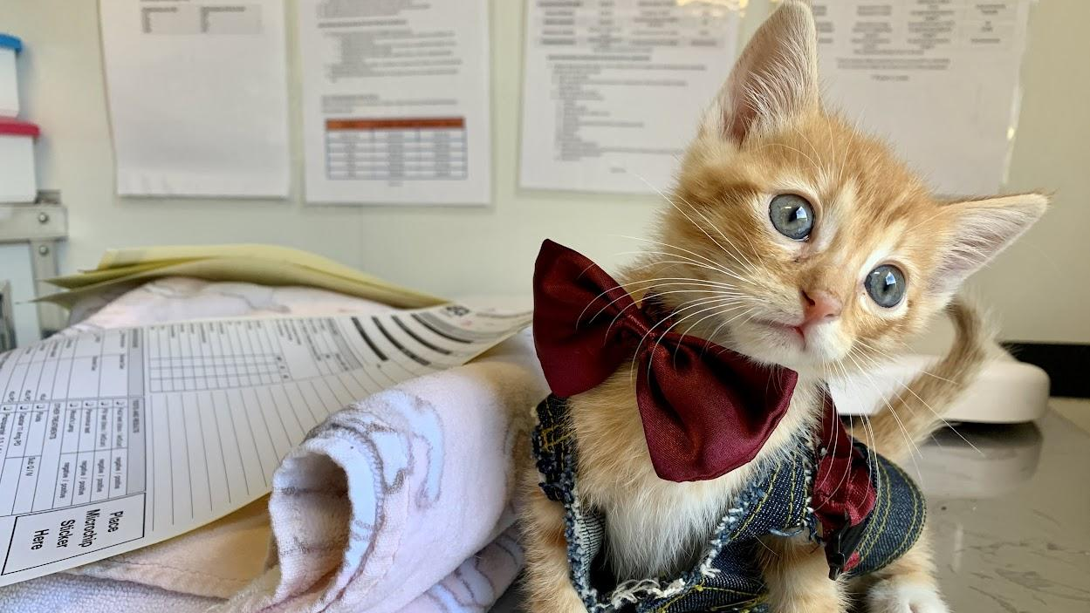
Questions?

