Slide 1
The Danger of a Single Story
Discussion of Chimamanda Ngozi Adichie’s Powerful TedTalk

Slide 2
Brave Space Guidelines
It’s ok for us all to be at different places with the
things we discuss today.
Speak from an “I” perspective.
Take space, make space, hold space.
Recognize that some discomfort can be useful for learning.
Expect and accept non-closure.
Confidentiality––Lessons leave; stories stay.
Adopted from DiAngelo and Sensoy, 2014

Slide 3
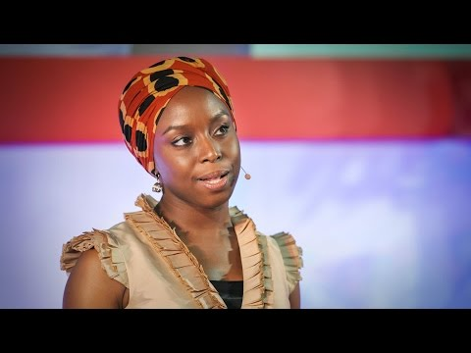
The Danger of a Single Story
Chimamanda Ngozi Adichie
Notes:
Inspired by Nigerian history and tragedies all but forgotten by recent generations of westerners, Chimamanda Ngozi Adichie’s novels and stories are jewels in the crown of diasporan literature.

Slide 4
Discussion Questions
What is one takeaway from Adichie's TED talk?
What single stories have been told about you or people like you?
How do you think single stories may impact relationships among employees?
What single stories get told in the animal welfare space?
About companion animals?
What is the impact of those single stories?
Have you ever fallen prey to a single story about a community we serve?
What do you wish you had done differently?
What can we do to disrupt these single stories?

Slide 5
Next Steps
Share this TedTalk with your friends, colleagues, staff and leaders
Hold space for a discussion about this in your organization
Use this deck

