Slide 1
Community Conversations
January 23, 2023
Kelly Duer, Senior Community Solutions Specialist, Maddie’s Fund
Notes:
Need title

Slide 2
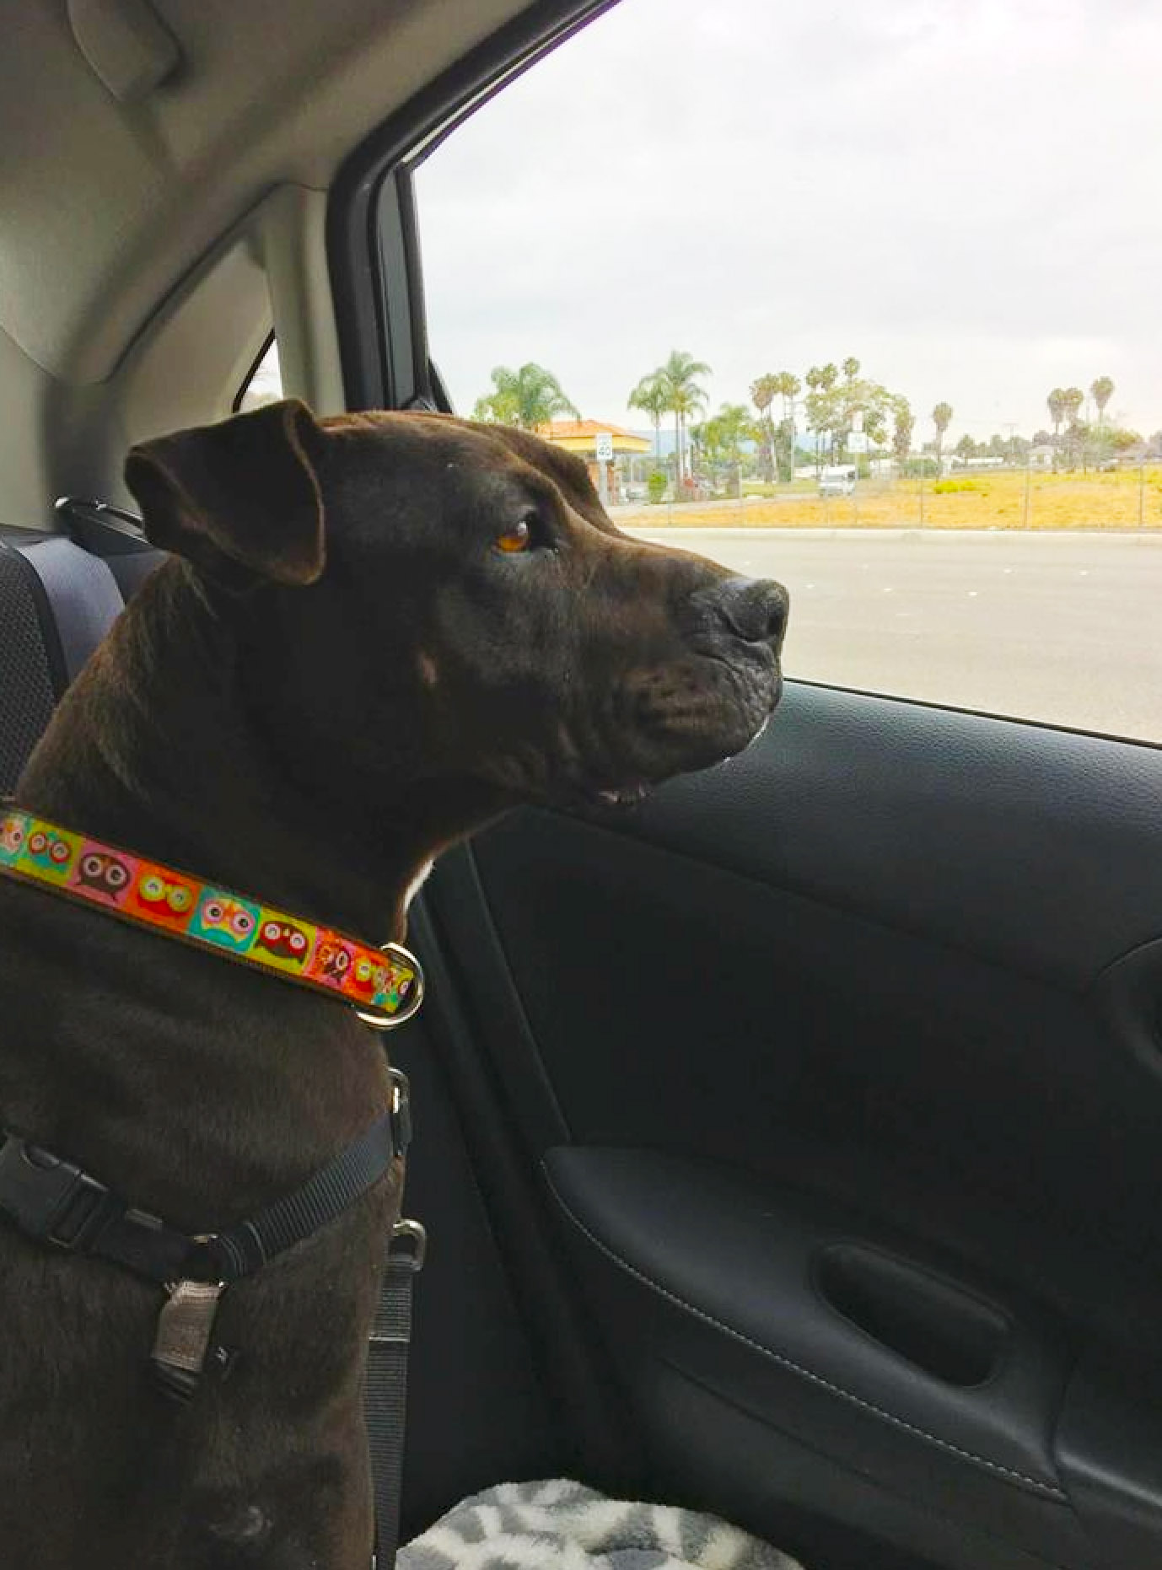
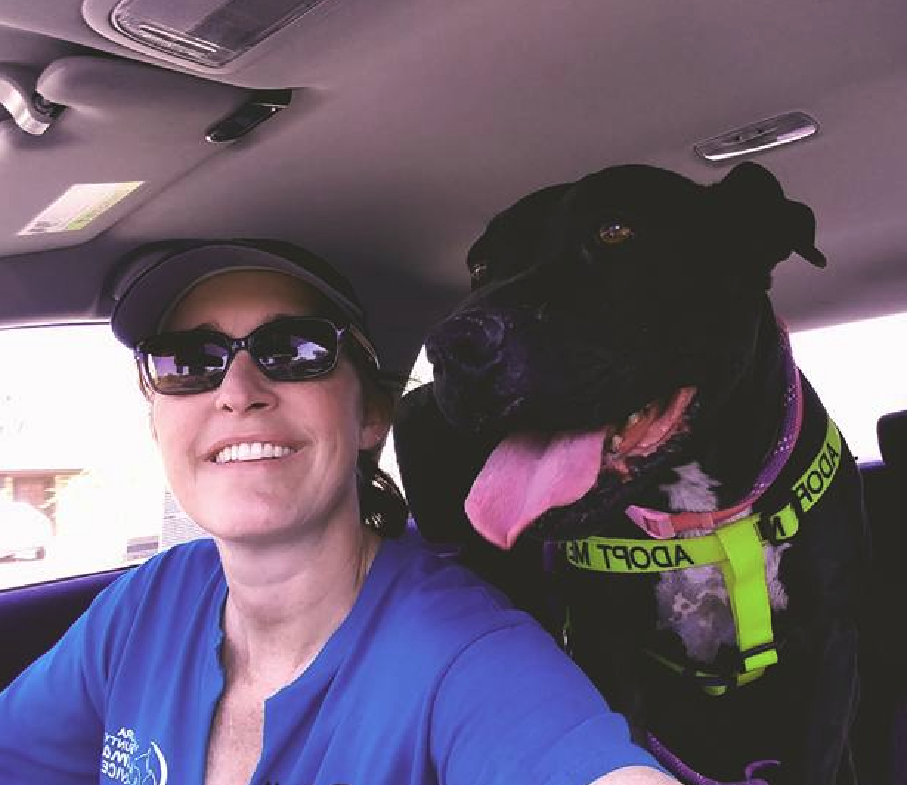
Ruby’s Story
Notes:
Our results indicate that although short-term fostering did not lead to a statistically significant improvement in human-directed social behavior or stress levels, foster cats also did not display more aggression or fear in the foster home, did not display a decrease in social behavior, and did not display an increase in UCCR after returning to the shelter when sent to foster for 1 week or even just 1 day. Therefore, cat fostering—even short-term fostering—may not be more stressful or problematic for this species than remaining in a shelter and could contribute to life-saving efforts by allowing cats to move into homes when shelter space is limited.
https://www.mdpi.com/2076-2615/12/17/2166

Slide 3
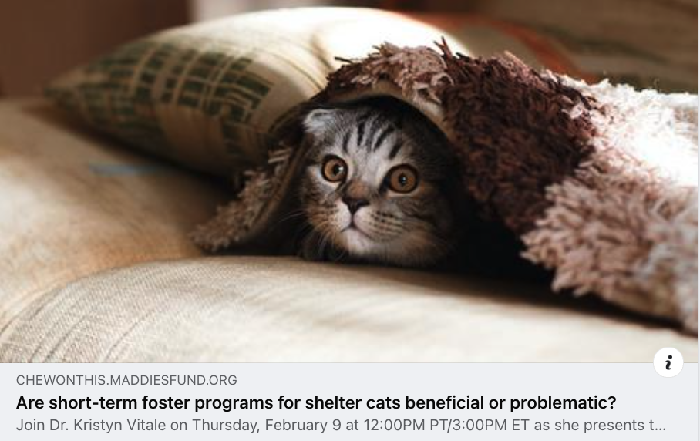
New Research on Foster Care for Cats
Notes:
Our results indicate that although short-term fostering did not lead to a statistically significant improvement in human-directed social behavior or stress levels, foster cats also did not display more aggression or fear in the foster home, did not display a decrease in social behavior, and did not display an increase in UCCR after returning to the shelter when sent to foster for 1 week or even just 1 day. Therefore, cat fostering—even short-term fostering—may not be more stressful or problematic for this species than remaining in a shelter and could contribute to life-saving efforts by allowing cats to move into homes when shelter space is limited.
https://www.mdpi.com/2076-2615/12/17/2166

Slide 4
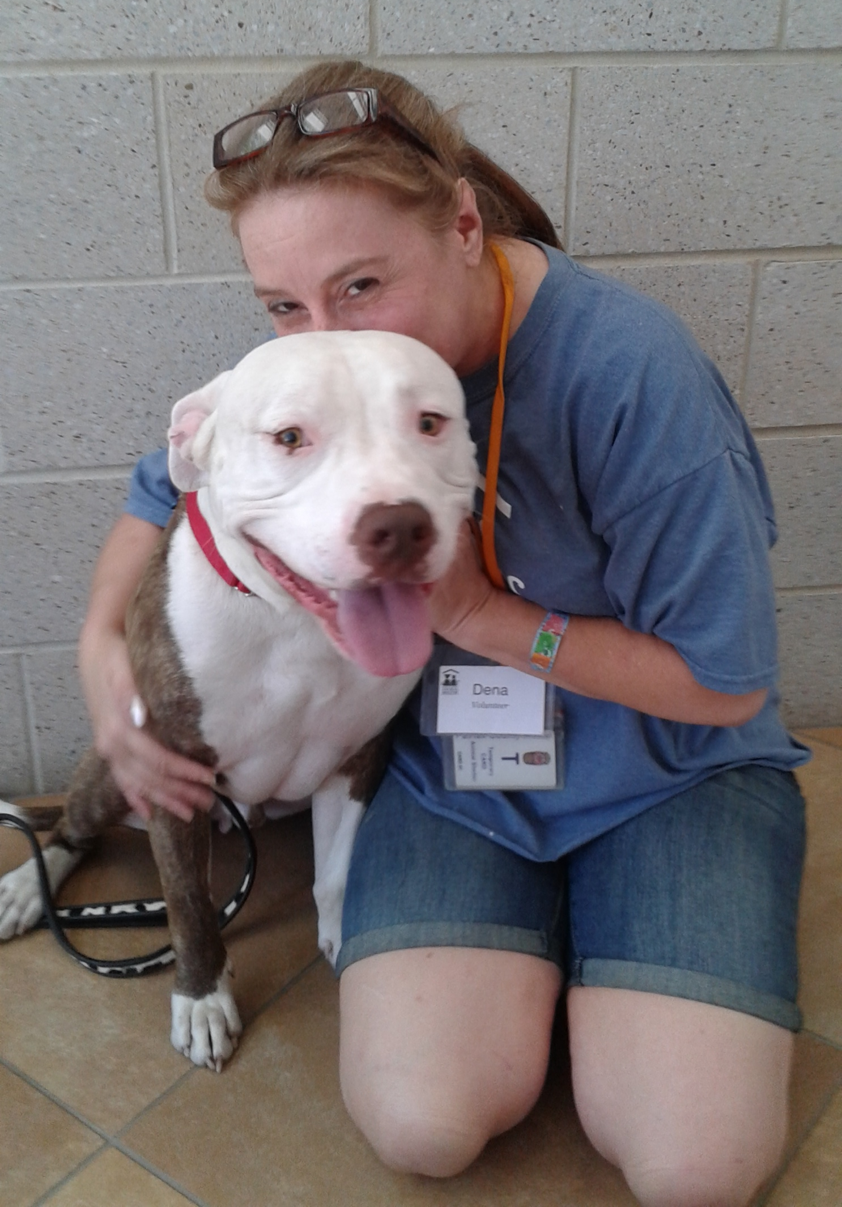
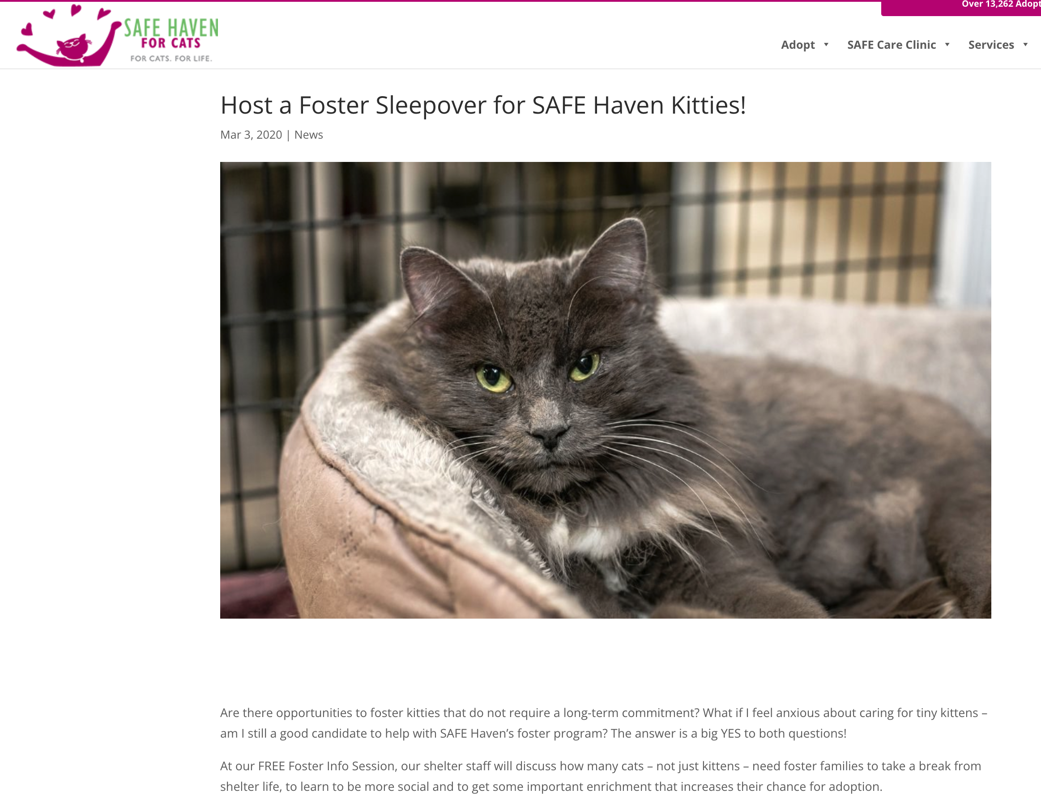
Short-Term Foster
Notes:
Special foster initiatives– somewhere between emergency foster and holiday foster
Newness --- urgency

Slide 5
Marketing and Adopting Pets from Foster Homes
Set expectations
Give fosters training and support
Make the marketing process EASY
On fosters
On you!

Slide 6
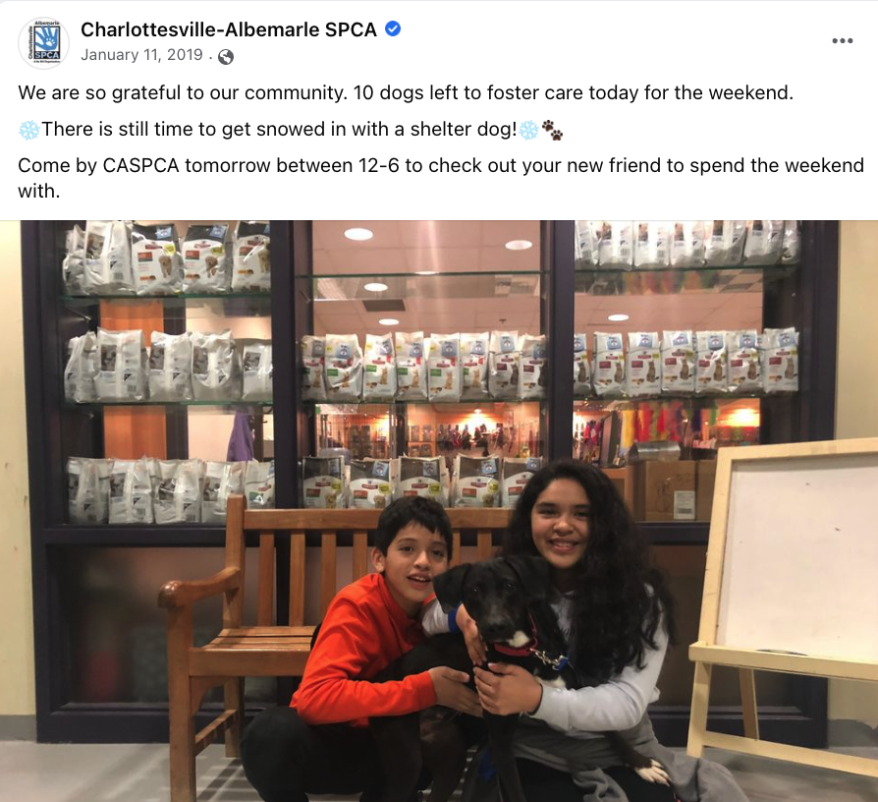
Special Foster Initiatives
Notes:
Special foster initiatives– somewhere between emergency foster and holiday foster
Newness --- urgency

Slide 7
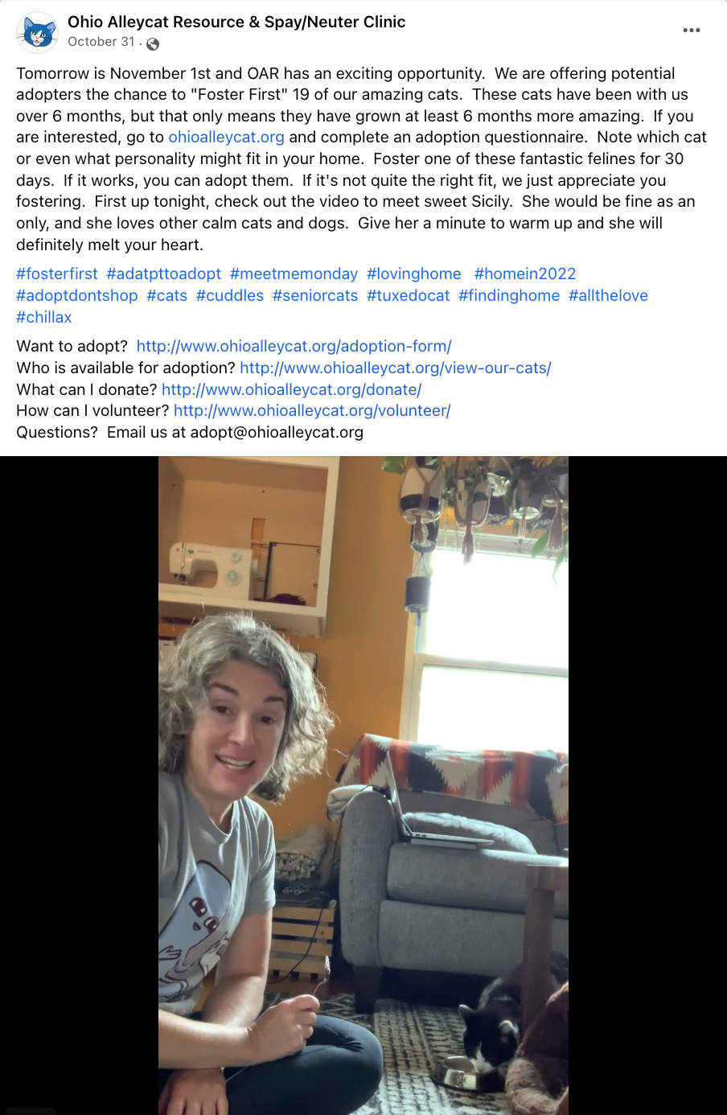
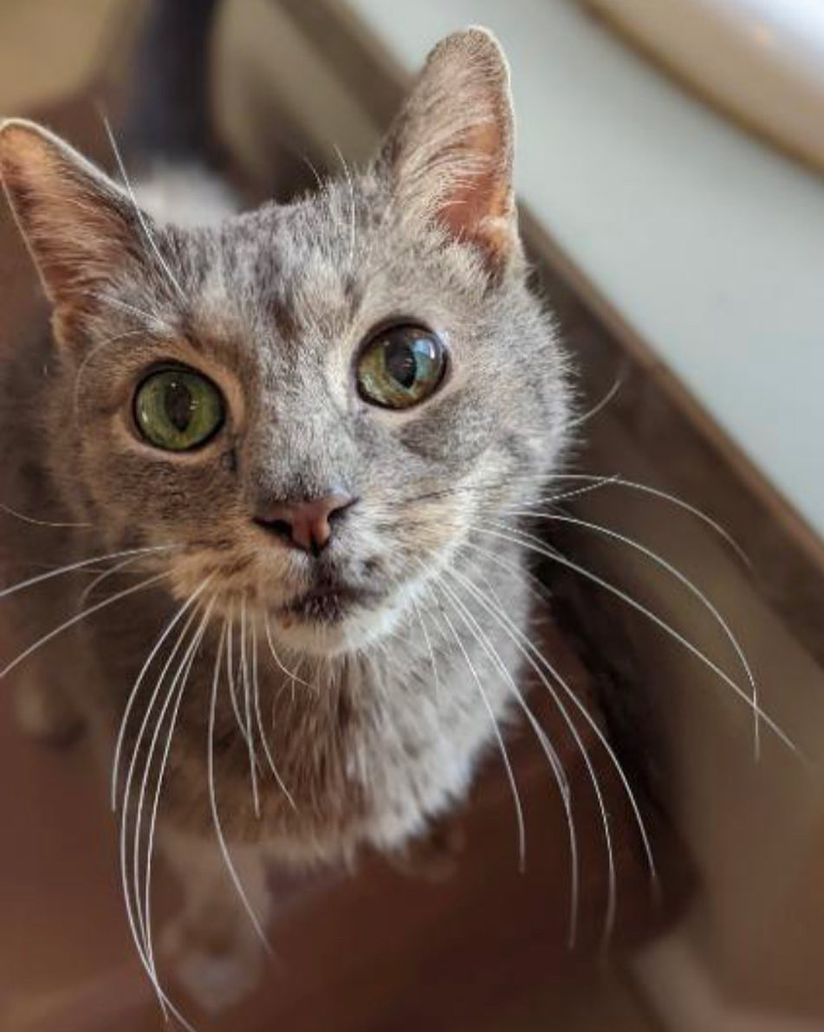
Foster to Adopt
Notes:
For the month of November, one of our fantastic volunteers initiated a Foster First adoption promotion (for some of our longer stay cats). She worked alongside our adoption coordinator to identify cats (those with us for 6 months or more) and promoted them on social media/informed our other adoption host volunteers. The promotion allowed the adopter to foster the cat for 30 days to see if it was a good fit and then they could finalize the adoption. During the month of November, 8 of our longer stay cats were adopted or foster-to-adopt (including one of our diabetic cats)!
Nearly three-quarters (72.96%) of fosterto-adopt experiences ended in adoption,

Slide 8
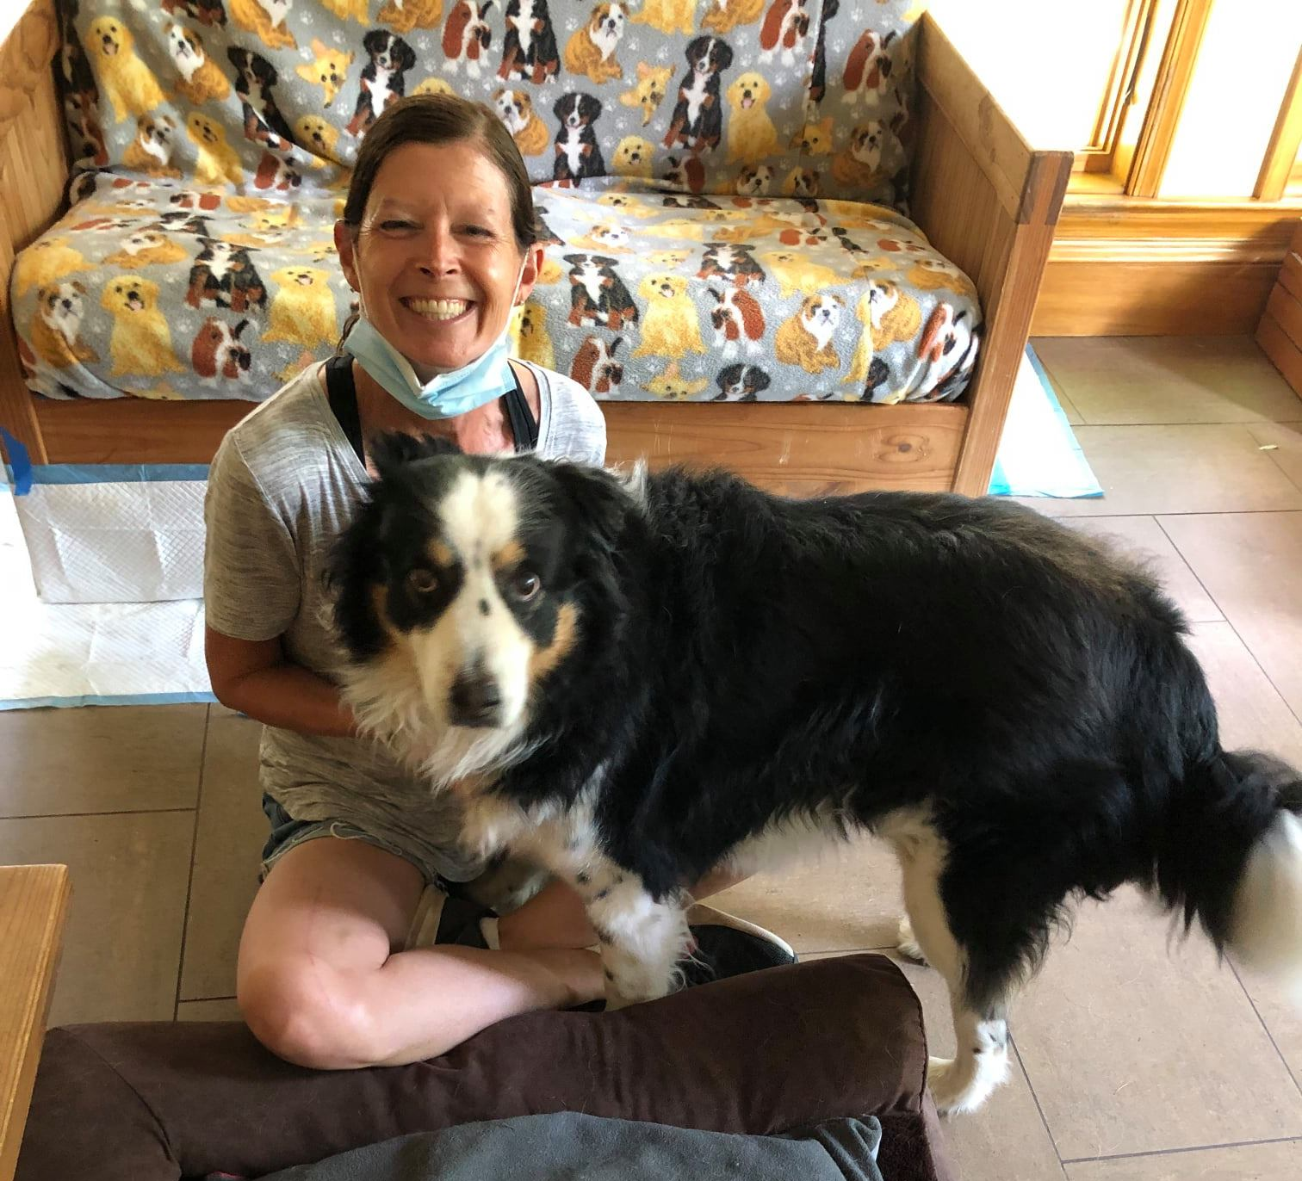
Virtual Foster

Slide 9
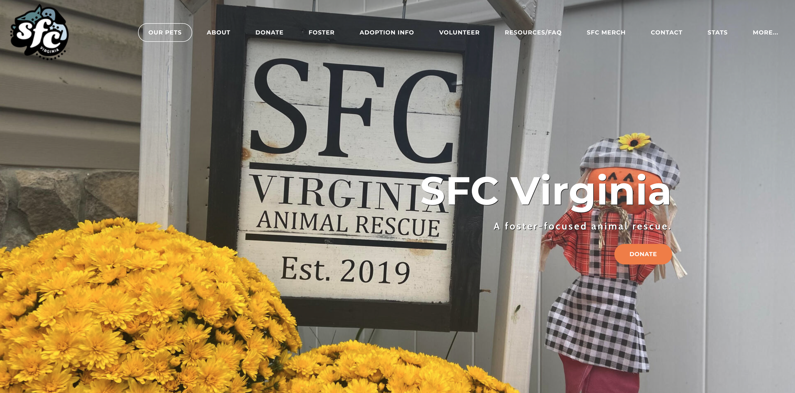
What is this rescue organization telling you about their foster program?

Slide 10
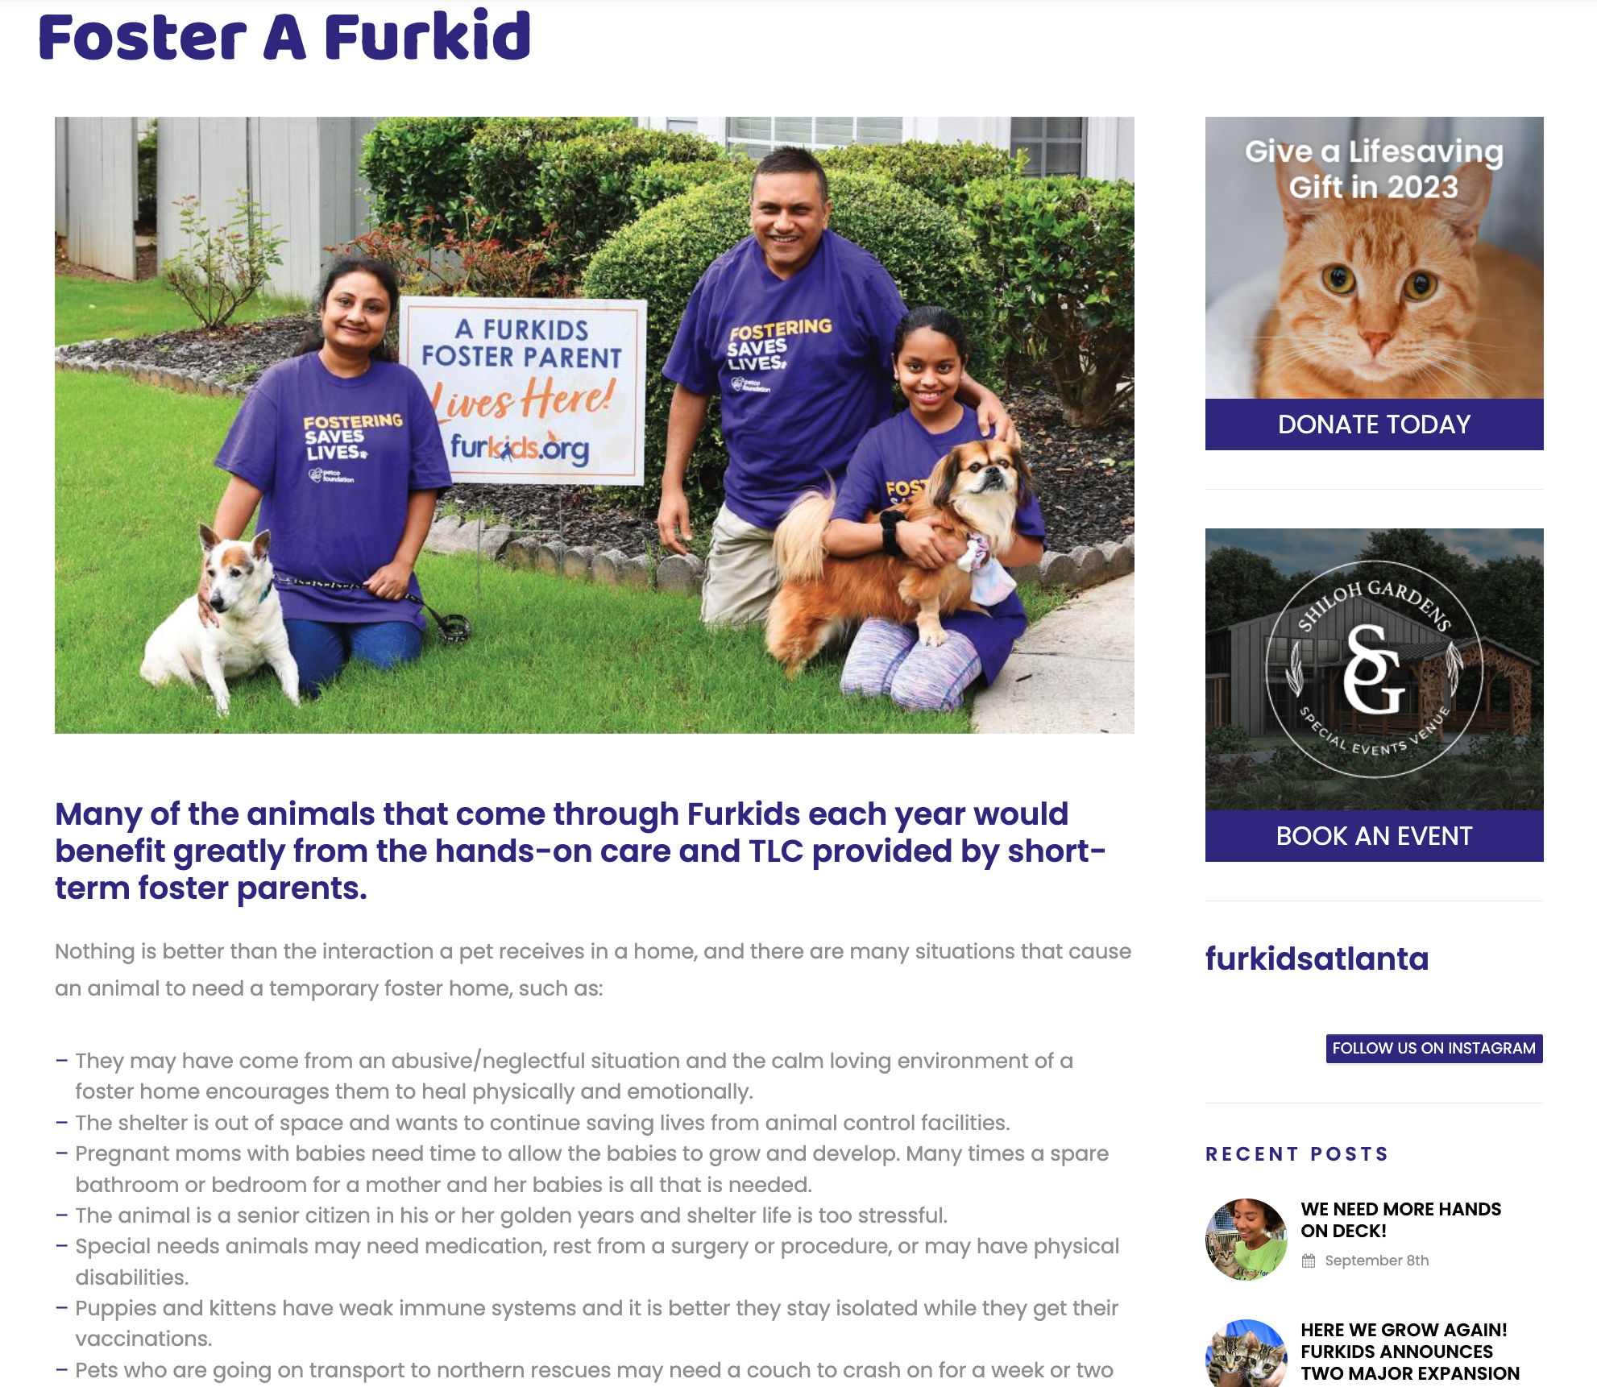
What strategies is this foster landing page using?

Slide 11
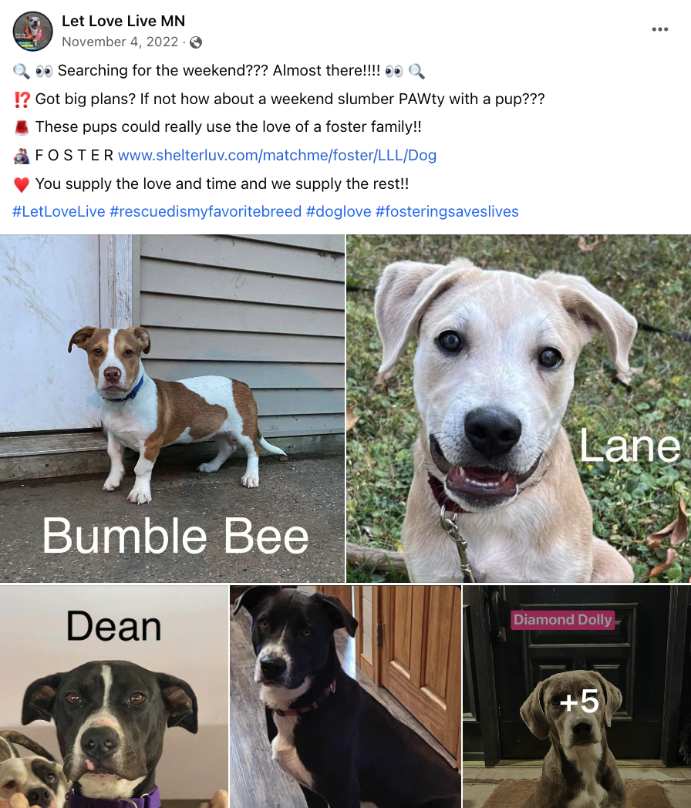
Why did this foster plea work?

Slide 12
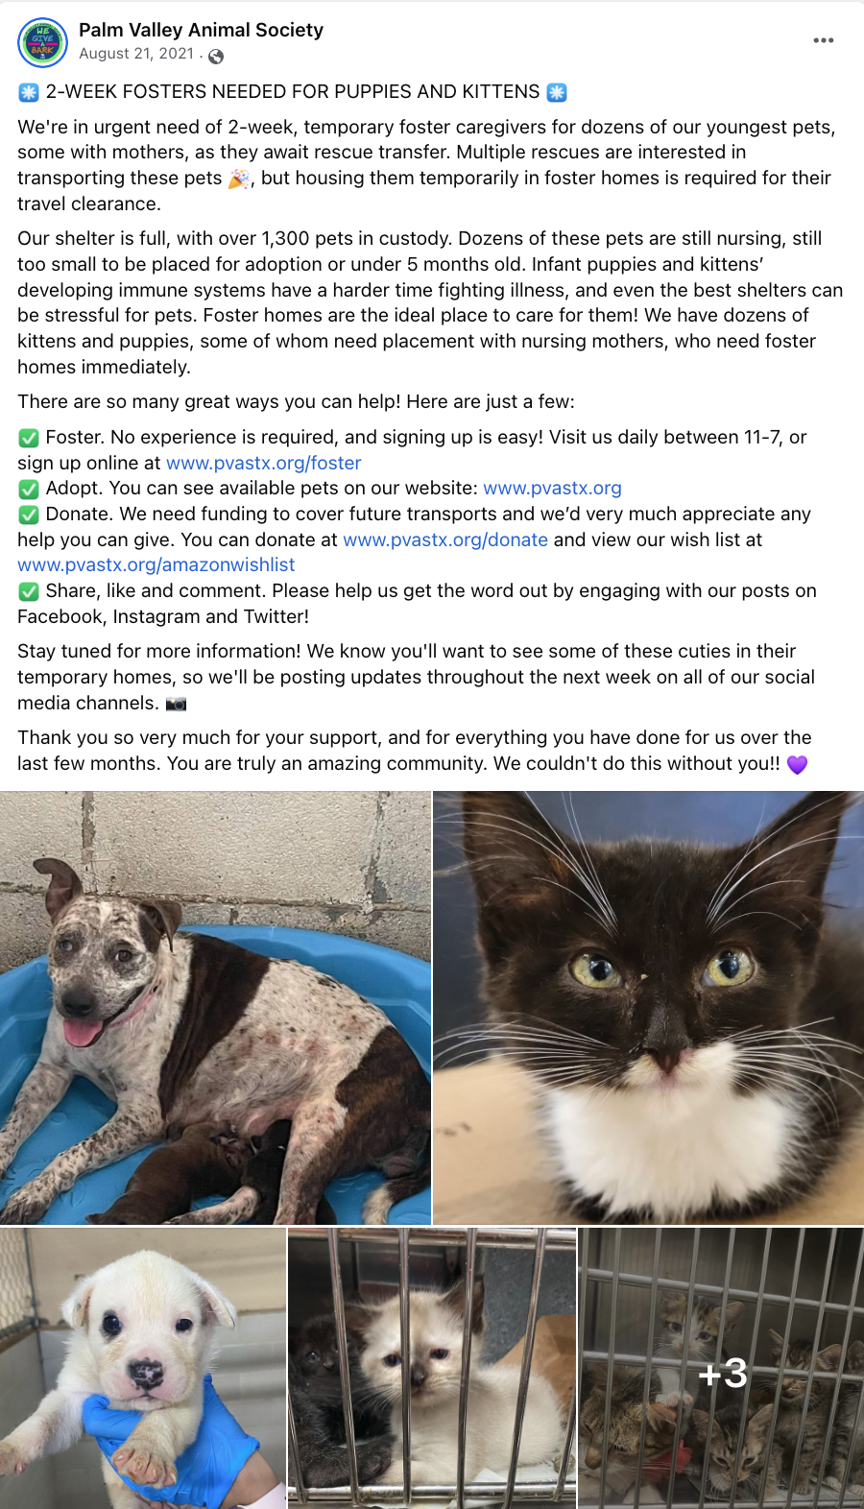
Why did this foster plea work?

Slide 13
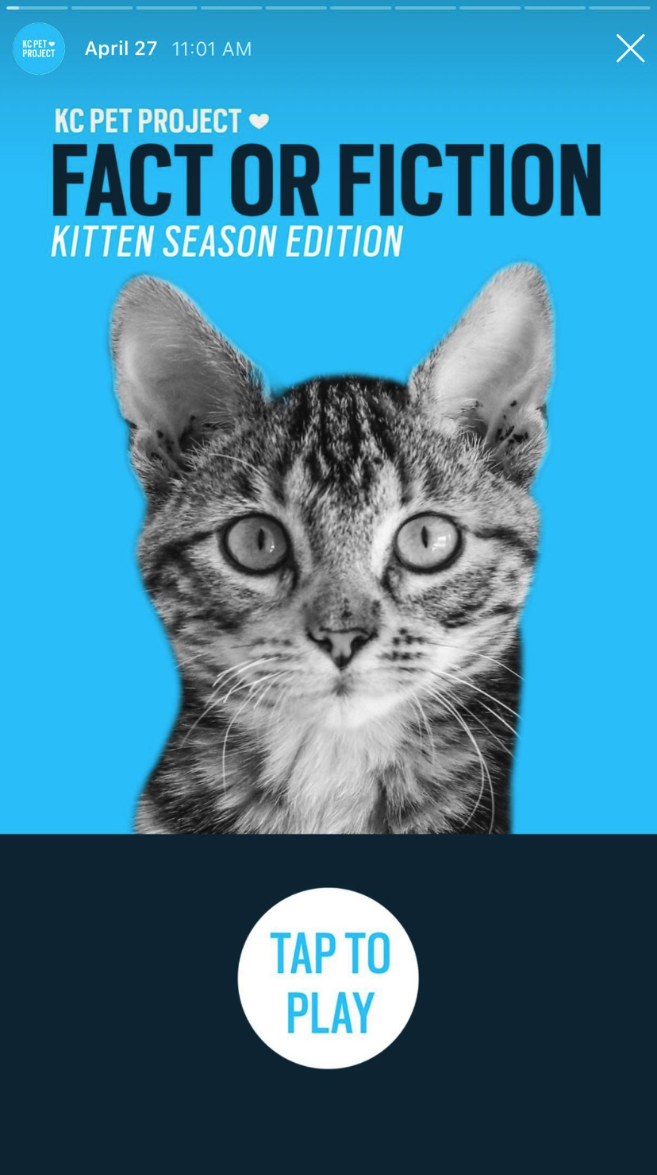
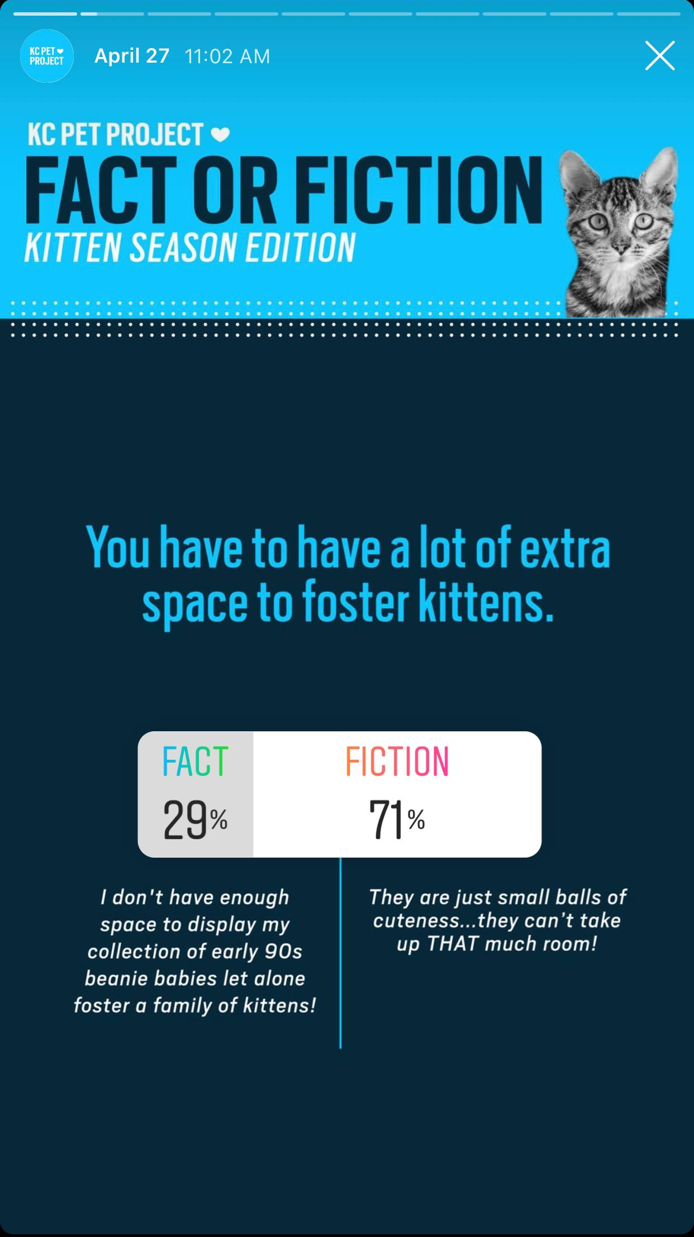
What strategies is this Instagram Story using?

Slide 14
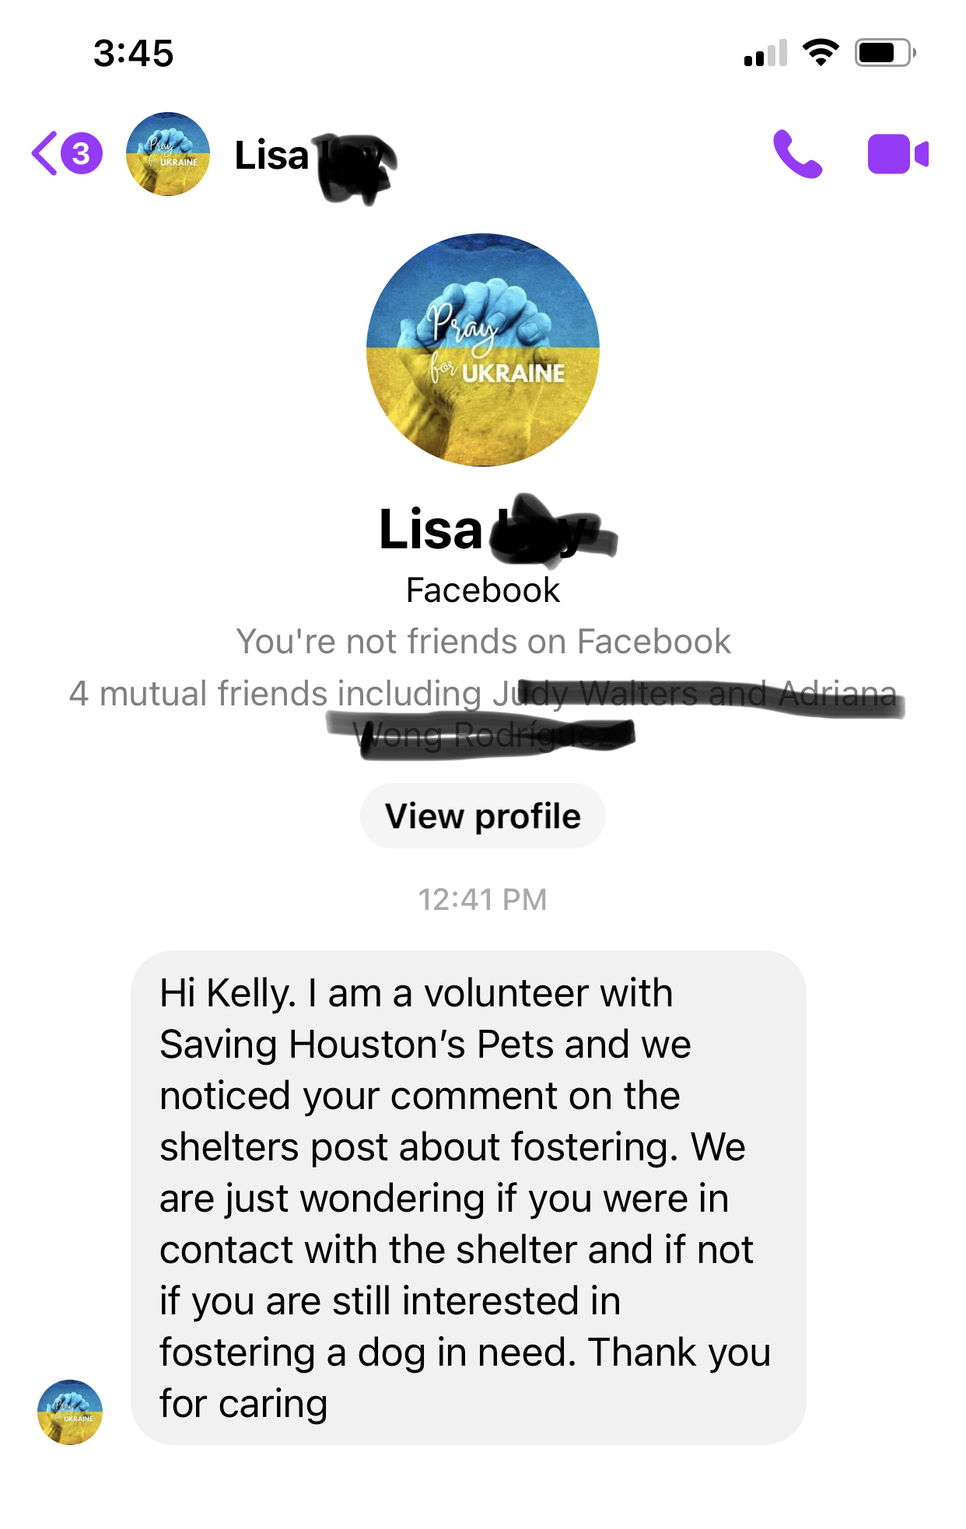
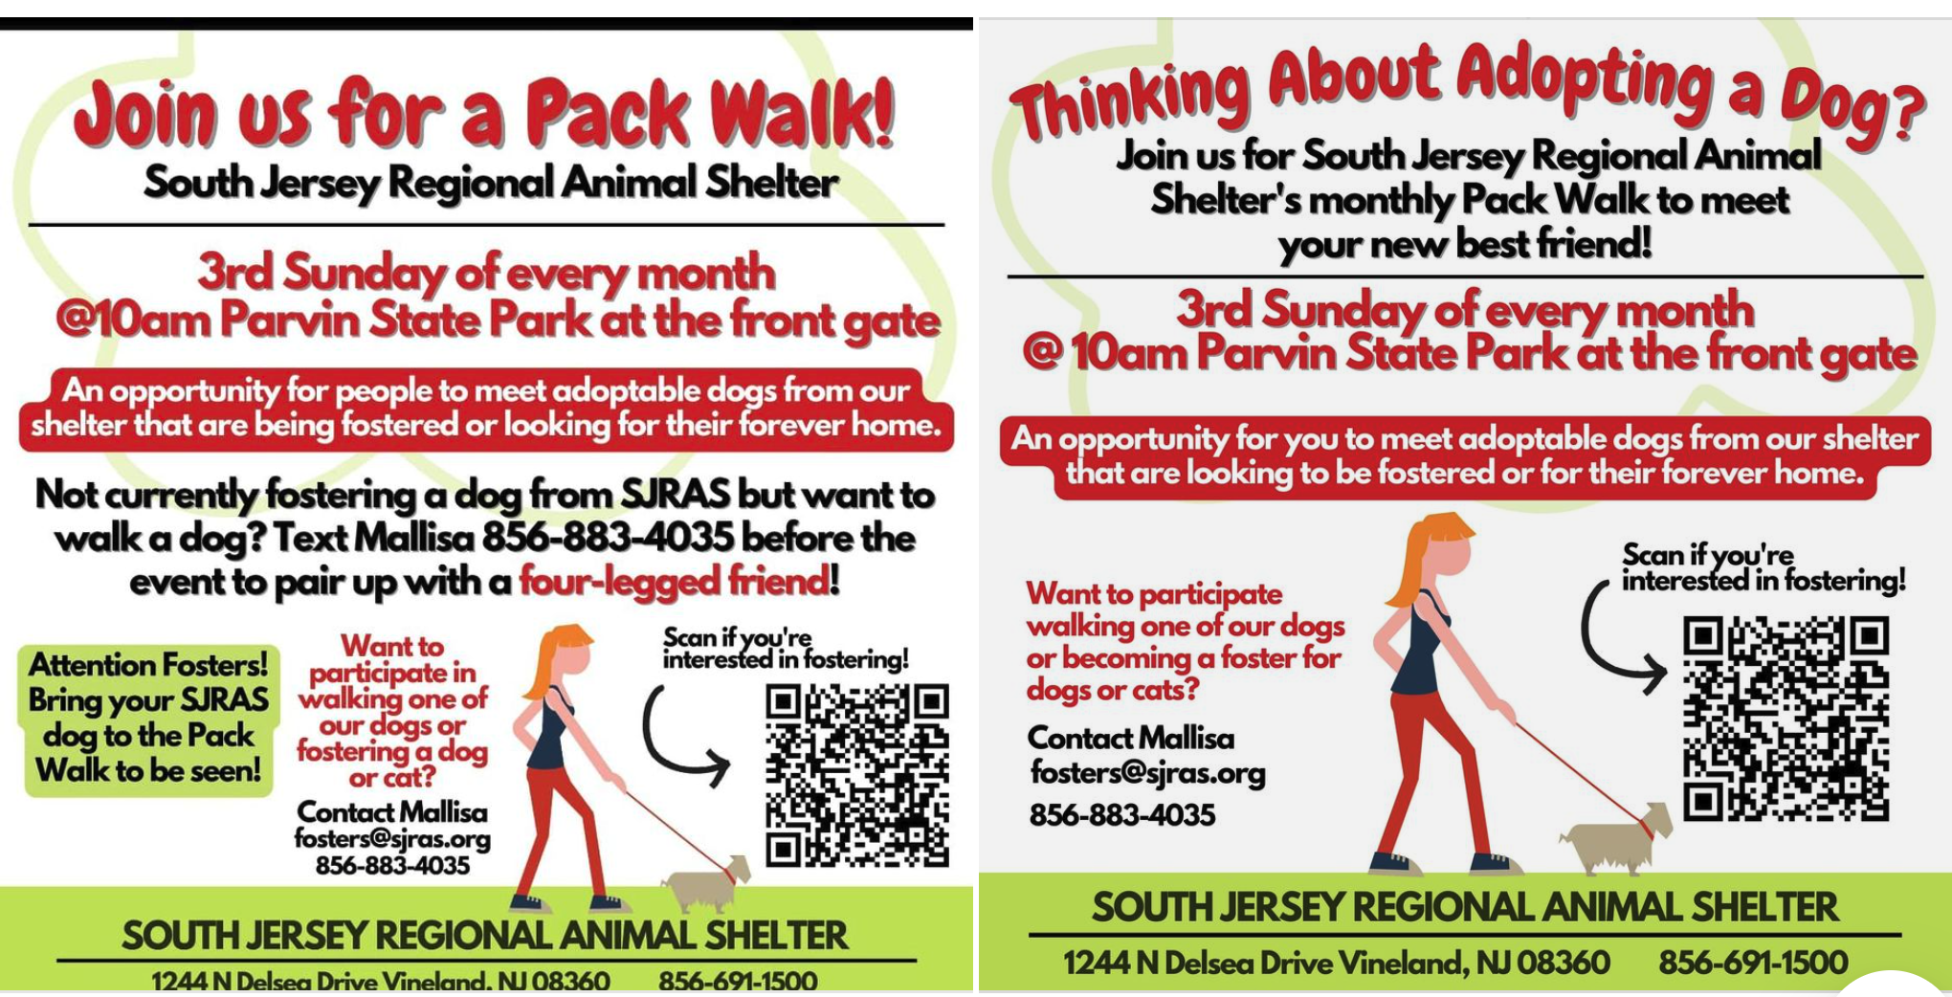

Slide 15
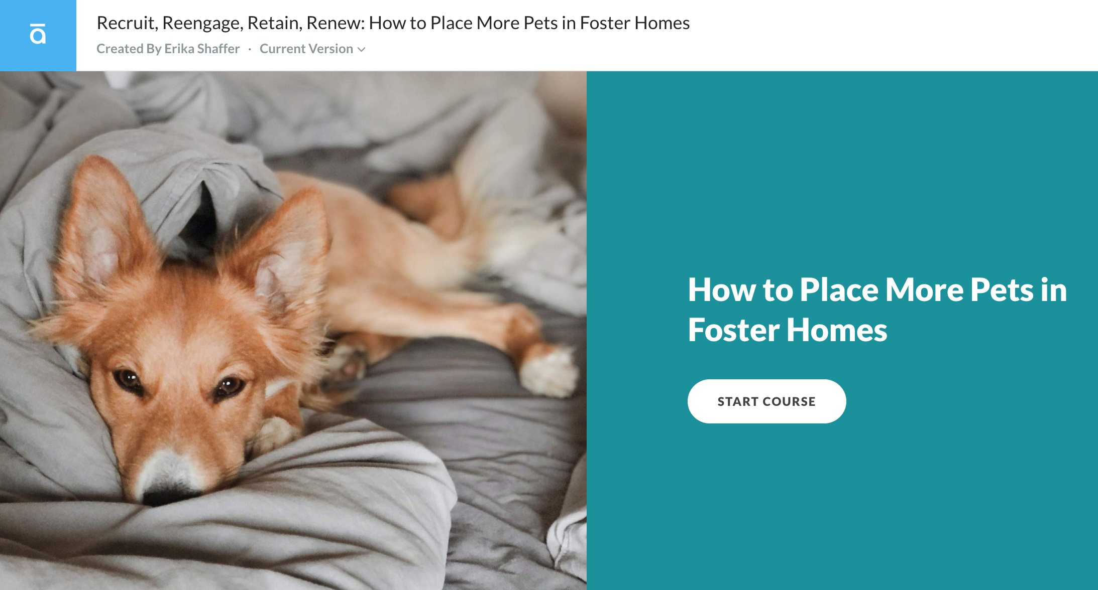
New MU Course

